Slide 1
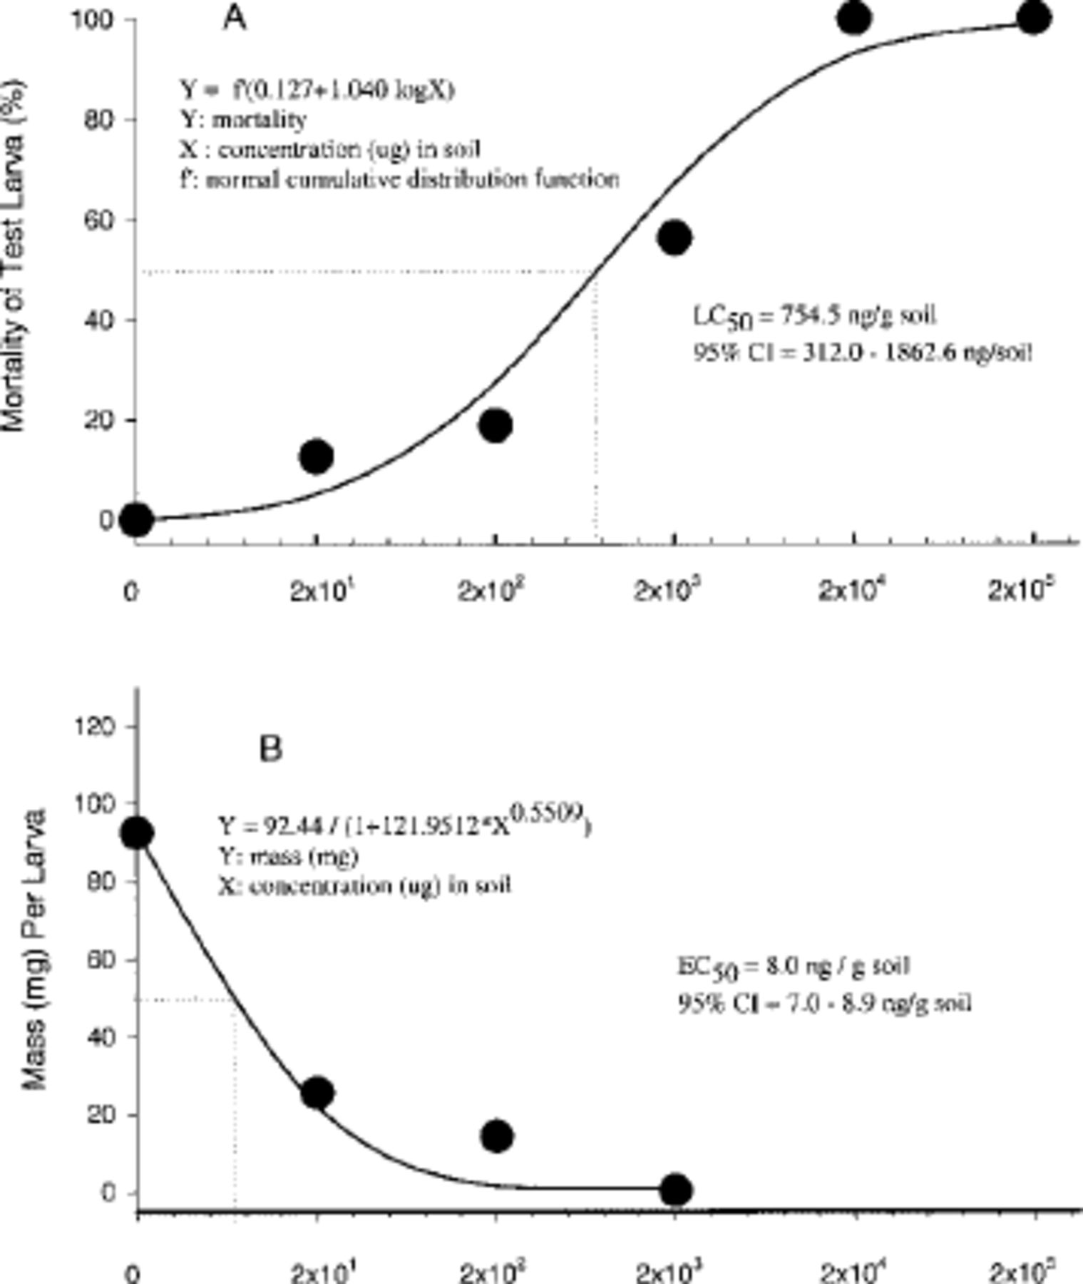
Fig. 1. Reference standard dose-response of H. virescens larvae feeding on diet mixed with soil samples spiked with ...
Notes:
Fig. 1. Reference standard dose-response of H. virescens larvae feeding on diet mixed with soil samples spiked with known doses (2 × 101, 2 × 102, 2 × 103, 2 × 104, and 2 × 105 ng) of pure CrylAc protein per gram soil. (A) Dose-response for larval survival, and (B) dose-response for larval mass (mg).
Unless provided in the caption above, the following copyright applies to the content of this slide: © 2002 Entomological Society of AmericaThis is an Open Access article distributed under the terms of the Creative Commons Attribution Non-Commercial License (http://creativecommons.org/licenses/by-nc/3.0/), which permits non-commercial reuse, distribution, and reproduction in any medium, provided the original work is properly cited. For commercial re-use, please contact journals.permissions@oup.com

Slide 2
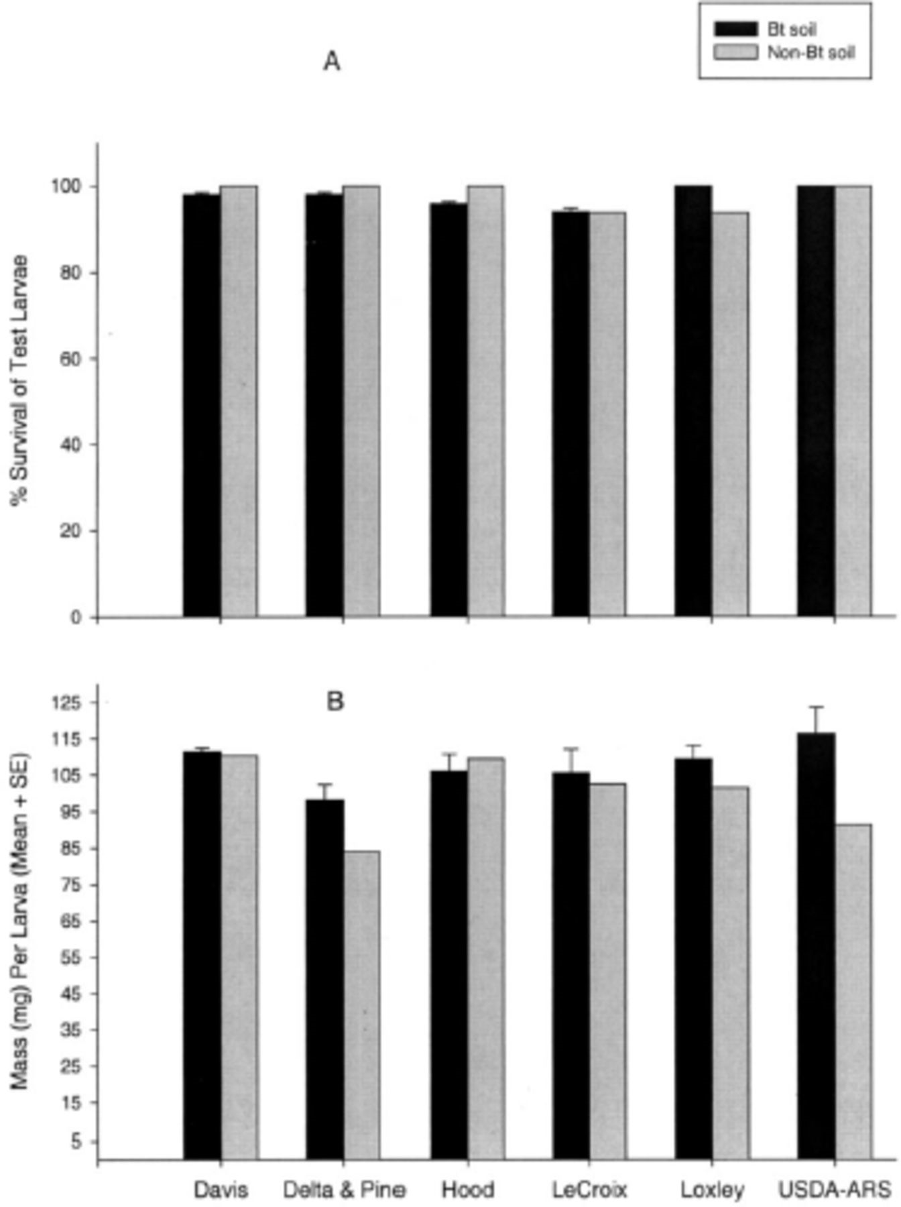
Fig. 2. Response of H. virescens larvae to diet mixed with soil samples collected from within and outside transgenic ...
Notes:
Fig. 2. Response of H. virescens larvae to diet mixed with soil samples collected from within and outside transgenic Bt cotton fields at six different sites. (A) Larval survival, and (B) average mass (mg) of surviving larvae.
Unless provided in the caption above, the following copyright applies to the content of this slide: © 2002 Entomological Society of AmericaThis is an Open Access article distributed under the terms of the Creative Commons Attribution Non-Commercial License (http://creativecommons.org/licenses/by-nc/3.0/), which permits non-commercial reuse, distribution, and reproduction in any medium, provided the original work is properly cited. For commercial re-use, please contact journals.permissions@oup.com

