Slide 1
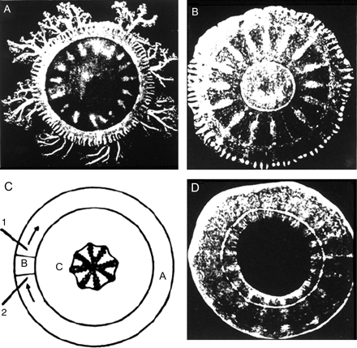
Figure 1 A.G. Mayer's circulating movements produced in rings cut from the bells of a jellyfish. (A) Top view of ...
Notes:
Figure 1 A.G. Mayer's circulating movements produced in rings cut from the bells of a jellyfish. (A) Top view of Cassiopea. (B) The bell shown after cutting the marginal sense organs which normally trigger pulsations of the subumbrella. The subumbrella tissue in the periphery is a better conductor than the gelatinous substance in the centre of the bell. (C) if an annulus is insulated by a shallow scratch through the subumbrella and then a small sector, B, is isolated by shallow radial cuts, then on stimulating the large sector A at 1 and 2 with a pair of electrodes, a contraction will travel all the distance around A, but the sector B will not contract. (D) The isolated disc can be stimulated mechanically or electrically to trigger a circular wave of current which may continue doing so for hours or days. Printed from a public domain book19 digitized by Google.
Unless provided in the caption above, the following copyright applies to the content of this slide: Published on behalf of the European Society of Cardiology. All rights reserved. © The Author 2010. For permissions please email: journals.permissions@oup.com.

Slide 2
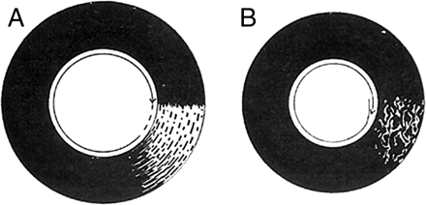
Figure 2 (A) Lewis’ schematic representation of the excitation wave as it circulates in flutter.¹⁴ (B) ...
Notes:
Figure 2 (A) Lewis’ schematic representation of the excitation wave as it circulates in flutter.14 (B) Similar representation of the excitation wave as it circulates in fibrillation. Arrows indicate the direction of propagation. See text for further details. Reprinted from Lewis24 by permission of the publisher.
Unless provided in the caption above, the following copyright applies to the content of this slide: Published on behalf of the European Society of Cardiology. All rights reserved. © The Author 2010. For permissions please email: journals.permissions@oup.com.

Slide 3
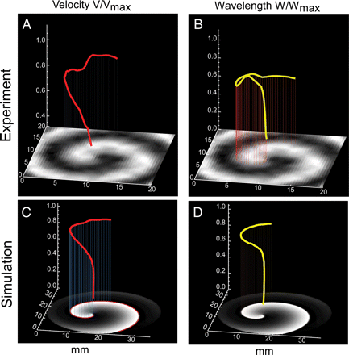
Figure 3 Three-dimensional plots of CV and wavelength in experimental (top) and numerical (bottom) spiral waves. (A ...
Notes:
Figure 3 Three-dimensional plots of CV and wavelength in experimental (top) and numerical (bottom) spiral waves. (A and C) CV (red) increases as wave front curvature decreases from the centre of rotation to the periphery. (B and D) Wavelength (yellow) is also a function of distance from the core and follows the changes in APD and CV. (A) and (B) were obtained from an optical mapping experiment in a 2D monolayer of neonatal rat ventricular myocytes; (C) and (D) were obtained from a simulation using the Luo and Rudy model. Y-axis in (A) and (C) is CV relative to maximal CV. Y-axis in (B) and (D) is wavelength relative to maximal wavelength.
Unless provided in the caption above, the following copyright applies to the content of this slide: Published on behalf of the European Society of Cardiology. All rights reserved. © The Author 2010. For permissions please email: journals.permissions@oup.com.

Slide 4
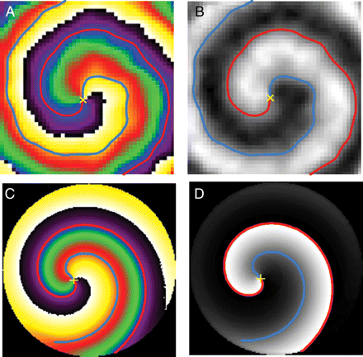
Figure 4 Spiral waves spin around a tiny pivoting phase singularity. (A and B) Phase singularity (yellow cross mark) ...
Notes:
Figure 4 Spiral waves spin around a tiny pivoting phase singularity. (A and B) Phase singularity (yellow cross mark) shown on a phase map (A) and black and white movie snapshot (B) of the same spiral in a neonatal rat ventricular myocyte monolayer. (C and D) Similar representations from an equivalent computer simulation. The phase singularity is the point at which all phases converge in the phase map (A and C) and wave front (red) and wave tail (blue) meet.
Unless provided in the caption above, the following copyright applies to the content of this slide: Published on behalf of the European Society of Cardiology. All rights reserved. © The Author 2010. For permissions please email: journals.permissions@oup.com.

