Slide 1
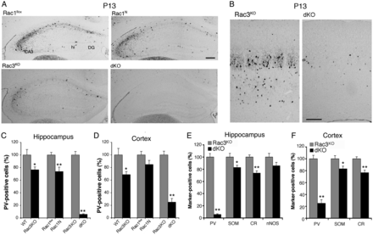
Figure 1. Double deletion of Rac1 and Rac3 causes the reduction of cortical and hippocampal PV-positive interneurons. ...
Notes:
Figure 1. Double deletion of Rac1 and Rac3 causes the reduction of cortical and hippocampal PV-positive interneurons. (A) PV staining of the hippocampus of Rac1flox, Rac1N, Rac3KO, and double KO mice. (B) PV staining of the somatosensory cortex of double KO and control Rac3KO littermates. DG, dentate gyrus; hi, hilus. Scale bars: 100 μm. (C) Number of PV-positive neurons/section of hippocampus from Rac1flox, Rac3KO, Rac1N, and double KO mice. Graph bars are normalized means ± SEM (n = 7–16 sections from 2 to 3 mice/genotype). (D) Density of PV-positive neurons in the somatosensory cortex of Rac1flox, Rac3KO, Rac1N and double KO mice. Graph bars are normalized means ± SEM (n = 11–31 cortical fields from 2 to 3 mice/genotype). (E and F) The strong decrease in the number of interneurons is specific for the PV-positive cells. Quantification from sections of hippocampus (E) and somatosensory cortex (F) immunostained for PV, SOM, CR, or nNOS. Normalized means ± SEM of (E) the number of marker-positive neurons/section (n = 10–23 sections from 2 to 3 mice/genotype), and (F) cell density (n = 31–50 cortical fields from 2 to 3 mice/genotype). *P < 0.05; **P < 0.005.
Unless provided in the caption above, the following copyright applies to the content of this slide: © The Author 2012. Published by Oxford University Press.This is an Open Access article distributed under the terms of the Creative Commons Attribution Non-commercial License (http://creativecommons.org/licenses/by-nc/3.0/), which permits unrestricted non-commercial use, distribution, and reproduction in any medium, provided the original work is properly cited.

Slide 2
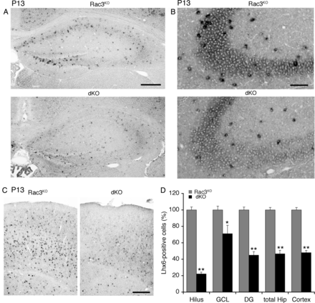
Figure 2. The number of Lhx6-positive neurons is decreased in the hippocampus and cortex of double KO mice. In situ ...
Notes:
Figure 2. The number of Lhx6-positive neurons is decreased in the hippocampus and cortex of double KO mice. In situ hybridization for Lhx6 in the hippocampus (A and B) and cortex (C) of Rac3KO and double KO mice. Scale bars: 300 μm (A and C); 100 μm (B). (D) Number of Lhx6-positive cells. Graph bars are normalized means ± SEM (n = 15 sections, 3 mice/genotype). *P < 0.05; **P < 0.005. GCL, granule cell layer; DG, dentate gyrus.
Unless provided in the caption above, the following copyright applies to the content of this slide: © The Author 2012. Published by Oxford University Press.This is an Open Access article distributed under the terms of the Creative Commons Attribution Non-commercial License (http://creativecommons.org/licenses/by-nc/3.0/), which permits unrestricted non-commercial use, distribution, and reproduction in any medium, provided the original work is properly cited.

Slide 3
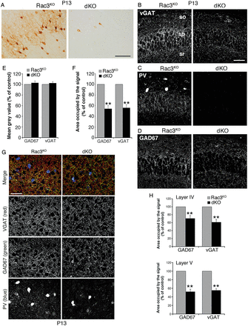
Figure 3. The inhibitory presynaptic input is reduced in the hippocampus and cortex of double KO mice. (A) PV-positive ...
Notes:
Figure 3. The inhibitory presynaptic input is reduced in the hippocampus and cortex of double KO mice. (A) PV-positive interneurons in the somatosensory cortex of P13 Rac3KO and double KO mice. Scale bar: 100 μm. (B–D) Confocal images of the CA1 region from P13 mice immunostained for VGAT (B), PV (C), or GAD67 (D). The inhibitory input is reduced in the stratum pyramidale of the CA1 region of double KO animals; so, stratum oriens; sp, stratum pyramidale; sr, stratum radiatum. Scale bar: 50 μm. (E) Mean gray values, corresponding to the average intensity of fluorescence per unit area for either GAD67 or VGAT within the stratum pyramidale of CA1. Graph bars are normalized means ± SEM (Rac3KO = 100%; n = 24 CA1 fields from 3 mice/genotype). (F) Area of CA1 stratum pyramidale positive for either GAD67 or VGAT. Graph bars are normalized means ± SEM (Rac3KO = 100%; n = 24 CA1 fields from 3 mice/genotype). (G) Confocal images of layer V of the somatosensory cortex immunostained for presynaptic markers and PV. (H) Reduction of the signal for both GAD67 and VGAT in layers IV and V of the somatosensory cortex of double KO mice. Graph bars are normalized means ± SEM (Rac3KO = 100%; n = 17–20 cortical fields from 3 mice/genotype). **P < 0.005.
Unless provided in the caption above, the following copyright applies to the content of this slide: © The Author 2012. Published by Oxford University Press.This is an Open Access article distributed under the terms of the Creative Commons Attribution Non-commercial License (http://creativecommons.org/licenses/by-nc/3.0/), which permits unrestricted non-commercial use, distribution, and reproduction in any medium, provided the original work is properly cited.

Slide 4
Figure 4. Quantification of Lhx6-positive cells during the postnatal development of the hippocampus. Graph bars are ...
Notes:
Figure 4. Quantification of Lhx6-positive cells during the postnatal development of the hippocampus. Graph bars are means ± SEM of density (A), number/section of hippocampal hemisphere (B), and percentage (controls = 100%) (C) of Lhx6-positive cells (n = 22–30 sections from 3 to 4 mice/genotype/stage). **P < 0.005.
Unless provided in the caption above, the following copyright applies to the content of this slide: © The Author 2012. Published by Oxford University Press.This is an Open Access article distributed under the terms of the Creative Commons Attribution Non-commercial License (http://creativecommons.org/licenses/by-nc/3.0/), which permits unrestricted non-commercial use, distribution, and reproduction in any medium, provided the original work is properly cited.

Slide 5
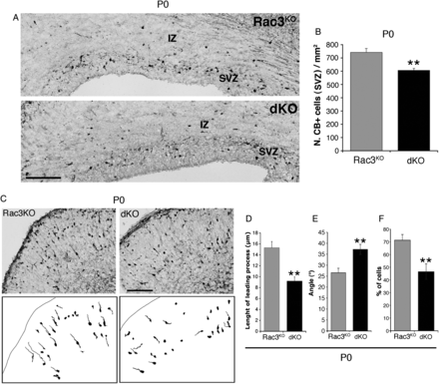
Figure 5. Number and morphology of cortical CB-positive precursors are affected in double KO mice. (A) CB-positive ...
Notes:
Figure 5. Number and morphology of cortical CB-positive precursors are affected in double KO mice. (A) CB-positive neurons in the SVZ migratory pathway of the cortex of P0 mice. Sections rostral to the hippocampus are shown. (B) Graph bars are means ± SEM of the number of CB-positive cells per mm2 of SVZ; n = 18–19 sections from 3 mice/genotype. **P < 0.005. (C) Immunohistochemistry for CB in cortical sections (upper), and camera lucida from same images (lower). Scale bars: 100 μm. (D) Length of the leading process of CB-positive cells of the CP. Graph bars are means ± SEM (n = 263 control and 243 double KO cells from 3 mice/genotype). (E) Angle of CB-positive cells in the CP (n = 145 control and 136 double KO cells from 4 mice/genotype). (F) Percentage of CB-positive cells with an angle ≤25° (n = 13 control and 14 double KO sections from 4 mice/genotype). **P < 0.005.
Unless provided in the caption above, the following copyright applies to the content of this slide: © The Author 2012. Published by Oxford University Press.This is an Open Access article distributed under the terms of the Creative Commons Attribution Non-commercial License (http://creativecommons.org/licenses/by-nc/3.0/), which permits unrestricted non-commercial use, distribution, and reproduction in any medium, provided the original work is properly cited.

Slide 6
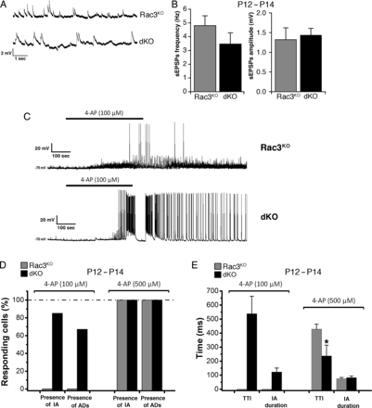
Figure 6. Rac deficiency increases hippocampal excitability and susceptibility to 4-AP-elicited epileptiform activity. ...
Notes:
Figure 6. Rac deficiency increases hippocampal excitability and susceptibility to 4-AP-elicited epileptiform activity. (A) Spontaneous EPSPs from pyramidal cells in slices prepared from Rac3KO and double KO mice. (B) Quantification revealed no differences in the instantaneous frequency and amplitude of spontaneous EPSPs. Bars are means ± SEM (n = 6 Rac3KO and 7 double KO neurons). (C) Perfusion with 100-μM 4-AP induced ictal discharges in 5 of 6 pyramidal neurons from double KO mice (bottom). No ictal activity was observed in 6 pyramidal neurons from Rac3KO mice (upper). (D and E) Quantification of the effects of 100- and 500- μM 4-AP on the presence of ictal activity (IA), afterdischarges (ADs); time-to-ictal event (TTI), and IA duration (n = 6 cells per genotype for 100 μM 4-AP; n = 9 and 5 Rac3KO and double KO neurons, respectively, for 500 μM 4-AP). *P < 0.05.
Unless provided in the caption above, the following copyright applies to the content of this slide: © The Author 2012. Published by Oxford University Press.This is an Open Access article distributed under the terms of the Creative Commons Attribution Non-commercial License (http://creativecommons.org/licenses/by-nc/3.0/), which permits unrestricted non-commercial use, distribution, and reproduction in any medium, provided the original work is properly cited.

Slide 7
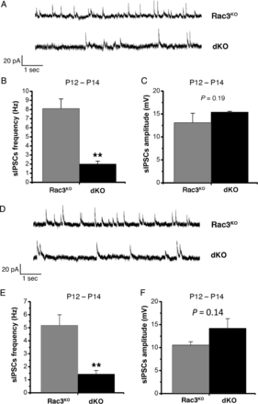
Figure 7. Comparative analysis of spontaneous inhibitory synaptic events in hippocampal CA1 and cortical pyramidal ...
Notes:
Figure 7. Comparative analysis of spontaneous inhibitory synaptic events in hippocampal CA1 and cortical pyramidal cells. (A–C) Analysis in CA1 hippocampal neurons. (A) Spontaneous IPSCs recorded in CA1 pyramidal cells of Rac3KO and double KO mice. (B) Instantaneous frequency of spontaneous IPSCs is significantly decreased in double KO cells (n = 9) compared with Rac3KO cells (n = 6). (C) The amplitude of spontaneous IPSCs is similar in Rac3KO and double KO neurons. (D–F) Analysis in cortical neurons. (D) Examples of spontaneous IPSCs recorded in pyramidal neurons from layer V of the somatosensory cortex of Rac3KO (upper trace) and double KO mice (lower trace). (E) The instantaneous frequency of spontaneous IPSCs is significantly decreased in double KO somatosensory pyramidal cells (n = 9) compared with Rac3KO cells (n = 8). (F) The amplitude of spontaneous IPSCs is similar in Rac3KO and double KO pyramidal neurons. **P < 0.005.
Unless provided in the caption above, the following copyright applies to the content of this slide: © The Author 2012. Published by Oxford University Press.This is an Open Access article distributed under the terms of the Creative Commons Attribution Non-commercial License (http://creativecommons.org/licenses/by-nc/3.0/), which permits unrestricted non-commercial use, distribution, and reproduction in any medium, provided the original work is properly cited.

