Slide 1
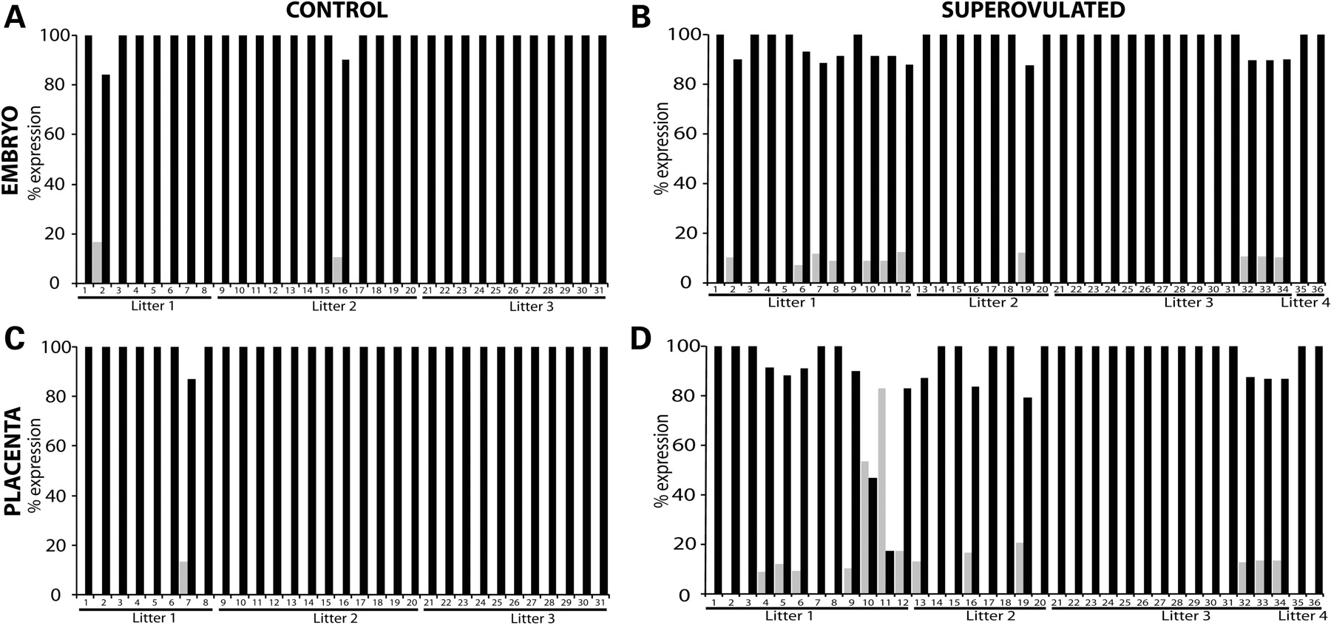
Figure 1. Allele-specific expression analysis of Snrpn in 9.5dpc embryos (A and B) and placentas (C and D) collected ...
Notes:
Figure 1. Allele-specific expression analysis of Snrpn in 9.5dpc embryos (A and B) and placentas (C and D) collected from control (A and C) or superovulated (B and D) females following development in vivo. Gray bars represent maternal expression, black bars represent paternal expression.
Unless provided in the caption above, the following copyright applies to the content of this slide: © The Author 2008. Published by Oxford University Press. All rights reserved. For Permissions, please email: journals.permissions@oxfordjournals.org

Slide 2
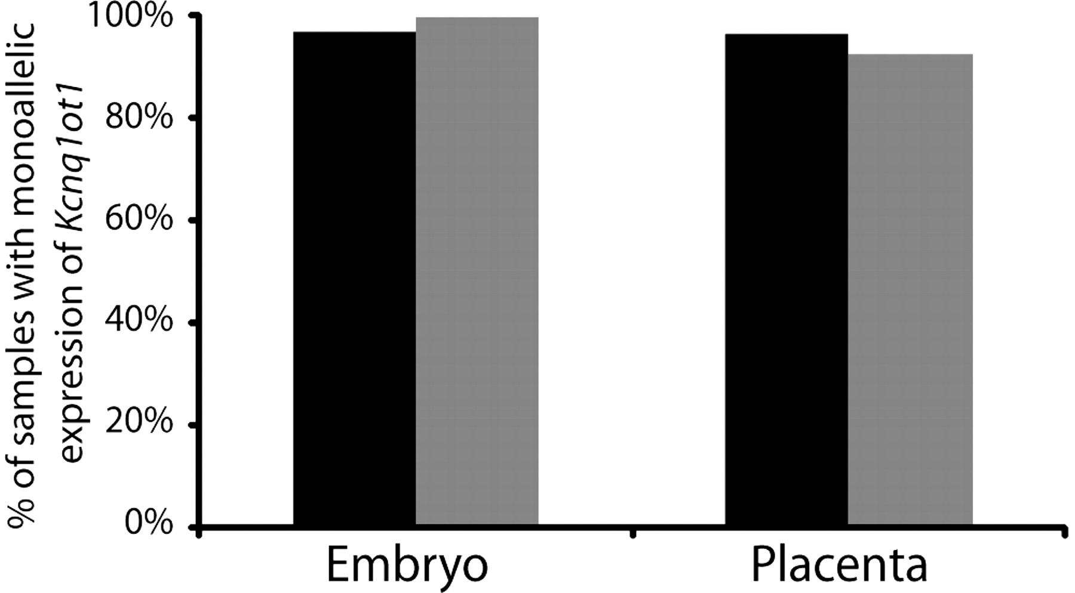
Figure 2. Allele-specific expression analysis of Kcnq1ot1 in 9.5dpc embryos and placentas collected from control or ...
Notes:
Figure 2. Allele-specific expression analysis of Kcnq1ot1 in 9.5dpc embryos and placentas collected from control or superovulated females following development in vivo. Black bars represent control samples (N = 31 embryos, 29 placentas), gray bars represent superovulated samples (N = 33 embryos, 39 placentas).
Unless provided in the caption above, the following copyright applies to the content of this slide: © The Author 2008. Published by Oxford University Press. All rights reserved. For Permissions, please email: journals.permissions@oxfordjournals.org

Slide 3
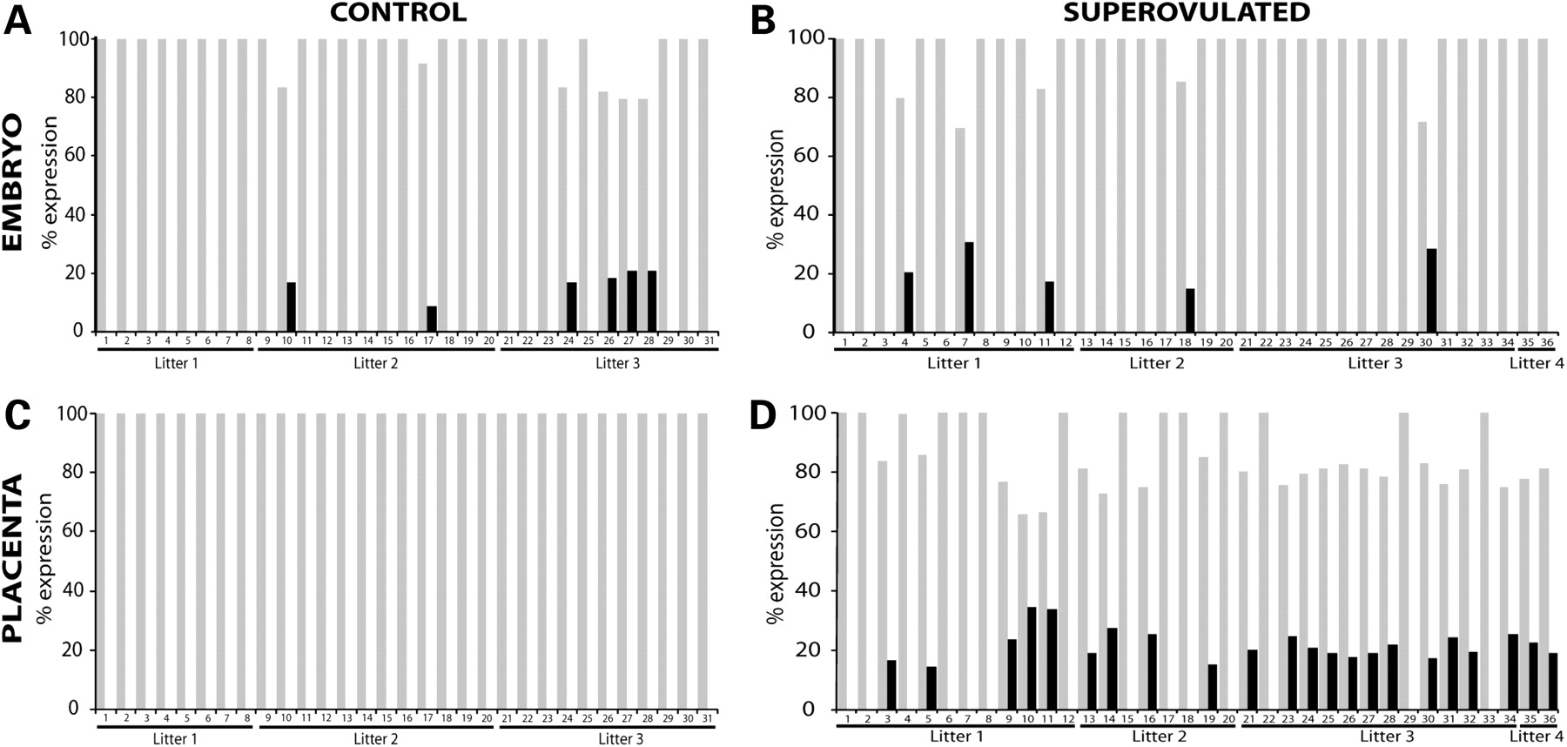
Figure 3. Allele-specific expression analysis of H19 in 9.5dpc embryos (A and B) and placentas (C and D) collected from ...
Notes:
Figure 3. Allele-specific expression analysis of H19 in 9.5dpc embryos (A and B) and placentas (C and D) collected from control (A and C) or superovulated (B and D) females following development in vivo. Details as described in Figure 1.
Unless provided in the caption above, the following copyright applies to the content of this slide: © The Author 2008. Published by Oxford University Press. All rights reserved. For Permissions, please email: journals.permissions@oxfordjournals.org

Slide 4
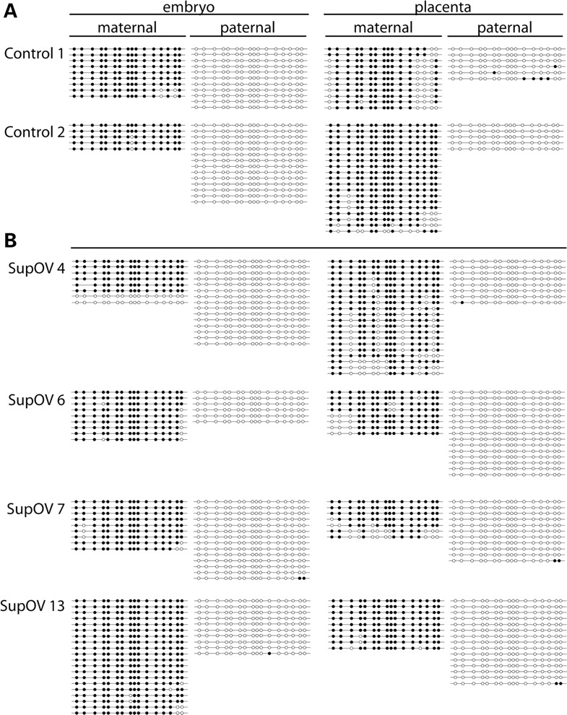
Figure 4. Allele-specific methylation status of Snrpn in 9.5dpc embryos and placentas collected from control (A) and ...
Notes:
Figure 4. Allele-specific methylation status of Snrpn in 9.5dpc embryos and placentas collected from control (A) and superovulated (B) CD1 female mice. Numbers beside each sample correspond to the number of each sample in Figures 1 and 3. Each line represents an individual clone; open circles denote unmethylated CpG sites and closed circles denote methylated CpG sites.
Unless provided in the caption above, the following copyright applies to the content of this slide: © The Author 2008. Published by Oxford University Press. All rights reserved. For Permissions, please email: journals.permissions@oxfordjournals.org

Slide 5
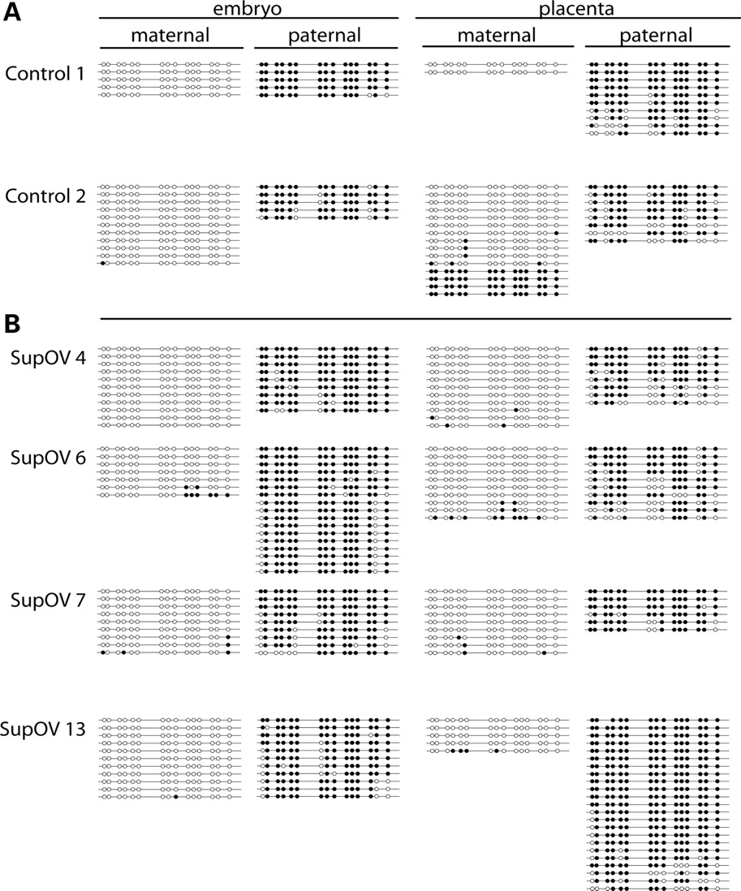
Figure 5. Allele-specific methylation status of H19 in 9.5dpc embryos and placentas collected from control (A) and ...
Notes:
Figure 5. Allele-specific methylation status of H19 in 9.5dpc embryos and placentas collected from control (A) and superovulated (B) CD1 female mice. Numbers beside each sample correspond to the number of each sample in Figures 1 and 3. Each line represents an individual clone; open circles denote unmethylated CpG sites and closed circles denote methylated CpG sites.
Unless provided in the caption above, the following copyright applies to the content of this slide: © The Author 2008. Published by Oxford University Press. All rights reserved. For Permissions, please email: journals.permissions@oxfordjournals.org

Slide 6
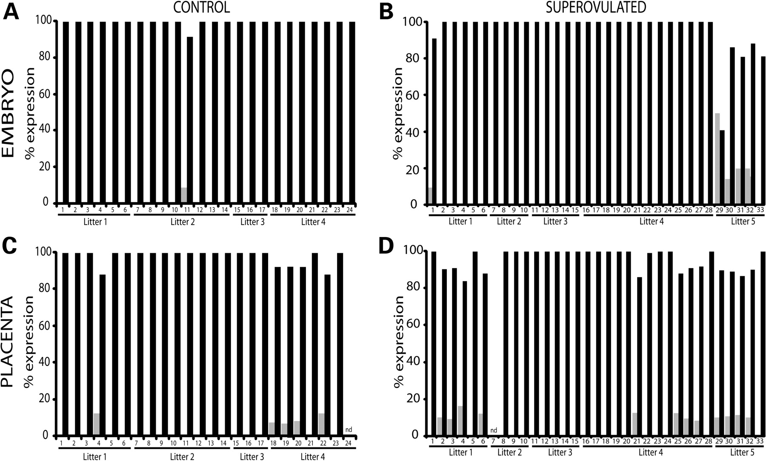
Figure 6. Allele-specific expression analysis of Snrpn in 9.5dpc embryos (A and B) and placentas (C and D). Donor CD1 ...
Notes:
Figure 6. Allele-specific expression analysis of Snrpn in 9.5dpc embryos (A and B) and placentas (C and D). Donor CD1 female mice were either naturally cycling (control) (A and C) or superovulated (B and D). Gray bars represent maternal expression, black bars represent paternal expression.
Unless provided in the caption above, the following copyright applies to the content of this slide: © The Author 2008. Published by Oxford University Press. All rights reserved. For Permissions, please email: journals.permissions@oxfordjournals.org

Slide 7
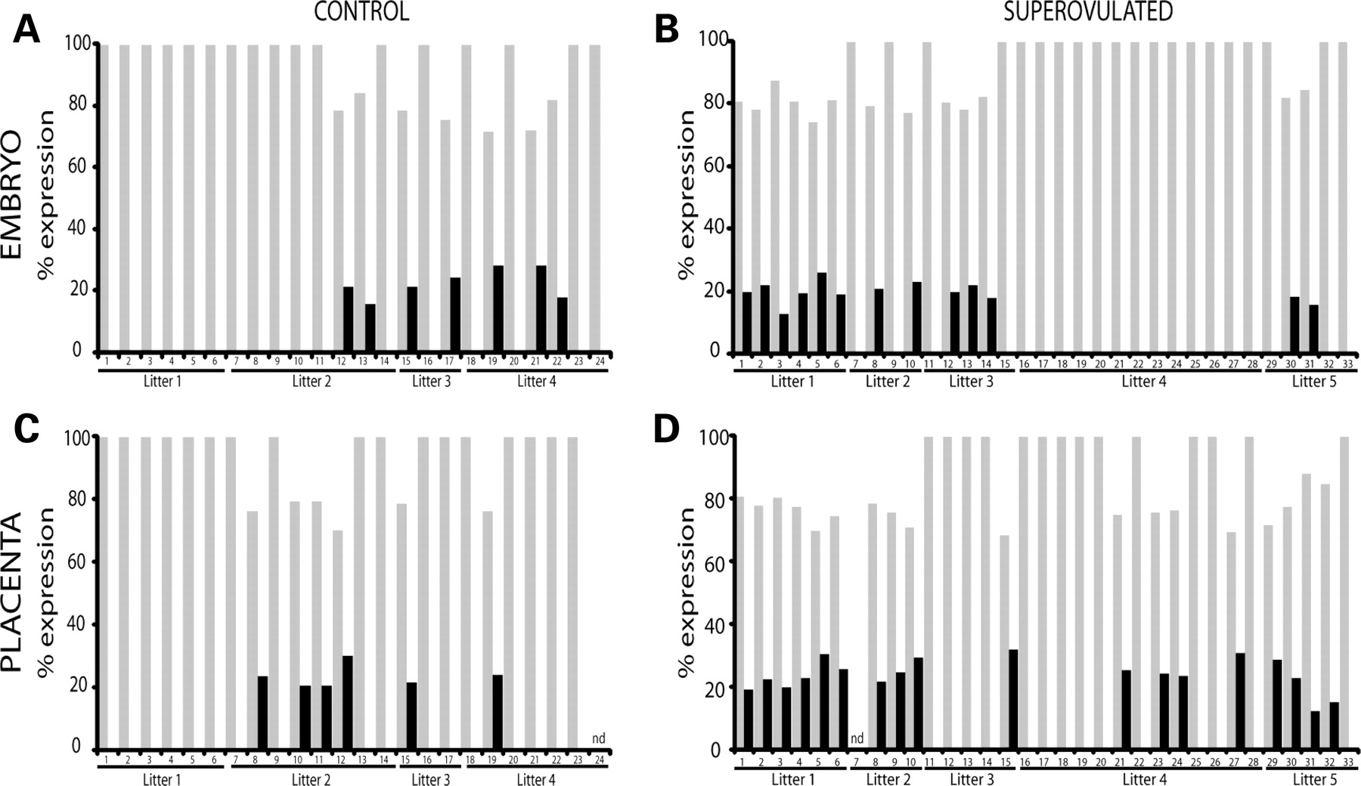
Figure 7. Allele-specific expression analysis of H19 in 9.5dpc embryos (A and B) and placentas (C and D). Donor CD1 ...
Notes:
Figure 7. Allele-specific expression analysis of H19 in 9.5dpc embryos (A and B) and placentas (C and D). Donor CD1 female mice were either naturally cycling (control) (A and C) or superovulated (B and D). Details as for Figure 6.
Unless provided in the caption above, the following copyright applies to the content of this slide: © The Author 2008. Published by Oxford University Press. All rights reserved. For Permissions, please email: journals.permissions@oxfordjournals.org

Slide 8
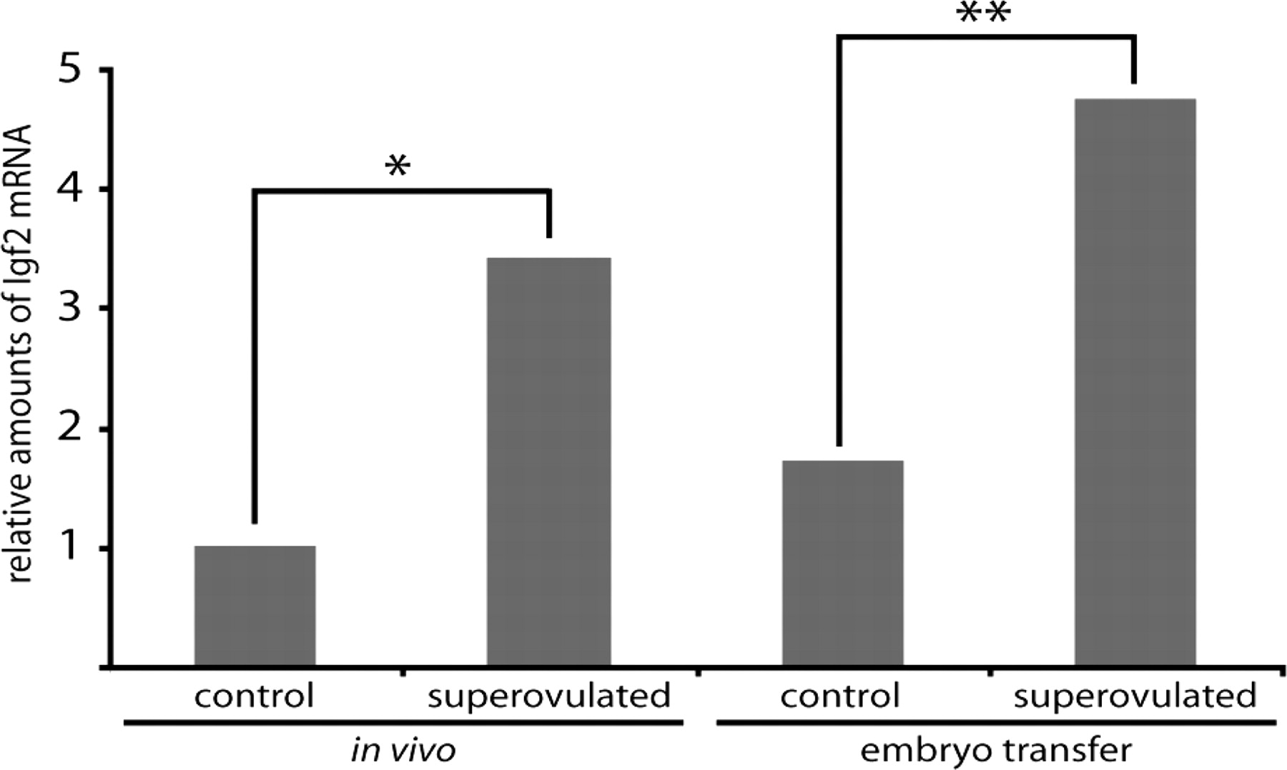
Figure 8. Analysis of Igf2 expression in 9.5dpc placentas. *P > 0.03 **P > 0.008. (N = 15 placentas for in vivo control ...
Notes:
Figure 8. Analysis of Igf2 expression in 9.5dpc placentas. *P > 0.03 **P > 0.008. (N = 15 placentas for in vivo control group, 16 placentas for all other groups).
Unless provided in the caption above, the following copyright applies to the content of this slide: © The Author 2008. Published by Oxford University Press. All rights reserved. For Permissions, please email: journals.permissions@oxfordjournals.org

