Slide 1
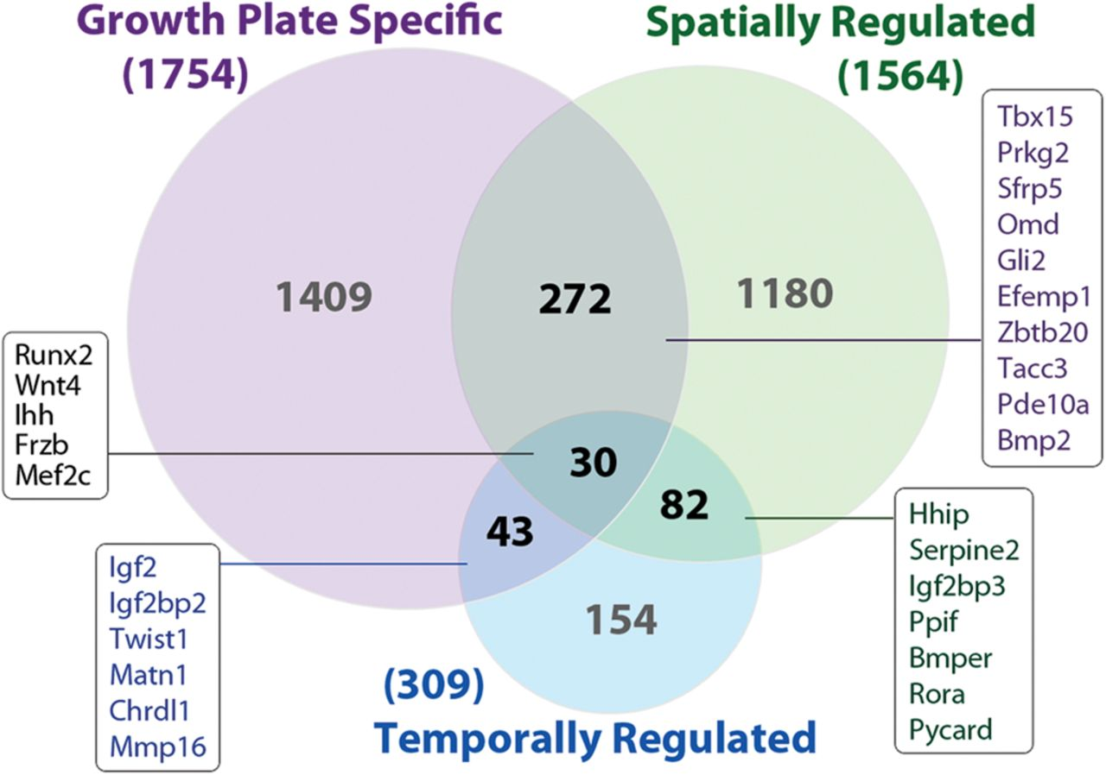
Figure 1. Venn diagram showing the number of genes with expression that is growth plate-specific, spatially regulated ...
Notes:
Figure 1. Venn diagram showing the number of genes with expression that is growth plate-specific, spatially regulated in growth plate or temporally regulated in growth plate by microarray. ‘Growth plate specific’ indicates expression in growth plate ≥2.0-fold greater than kidney, lung and heart in 1-week-old mouse (n = 5, FDR < 1%, Genome Array 430 2.0, Affymetrix). ‘Spatially regulated’ indicates up- or downregulated from resting to proliferative zone (≥2.0-fold, FDR < 5%) or from proliferative to hypertrophic zone (≥2.0-fold, FDR < 5%) in 1-week-old rat (n = 6, Genome Array 230 2.0, Affymetrix). ‘Temporally regulated’ indicates expression that is up- or downregulated from 3 weeks to 12 weeks of age in rat proliferative zone (≥2.0-fold, FDR < 5%, n = 6, Rat Genome Array 230 2.0, Affymetrix,). Examples of genes in each overlapping subset are shown in boxes.
Unless provided in the caption above, the following copyright applies to the content of this slide: Published by Oxford University Press 2012

Slide 2
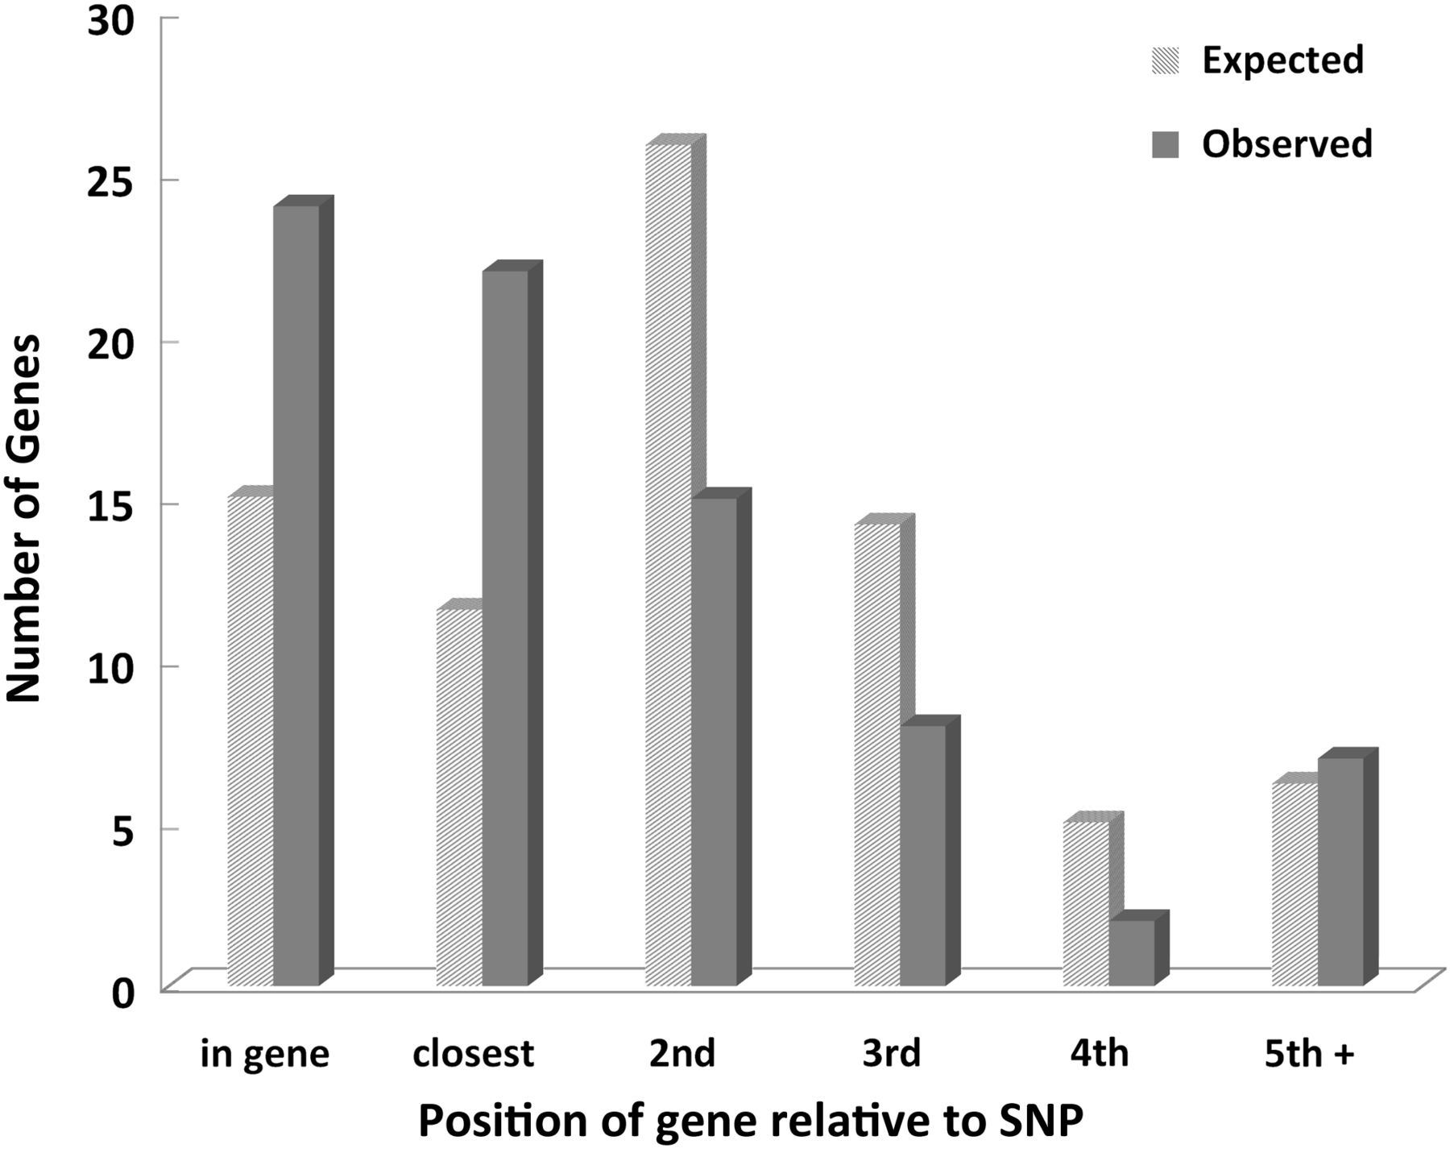
Figure 2. Observed and expected positional distribution of 78 growth plate-related genes relative to SNP. Seventy-eight ...
Notes:
Figure 2. Observed and expected positional distribution of 78 growth plate-related genes relative to SNP. Seventy-eight genes in the GWA loci were implicated in growth plate function by expression analysis, mouse phenotype or human phenotype. Of these 78, 46 are located closest to the height SNP. In 24 of these cases, the strongly associated height SNP is located within the growth plate gene itself. This distribution differs significantly (P < 0.0001, χ2 test) from a random allocation calculated based on the overall distribution of 833 genes in 207 loci. Thus, the growth plate-related genes tend to lie closer to the SNP identified by GWA than would be expected by chance.
Unless provided in the caption above, the following copyright applies to the content of this slide: Published by Oxford University Press 2012

Slide 3
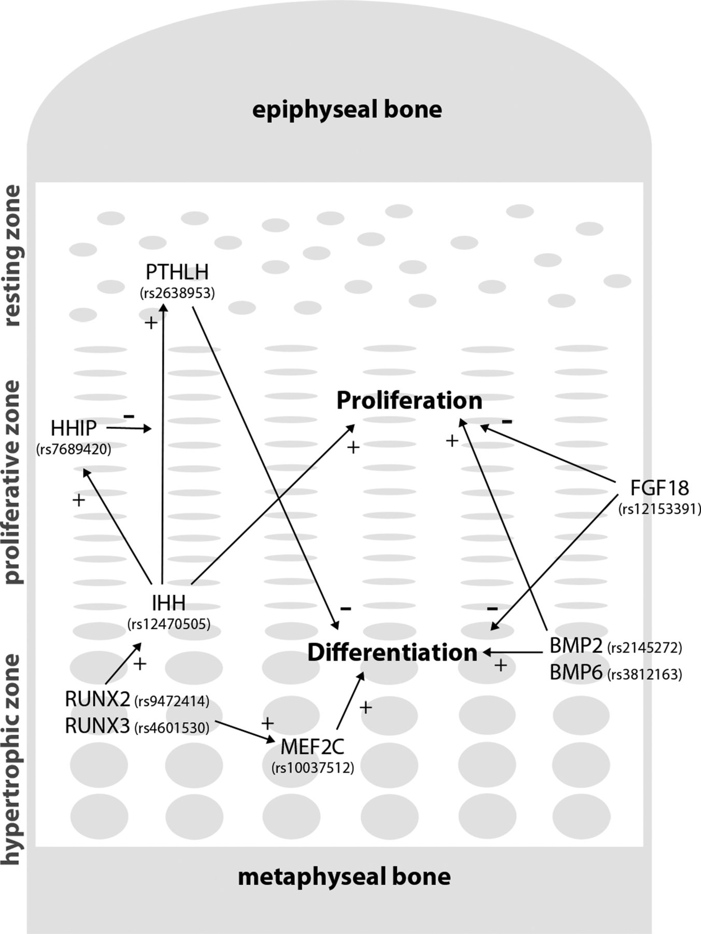
Figure 3. Examples of genes from GWA analysis that have a well-established role in chondrogenesis. PTHrP (encoded by ...
Notes:
Figure 3. Examples of genes from GWA analysis that have a well-established role in chondrogenesis. PTHrP (encoded by PTHLH) produced in the resting zone inhibits differentiation of proliferative chondrocytes. The production of PTHrP is in turn stimulated by IHH from the hypertrophic zone. IHH stimulates chondrocyte proliferation in the proliferative zone and the expression of HHIP, which inhibits and modulates the action of IHH in the resting zone. Together, IHH and PTHrP form a negative feedback loop that determines the height of the proliferative zone. BMP2 and BMP6, produced by hypertrophic chondrocytes, stimulate proliferation and differentiation of chondrocytes, which is partially antagonized by an inhibitory effect of FGFs, such as FGF18. RUNX2 and RUNX3 are expressed in the hypertrophic zone and stimulate hypertrophic differentiation through one of their downstream targets MEF2C, which is also highly expressed in the hypertrophic zone. RUNX2 also interacts with the IHH-PTHrP feedback loop by inducing IHH expression. +, stimulatory effect; −, inhibitory effect.
Unless provided in the caption above, the following copyright applies to the content of this slide: Published by Oxford University Press 2012

