Slide 1
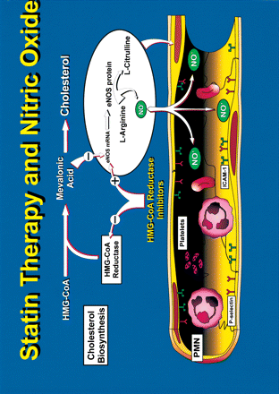
Fig. 1 Schematic diagram of mechanism of the vasculoprotective effects of statins via enhancement of endothelial NO ...
Notes:
Fig. 1 Schematic diagram of mechanism of the vasculoprotective effects of statins via enhancement of endothelial NO release. Statins inhibit the biosynthesis of cholesterol at the mevalonic acid step. Mevalonic acid destabilizes the mRNA for endothelial nitric oxide synthase (eNOS) thus effectively reducing synthesis of NO from l-arginine to l-citrulline and the subsequent release of NO. Statins inhibit the formation of mevalonic acid preventing this reduction in NO release. NO is essential in retarding platelet aggregation and polymorphonuclear (PMN) leukocyte adherence to the endothelium via the endothelial cell adhesion molecules, P-selectin and intercellular adhesion molecule-1 (ICAM-1). Statins promote these anti-inflammatory actions of physiological concentrations of endothelium-derived (NO).
Unless provided in the caption above, the following copyright applies to the content of this slide: Copyright © 2000, European Society of Cardiology

