Slide 1
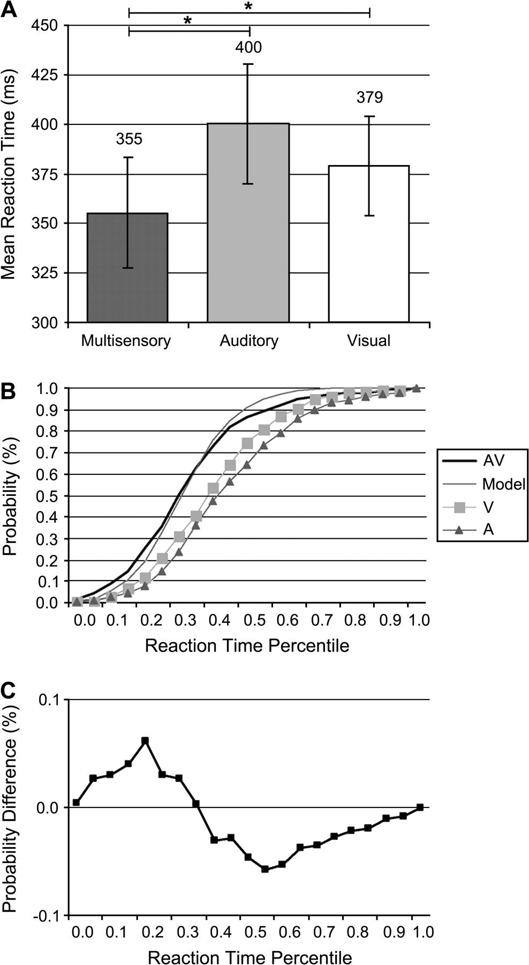
Figure 1. Mean reaction times. (a) Subjects responded faster to the multisensory than to either visual (t₍₉₎ ...
Notes:
Figure 1. Mean reaction times. (a) Subjects responded faster to the multisensory than to either visual (t(9) = 3.4; P = 0.008) or auditory (t(9) = 6.4; P < 0.001) condition, and reaction times to unisensory stimuli did not significantly differ (t(9) = 1.8; P > 0.10). Asterisk indicates significant difference (P < 0.05; 2-tailed paired t-test). (b) Group-average cumulative probability distributions for each stimulus condition as well as the modeled data based on Miller's (1982) inequality. (c) Reaction times to multisensory stimuli exceeded predictions of probability summation over the fastest third of the distribution (indicated by positive values).
Unless provided in the caption above, the following copyright applies to the content of this slide: © The Author 2006. Published by Oxford University Press. All rights reserved. For permissions, please e-mail: journals.permissions@oxfordjournals.org

Slide 2
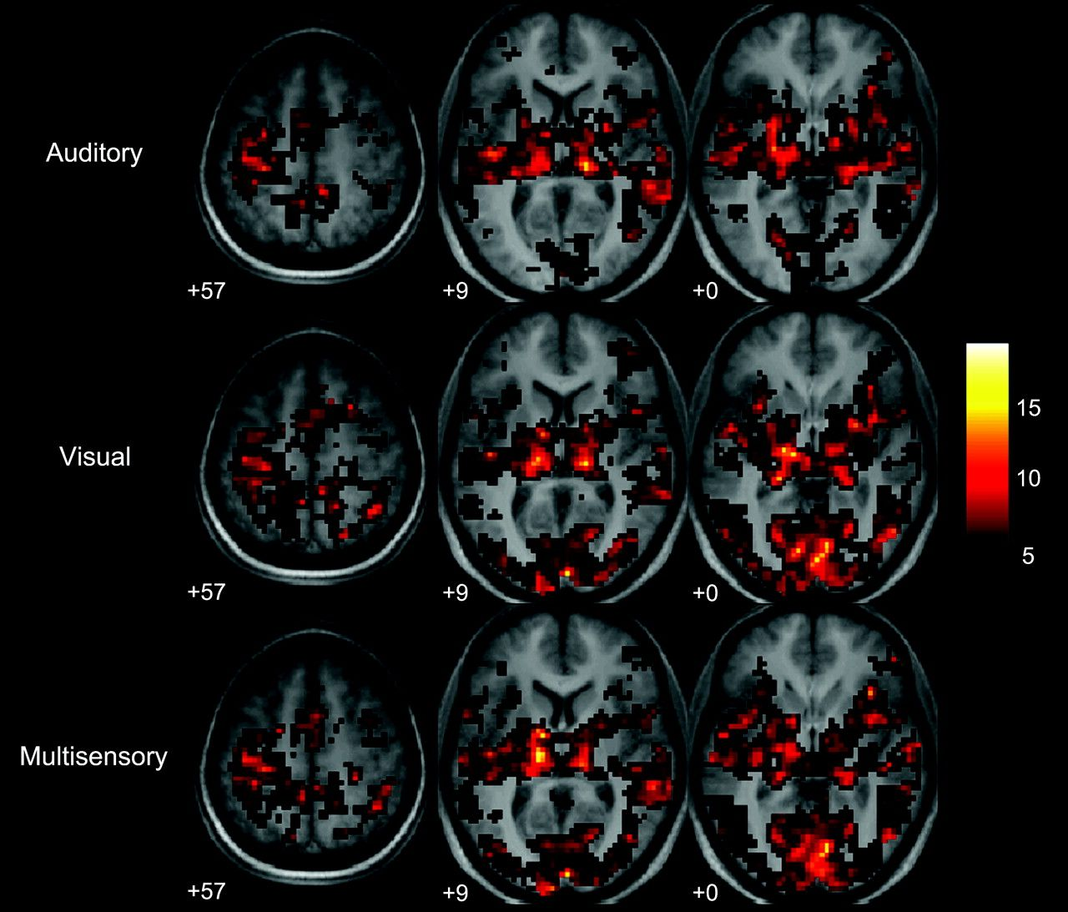
Figure 2. Activation maps (P < 0.001, cluster-size > 15 voxels; color scale represents t-values) for each stimulus ...
Notes:
Figure 2. Activation maps (P 15 voxels; color scale represents t-values) for each stimulus condition show that all conditions led to responses within primary auditory and visual cortices, the left primary motor cortex, the SMA, and thalamic regions. Axial slices are shown at 3 z-coordinates (indicated in insets), using the MNI system. The left hemisphere is displayed on the left side of the image.
Unless provided in the caption above, the following copyright applies to the content of this slide: © The Author 2006. Published by Oxford University Press. All rights reserved. For permissions, please e-mail: journals.permissions@oxfordjournals.org

Slide 3
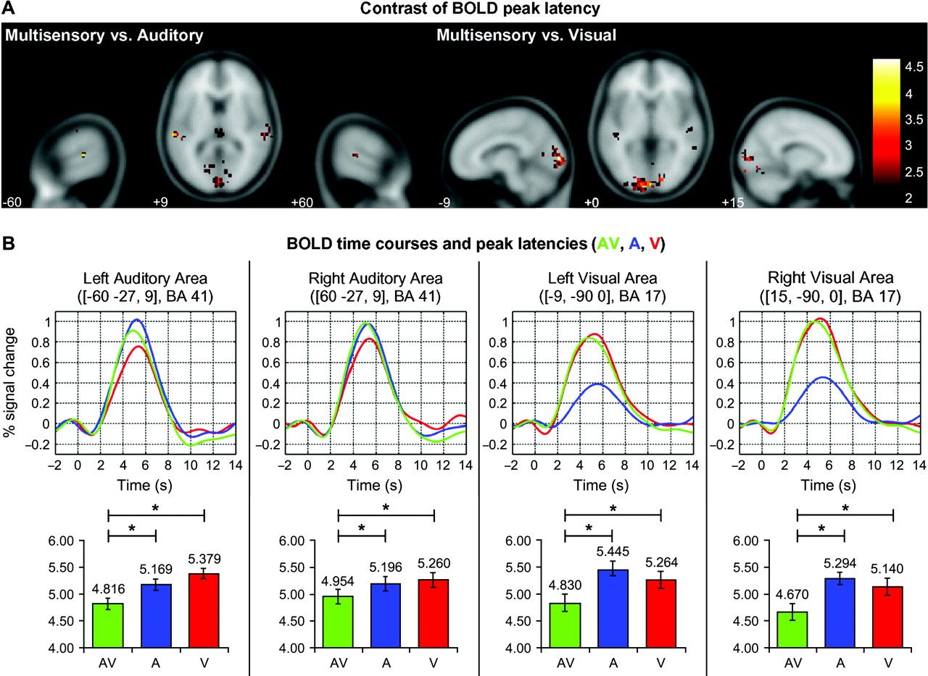
Figure 3. Facilitation in BOLD peak latencies in response to A, V, and AV multisensory stimulation (blue, red, and ...
Notes:
Figure 3. Facilitation in BOLD peak latencies in response to A, V, and AV multisensory stimulation (blue, red, and green traces, respectively). (a) Contrast of BOLD peak latency (paired t-test, 1-tailed, t-value indicated) at each voxel within VRRs and ARRs (see Experimental Procedures for details). (b) Dynamic shifts in BOLD peak latencies within primary cortices. MNI coordinates and Brodmann Area of the center of the cluster are indicated. Bar graphs show mean peak latencies (standard error of the mean indicated). Asterisk indicates significant difference (P < 0.05, paired t-test, 2-tailed).
Unless provided in the caption above, the following copyright applies to the content of this slide: © The Author 2006. Published by Oxford University Press. All rights reserved. For permissions, please e-mail: journals.permissions@oxfordjournals.org

