Slide 1
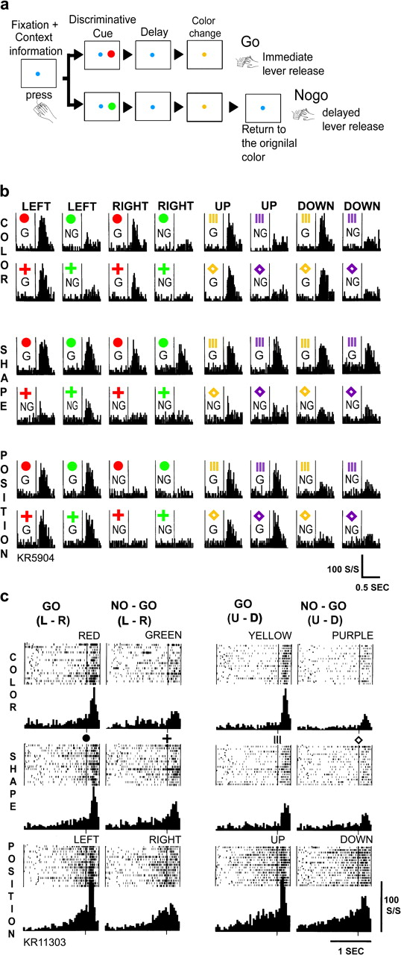
Figure 1. (a) Sequence of events in the conditional Go/No-go discrimination task. (b) An example of a primate LPFC ...
Notes:
Figure 1. (a) Sequence of events in the conditional Go/No-go discrimination task. (b) An example of a primate LPFC neuron that coded not the physical properties, but the behavioral significance of the Discriminative Cue depending on the context information. First row, color dimension; second row, shape dimension; third row, position dimension. G indicates Go and NG indicates No-go trial. Neuronal activity in response to each cue is shown in the histogram display. The vertical line in the center of the display indicates the time of the Discriminative Cue presentation. The scales are indicated on the lower right. (c) An example of a primate LPFC neuron that showed differential precue baseline activity in relation to the task dimension (from top to down, color, shape, and position). Neuronal activity is shown in raster and histogram displays. For raster displays, each row indicates one trial, and each dot represents one spike discharge. Correct response (Go or No-go) is indicated at the top of the figure. The presented cue is indicated on the upper right side of each raster. The vertical line under the symbol of the cue indicates the time of the Discriminative Cue presentation. The scales are indicated on the lower right. (From Sakagami and Niki 1994, with kind permission from the Springer Science and Business Media.)
Unless provided in the caption above, the following copyright applies to the content of this slide: © The Author 2007. Published by Oxford University Press. All rights reserved. For permissions, please e-mail: journals.permissions@oxfordjournals.org

Slide 2
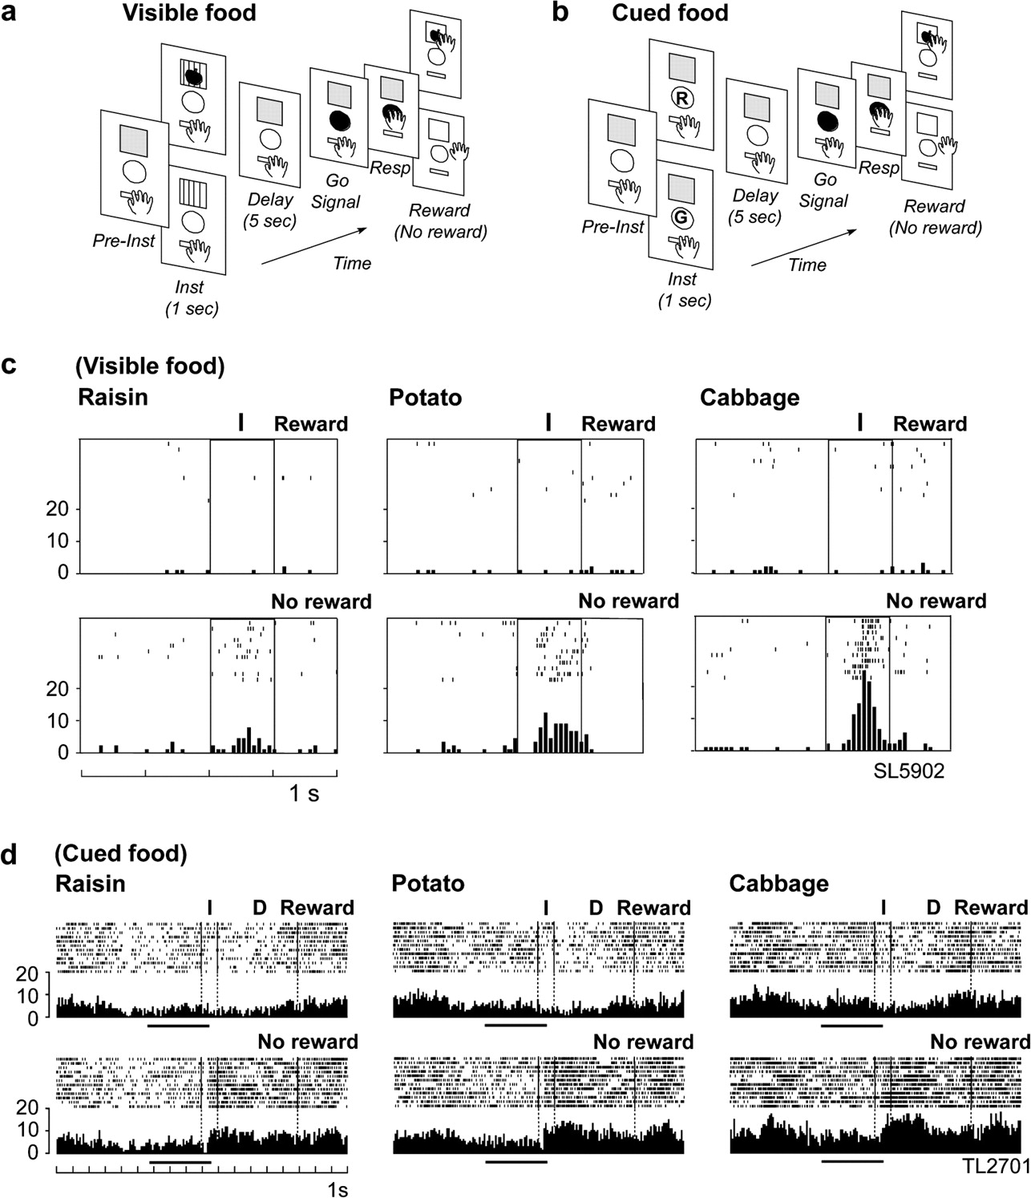
Figure 2. (a, b) Sequence of events in the delayed reaction task with reward and no-reward in the Visible food version ...
Notes:
Figure 2. (a, b) Sequence of events in the delayed reaction task with reward and no-reward in the Visible food version (a) and Cued food version (b). Pre-inst, preinstruction period; Inst, instruction period; Resp, response. (c) An example of an LPFC neuron that showed differential activity to an identical cue (empty food tray) depending on the motivational context. Neuronal activity is shown in raster and histogram displays. The activity is shown from 2 s before the Instruction cue presentation to 1 s after the Instruction cue presentation. Each row indicates one trial, and each dot represents one spike discharge. Upper displays are for reward trials, and lower displays are for no-reward trials. I indicates Instruction cue presentation. Rewards used are stated. (d) An example of an LPFC neuron that showed differential precue baseline activity in relation to the motivational context. This neuron also showed differential activity during the cue and delay periods depending on the reward block in both reward and no-reward trials. The activity is shown from 9 s before the Instruction cue presentation to 3 s after the Go signal presentation. The 2 vertical dotted lines from the left indicate Instruction cue onset and offset, and the third line indicates the end of the delay period. D indicates the delay period. Horizontal heavy lines indicate 3 s of precue period, used for statistical analysis. (From Watanabe et al. 2002, with kind permission from the Journal of Neuroscience.)
Unless provided in the caption above, the following copyright applies to the content of this slide: © The Author 2007. Published by Oxford University Press. All rights reserved. For permissions, please e-mail: journals.permissions@oxfordjournals.org

Slide 3
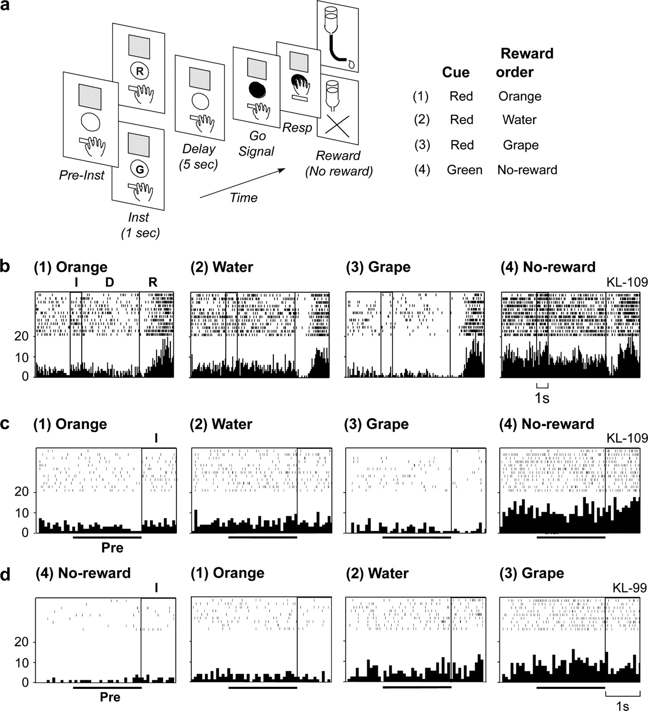
Figure 3. (a) Sequence of events in the delayed reaction task with varying rewards and the order of delivery of ...
Notes:
Figure 3. (a) Sequence of events in the delayed reaction task with varying rewards and the order of delivery of different kinds of liquid reward. R, red light cue; G, green light cue. (b) An example of an OFC neuron that showed differential activity to the same red instruction cue depending on the difference of its motivational significance. (c) An example of an OFC neuron that showed differential precue baseline activity depending on the current trial's reward. (d) An example of an OFC neuron that showed (increased) gradual changes in precue baseline activity in relation to the motivational context in terms of long-range reward. For (b), (c), and (d), rewards used are stated above each display. Left-most scales indicate impulses/s. (b, c) The activity of the same neuron in a different time scale. For (c) and (d), Pre indicates the precue period examined. Other conventions are the same as in Figure 2. (From Hikosaka and Watanabe 2004, with kind permission from Blackwell Publishing.)
Unless provided in the caption above, the following copyright applies to the content of this slide: © The Author 2007. Published by Oxford University Press. All rights reserved. For permissions, please e-mail: journals.permissions@oxfordjournals.org

Slide 4
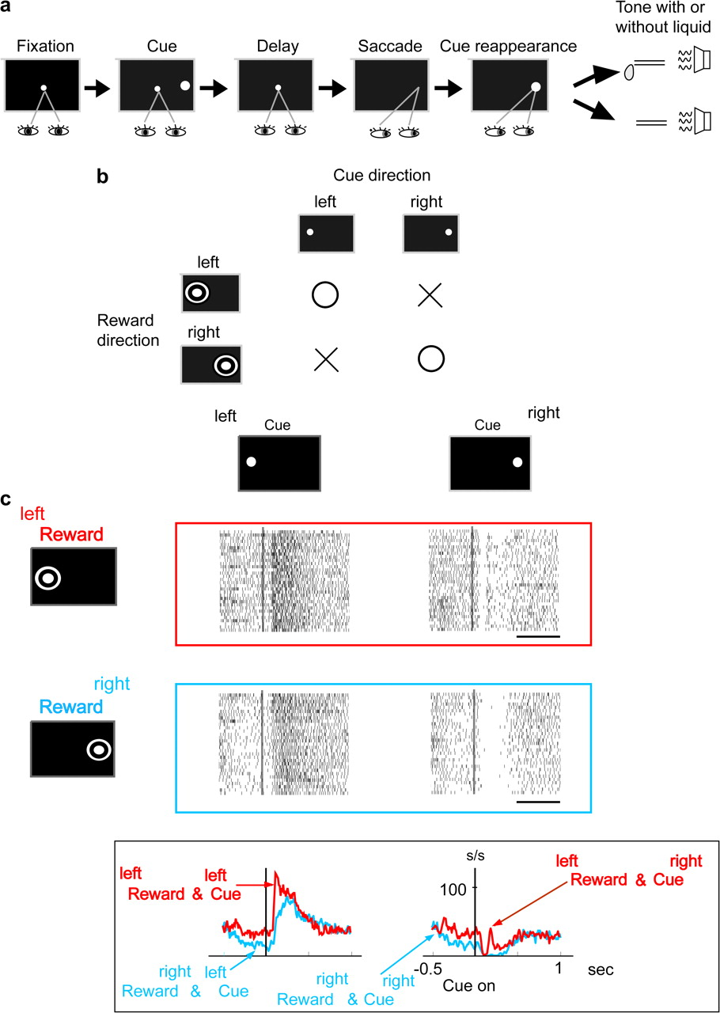
Figure 4. (a) Sequence of events in the oculomotor delayed response task in which the monkey could obtain the reward ...
Notes:
Figure 4. (a) Sequence of events in the oculomotor delayed response task in which the monkey could obtain the reward only when the saccade response was directed to the predetermined one of 2 directions. (b) Presence and absence (indicated as a circle and x) of reward depending on both the cognitive and motivational context (indicated as “Reward direction”) and the Discriminative Cue (indicated as “Cue direction”). Note that the reward-associated direction (indicated here by a bull's eye mark) was not indicated to the monkey by any visual cue. (c) An example of an LPFC neuron that coded the cue stimulus depending on both the cognitive and motivational context, as represented in its own precue activity. Neuronal activities are shown in raster and line graph displays. The left-reward condition is illustrated in red, and the right-reward condition is illustrated in blue. The time scale indicates 0.5 s. (From Kobayashi et al. 2007, with kind permission from the Springer Science and Business Media.)
Unless provided in the caption above, the following copyright applies to the content of this slide: © The Author 2007. Published by Oxford University Press. All rights reserved. For permissions, please e-mail: journals.permissions@oxfordjournals.org

