Slide 1
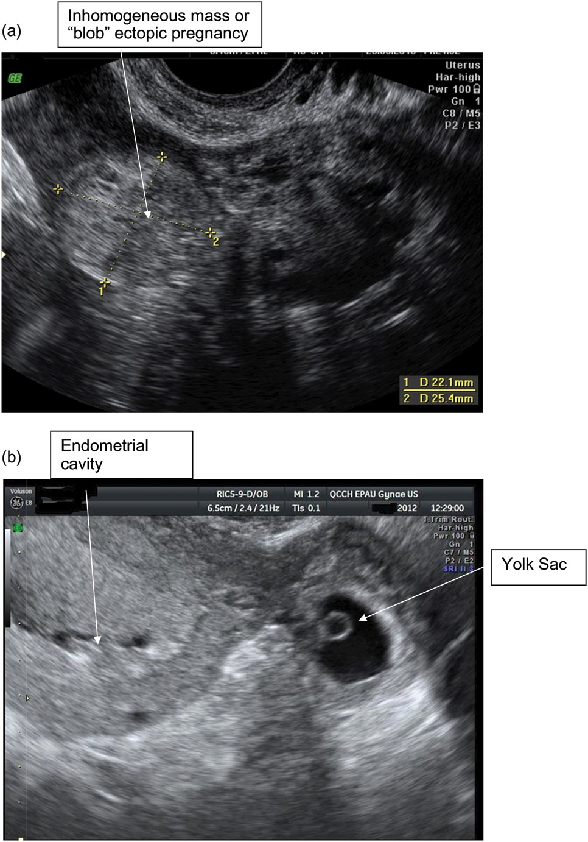
Figure 1 Transvaginal scan images of tubal ectopic pregnancies: (a) an inhomogeneous mass and (b) a yolk sac and fetal ...
Notes:
Figure 1 Transvaginal scan images of tubal ectopic pregnancies: (a) an inhomogeneous mass and (b) a yolk sac and fetal pole in an extra-uterine sac.
Unless provided in the caption above, the following copyright applies to the content of this slide: © The Author 2013. Published by Oxford University Press on behalf of the European Society of Human Reproduction and Embryology. All rights reserved. For Permissions, please email: journals.permissions@oup.com

Slide 2
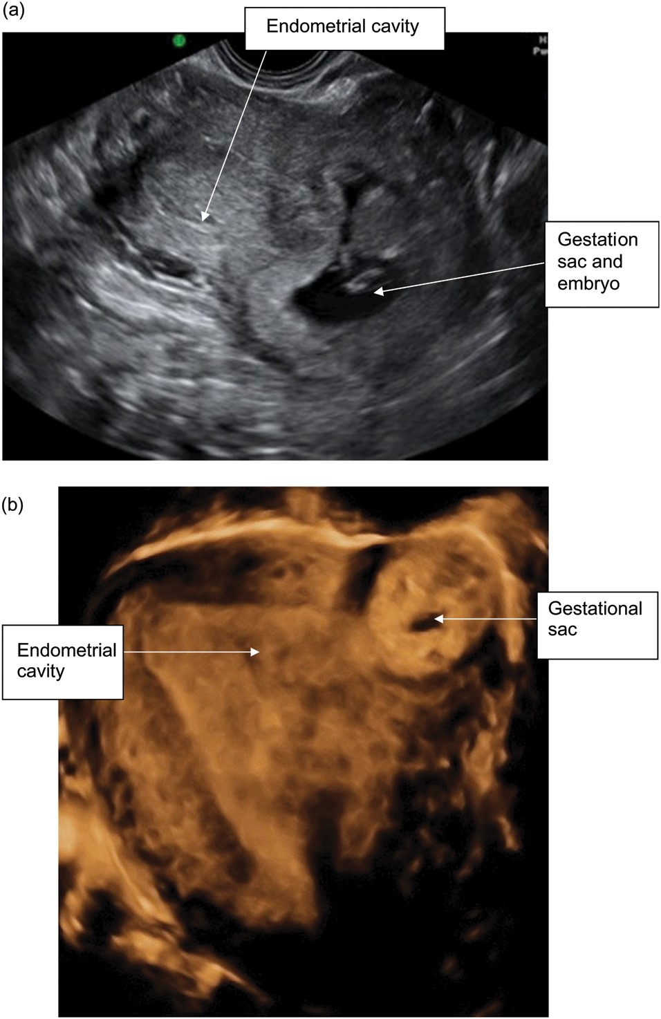
Figure 2 Interstitial ectopic pregnancy: (a) 2D grey-scale image and (b) 3D image.
Notes:
Figure 2 Interstitial ectopic pregnancy: (a) 2D grey-scale image and (b) 3D image.
Unless provided in the caption above, the following copyright applies to the content of this slide: © The Author 2013. Published by Oxford University Press on behalf of the European Society of Human Reproduction and Embryology. All rights reserved. For Permissions, please email: journals.permissions@oup.com

Slide 3
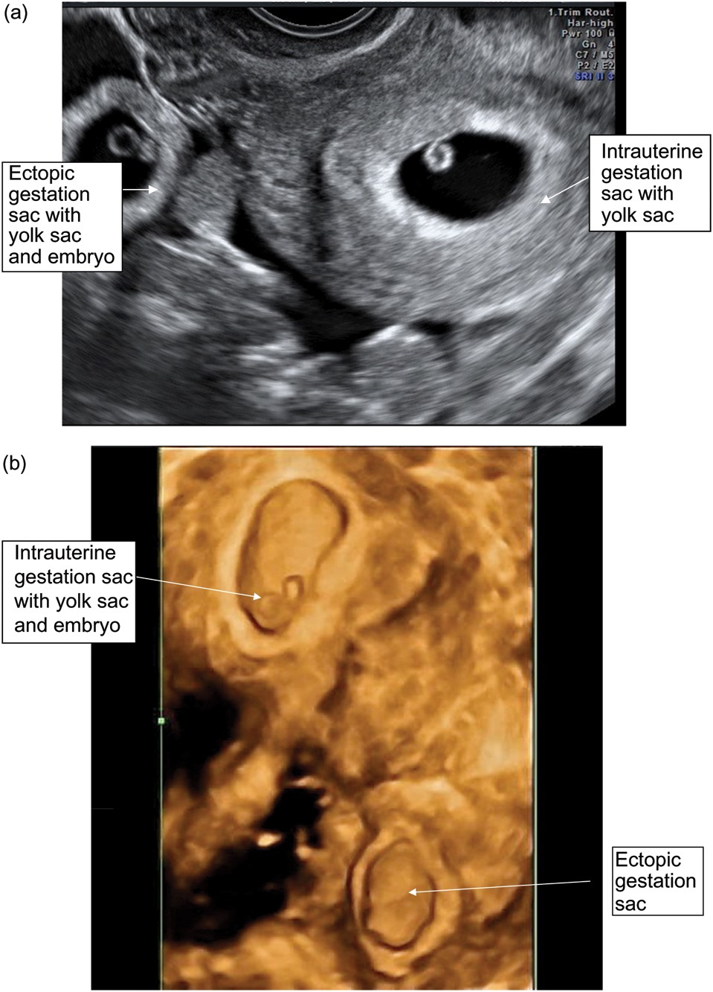
Figure 3 Heterotopic pregnancy: (a) 2D grey-scale image and (b) 3D image. The two images are not of the same case.
Notes:
Figure 3 Heterotopic pregnancy: (a) 2D grey-scale image and (b) 3D image. The two images are not of the same case.
Unless provided in the caption above, the following copyright applies to the content of this slide: © The Author 2013. Published by Oxford University Press on behalf of the European Society of Human Reproduction and Embryology. All rights reserved. For Permissions, please email: journals.permissions@oup.com

Slide 4
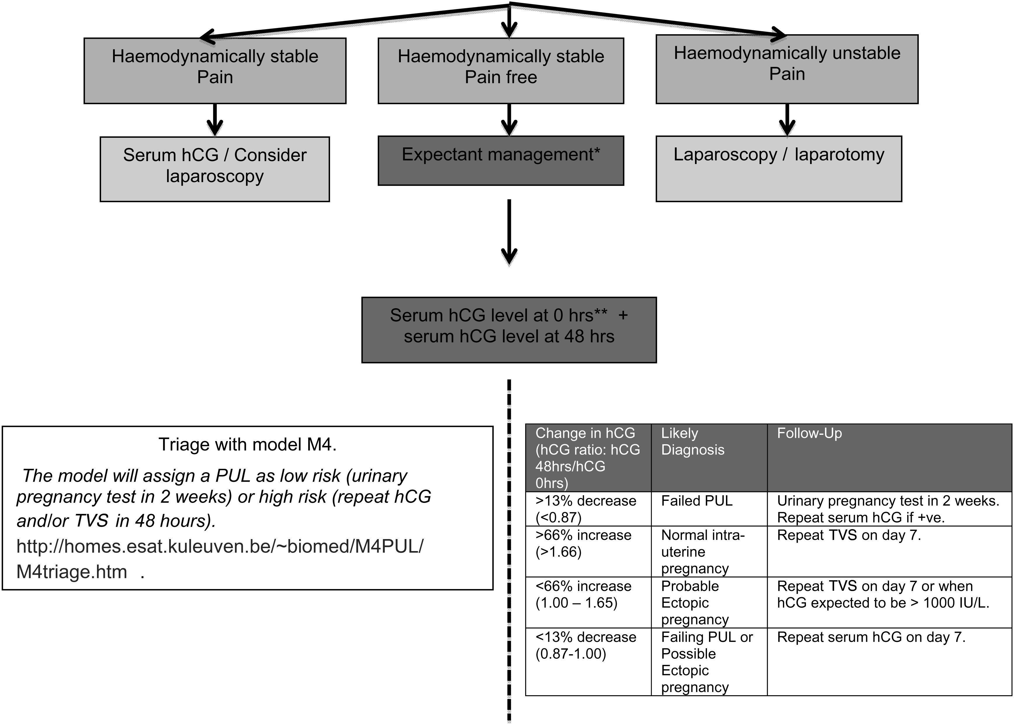
Figure 4 Possible PUL management algorithm. *Women must be given information and advice, be deemed compliant with ...
Notes:
Figure 4 Possible PUL management algorithm. *Women must be given information and advice, be deemed compliant with follow-up and have no significant language or other communication barrier. Women should be advised to return for review before the scheduled follow-up visit if they have any severe pain or concerns. **If hCG > 1000 IU/l at 0 h and history not suggestive of complete miscarriage, then repeat TVS as soon as possible. Adapted from Condous et al. (2006b); Kirk et al. (2007b). TVS, transvaginal ultrasound.
Unless provided in the caption above, the following copyright applies to the content of this slide: © The Author 2013. Published by Oxford University Press on behalf of the European Society of Human Reproduction and Embryology. All rights reserved. For Permissions, please email: journals.permissions@oup.com

