Slide 1
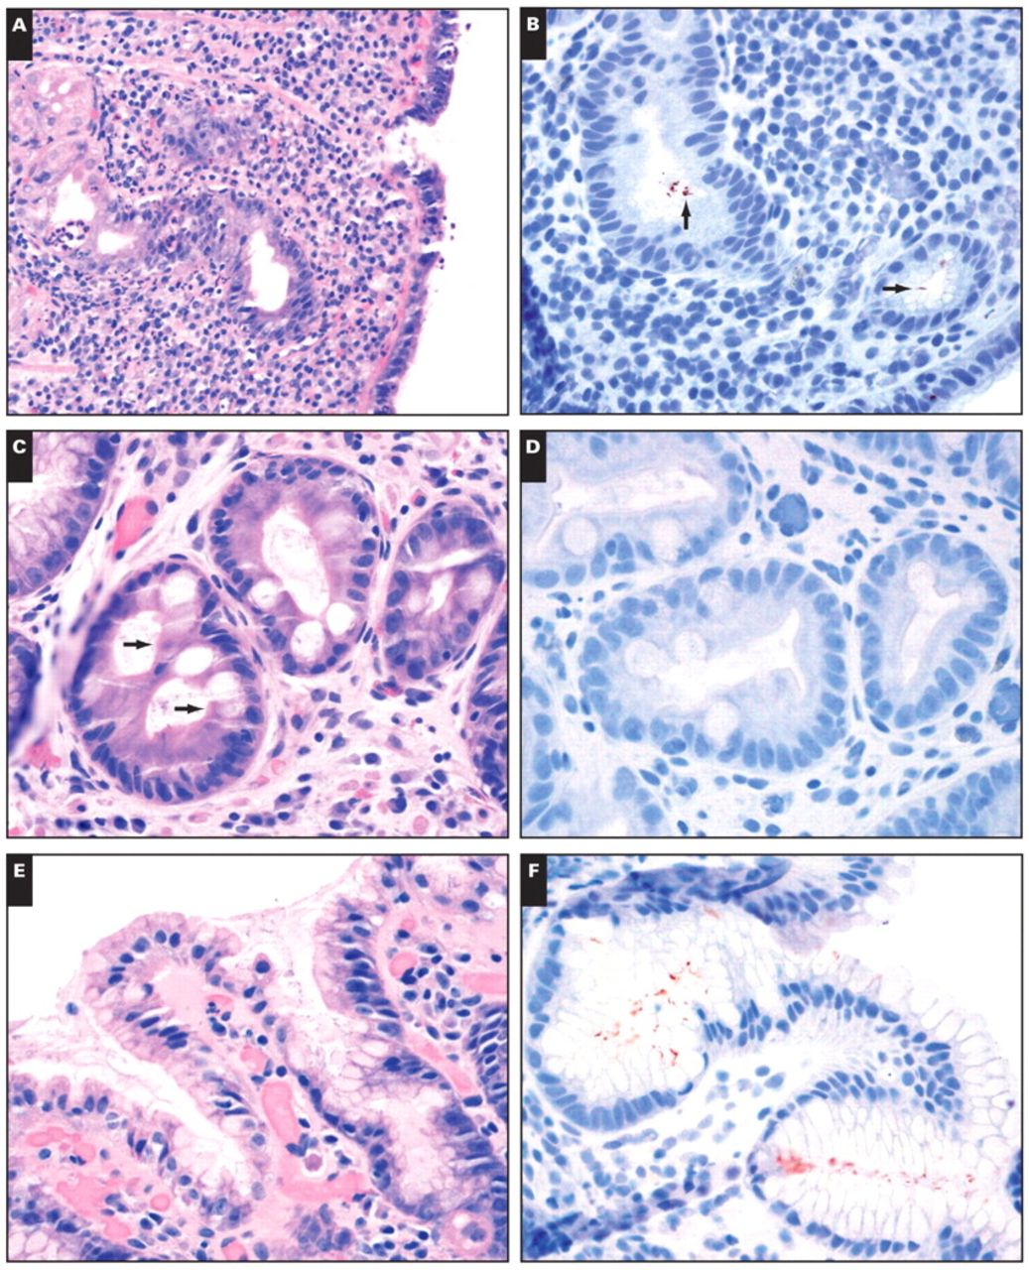
Image 1 A case of chronic active gastritis in which the organisms cannot be seen with H&E staining (A), but the ...
Notes:
Image 1 A case of chronic active gastritis in which the organisms cannot be seen with H&E staining (A), but the immunohistochemical stain is focally positive (B, arrows). A case of chronic gastritis with intestinal metaplasia and small cylindrical structures “suspicious” for Helicobacter pylori seen with H&E staining (C, arrows); however, the immunohistochemical stain is negative (D). A case of chronic active gastritis with abundant organisms on the surface (E, H&E), confirmed by immunohistochemical staining (F) (A, ×200; B–F, ×400).
Unless provided in the caption above, the following copyright applies to the content of this slide: © American Society for Clinical Pathology

Slide 2
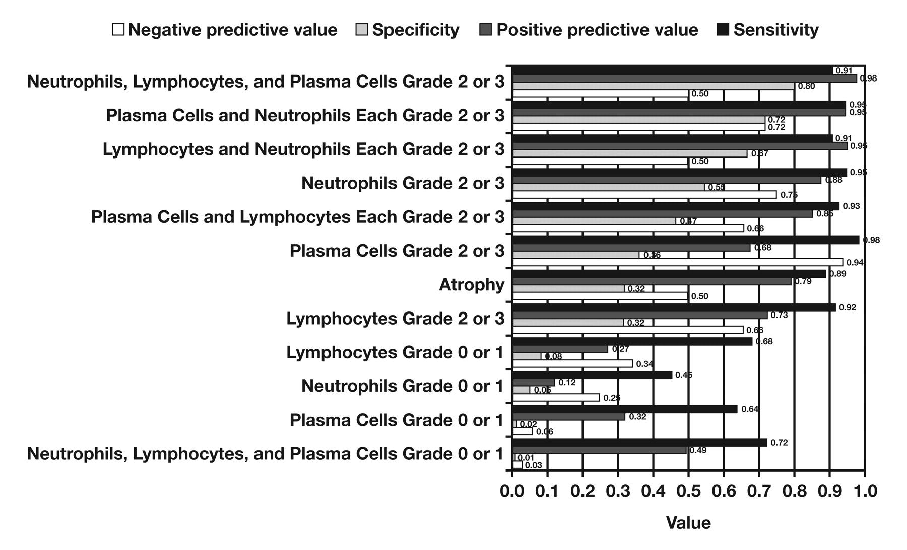
Figure 1 Graphic representation of the factors studied and their relative significance.
Notes:
Figure 1 Graphic representation of the factors studied and their relative significance.
Unless provided in the caption above, the following copyright applies to the content of this slide: © American Society for Clinical Pathology

