Slide 1
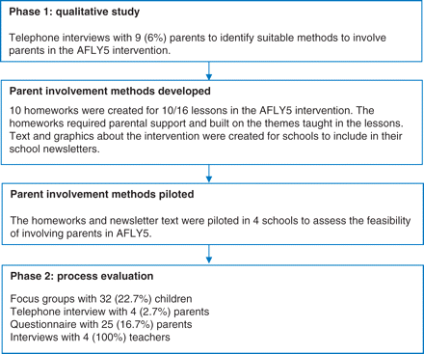
Fig. 1 Study design and methods.
Notes:
Fig. 1 Study design and methods.
Unless provided in the caption above, the following copyright applies to the content of this slide: © The Author 2011, Published by Oxford University Press on behalf of Faculty of Public Health. All rights reserved

Slide 2
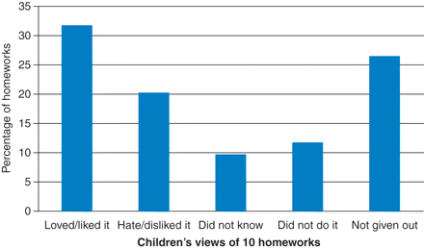
Fig. 2 Children's views of 10 homeworks from focus groups (n = 34).
Notes:
Fig. 2 Children's views of 10 homeworks from focus groups (n = 34).
Unless provided in the caption above, the following copyright applies to the content of this slide: © The Author 2011, Published by Oxford University Press on behalf of Faculty of Public Health. All rights reserved

