Slide 1
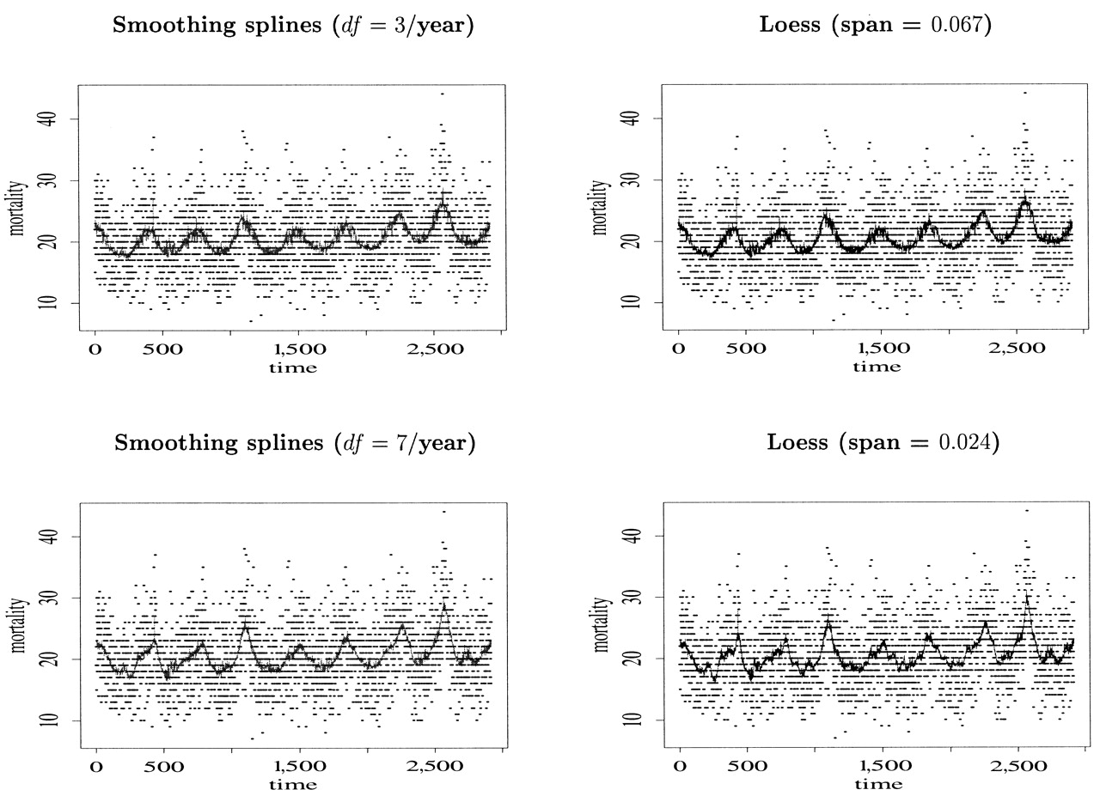
FIGURE 1. Fitted values for daily mortality (number of deaths) under generalized additive models with ...
Notes:
FIGURE 1. Fitted values for daily mortality (number of deaths) under generalized additive models with smoothing splines (left) and LOESS smoothers (right). Black dots are the observed mortality counts for the Pittsburgh, Pennsylvania, database (1987–1994) of the National Morbidity, Mortality, and Air Pollution Study. Time is given in days.
Unless provided in the caption above, the following copyright applies to the content of this slide:

Slide 2
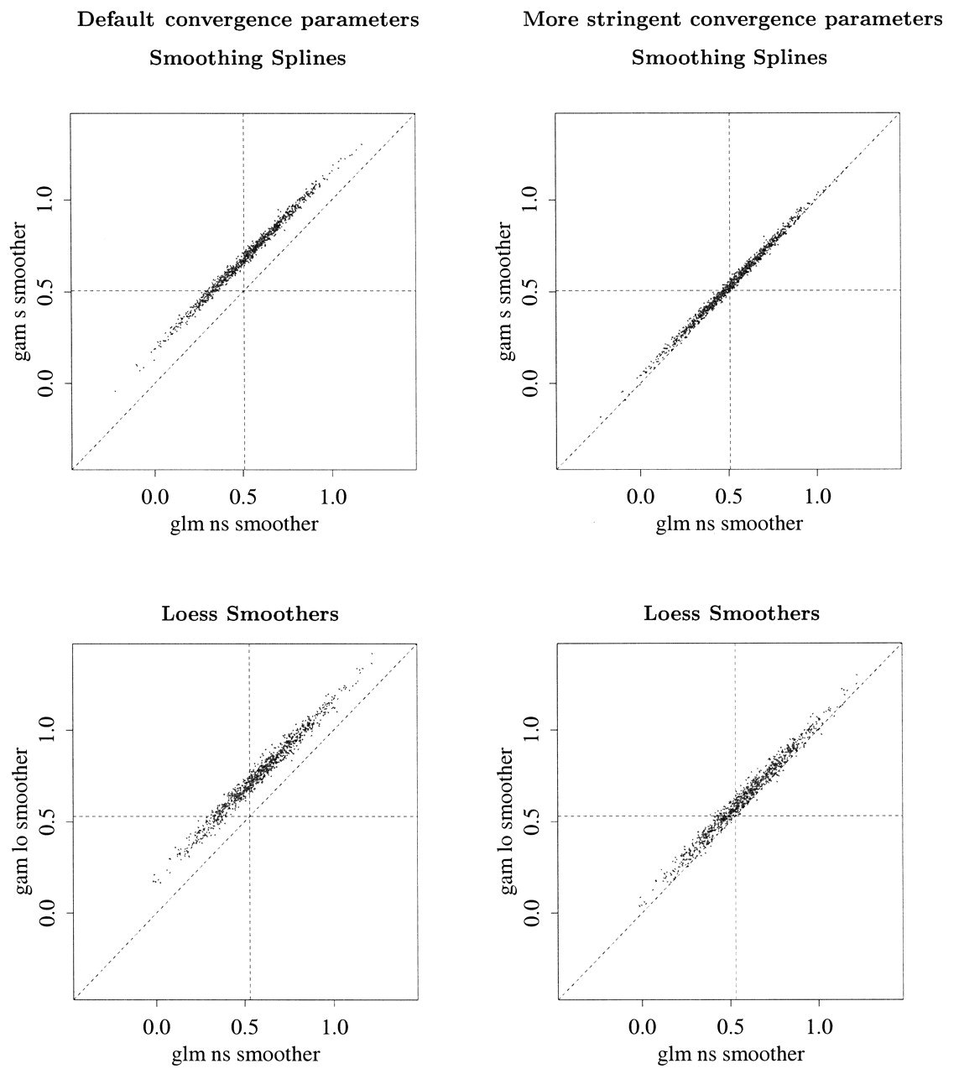
FIGURE 2. Top: estimates of β obtained by fitting a Poisson regression model with parametric nonlinear ...
Notes:
FIGURE 2. Top: estimates of β obtained by fitting a Poisson regression model with parametric nonlinear adjustments for confounding factors glm + ns versus estimates obtained by fitting generalized additive models with smoothing splines gam + s. Vertical and horizontal lines indicate true values. . Bottom: estimates of β obtained by fitting a Poisson regression model with parametric nonlinear adjustments for confounding factors glm + ns versus estimates obtained by fitting generalized additive models with LOESS smoothers gam + lo. Vertical and horizontal lines indicate true values. Note that in the right panels small bias still remains (see table 2).
Unless provided in the caption above, the following copyright applies to the content of this slide:

Slide 3
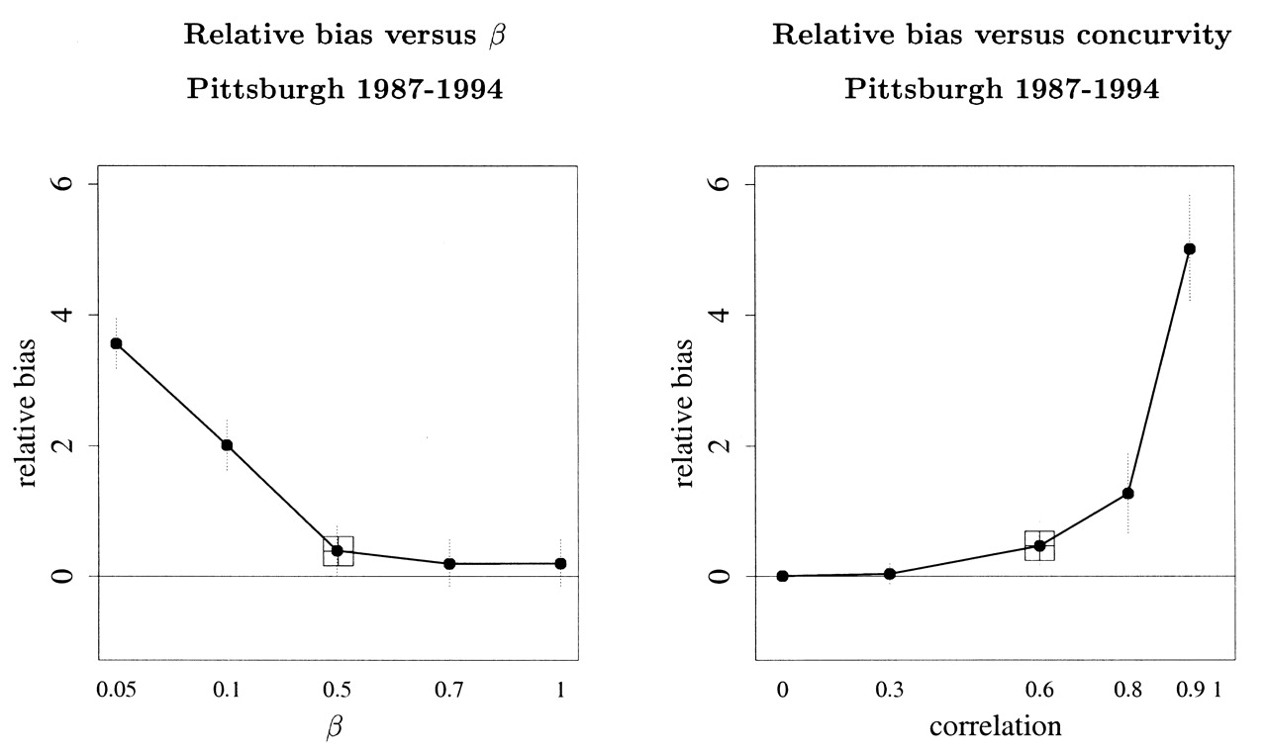
FIGURE 3. Right: relative bias in the log relative rate versus the true β. The relative bias is measured as ...
Notes:
FIGURE 3. Right: relative bias in the log relative rate versus the true β. The relative bias is measured as – β)/β, where is obtained by averaging the gam + s + default estimates across the 1,000 iterations. The square is plotted at β = 0.51 percent increase in mortality per 10-µg/m3 increase in particulate matter less than µm in diameter—for example, the estimate for the Pittsburgh, Pennsylvania, database (1987–1994) of the National Morbidity, Mortality, and Air Pollution Study—using glm + ns. Left: relative bias versus different values for concurvity. The relative bias is measured as ( – β)/β, where is obtained by averaging the gam + s + default 1,000 estimates and β is set to be 0.51 percent. The square is plotted at the observed concurvity for Pittsburgh (0.6).
Unless provided in the caption above, the following copyright applies to the content of this slide:

Slide 4
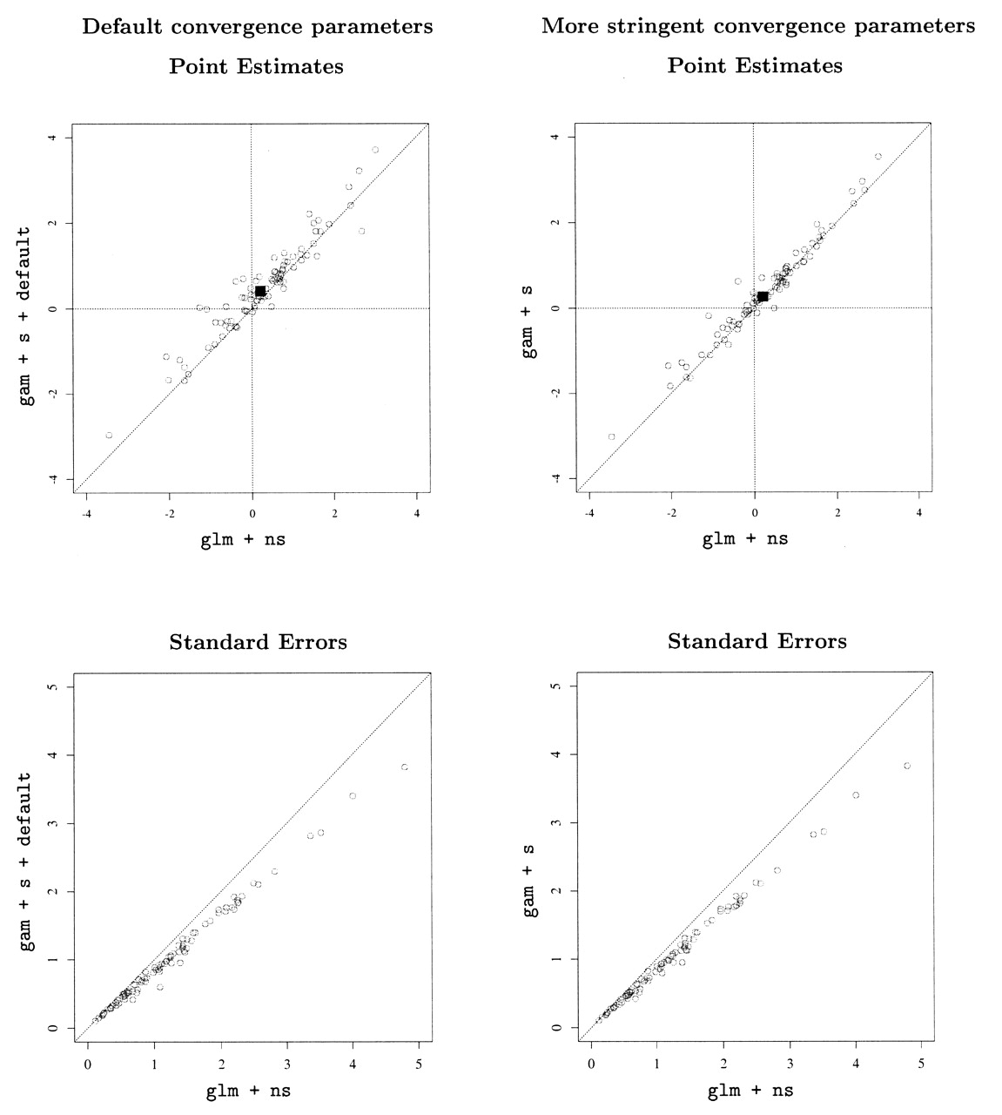
FIGURE 4. Relative rate estimates (top) and standard errors (bottom) for mortality across 90 US cities in the ...
Notes:
FIGURE 4. Relative rate estimates (top) and standard errors (bottom) for mortality across 90 US cities in the National Morbidity, Mortality, and Air Pollution Study. Shown are estimates obtained by fitting a Poisson regression model with parametric nonlinear adjustments for confounding factors glm + ns versus estimates obtained by fitting generalized additive models with smoothing splines gam + s + default (left) and by using more restrictive convergence criteria gam + s (right). The black square is plotted at the pooled estimate across the 90 cities; its size corresponds to ±2 standard errors of the pooled estimates.
Unless provided in the caption above, the following copyright applies to the content of this slide:

Slide 5
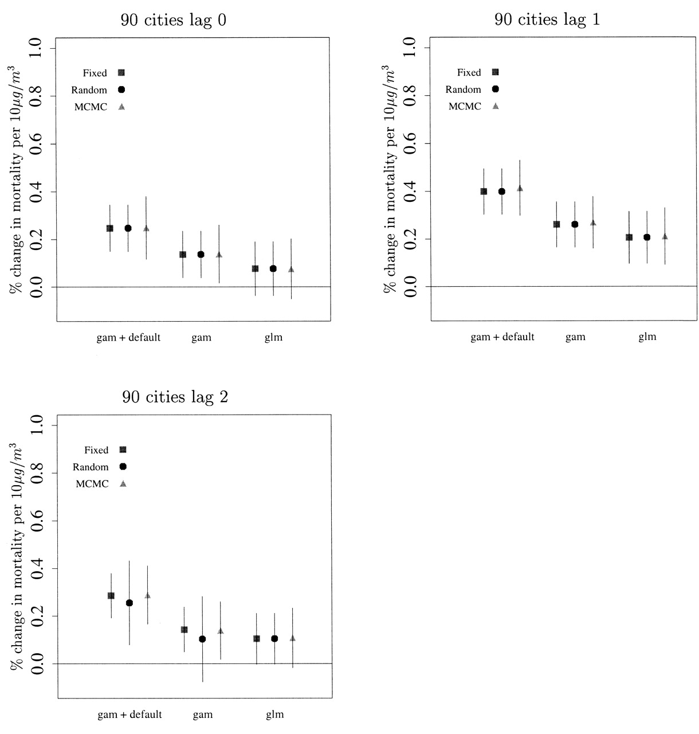
FIGURE 5. Pooled relative rate estimates for mortality across 90 US cities in the National Morbidity, ...
Notes:
FIGURE 5. Pooled relative rate estimates for mortality across 90 US cities in the National Morbidity, Mortality, and Air Pollution Study under three models: 1) gam + s + default, 2) gam + s, and 3) glm + ns. The 90 city-specific estimates obtained under each model were pooled across cities under 1) a fixed-effect model, 2) a random-effect model (30) with a moment estimator of the across-city variance, and 3) a Bayesian two-stage model with a noninformative prior for the across-city variance and a Markov chain Monte Carlo estimation procedure (31), as in the paper by Dominici et al. (7).
Unless provided in the caption above, the following copyright applies to the content of this slide:

Slide 6
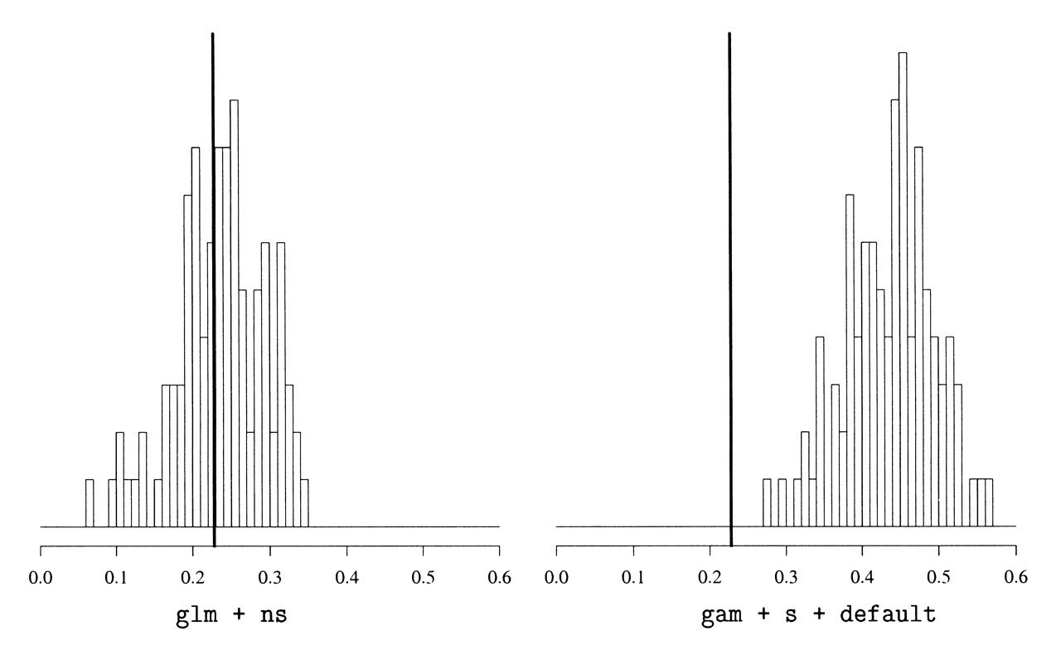
FIGURE 6. Percent change in mortality per 10-µg/m³ increase in particulate matter less than 10 µm ...
Notes:
FIGURE 6. Percent change in mortality per 10-µg/m3 increase in particulate matter less than 10 µm in diameter for 100 pooled estimates from a simulation study using glm + ns (left) and gam + s + default (right). Solid vertical lines indicate the true parameter values (0.21).
Unless provided in the caption above, the following copyright applies to the content of this slide:

