Slide 1
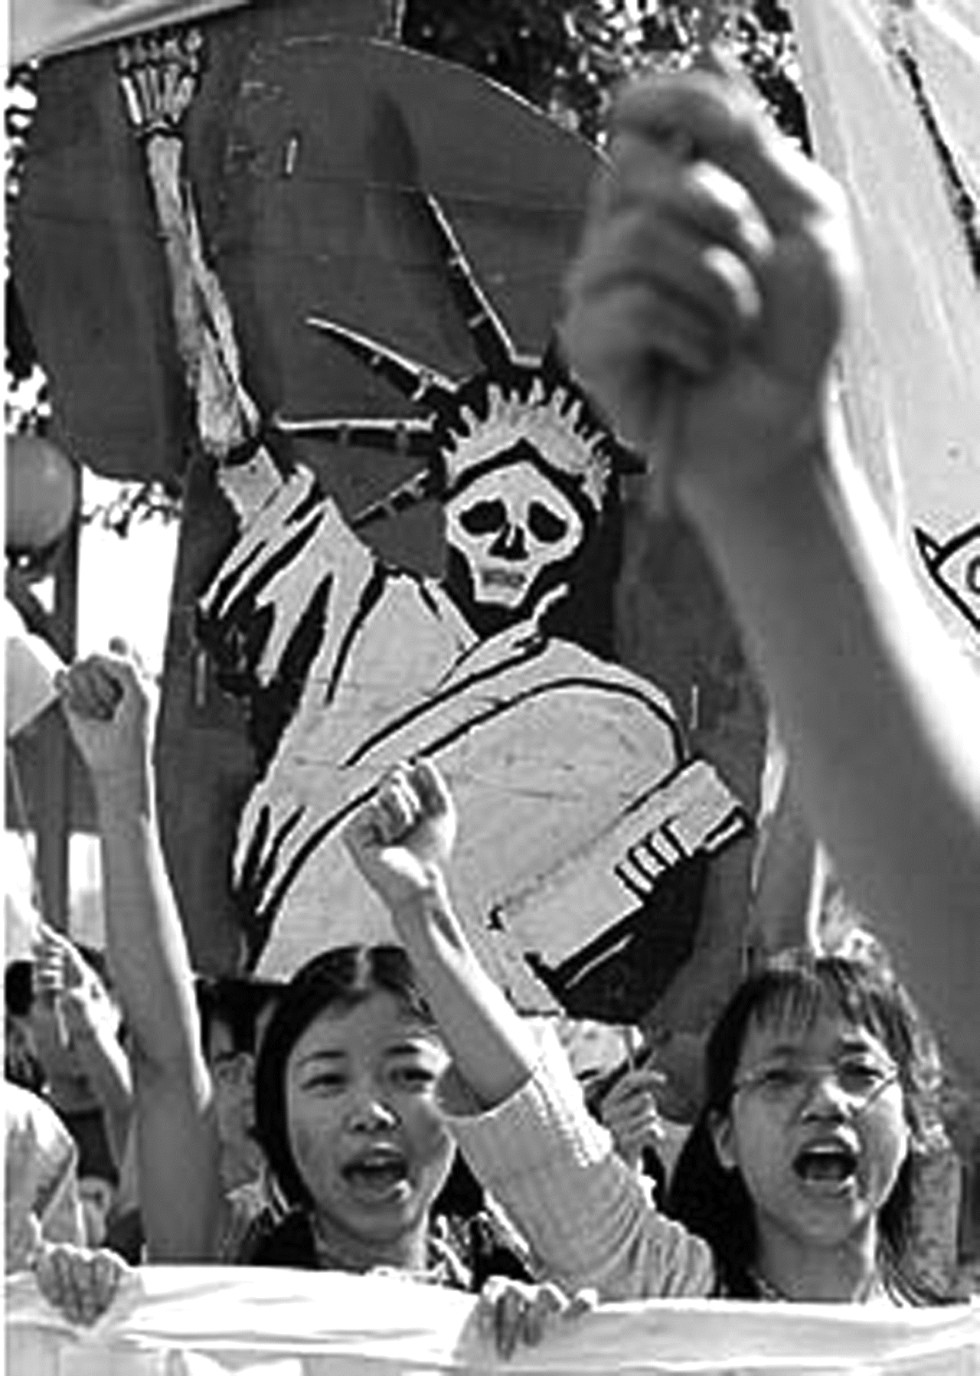
Figure 1 The Statue of Liberty did not always symbolize U.S. virtue. In 1999, Chinese students converted it into the ...
Notes:
Figure 1 The Statue of Liberty did not always symbolize U.S. virtue. In 1999, Chinese students converted it into the “Demon of Liberty” to protest the U.S. bombing of China's embassy in Belgrade. Reprinted with assistance from Peter Hays Gries; original source unknown.
Unless provided in the caption above, the following copyright applies to the content of this slide: © American Historical Association 2006

Slide 2
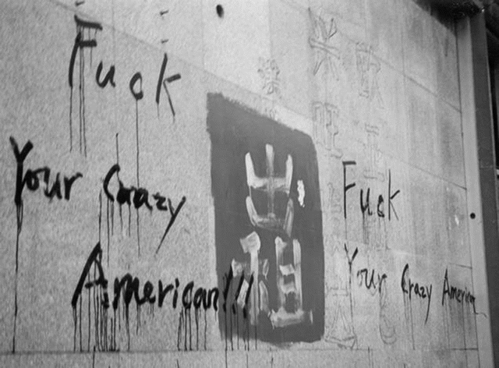
Figure 2 : “Fuck your crazy American!!!” Graffiti marking anti-American anger at People's University in Beijing, China, ...
Notes:
Figure 2 : “Fuck your crazy American!!!” Graffiti marking anti-American anger at People's University in Beijing, China, in 1999. Reprinted with permission from Scott Kennedy and with the assistance of Peter Hays Gries.
Unless provided in the caption above, the following copyright applies to the content of this slide: © American Historical Association 2006

