Slide 1
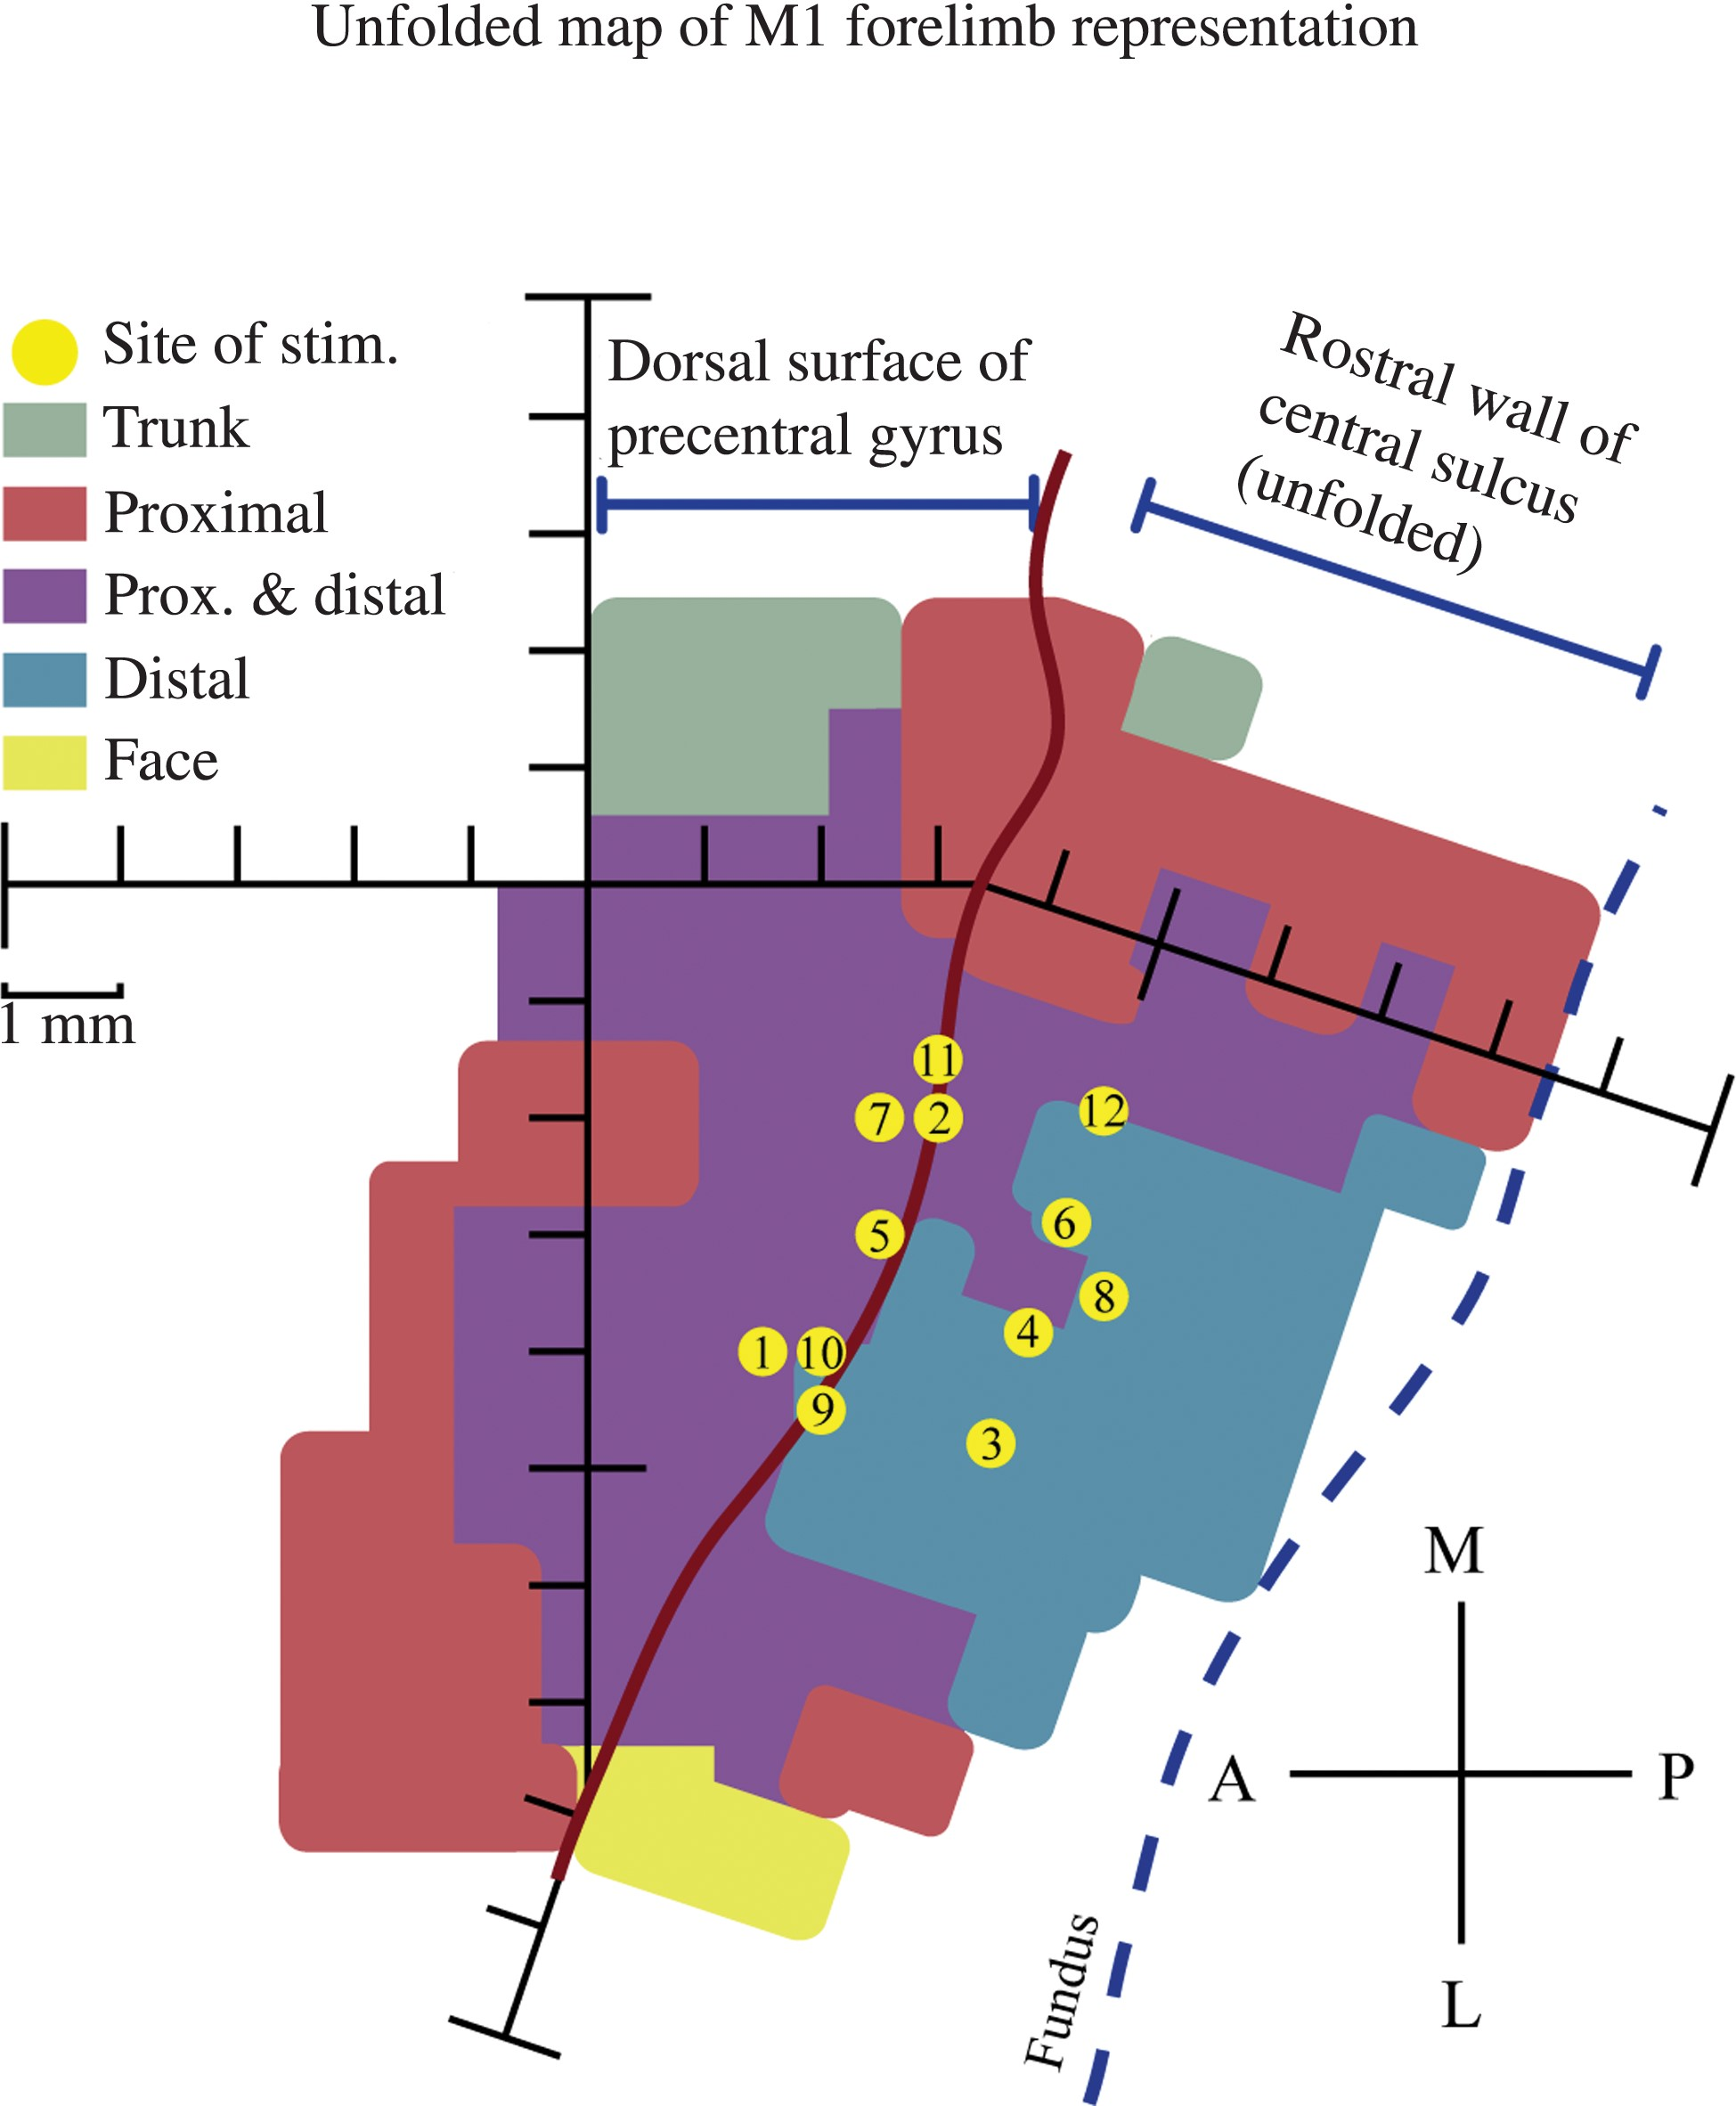
Figure 1. Unfolded map of the monkey's M1 forelimb representation in the left hemisphere with a view of the dorsal ...
Notes:
Figure 1. Unfolded map of the monkey's M1 forelimb representation in the left hemisphere with a view of the dorsal surface of the precentral gyrus and the rostral wall of the central sulcus. Anterior, posterior, medial, and lateral are indicated by the compass rose. Sites of frequency-modulated sinusoidal stimulation are indicated by the yellow dots, and are numbered in chronological order of stimulation. The color-coded muscle representation map was obtained from a previous StTA mapping study in this monkey (Griffin et al. 2014). Each hash mark represents a distance of 1 mm.
Unless provided in the caption above, the following copyright applies to the content of this slide: Published by Oxford University Press 2015. This work is written by (a) US Government employee(s) and is in the public domain in the US.

Slide 2
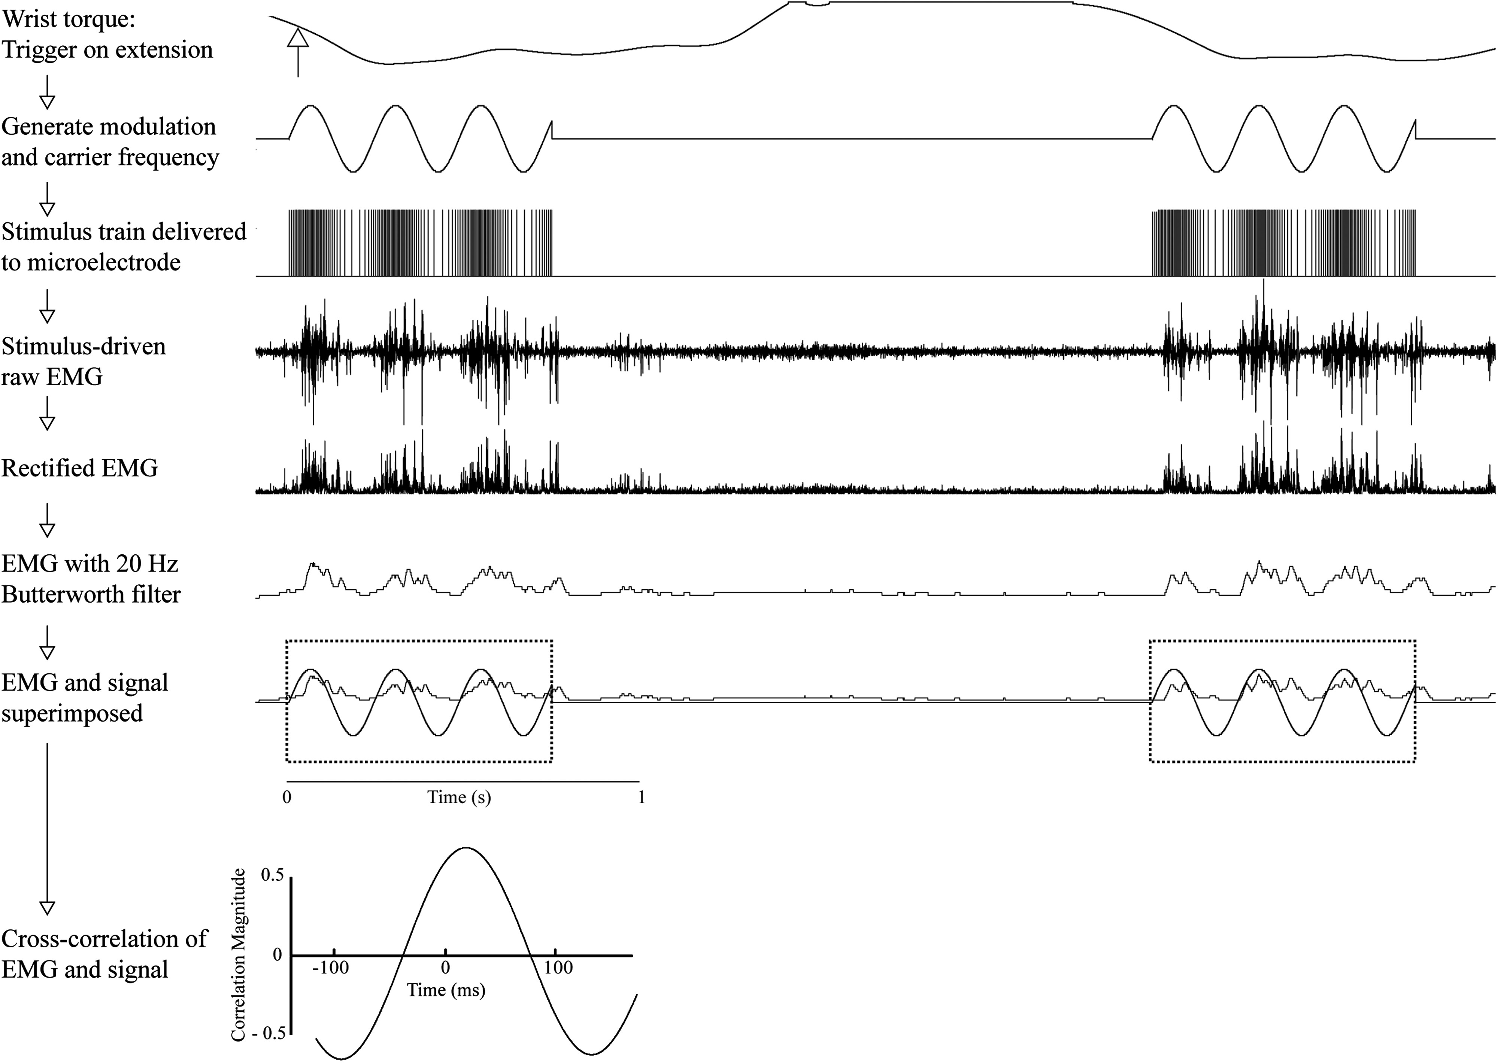
Figure 2. Methodology for stimulation, recording, and cross-correlation. Stimulation was applied either on wrist ...
Notes:
Figure 2. Methodology for stimulation, recording, and cross-correlation. Stimulation was applied either on wrist flexion or extension, applying a combination of modulation frequency and carrier frequency. Stimulation at this modulated frequency was delivered to the stimulating electrode at a set stimulus intensity, and the output electromyography (EMG) activity was recorded. This stimulus-driven EMG activity was then rectified and smoothed using a 20-Hz Butterworth filter. This smoothed and rectified EMG was then cross-correlated with the signal used to drive frequency modulation to determine the overall phase shift offset between the modulated stimulus delivered to the cortex and the resulting modulated EMG activity. Only sections of data in which stimulation was delivered were used for analysis (dotted boxes). Data in this example used a modulation frequency of 4 Hz, a carrier frequency of 150 Hz, and stimulation intensity of 30 µA; EMG was recorded from extensor carpi radialis (ECR) and triggered on wrist extension.
Unless provided in the caption above, the following copyright applies to the content of this slide: Published by Oxford University Press 2015. This work is written by (a) US Government employee(s) and is in the public domain in the US.

Slide 3
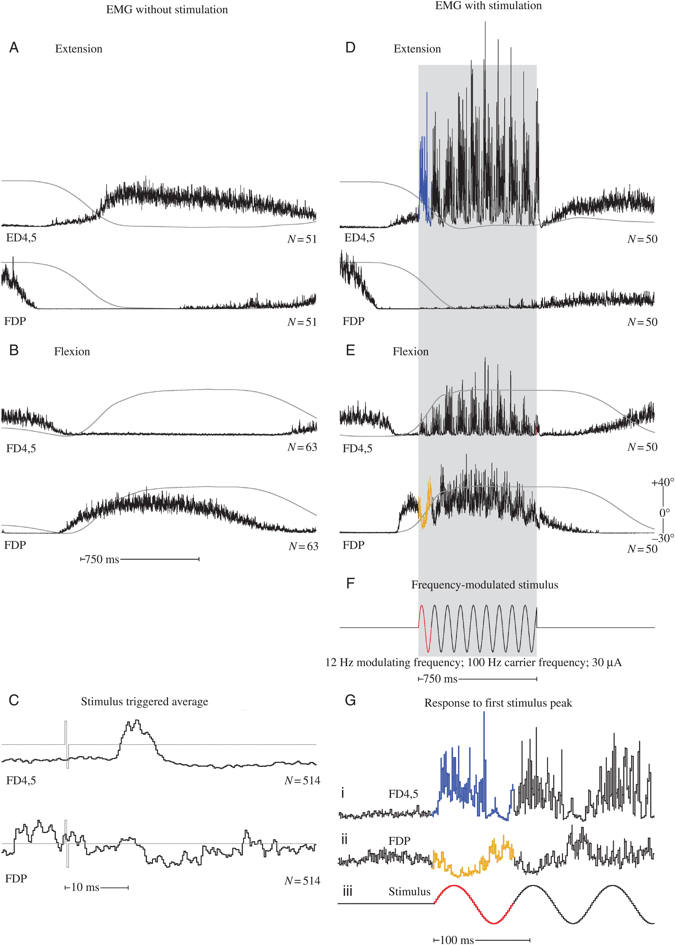
Figure 3. Baseline muscle activity and frequency-modulated activation of the same muscles. All records included in this ...
Notes:
Figure 3. Baseline muscle activity and frequency-modulated activation of the same muscles. All records included in this figure were obtained from cortical site 5 (Fig. 1). (A and B) ED 4,5 and FDP EMG activity associated with wrist extension and flexion, respectively, in the absence of stimulation. (C) Stimulus-triggered averages for ED 4,5 and FDP acquired at 30 µA. The stimulus is shown as a light gray line superimposed on the EMG records. (D and E) Wrist extension and flexion, respectively, in response to frequency-modulated stimulation. The period of stimulation is represented by gray shading. (F) Frequency-modulated stimulation beginning midway through the dynamic phase of movement. (G) Response of ED4,5 during extension (i) and FDP during flexion (ii) in response to the first cycle of modulated stimulation (iii). Records are expansions of those in D, E, and F indicated by the corresponding colors. The number under each set of records is the number of events averaged. EMG activity has been uniformly scaled for each muscle. For muscle abbreviations, see Materials and Methods. Wrist position record (gray line) is superimposed on each EMG record, and ranges from 40° ± 10 in flexion to 30° ± 15 in extension. Upward deflection of the position record is flexion.
Unless provided in the caption above, the following copyright applies to the content of this slide: Published by Oxford University Press 2015. This work is written by (a) US Government employee(s) and is in the public domain in the US.

Slide 4
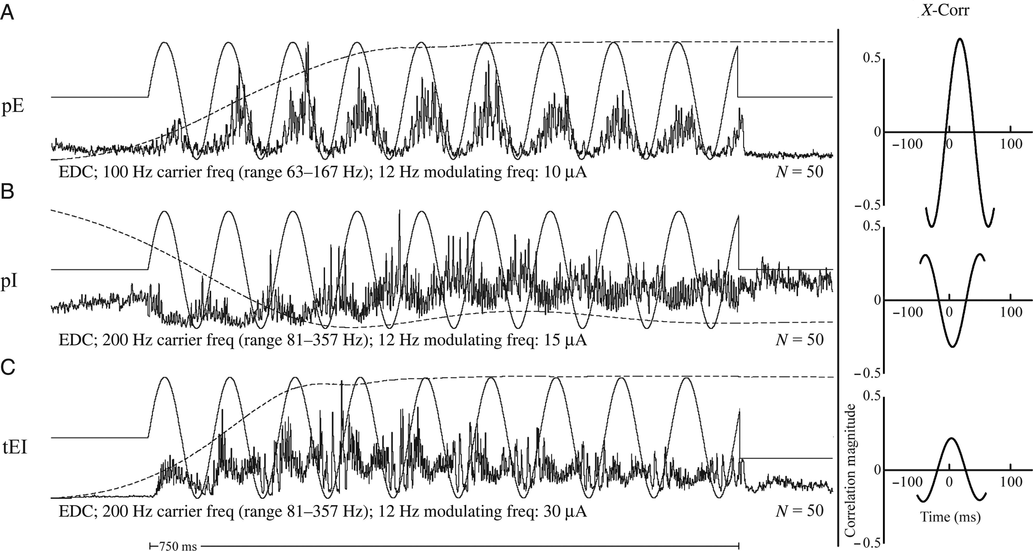
Figure 4. (A) pE response. EMG activity increases in response to increasing stimulus frequency. (B) pI response. EMG ...
Notes:
Figure 4. (A) pE response. EMG activity increases in response to increasing stimulus frequency. (B) pI response. EMG activity decreases in response to increasing stimulus frequency. (C) tEI, or excitation transitioning to inhibition. EMG activity initially responds with an increase in activity in response to increasing stimulus frequency, but gradually transitions to inhibition as the stimulus train continues. Cross-correlations are included on the right for each example. Vertical scale bar is the magnitude of correlation. For muscle abbreviations, see Materials and Methods. Wrist position record (dashed line) is superimposed on each EMG record, and ranges from 40° ± 10 in flexion (upward deflection) to 30° ± 15 in extension (downward deflection). The 12-Hz signal used to modulate the stimulus train is superimposed on the EMG records (solid sinusoidal line).
Unless provided in the caption above, the following copyright applies to the content of this slide: Published by Oxford University Press 2015. This work is written by (a) US Government employee(s) and is in the public domain in the US.

Slide 5
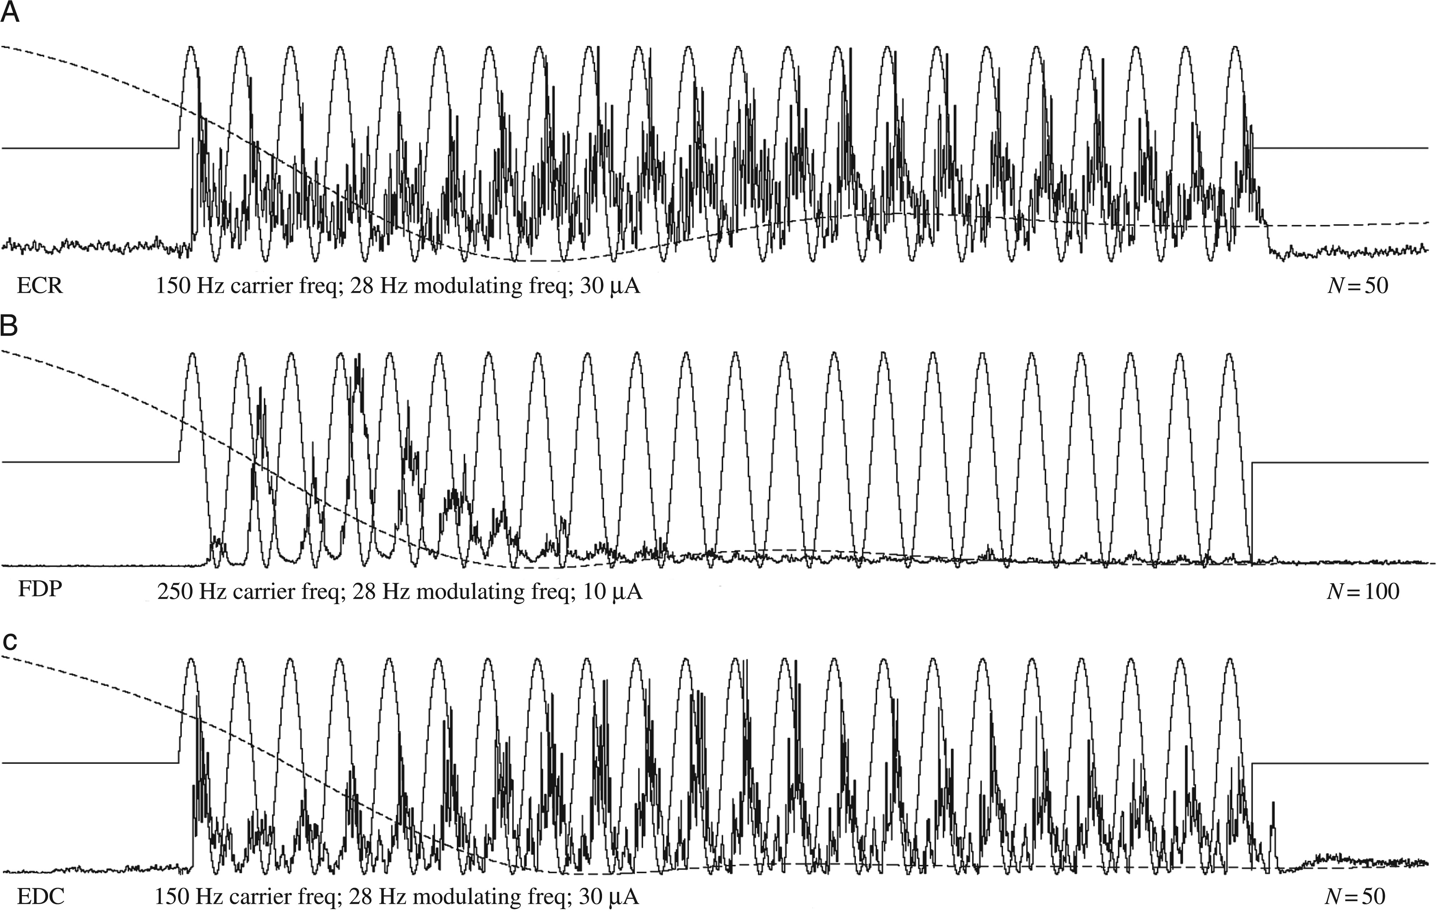
Figure 5. (A) Consistent modulation throughout stimulation. (B) Strong excitatory responses followed by almost complete ...
Notes:
Figure 5. (A) Consistent modulation throughout stimulation. (B) Strong excitatory responses followed by almost complete loss of modulation after about 10 cycles. (C) Waxing and waning of EMG excitatory responses throughout the stimulus train. For muscle abbreviations, see Materials and Methods. Wrist position record (gray line) is superimposed on each EMG record, and ranges from 40° ± 10 in flexion to 30° ± 15 in extension. The stimulus modulation signal is shown as a sinusoidal line superimposed on the EMG records.
Unless provided in the caption above, the following copyright applies to the content of this slide: Published by Oxford University Press 2015. This work is written by (a) US Government employee(s) and is in the public domain in the US.

