Slide 1
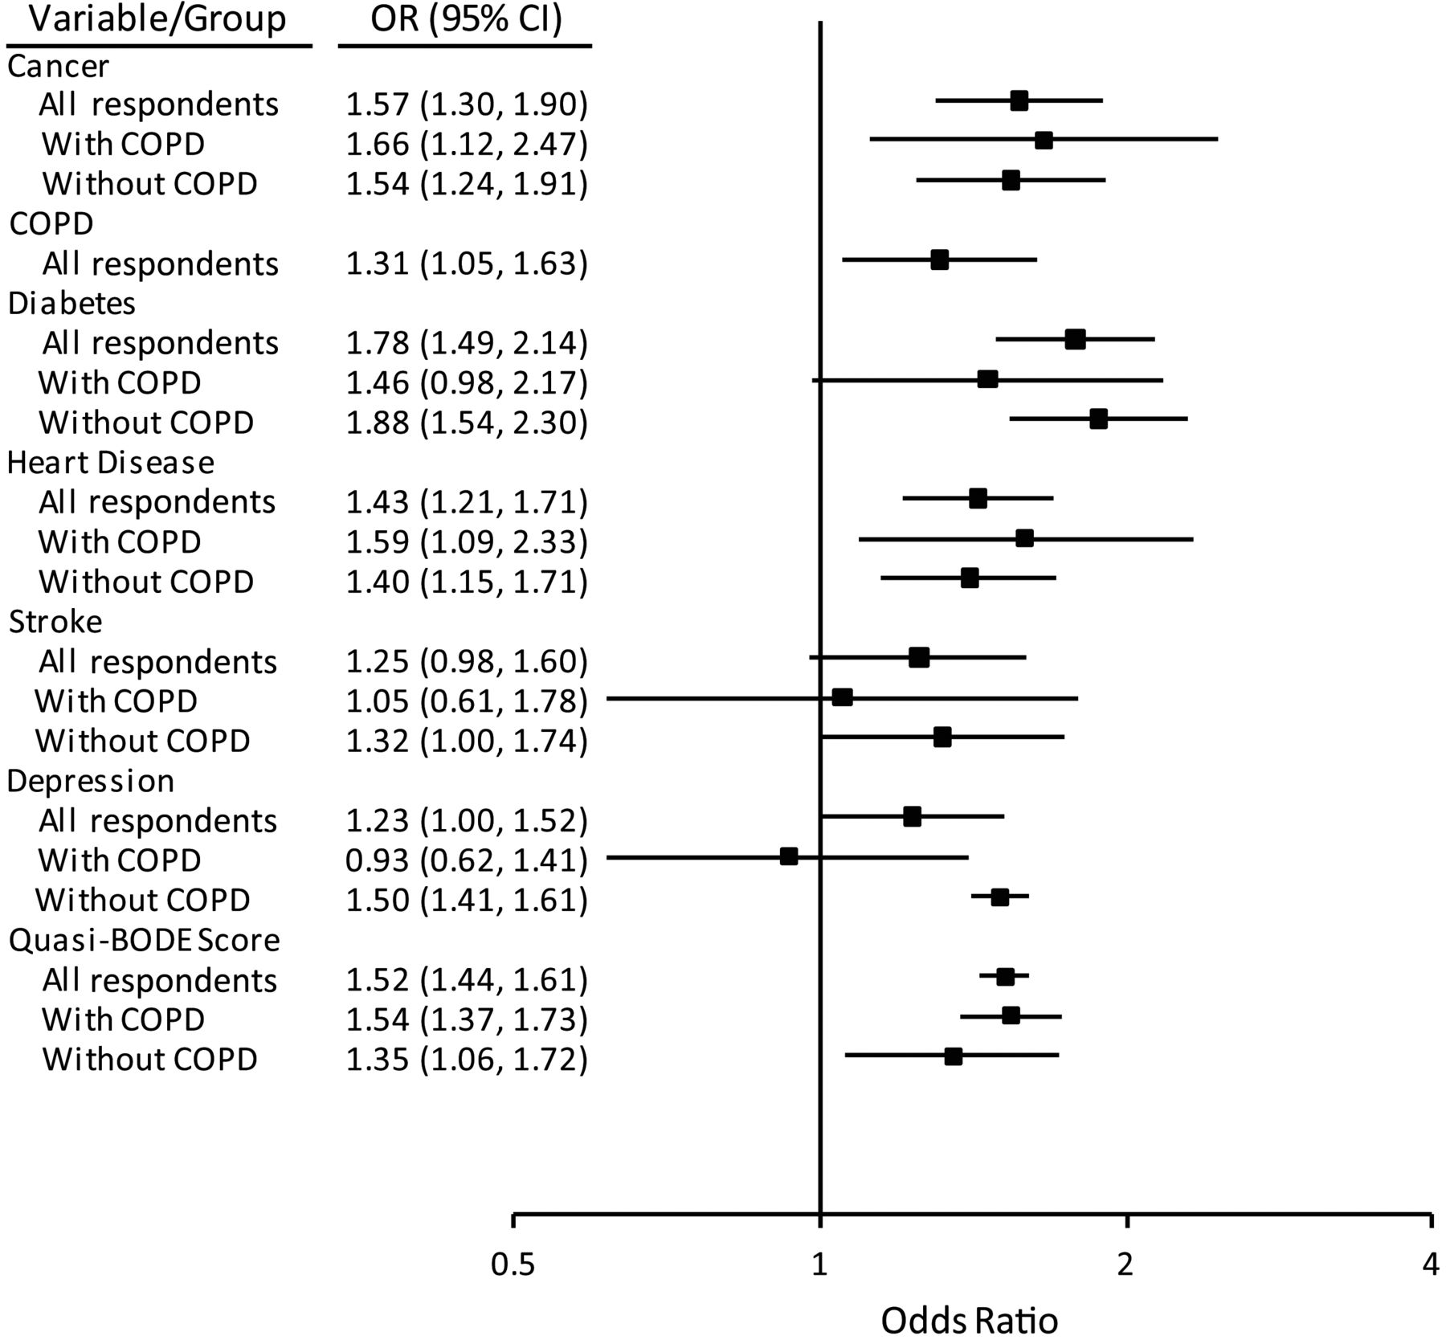
Figure 3. Adjusted odds ratio (OR) for risk of mortality within 2 years postsurvey among all respondents over age 50 ...
Notes:
Figure 3. Adjusted odds ratio (OR) for risk of mortality within 2 years postsurvey among all respondents over age 50 years (n = 12,501), respondents with chronic obstructive pulmonary disease (COPD) (n = 1,328), and respondents without COPD (n = 11,173), Health Retirement Study national surveys, United States, 2006 and 2008. Odds ratios for a 1-unit increase in quasi-BODE score were estimated separately by group (all respondents, respondents with COPD, and respondents without COPD); odds ratios were also adjusted for sex and age (not shown). Bars, 95% confidence interval (CI).
Unless provided in the caption above, the following copyright applies to the content of this slide: © The Author 2013. Published by Oxford University Press on behalf of the Johns Hopkins Bloomberg School of Public Health. All rights reserved. For permissions, please e-mail: journals.permissions@oup.com.

Slide 2
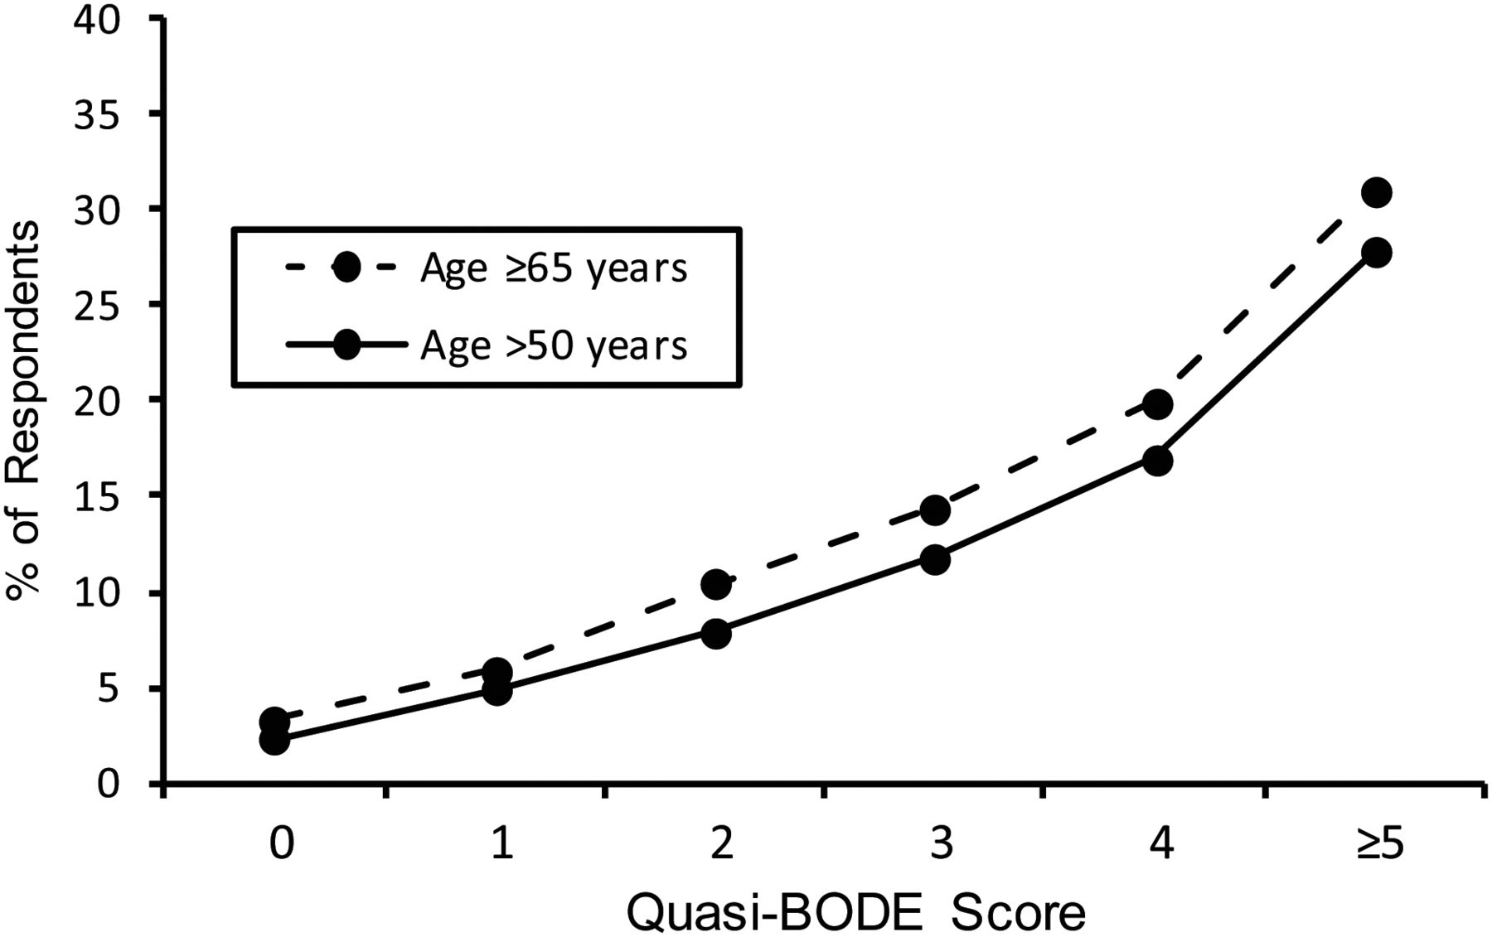
Figure 2. Percentages of respondents over age 50 years (n = 12,501) and aged 65 years or older (n = 8,301) within each ...
Notes:
Figure 2. Percentages of respondents over age 50 years (n = 12,501) and aged 65 years or older (n = 8,301) within each quasi-BODE index score who died within 2 years postsurvey, Health Retirement Study national surveys, United States, 2006 and 2008.
Unless provided in the caption above, the following copyright applies to the content of this slide: © The Author 2013. Published by Oxford University Press on behalf of the Johns Hopkins Bloomberg School of Public Health. All rights reserved. For permissions, please e-mail: journals.permissions@oup.com.

Slide 3
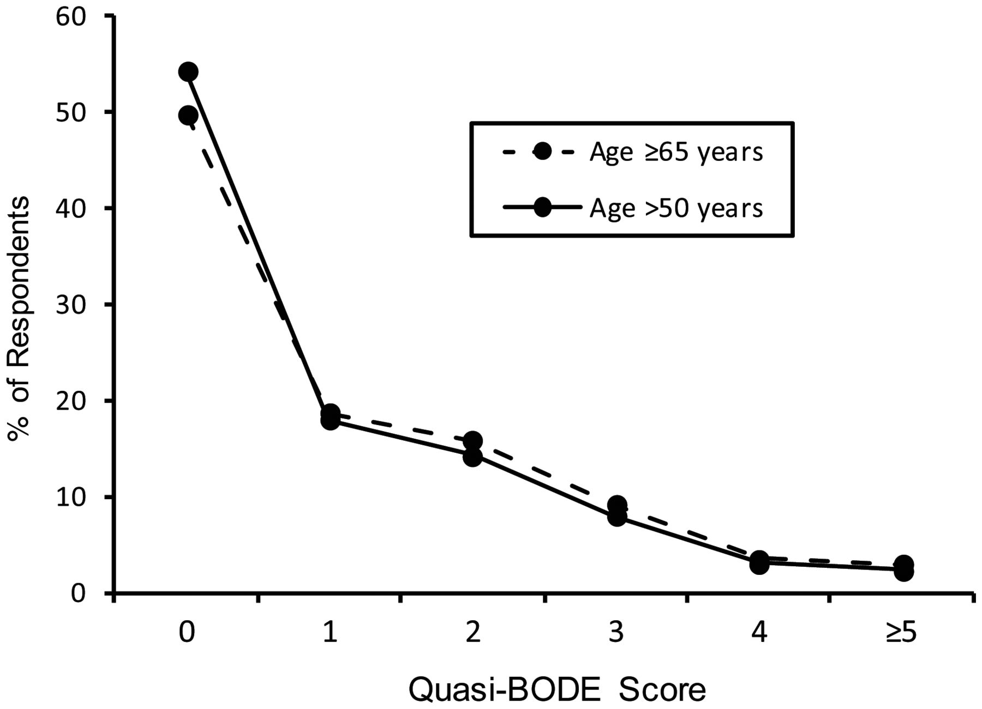
Figure 1. Percentages of respondents over age 50 years (n = 12,501) and aged 65 years or older (n = 8,301) by ...
Notes:
Figure 1. Percentages of respondents over age 50 years (n = 12,501) and aged 65 years or older (n = 8,301) by quasi-BODE index score, Health Retirement Study national surveys, United States, 2006 and 2008.
Unless provided in the caption above, the following copyright applies to the content of this slide: © The Author 2013. Published by Oxford University Press on behalf of the Johns Hopkins Bloomberg School of Public Health. All rights reserved. For permissions, please e-mail: journals.permissions@oup.com.

