Slide 1
Figure 1. Relative positions on chromosome 19 of CYP2A6, EGLN2 and RAB4B genes and variants associated with cigarette ...
Notes:
Figure 1. Relative positions on chromosome 19 of CYP2A6, EGLN2 and RAB4B genes and variants associated with cigarette consumption and related disease in GWAS (5,7,18).
Unless provided in the caption above, the following copyright applies to the content of this slide: © The Author 2013. Published by Oxford University Press. All rights reserved. For Permissions, please email: journals.permissions@oup.com

Slide 2
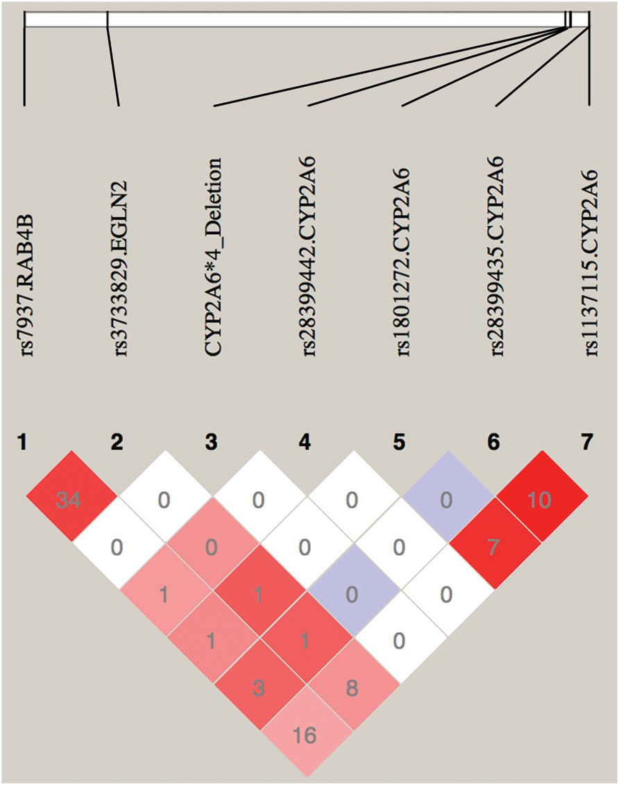
Figure 2. Linkage disequilibrium (R² and D′) plot of rs3733829 in EGLN2, rs7937 in RAB4B and functional ...
Notes:
Figure 2. Linkage disequilibrium (R2 and D′) plot of rs3733829 in EGLN2, rs7937 in RAB4B and functional variants in CYP2A6 among TTURC European American Subjects. Numbers represent the R2 value expressed as a percentile. Red squares represent pairs with logarithm of odds (LOD) scores for linkage disequilibrium ≥2 and D′ = 1.0, pink squares represent LOD ≥ 2 and D′ < 1.0, blue squares represent D′ = 1 but LOD < 2, white squares represent LOD < 2 and D′ < 1.0. Plot generated using HaploView v4.2.
Unless provided in the caption above, the following copyright applies to the content of this slide: © The Author 2013. Published by Oxford University Press. All rights reserved. For Permissions, please email: journals.permissions@oup.com

