Slide 1
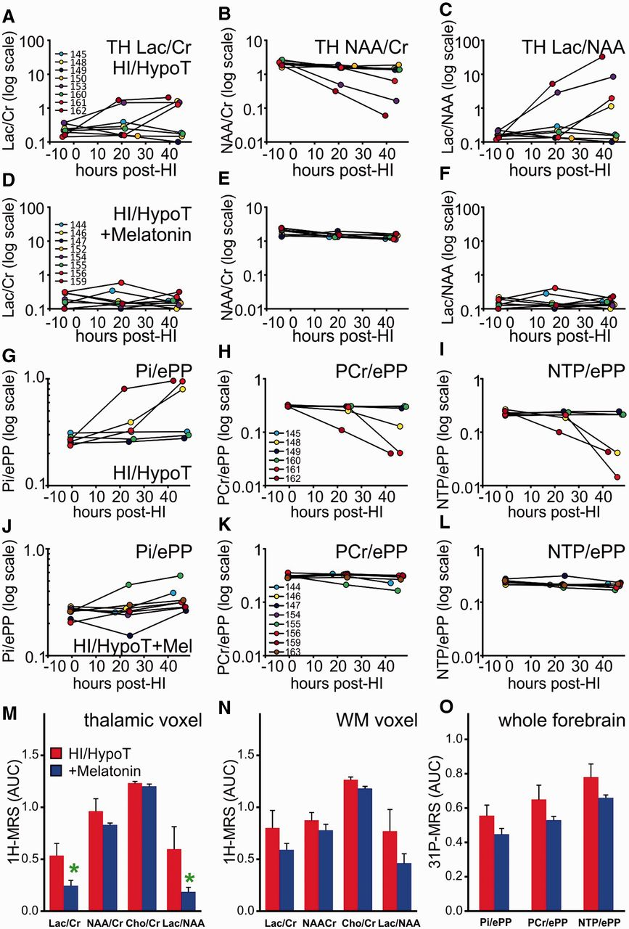
Figure 1 ¹H and ³¹P MRS shows that melatonin reduces metabolic changes after a hypoxic–ischaemic ...
Notes:
Figure 1 1H and 31P MRS shows that melatonin reduces metabolic changes after a hypoxic–ischaemic insult in the neonatal piglet. (A–F) Time course changes for the lactate/creatine (A and D), N-acetyl aspartate/creatine (B and E) and lactate/N-acetyl aspartate (C and F) ratios in the thalamic voxel, in animals treated with hypothermia alone (HypoT, A–C), and those cotreated with melatonin (HypoT+Mel, D–F) in the 48 h after a hypoxic–ischaemic insult (0 h is end of insult). The data points are plotted on a semi-logarithmic scale, and each trace of data points represents an individual animal. Note in the HypoT group the increase of lactate/creatine (A) and lactate/N-acetyl aspartate (C) ratios in four of eight animals, and a decrease in N-acetyl aspartate in three of eight animals (B). These changes were abrogated in the HypoT+Mel group. (G–L) 31P-MRS time course for inorganic phosphate/exchangeable phosphate pool (G and J), phosphocreatine/exchangeable phosphate pool (H and K) and NTP/exchangeable phosphate pool (I and L) in the whole forebrain voxel in HypoT (G–I), and HypoT+Mel piglets (J–L). In 31P-MRS, the HypoT group shows three of six animals had increasing inorganic phosphate/exchangeable phosphate pool (G) and reductions in phosphocreatine/exchangeable phosphate pool (H) and NTP/exchangeable phosphate pool (I). These changes were abrogated in the HypoT+Mel group. (M–O) Summary of the area under the curve data (mean ± SEM) for the thalamic 1H (M), the white matter 1H (N) and the 31P whole forebrain (O) metabolite ratio time courses. In the case of decreasing ratios (N-acetyl aspartate/creatine, phosphocreatine/exchangeable phosphate pool and NTP/exchangeable phosphate pool), the bars represent the area over the curve algorithm. Red bars show data for the HypoT group, blue bars for the HypoT and Mel group, mean ± SEM. *P < 0.05 in t-test. Cr = creatine; ePP = exchangeable phosphate pool; HI = hypoxia–ischaemia; Lac = lactate; NAA = N-acetyl aspartate; PCr = phosphocreatine; Pi = inorganic phosphate; TH = thalamic; WM = white matter.
Unless provided in the caption above, the following copyright applies to the content of this slide: © The Author (2012). Published by Oxford University Press on behalf of the Guarantors of Brain. All rights reserved. For Permissions, please email: journals.permissions@oup.com

Slide 2
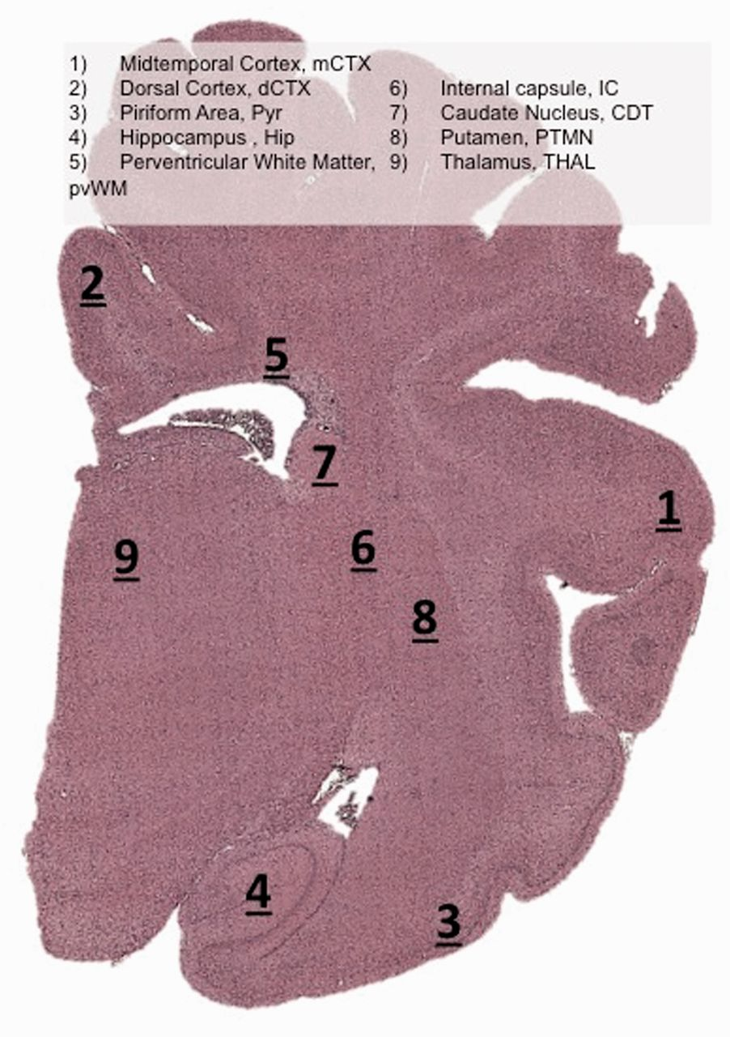
Figure 2 Representative piglet brain photomicrograph indicating brain regions assessed for histology and ...
Notes:
Figure 2 Representative piglet brain photomicrograph indicating brain regions assessed for histology and immunohistochemistry.
Unless provided in the caption above, the following copyright applies to the content of this slide: © The Author (2012). Published by Oxford University Press on behalf of the Guarantors of Brain. All rights reserved. For Permissions, please email: journals.permissions@oup.com

Slide 3
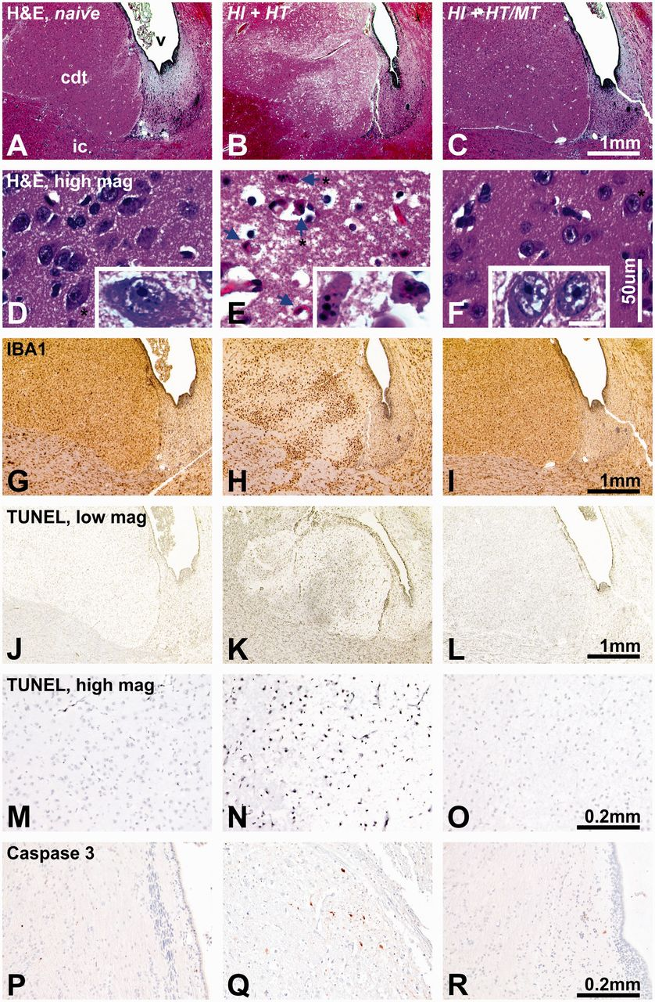
Figure 3 (A–R) Cotreatment with melatonin decreases histological damage, 48 h after hypoxia–ischaemia. For comparison, ...
Notes:
Figure 3 (A–R) Cotreatment with melatonin decreases histological damage, 48 h after hypoxia–ischaemia. For comparison, naïve tissue is shown in the left column. Each column shows representative sections from the same animal in the HypoT (middle column) and HypoT+Mel groups (right column) from the caudate nucleus (A–O) or thalamus (P–R). The tissue is stained for haematoxylin and eosin (H&E) histology at low (A–C) and high (D–F) magnification, immunohistochemistry for microglial IBA1 (G–I), TUNEL at low (J–L) and high (M–O) magnification and activated caspase 3 (P–R). In the HypoT animal, there is extensive vacuolation in the areas of the caudate nucleus near the ventricle (B), associated with pronounced nuclear pyknosis and karyorrhectic fragmentation (E), microglial activation and clustering in the caudate and the overlying internal capsule (H), a large number of TUNEL-positive cells (K and N) and numerous activated caspase 3 cells in the thalamus (Q). These changes are ameliorated in the HypoT+Mel animal. cdt = caudate nucleus; ic = internal capsule; v = cerebral ventricle. The blue arrows in E point to the karyorrhectic nuclear profiles, the asterisks to the cells shown at higher magnification in the inserts (rotated in D and E). Scale bars: A–C, G–L = 1 mm; D–F = 50 µm; D–F inserts = 10 µm; M–R = 0.2 mm.
Unless provided in the caption above, the following copyright applies to the content of this slide: © The Author (2012). Published by Oxford University Press on behalf of the Guarantors of Brain. All rights reserved. For Permissions, please email: journals.permissions@oup.com

Slide 4
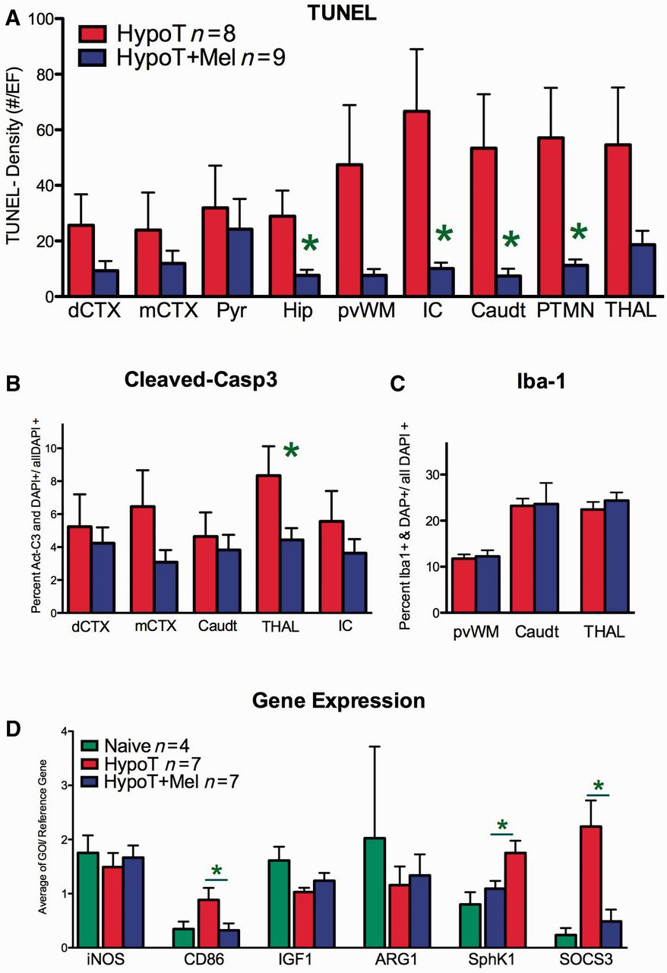
Figure 4 (A–C) Cotreatment with melatonin reduces TUNEL-positive cell number (A) activated caspase 3 (B), but not ...
Notes:
Figure 4 (A–C) Cotreatment with melatonin reduces TUNEL-positive cell number (A) activated caspase 3 (B), but not IBA1-positive microglial cell density (C) as assessed with histochemistry 48 h after hypoxia–ischaemia insult (mean ± SEM, eight HypoT alone animals (red bars) and nine HypoT+Mel). (D) Gene expression data for inducible nitric oxide synthase (iNOS), CD86, insulin-like growth factor (IGF1), arginase-1 (ARG1), sphingosine kinase (SphK1) and suppressor of cytokines 3 (SOCS3) (n = 4 naïve, n = 7 HypoT, n = 7 HypoT+Mel). *P < 0.05 in t-test. CDT = caudate nucleus; dCTX = dorsal parietal cortex; GOI = gene of interest; Hip = hippocampus; IC = internal capsule; mCTX = midtemporal cortex (insula); PTMN = putamen; pvWM = periventricular white matter; Pyr = pyramidal cortex; THLM = thalamus.
Unless provided in the caption above, the following copyright applies to the content of this slide: © The Author (2012). Published by Oxford University Press on behalf of the Guarantors of Brain. All rights reserved. For Permissions, please email: journals.permissions@oup.com

Slide 5
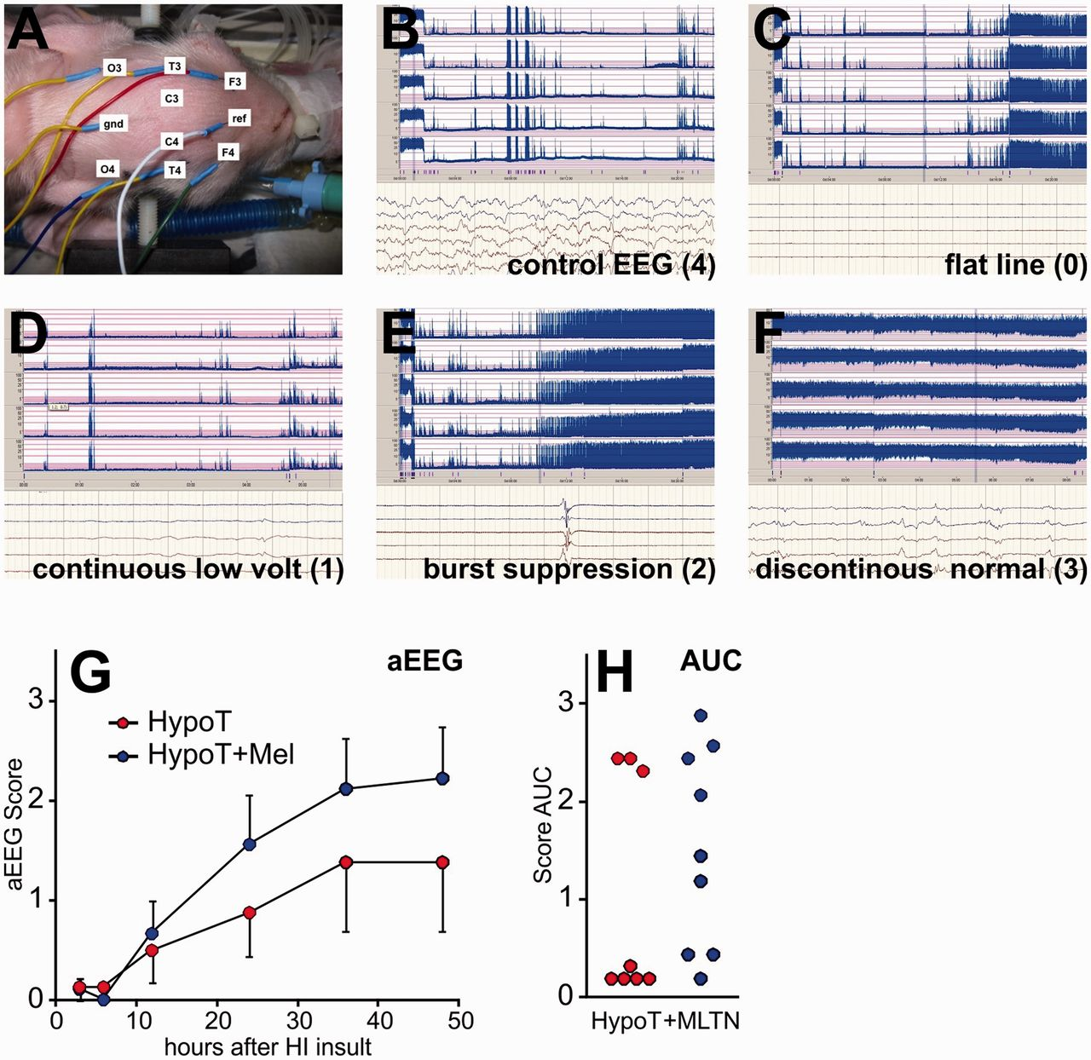
Figure 5 Effect of melatonin cotreatment on amplitude-integrated EEG. (A) Position of recording amplitude-integrated ...
Notes:
Figure 5 Effect of melatonin cotreatment on amplitude-integrated EEG. (A) Position of recording amplitude-integrated EEG leads. (B-F) Amplitude-integrated EEG bandwidth analysis (top) and continuous EEG recordings (bottom) in case of continuous normal voltage (B), flat trace (C), continuous low voltage (D), burst suppression (E) and discontinuous normal voltage (F). (G) Amplitude-integrated EEG time course for the hypothermia alone (red dots) and hypothermia plus melatonin groups (blue dots) as mean ± SEM. Most recovery takes place before 36 h, in both groups. (H) Distribution of individual amplitude-integrated EEG responses using area under the curve parameter; each dot represents a single animal. Note the dichotomous distribution (three high, five very low) in the hypothermia alone group, and the appearance of intermediates in the group cotreated with melatonin. aEEG = amplitude-integrated EEG HypoT = hypothermia group; HypoT + Mel = hypothermia plus melatonin group.
Unless provided in the caption above, the following copyright applies to the content of this slide: © The Author (2012). Published by Oxford University Press on behalf of the Guarantors of Brain. All rights reserved. For Permissions, please email: journals.permissions@oup.com

Slide 6
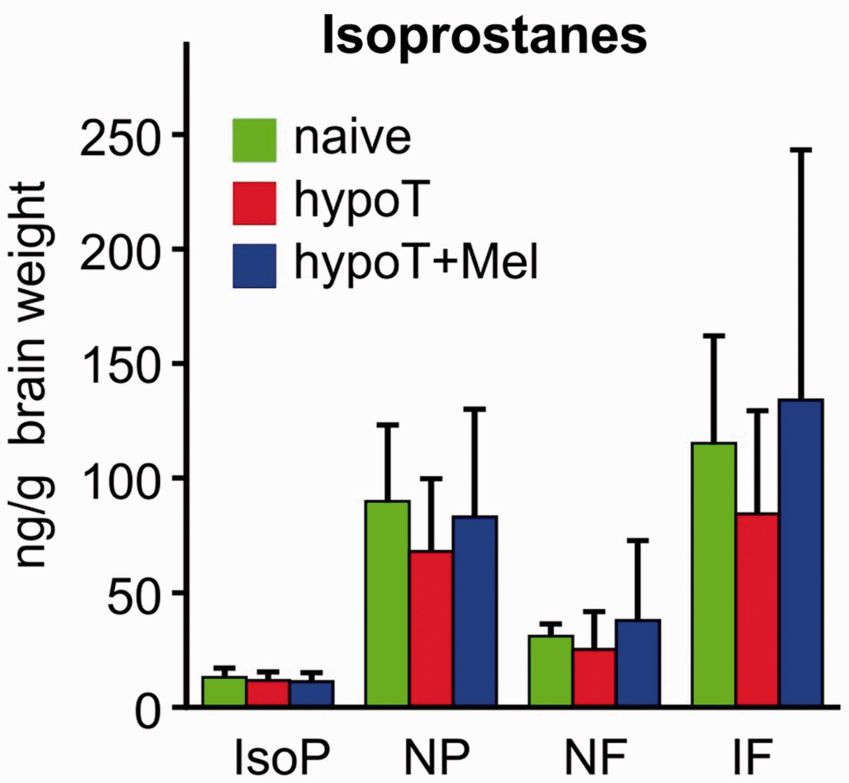
Figure 6 (A) Effect of melatonin treatment on isoprostane (IP), neuroprostane (NP), neurofurans (NF) and isoflurane ...
Notes:
Figure 6 (A) Effect of melatonin treatment on isoprostane (IP), neuroprostane (NP), neurofurans (NF) and isoflurane (IF) brain levels 48 h after insult. Mean ± SEM for naïve (green bars, n = 2), HypoT (red bars, n = 8) and HypoT+Mel (blue bars, n = 7) groups, respectively. None of the four neurochemicals affected by oxidative stress showed a significant difference between groups.
Unless provided in the caption above, the following copyright applies to the content of this slide: © The Author (2012). Published by Oxford University Press on behalf of the Guarantors of Brain. All rights reserved. For Permissions, please email: journals.permissions@oup.com

Slide 7
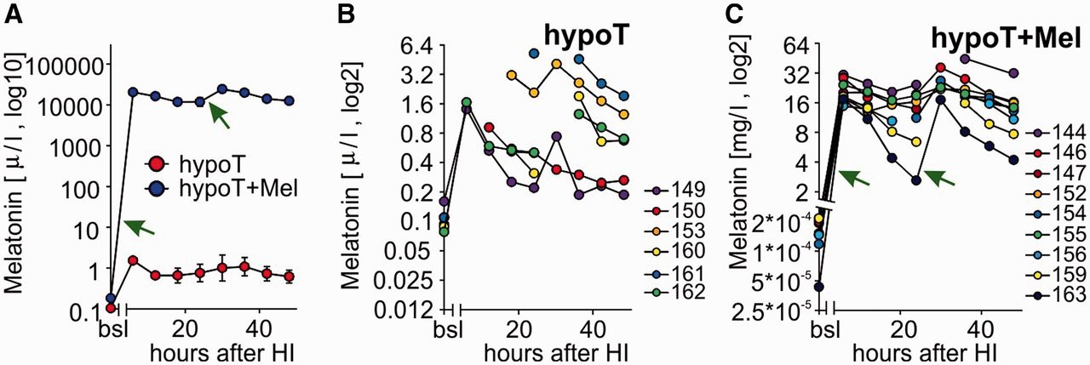
Figure 7 Melatonin pharmacokinetics. (A–C) Concentrations in blood plasma at the basal level (bsl) and 6–48 h after ...
Notes:
Figure 7 Melatonin pharmacokinetics. (A–C) Concentrations in blood plasma at the basal level (bsl) and 6–48 h after hypoxic–ischaemic insult. (A) Mean ± SEM levels for the HypoT alone (red circles, n = 6 animals) and HypoT+Mel (blue circles, n = 9 animals). (B and C) Time course data for individual HypoT (D) and HypoT+Mel (E) animals. Green arrows in A and C indicate intravenous melatonin injection. In B, the interruptions in individual traces were due to missing time points. Note that in B the y-axis is in µg/l and in C the y-axis is in mg/l. bsl = baseline; HI = hypoxia–ischaemia.
Unless provided in the caption above, the following copyright applies to the content of this slide: © The Author (2012). Published by Oxford University Press on behalf of the Guarantors of Brain. All rights reserved. For Permissions, please email: journals.permissions@oup.com

