Slide 1
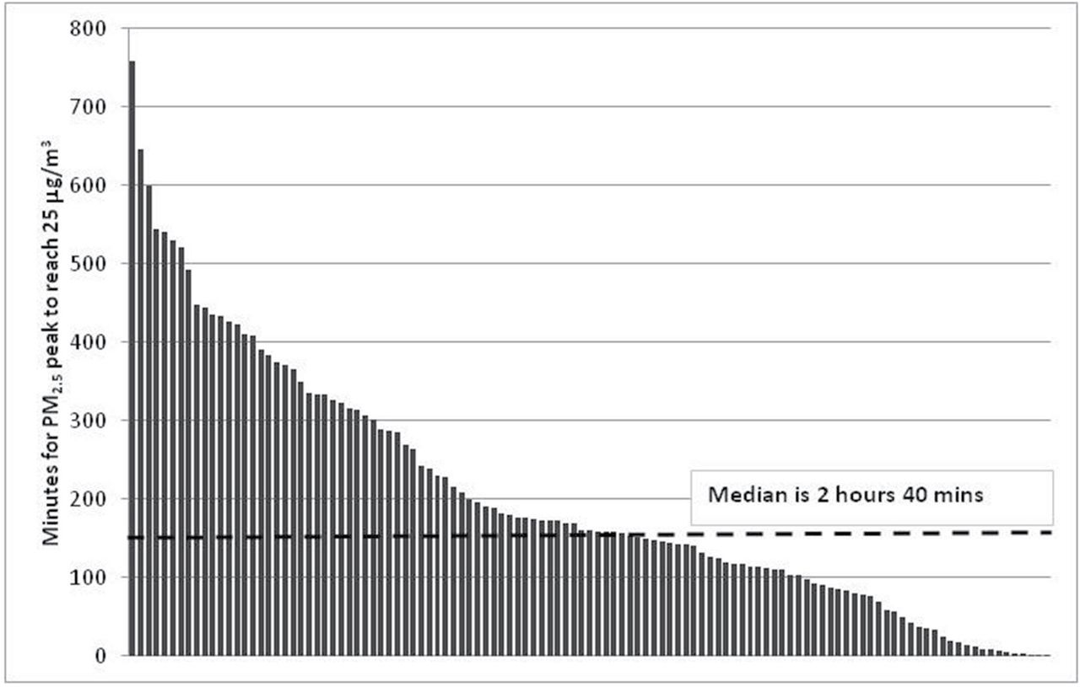
Figure 3. Distribution of number of minutes for the SHS-PM_{2.5} to decay to a concentration of 25 ...
Notes:
Figure 3. Distribution of number of minutes for the SHS-PM2.5 to decay to a concentration of 25 µg/m3 (n = 115).
Unless provided in the caption above, the following copyright applies to the content of this slide: © The Author 2014. Published by Oxford University Press on behalf of the Society for Research on Nicotine and Tobacco. All rights reserved. For permissions, please e-mail: journals.permissions@oup.com.

Slide 2
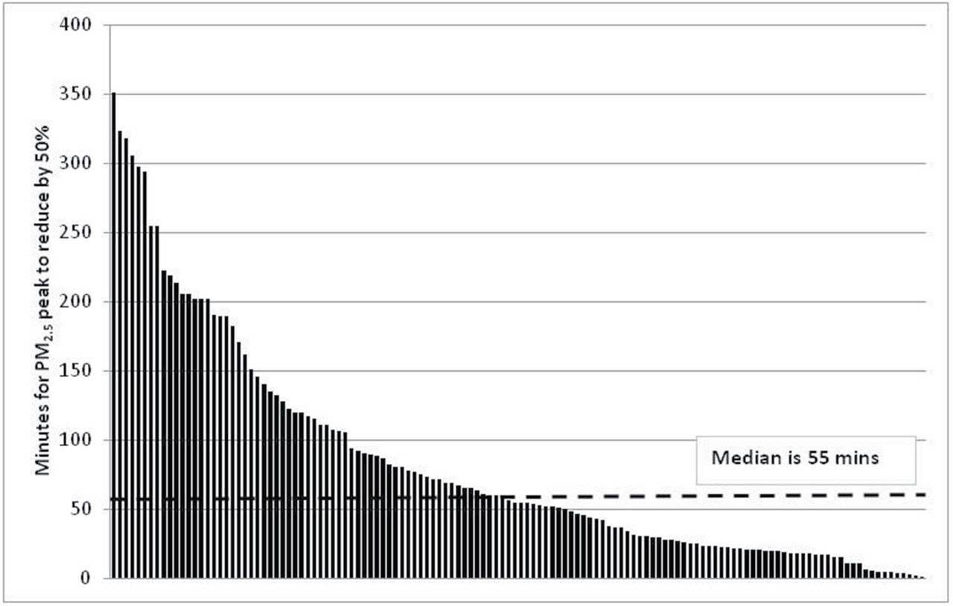
Figure 2. Distribution of number of minutes for the SHS-PM_{2.5} to decay to a concentration of 50% of the peak ...
Notes:
Figure 2. Distribution of number of minutes for the SHS-PM2.5 to decay to a concentration of 50% of the peak value (n = 130).
Unless provided in the caption above, the following copyright applies to the content of this slide: © The Author 2014. Published by Oxford University Press on behalf of the Society for Research on Nicotine and Tobacco. All rights reserved. For permissions, please e-mail: journals.permissions@oup.com.

Slide 3
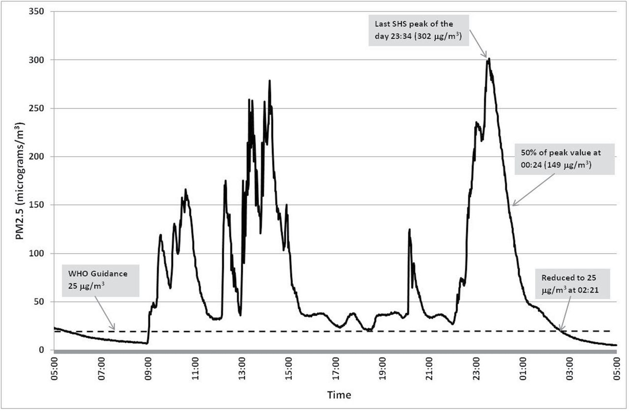
Figure 1. Typical 24-hr plot illustrating the time-profile of PM_{2.5} concentrations measured in one of the ...
Notes:
Figure 1. Typical 24-hr plot illustrating the time-profile of PM2.5 concentrations measured in one of the homes.
Unless provided in the caption above, the following copyright applies to the content of this slide: © The Author 2014. Published by Oxford University Press on behalf of the Society for Research on Nicotine and Tobacco. All rights reserved. For permissions, please e-mail: journals.permissions@oup.com.

