Slide 1
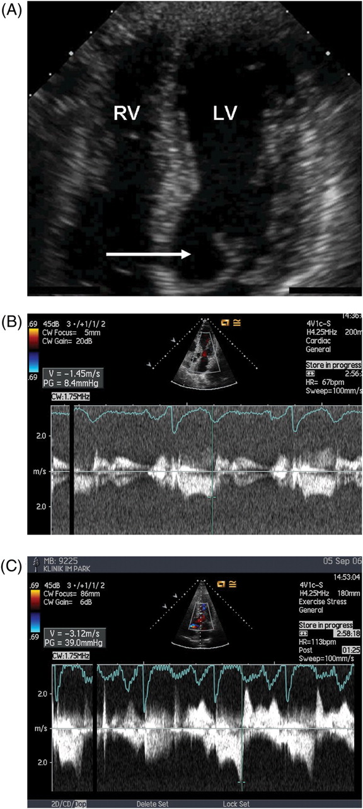
Figure 1 Example of echocardiographic findings in Patient 35, Table 6 with a gradient at rest, after Valsalva and ...
Notes:
Figure 1 Example of echocardiographic findings in Patient 35, Table 6 with a gradient at rest, after Valsalva and with exercise. ( A ) Apical four-chamber view showing chordal SAM of the mitral valve (arrow). LV, left ventricle; RV, right ventricle. Septal wall thickness was 1.3 cm, posterior wall 1 cm, left ventricular ejection fraction 78%, shortening fraction 60%. ( B ) Gradient in the LVOT at rest of only 8 mmHg. ( C ) Gradient in the left ventricular outflow tract after exercise of 39 mmHg at heart rate of 113 bpm.
Unless provided in the caption above, the following copyright applies to the content of this slide: Published on behalf of the European Society of Cardiology. All rights reserved. © The Author 2008. For permissions please email: journals.permissions@oxfordjournals.org

Slide 2
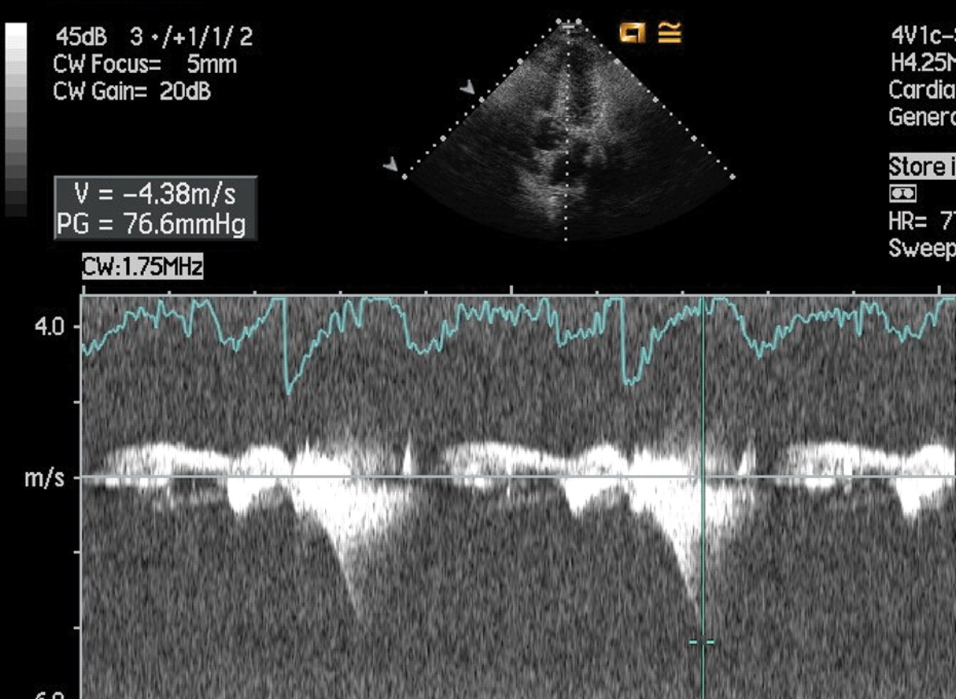
Figure 2 Gradient in the left ventricular outflow tract at rest after a Valsalva manoeuvre with a gradient of 77 ...
Notes:
Figure 2 Gradient in the left ventricular outflow tract at rest after a Valsalva manoeuvre with a gradient of 77 mmHg.
Unless provided in the caption above, the following copyright applies to the content of this slide: Published on behalf of the European Society of Cardiology. All rights reserved. © The Author 2008. For permissions please email: journals.permissions@oxfordjournals.org

