Slide 1
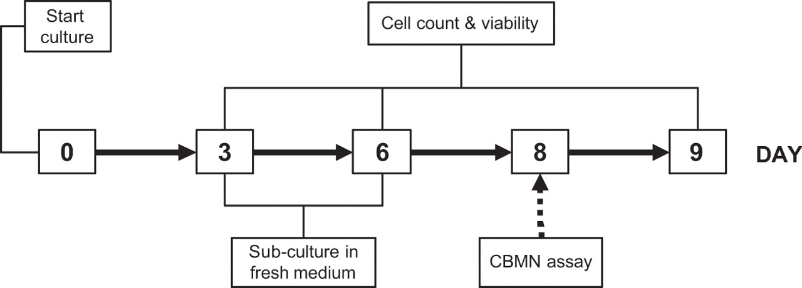
Fig. 1. Experimental design showing the days when cell counts and viabilities, subcultures and CBMN-assay were ...
Notes:
Fig. 1. Experimental design showing the days when cell counts and viabilities, subcultures and CBMN-assay were performed. Cells were initiated at 1.0 × 10 6 cells/ml and subcultured on day 3 and day 6 to a concentration of 0.5 × 10 6 cells/ml. In the CBMN-assay, cytochalasin-B was added on day 8 and cells were harvested on day 9.
Unless provided in the caption above, the following copyright applies to the content of this slide: Carcinogenesis vol.27 no.3 © Oxford University Press 2005; all rights reserved.

Slide 2
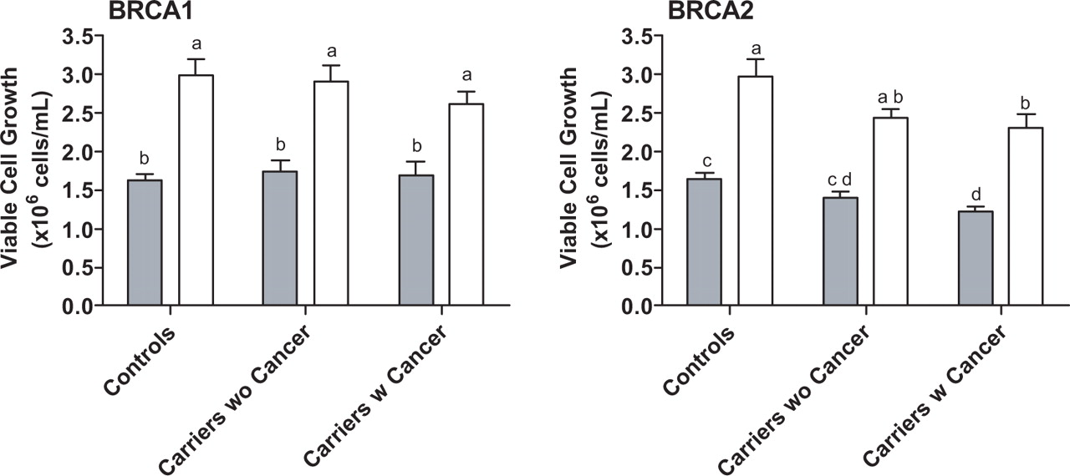
Fig. 2. Viable cell growth of peripheral lymphocytes from BRCA1 and BRCA2 carriers with or without breast cancer and ...
Notes:
Fig. 2. Viable cell growth of peripheral lymphocytes from BRCA1 and BRCA2 carriers with or without breast cancer and non-carrier controls, on day 9 in media containing 12 or 120 nM FA. Cultures were initiated at 1.0 × 10 6 cells/ml and subcultured at 0.5 × 10 6 cells/ml on day 3 and day 6. Grey bars represent the viable cell growth in 12 nM FA, black bars the viable cell growth in 120 nM FA. Bars that do not share the same letter are significantly different from each other ( P < 0.05). Data shown were adjusted for the effect of age and BMI.
Unless provided in the caption above, the following copyright applies to the content of this slide: Carcinogenesis vol.27 no.3 © Oxford University Press 2005; all rights reserved.

