Slide 1
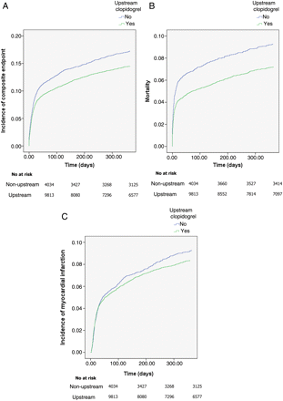
Figure 1 Propensity score-adjusted incidence of (A) composite endpoint of death/myocardial infarction (B) mortality, ...
Notes:
Figure 1 Propensity score-adjusted incidence of (A) composite endpoint of death/myocardial infarction (B) mortality, and (C) myocardial infarction at 1 year.
Unless provided in the caption above, the following copyright applies to the content of this slide: Published on behalf of the European Society of Cardiology. All rights reserved. © The Author 2011. For permissions please email: journals.permissions@oup.com

Slide 2
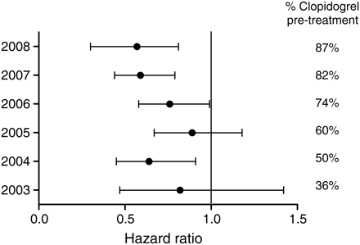
Figure 2 Subgroup analysis of 1-year mortality over time with percentage of total population receiving upstream ...
Notes:
Figure 2 Subgroup analysis of 1-year mortality over time with percentage of total population receiving upstream clopidogrel visualized in the right column.
Unless provided in the caption above, the following copyright applies to the content of this slide: Published on behalf of the European Society of Cardiology. All rights reserved. © The Author 2011. For permissions please email: journals.permissions@oup.com

Slide 3
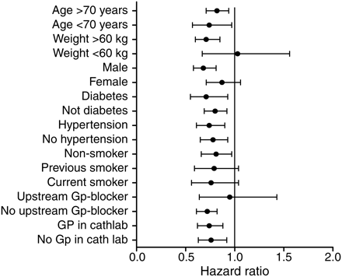
Figure 3 Forrest plot showing effect of upstream clopidogrel on various subgroups (mortality).
Notes:
Figure 3 Forrest plot showing effect of upstream clopidogrel on various subgroups (mortality).
Unless provided in the caption above, the following copyright applies to the content of this slide: Published on behalf of the European Society of Cardiology. All rights reserved. © The Author 2011. For permissions please email: journals.permissions@oup.com

