Slide 1
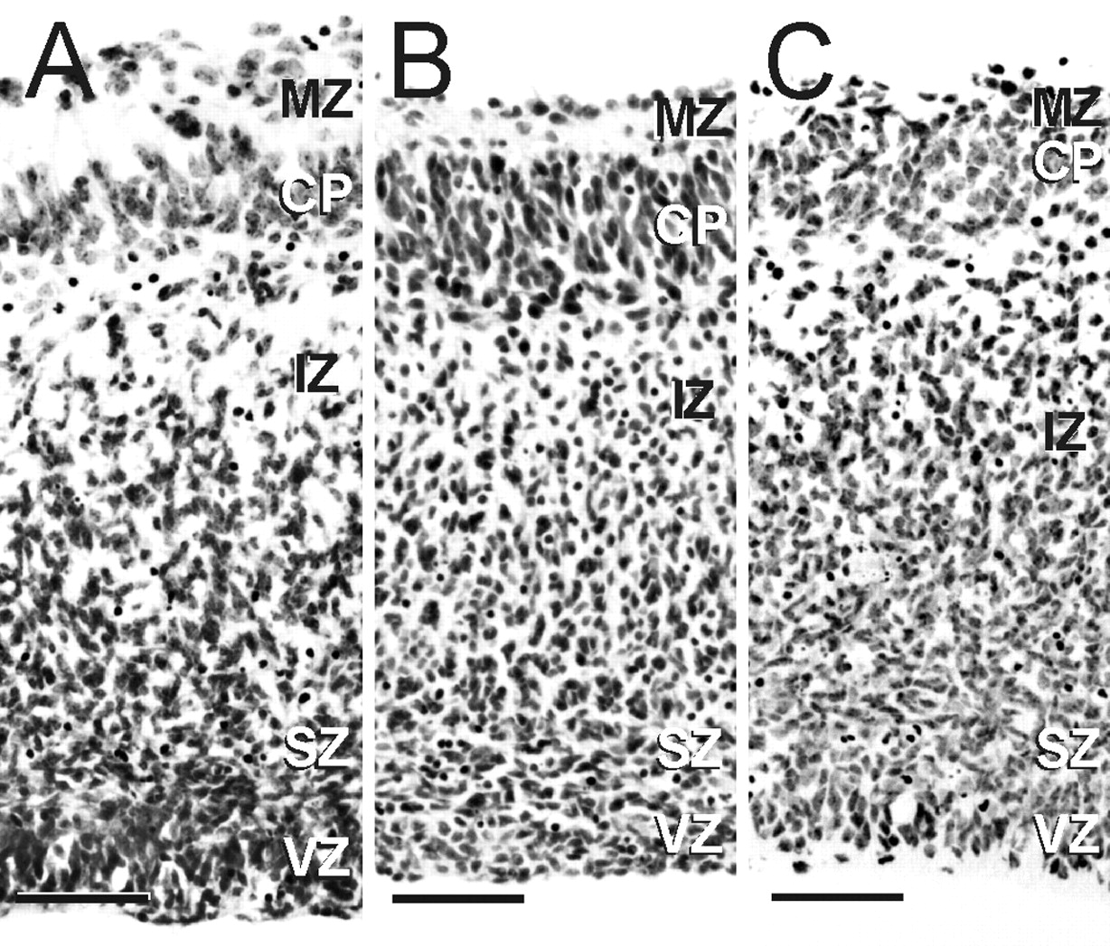
Figure 1. Cytoarchitecture of the cerebral wall. (A) Five main strata are distinguished in the cerebral wall ...
Notes:
Figure 1. Cytoarchitecture of the cerebral wall. (A) Five main strata are distinguished in the cerebral wall of an organotypic slice culture: the marginal zone (MZ), cortical plate (CP), intermediate zone (IZ), subventricular zone (SZ) and ventricular zone (VZ). (B) These five regions are discriminable in ethanol-treated slices. (C) This ethanol-treated slice shows an ill-defined MZ characterized by increased cellularity. Scale bars = 50 µm.
Unless provided in the caption above, the following copyright applies to the content of this slide:

Slide 2
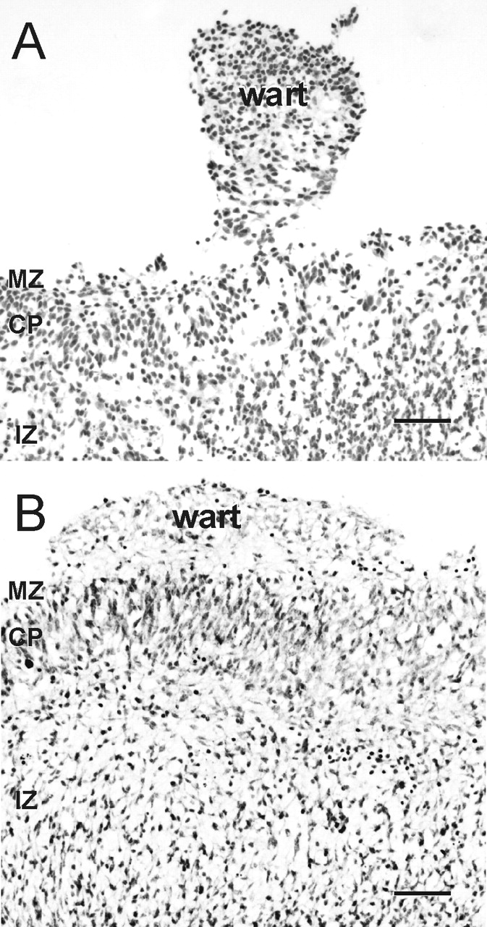
Figure 2. Wart morphology. (A) A peduncular wart is characterized by a large cluster of cells attached to the ...
Notes:
Figure 2. Wart morphology. (A) A peduncular wart is characterized by a large cluster of cells attached to the cerebral wall by a ‘stalk’. (B) An appositional wart is a suprapial aggregate of cells juxtaposed to the surface of the cerebral wall. Scale bars = 50 µm.
Unless provided in the caption above, the following copyright applies to the content of this slide:

Slide 3
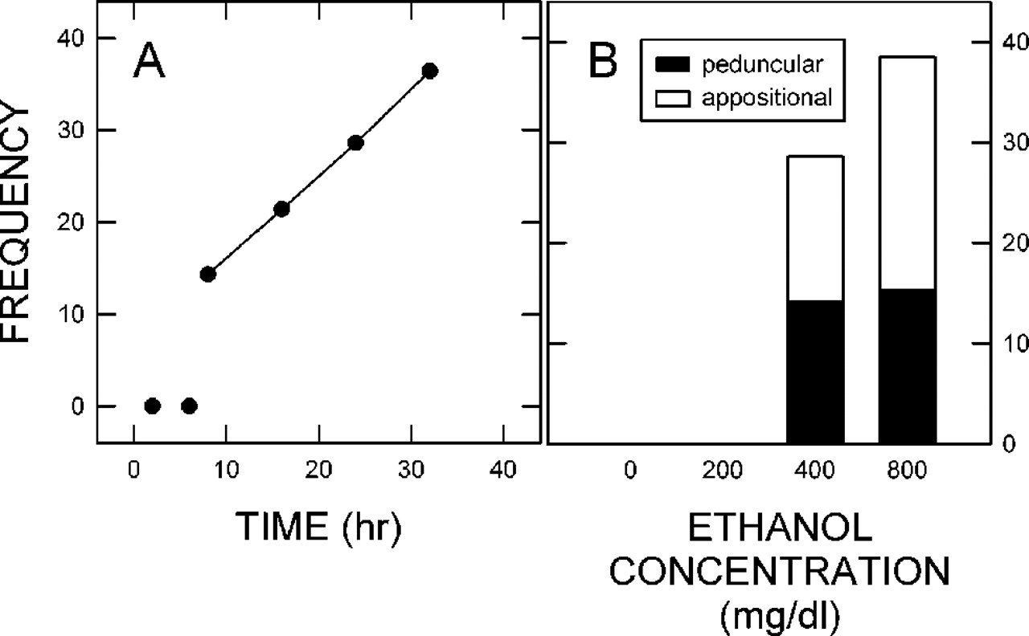
Figure 3. Factors influencing the appearance of warts. (A) The effect of the length of exposure to ethanol ...
Notes:
Figure 3. Factors influencing the appearance of warts. (A) The effect of the length of exposure to ethanol (400 mg/dl) on the frequency of slices exhibiting a wart is described. Slices (n = 54) taken from a dozen litters were treated with ethanol for 2, 8, 16, 24, or 32 h. (B) The effect of ethanol concentration on the frequency of warts is shown. Bars depict the percentage of slices that have warts caused by treatment with ethanol (0, 200, 400 and 800 mg/dl) for 24 h. The solid and open portions of the bars represent the ratios of peduncular and appositional warts, respectively. n = 31 slices from seven litters.
Unless provided in the caption above, the following copyright applies to the content of this slide:

Slide 4
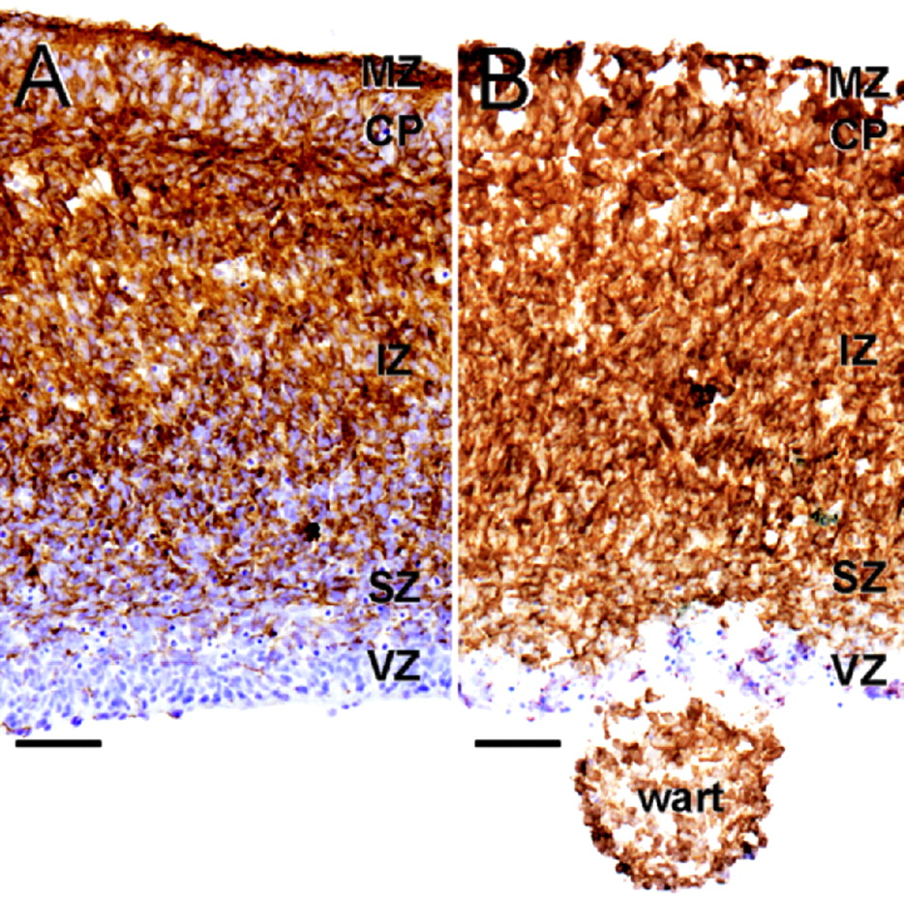
Figure 4. Doublecortin labeling in a ventricular surface wart. (A) Doublecortin immunolabeling in the ...
Notes:
Figure 4. Doublecortin labeling in a ventricular surface wart. (A) Doublecortin immunolabeling in the cerebral wall is highest in the IZ. Reduced labeling is evident in the SZ, CP and MZ, and none is detected in the VZ. (B) Treatment with a high concentration of ethanol induces a wart at the ventricular surface. Most cells in this wart are doublecortin-positive. Scale bars = 50 µm.
Unless provided in the caption above, the following copyright applies to the content of this slide:

Slide 5
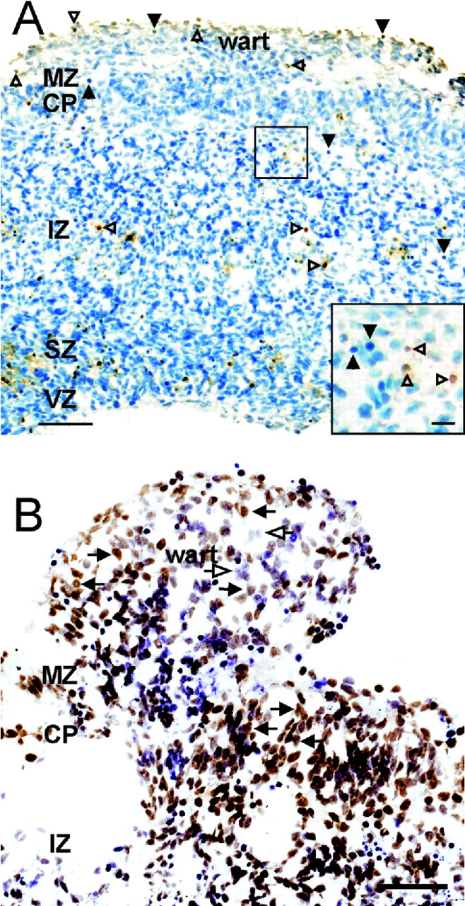
Figure 5. Cells in wart are viable and Neu-N positive. (A) Few cells in the cerebral wall or the wart are ...
Notes:
Figure 5. Cells in wart are viable and Neu-N positive. (A) Few cells in the cerebral wall or the wart are TUNEL-positive (solid arrowheads) or have condensed chromatin (open arrowheads). Thus, the majority of cells are viable. The inset is a high magnification image depicting the two types of cells. (B) Most cells in the CP and the wart are Neu-N immunolabeled (solid arrows). Only a few cells in the wart are Neu-N-negative (open arrows). Scale bars = 50 µm for the low magnification images (A, B) and 10 µm for the inset.
Unless provided in the caption above, the following copyright applies to the content of this slide:

Slide 6
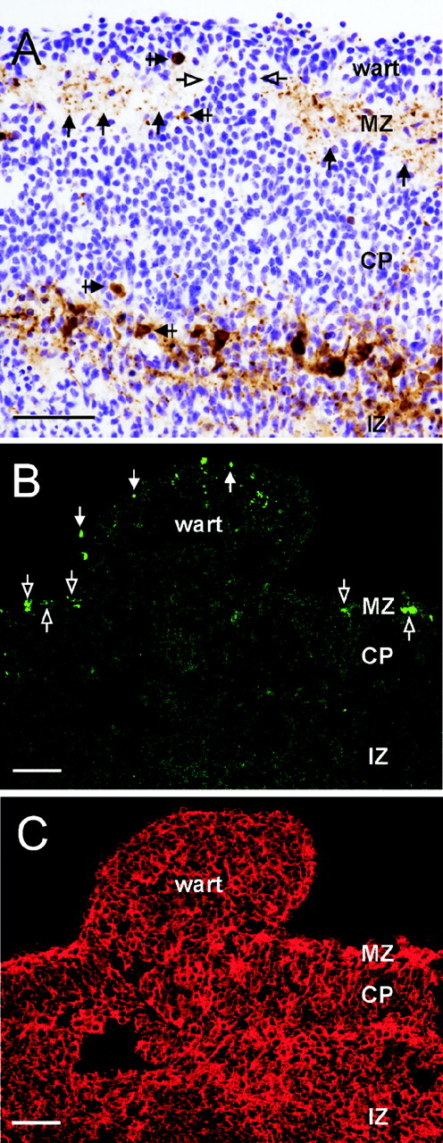
Figure 6. MZ is compromised beneath wart region. (A) Calretinin-positive somata (crossed, solid arrows) and ...
Notes:
Figure 6. MZ is compromised beneath wart region. (A) Calretinin-positive somata (crossed, solid arrows) and processes (solid arrows) are distributed in both the MZ and subplate. The immunolabeling in the MZ is interrupted beneath the wart and calretinin-negative cells (open arrows) are in the breach. (B) Reelin immunolabeling (open arrows) is common in the MZ. Labeled cells tend to be aligned in the MZ. This array is noticeably absent below the wart, however, reelin immunolabeling is evident toward the limit of the wart (solid arrows). (C) Most cells in a suprapial wart express doublecortin. Scale bars = 50 µm.
Unless provided in the caption above, the following copyright applies to the content of this slide:

Slide 7
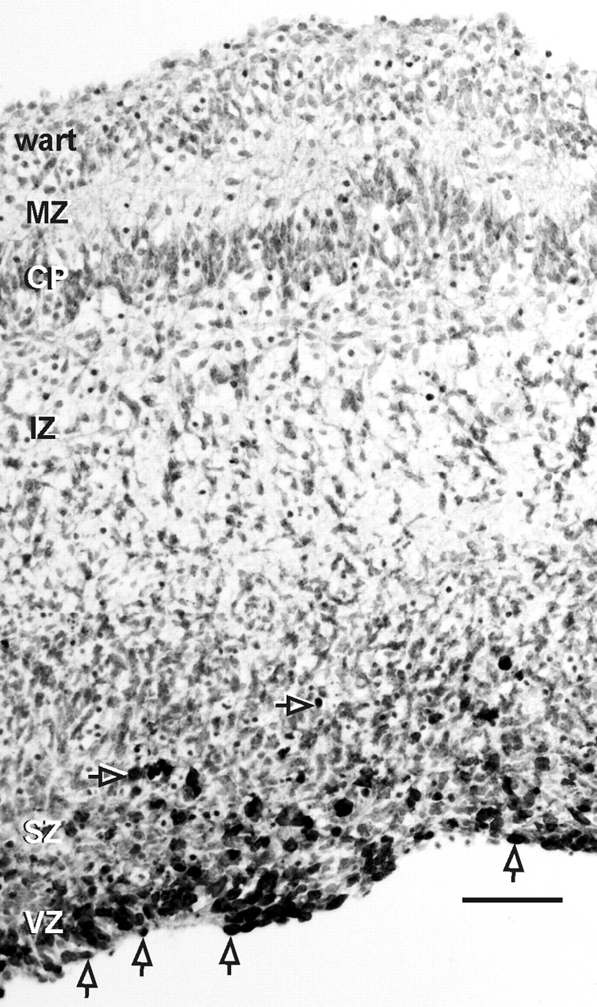
Figure 7. Cumulative BrdU labeling. BrdU-labeled cells are confined to the proliferative zones of the ...
Notes:
Figure 7. Cumulative BrdU labeling. BrdU-labeled cells are confined to the proliferative zones of the cerebral wall, the ventricular zone (VZ) and the subventricular zone (SZ)(open arrows). The wart is devoid of BrdU-labeled cells. Scale bar = 50 µm.
Unless provided in the caption above, the following copyright applies to the content of this slide:

Slide 8
Figure 8. Radial glial fibers. (A) Nestin-immunoreactive radial glial processes extend into the superficial ...
Notes:
Figure 8. Radial glial fibers. (A) Nestin-immunoreactive radial glial processes extend into the superficial cerebral wall. These processes extend into an appositional wart (black arrows). The breach of the MZ is identified by an asterisk. (B) The normal and abnormal termination of radial glia are shown in a whole-mount preparation. End-feet of radial glia (crossed arrows) are commonly located in the MZ. Radial glia enter and ramify in the wart (white arrows). (C) A drawing of this wart shows the passage of nestin-positive fibers from the MZ into the wart (black arrow) and the disorganized array of fibers and glial end-feet in the wart. Scale bars = 50 µm.
Unless provided in the caption above, the following copyright applies to the content of this slide:

