Slide 1
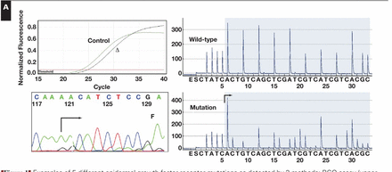
Figure 1 Examples of 5 different epidermal growth factor receptor mutations as detected by 3 methods: RGQ assay (upper ...
Notes:
Figure 1 Examples of 5 different epidermal growth factor receptor mutations as detected by 3 methods: RGQ assay (upper left panel), dideoxy sequencing (lower left panel), and pyrosequencing (lower right panel). A wild-type pyrosequence is shown for comparison in the upper right panel. A, Exon 19 deletion (p.E746_A750; c.2235_2249del15 [estimated tumor percentage = 80%]; ΔCt = 1.28). B, Exon 18 mutation (p.G719A; c.2156G>C [estimated tumor percentage = 50%]; ΔCt = 5.23). C, Exon 20 mutation (p.S768I; c.2303G>T [estimated tumor percentage = 50%]; ΔCt = 4.21). D, Exon 20 mutation (p.T790M; c.2369C>T [estimated tumor percentage = 50%]; ΔCt = 3.61). E, Exon 21 mutation (p.L858R; c.2573T>G [estimated tumor percentage = 30%]; ΔCt = 5.25). The bent arrow marks the site of the deletion start site. Up arrows indicate nucleotide gain and down arrows indicate nucleotide loss for missense mutations. Control, template control curve; Δ, mutant curve; F, forward sequencing reaction; R, reverse sequencing reaction.
Unless provided in the caption above, the following copyright applies to the content of this slide: © American Society for Clinical Pathology

Slide 2
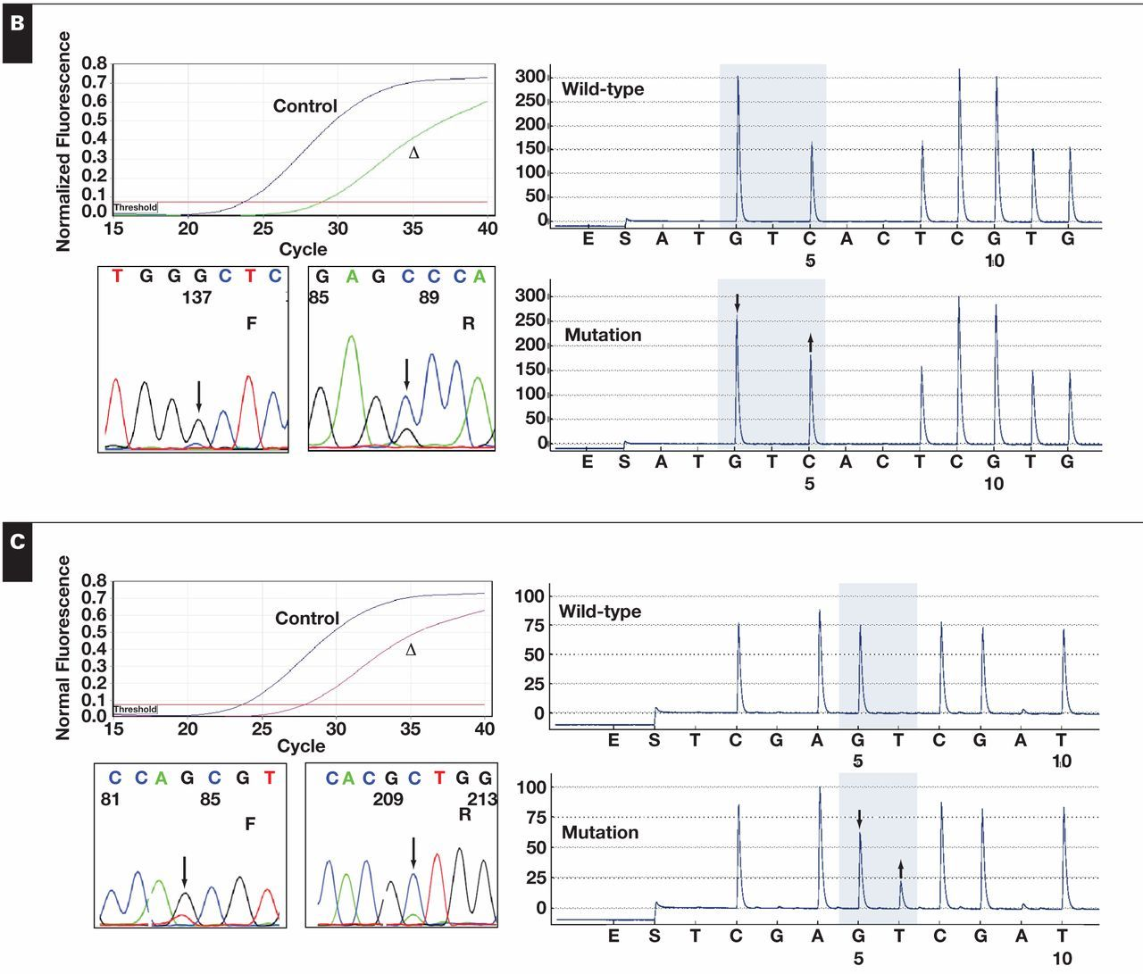
Figure 1 Examples of 5 different epidermal growth factor receptor mutations as detected by 3 methods: RGQ assay (upper ...
Notes:
Figure 1 Examples of 5 different epidermal growth factor receptor mutations as detected by 3 methods: RGQ assay (upper left panel), dideoxy sequencing (lower left panel), and pyrosequencing (lower right panel). A wild-type pyrosequence is shown for comparison in the upper right panel. A, Exon 19 deletion (p.E746_A750; c.2235_2249del15 [estimated tumor percentage = 80%]; ΔCt = 1.28). B, Exon 18 mutation (p.G719A; c.2156G>C [estimated tumor percentage = 50%]; ΔCt = 5.23). C, Exon 20 mutation (p.S768I; c.2303G>T [estimated tumor percentage = 50%]; ΔCt = 4.21). D, Exon 20 mutation (p.T790M; c.2369C>T [estimated tumor percentage = 50%]; ΔCt = 3.61). E, Exon 21 mutation (p.L858R; c.2573T>G [estimated tumor percentage = 30%]; ΔCt = 5.25). The bent arrow marks the site of the deletion start site. Up arrows indicate nucleotide gain and down arrows indicate nucleotide loss for missense mutations. Control, template control curve; Δ, mutant curve; F, forward sequencing reaction; R, reverse sequencing reaction.
Unless provided in the caption above, the following copyright applies to the content of this slide: © American Society for Clinical Pathology

Slide 3
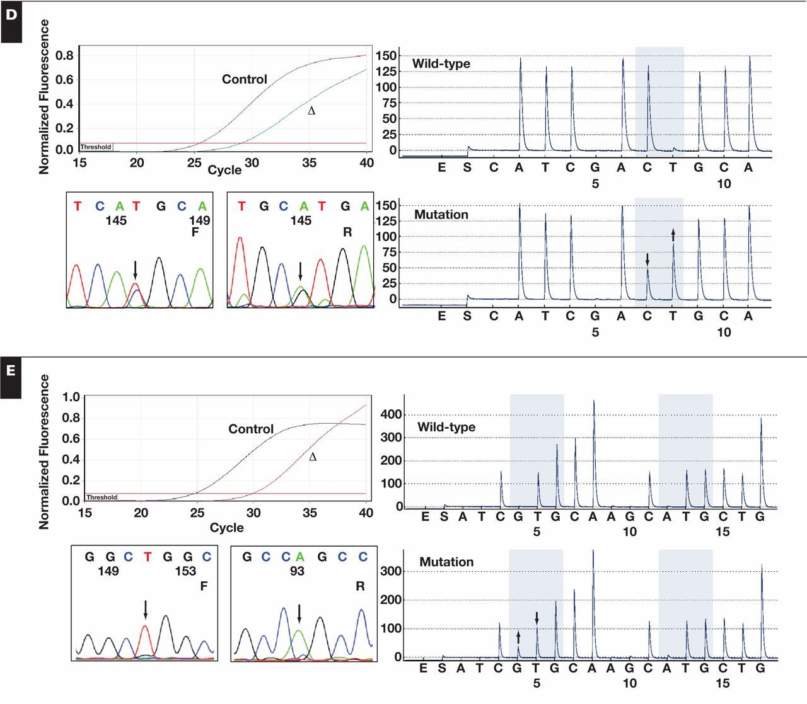
Figure 1 Examples of 5 different epidermal growth factor receptor mutations as detected by 3 methods: RGQ assay (upper ...
Notes:
Figure 1 Examples of 5 different epidermal growth factor receptor mutations as detected by 3 methods: RGQ assay (upper left panel), dideoxy sequencing (lower left panel), and pyrosequencing (lower right panel). A wild-type pyrosequence is shown for comparison in the upper right panel. A, Exon 19 deletion (p.E746_A750; c.2235_2249del15 [estimated tumor percentage = 80%]; ΔCt = 1.28). B, Exon 18 mutation (p.G719A; c.2156G>C [estimated tumor percentage = 50%]; ΔCt = 5.23). C, Exon 20 mutation (p.S768I; c.2303G>T [estimated tumor percentage = 50%]; ΔCt = 4.21). D, Exon 20 mutation (p.T790M; c.2369C>T [estimated tumor percentage = 50%]; ΔCt = 3.61). E, Exon 21 mutation (p.L858R; c.2573T>G [estimated tumor percentage = 30%]; ΔCt = 5.25). The bent arrow marks the site of the deletion start site. Up arrows indicate nucleotide gain and down arrows indicate nucleotide loss for missense mutations. Control, template control curve; Δ, mutant curve; F, forward sequencing reaction; R, reverse sequencing reaction.
Unless provided in the caption above, the following copyright applies to the content of this slide: © American Society for Clinical Pathology

Slide 4
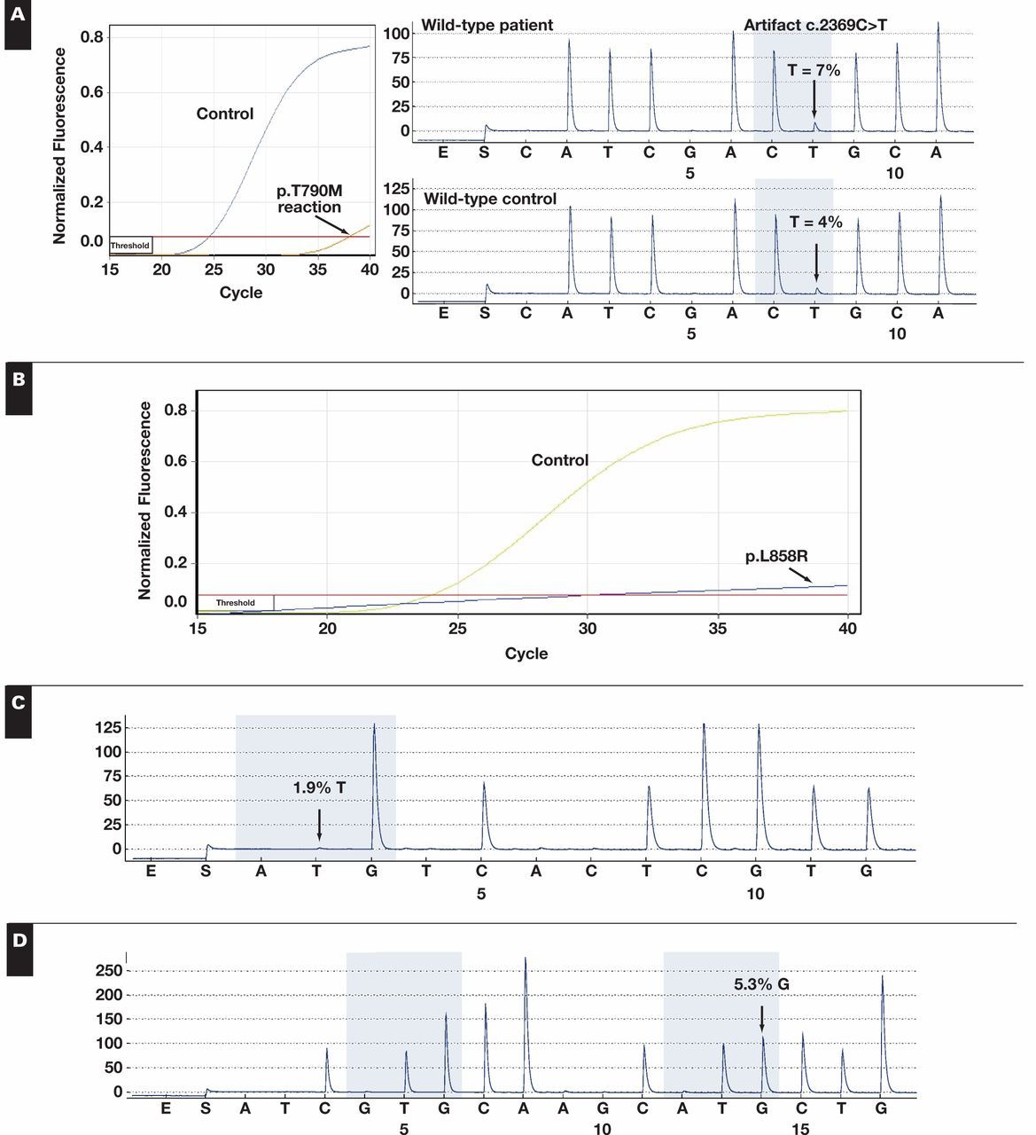
Figure 2 Examples of various artifacts identified in RGQ and Pyro assays. A, Artifacts associated with the p.T790M ...
Notes:
Figure 2 Examples of various artifacts identified in RGQ and Pyro assays. A, Artifacts associated with the p.T790M assays. Left panel, an RGQ curve with a late Ct value in a wild-type specimen for the p.T790M mutation. Upper right panel, the same specimen with an artifact peak at the site of the mutation (7% “mutant” peak, arrow). Lower right panel, the corresponding wild-type control with an artifact peak (4% “mutant” peak, arrow). The tumor percentage was 30%, and the specimen was wild type for all other mutations tested. B, An artifactual linear amplification curve that gave a positive Ct and ΔCt value for the p.L858R mutation (blue curve). Compare with the template control curve for that specimen (Control). Artifactual pyrosequencing peaks (arrows) for the p.G719C (C) and p.L861R (D) mutations. The tumor percentages were 60% and 80%, respectively. Both specimens were wild type for that specific mutation by either the RGQ system (p.G719C) or follow-up pyrosequencing (p.L861R).
Unless provided in the caption above, the following copyright applies to the content of this slide: © American Society for Clinical Pathology

