Slide 1
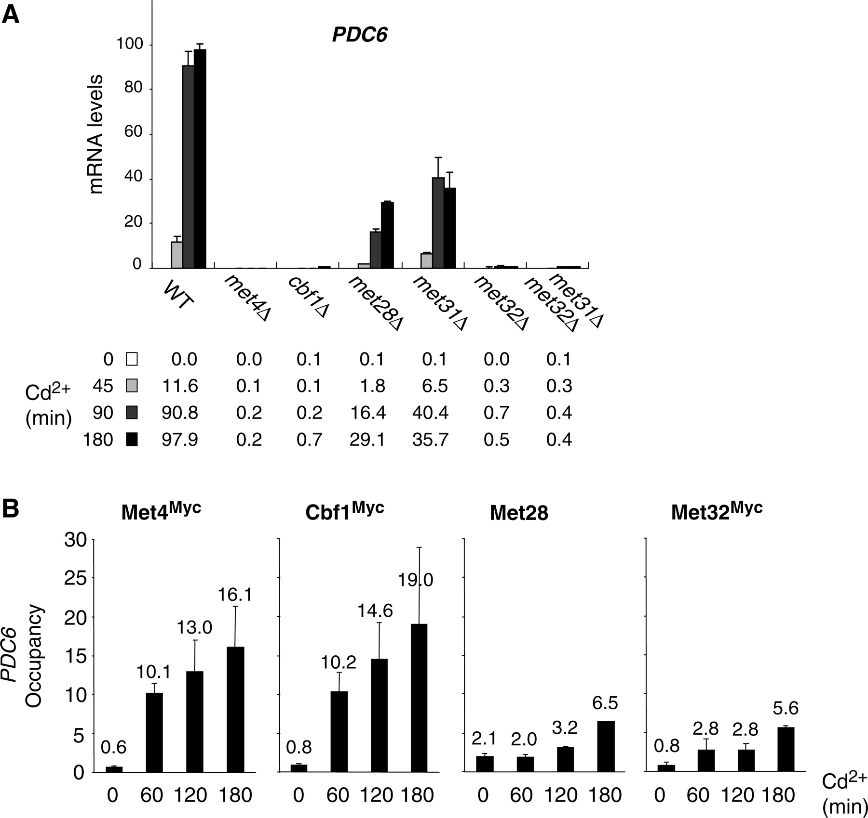
Figure 1. PDC6 activation in response to Cd ²⁺ is controlled by Met4 and its cofactors. ( A ) mRNA levels ...
Notes:
Figure 1. PDC6 activation in response to Cd 2+ is controlled by Met4 and its cofactors. ( A ) mRNA levels for PDC6 in mutant strains. A WT, and the indicated mutants were grown to early log phase in YPD medium and exposed to 0.5 mM Cd 2+ . Total RNA was prepared from samples taken before and at different time points after addition of Cd 2+ . RNA was quantified by RT followed by real-time PCR. Values were normalized to 25S ribosomal RNA and represent the average of two independent experiments. To facilitate comparison, the maximum value was set up to 100 and other values were expressed in proportion. Error bars indicate average deviations. ( B ) Association of Met4 and its cofactors with PDC6 promoter. Isogenic strains expressing Myc-tagged Met4, Cbf1 or Met32 were grown and exposed to Cd 2+ as in (A). Aliquots were crosslinked with formaldehyde at the time points indicated following Cd 2+ addition and subjected to ChIP using antibodies to Myc or to Met28. DNA fragments were quantified by real time PCR using primer pairs specific for PDC6 upstream region (from −455 to −306 relative to ATG), and primer pairs specific for IME2 ORF as a negative control. Occupancy levels correspond to the fraction of PDC6 promoter immunoprecipitates relative to the fraction IME2 ORF immunoprecipitates. Values represent the average of two independent experiments, and error bars indicate average deviations.
Unless provided in the caption above, the following copyright applies to the content of this slide: © The Author(s) 2010. Published by Oxford University Press.This is an Open Access article distributed under the terms of the Creative Commons Attribution Non-Commercial License (http://creativecommons.org/licenses/by-nc/2.5), which permits unrestricted non-commercial use, distribution, and reproduction in any medium, provided the original work is properly cited.

Slide 2
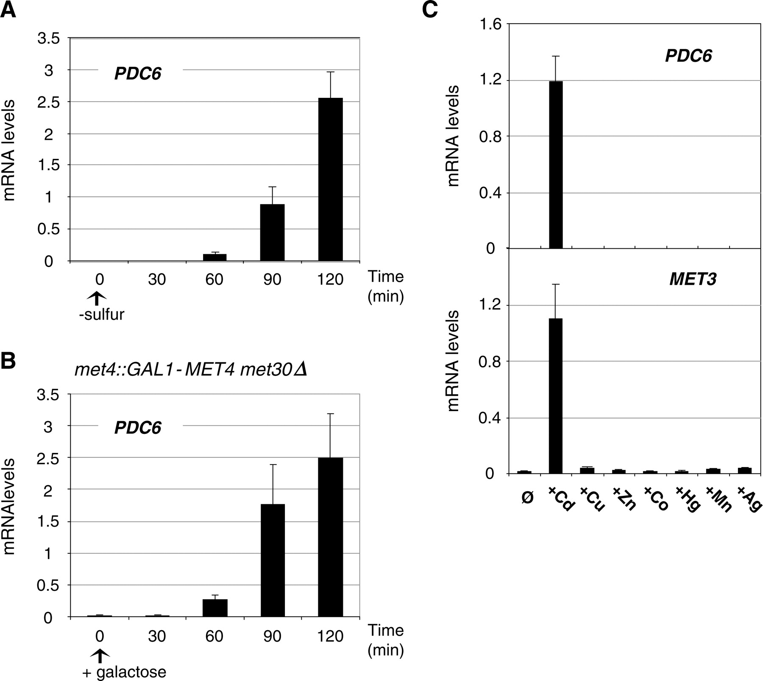
Figure 2. Analysis of PDC6 transcription under various conditions. ( A ) PDC6 transcription in response to sulfur ...
Notes:
Figure 2. Analysis of PDC6 transcription under various conditions. ( A ) PDC6 transcription in response to sulfur limitation. WT cells were grown to early log phase into B-medium supplemented with 0.5 mM methionine, collected by filtration, and transferred into B-medium with no sulfur source at time zero. Samples were taken at the time points indicated and total RNA was extracted and quantified by RT-real time PCR. Values were normalized to 25S ribosomal RNA and represent the average of two independent experiments. Error bars indicate average deviations. ( B ) PDC6 transcription in response to Met4 hyperactivation. met4::GAL1-MET4 Δ met30 (CC932-8B) cells were grown in YP-raffinose medium to early log phase and supplemented with galactose at the zero time point. ( C ) PDC6 and MET3 transcription upon exposure to various heavy metals. Wild-type cells were grown to early-log phase in YPD medium and exposed to 0.5 mM CdCl 2 , 1 mM CuCl 2 , 1 mM ZnCl 2 , 2 mM CoCl 2 , 50 µM HgCl 2 , 0.5 mM MnCl 2 or 30 µM AgNO 3 for 90 min.
Unless provided in the caption above, the following copyright applies to the content of this slide: © The Author(s) 2010. Published by Oxford University Press.This is an Open Access article distributed under the terms of the Creative Commons Attribution Non-Commercial License (http://creativecommons.org/licenses/by-nc/2.5), which permits unrestricted non-commercial use, distribution, and reproduction in any medium, provided the original work is properly cited.

Slide 3
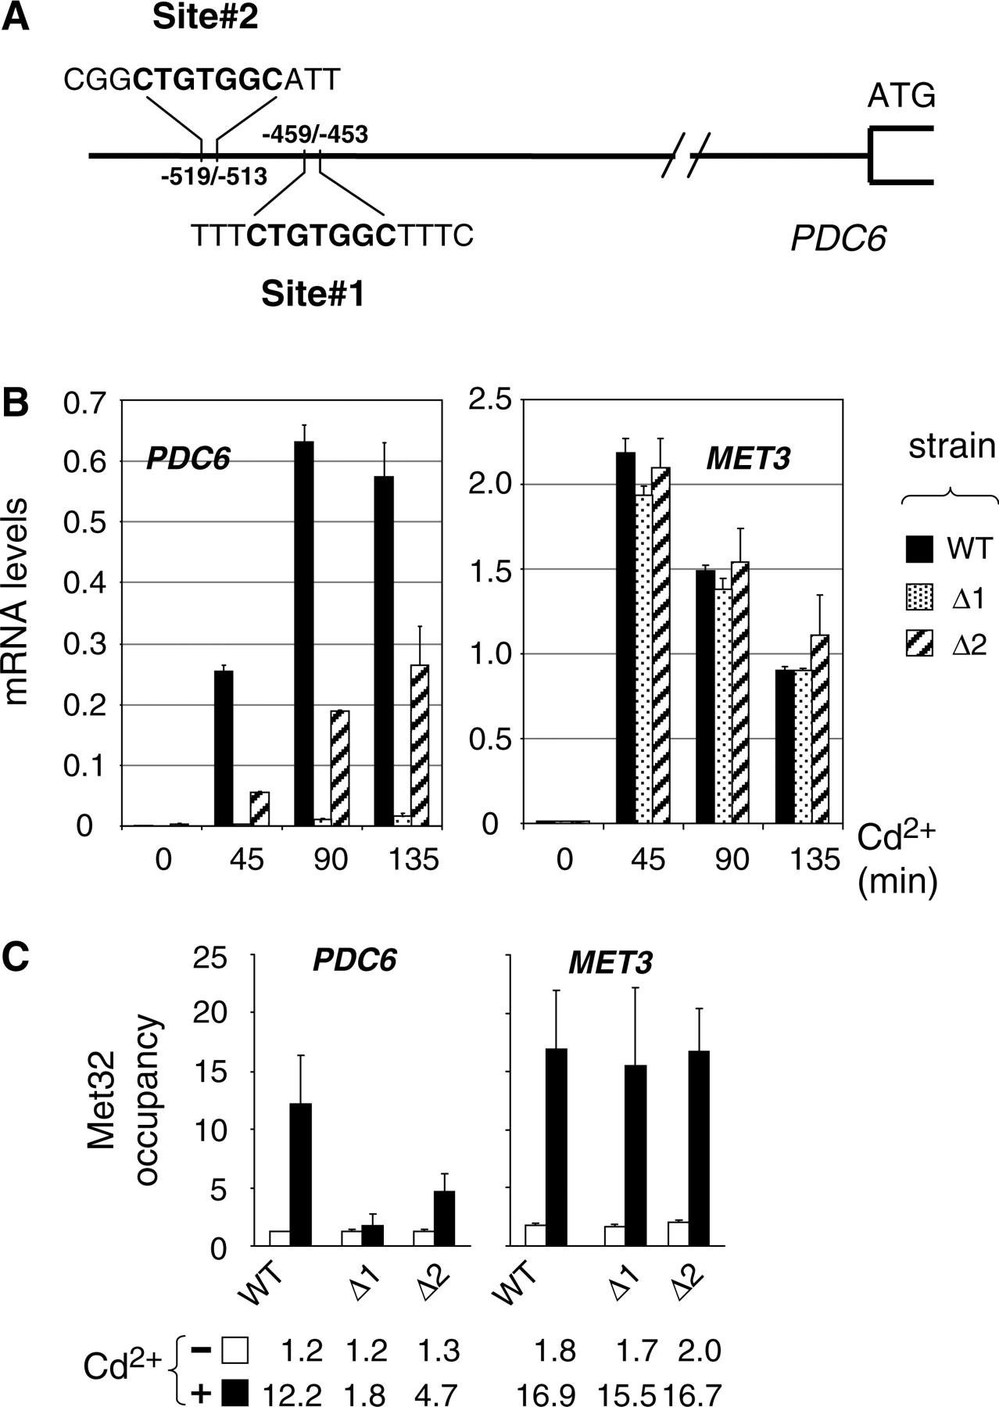
Figure 3. Characterization of PDC6 upstream activating sequences (UAS). ( A ) Schematic of PDC6 promoter. ( B ) Effect ...
Notes:
Figure 3. Characterization of PDC6 upstream activating sequences (UAS). ( A ) Schematic of PDC6 promoter. ( B ) Effect of deletion of the CTGTGGC sequences on PDC6 transcription. Two mutants containing at the chromosome a PDC6-Kan derivative lacking either the first (Δ1) or the second (Δ2) CTGTGGC sequence, and the isogenic WT strain, were grown to early log phase in YPD medium and exposed to 0.5 mM Cd 2+ . Total RNA was extracted from samples taken at the time points indicated and RNA levels were quantified by RT-real time PCR. Values were normalized to 25S ribosomal RNA levels and represent the average of two independent experiments. Error bars indicate average deviations. ( C ) ChIP assay on Met32. The same strains as in (B) were grown to early log phase in YPD medium and exposed to 0.5 mM Cd 2+ . ChIPs were performed on aliquots crosslinked with formaldehyde before (−) or 180 min after Cd 2+ addition (+) using antibodies to Met32. DNA fragments were quantified by real time PCR using primer pairs for the promoter region of PDC6 (−620/−461 relative to ATG) and MET3 . Occupancy levels were calculated as in Figure 1 B. Values represent the average of two independent experiments, and error bars indicate average deviations.
Unless provided in the caption above, the following copyright applies to the content of this slide: © The Author(s) 2010. Published by Oxford University Press.This is an Open Access article distributed under the terms of the Creative Commons Attribution Non-Commercial License (http://creativecommons.org/licenses/by-nc/2.5), which permits unrestricted non-commercial use, distribution, and reproduction in any medium, provided the original work is properly cited.

Slide 4
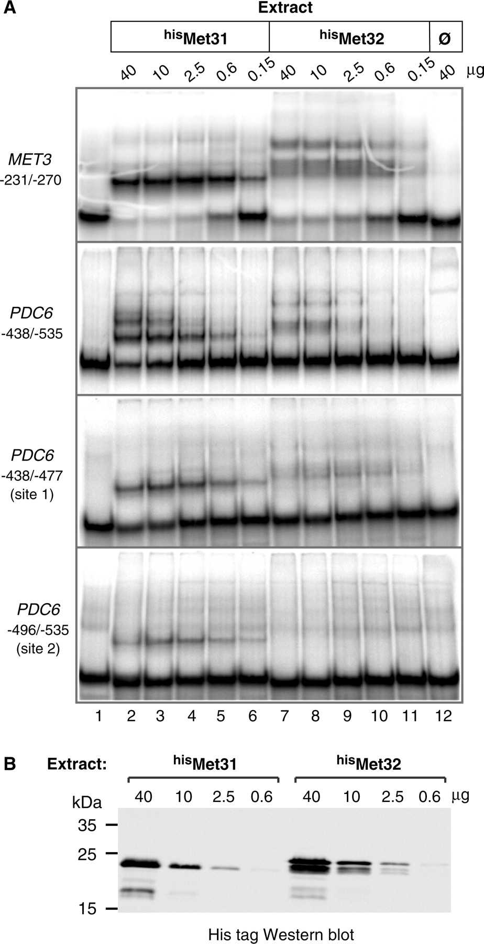
Figure 4. In vitro associations of Met31 and Met32 with PDC6 promoter. ( A ) Gel shift assays. The indicated amounts of ...
Notes:
Figure 4. In vitro associations of Met31 and Met32 with PDC6 promoter. ( A ) Gel shift assays. The indicated amounts of E. coli cell extracts expressing polyhistidine-tagged Met31 and Met32 (lanes 2–6 and 7–11, respectively) or not (lane 12) were incubated with equimolar amounts of the indicated 32 P-labeled DNA fragments. The MET3 fragment contains AAACTGTGGC. The PDC6 fragments contain both CTGTGG sites (second panel) and either of them (third and fourth panel). Fragments were resolved by 5% polyacrylamide gel electrophoresis and visualized by PhosphorImager analysis. ( B ) Western blot. Extracts used in (A) containing his Met31 or his Met32 were separated by 12% SDS–polyacrylamide gel electrophoresis and analyzed by immunoblotting with a monoclonal antibody to the his-tag (Novagen). The calculated molecular weights of his Met31 and his Met32 are 23 226.5 and 25 441, respectively.
Unless provided in the caption above, the following copyright applies to the content of this slide: © The Author(s) 2010. Published by Oxford University Press.This is an Open Access article distributed under the terms of the Creative Commons Attribution Non-Commercial License (http://creativecommons.org/licenses/by-nc/2.5), which permits unrestricted non-commercial use, distribution, and reproduction in any medium, provided the original work is properly cited.

Slide 5
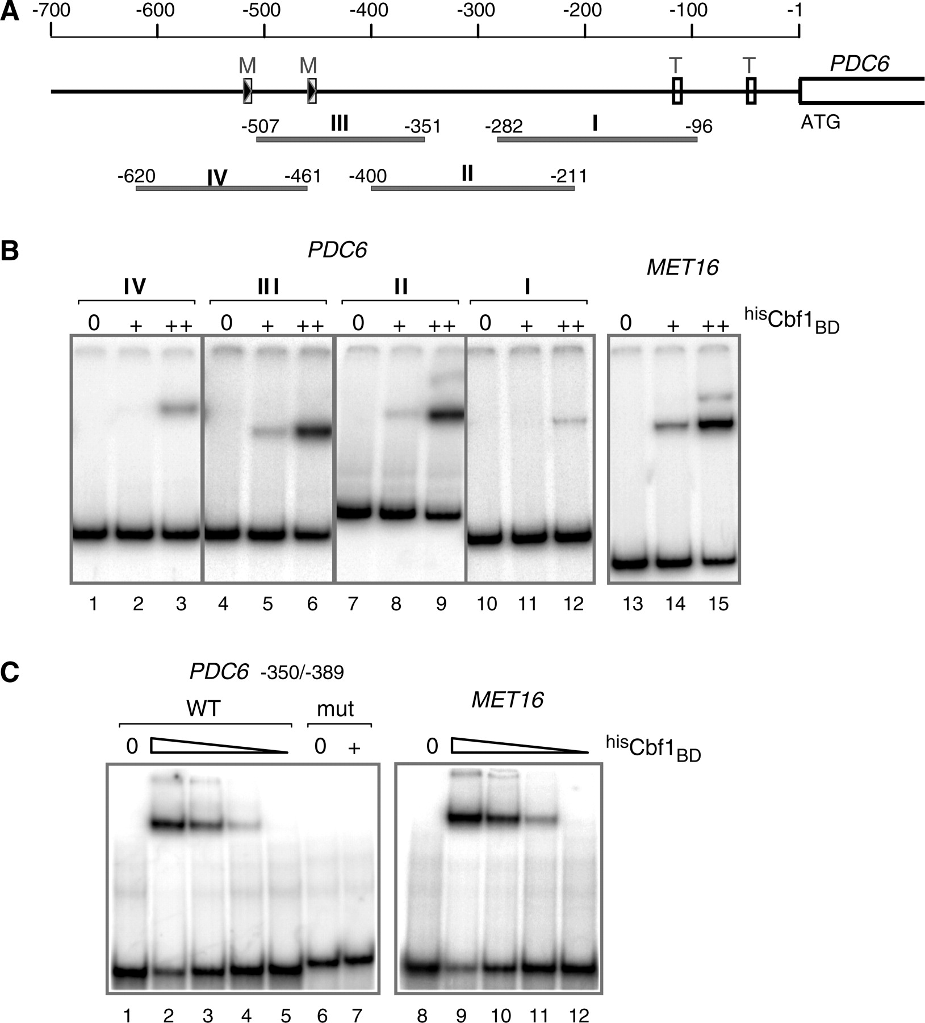
Figure 5. In vitro association of Cbf1 with PDC6 promoter. ( A ) Schematic of PDC6 showing the DNA fragments used in ...
Notes:
Figure 5. In vitro association of Cbf1 with PDC6 promoter. ( A ) Schematic of PDC6 showing the DNA fragments used in the gel shift assay. ‘M’ boxes represent the CTGTGGC motifs. ‘T’ boxes represent the TATA elements. ( B ) Gel shift assays with large DNA fragments. The 32 P-labeled DNA fragments indicated were incubated with 0, 50 and 200 ng of a recombinant derivative of Cbf1 containing the bHLH domain fused to a polyhistidine tag ( his Cbf1 BD ). Fragments were resolved by 5% polyacrylamide gel electrophoresis and visualized by PhosphorImager analysis. The MET16 fragment covers positions from –126 to –270 and contains TCACGTG. ( C ) Gel shift assays with 40 bp DNA fragments. The 32 P-labeled DNA fragments indicated were incubated with 0, 200, 100, 50 and 25 ng of his Cbf1 BD (only 0 and 200 ng in the case of mut PDC6 ). The PDC6 fragment covers positions from –350 to –389 and contains the TCACGTT sequence. The MET16 fragment covers positions from –155 to –194 and contains the TCACGTG sequence. mut PDC6 contains TC CA GTT instead of TCACGTT.
Unless provided in the caption above, the following copyright applies to the content of this slide: © The Author(s) 2010. Published by Oxford University Press.This is an Open Access article distributed under the terms of the Creative Commons Attribution Non-Commercial License (http://creativecommons.org/licenses/by-nc/2.5), which permits unrestricted non-commercial use, distribution, and reproduction in any medium, provided the original work is properly cited.

Slide 6
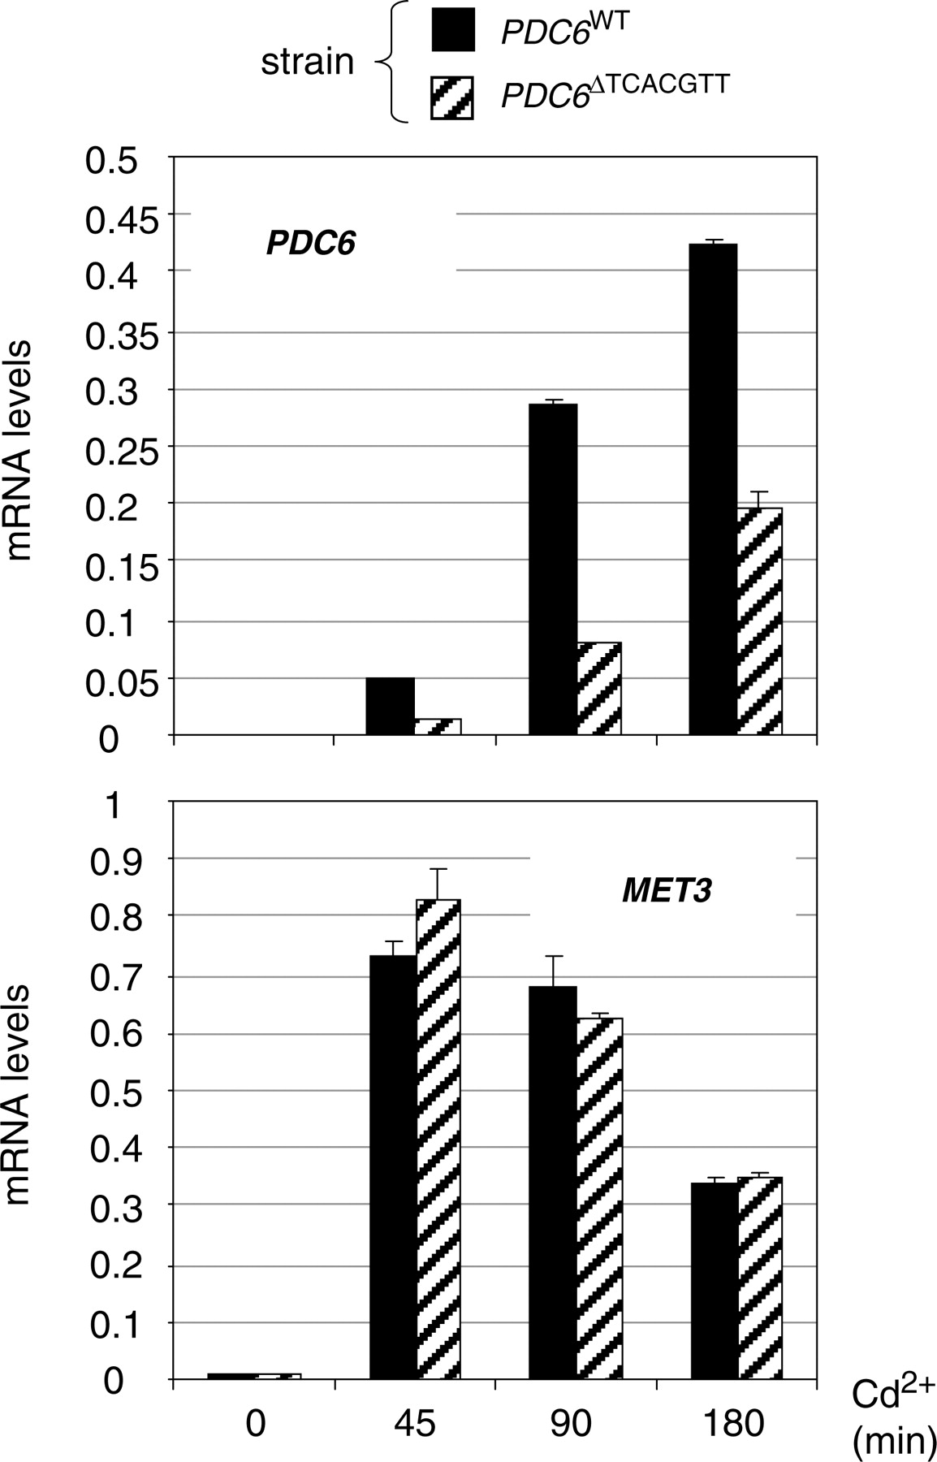
Figure 6. PDC6 transcription in the absence of the TCACGTT motif. pdc6Δ strains containing at the URA3 locus a WT PDC6 ...
Notes:
Figure 6. PDC6 transcription in the absence of the TCACGTT motif. pdc6Δ strains containing at the URA3 locus a WT PDC6 allele or a derivative lacking the TCACGTT sequence were grown to early log phase in YPD medium and exposed to 0.5 mM Cd 2+ . Total RNA was extracted from samples taken at the time points indicated and RNA levels for PDC6 and MET3 were quantified by RT-real time PCR and normalized to 25S ribosomal RNA. Values represent the average of two independent experiments and error bars indicate average deviations.
Unless provided in the caption above, the following copyright applies to the content of this slide: © The Author(s) 2010. Published by Oxford University Press.This is an Open Access article distributed under the terms of the Creative Commons Attribution Non-Commercial License (http://creativecommons.org/licenses/by-nc/2.5), which permits unrestricted non-commercial use, distribution, and reproduction in any medium, provided the original work is properly cited.

Slide 7
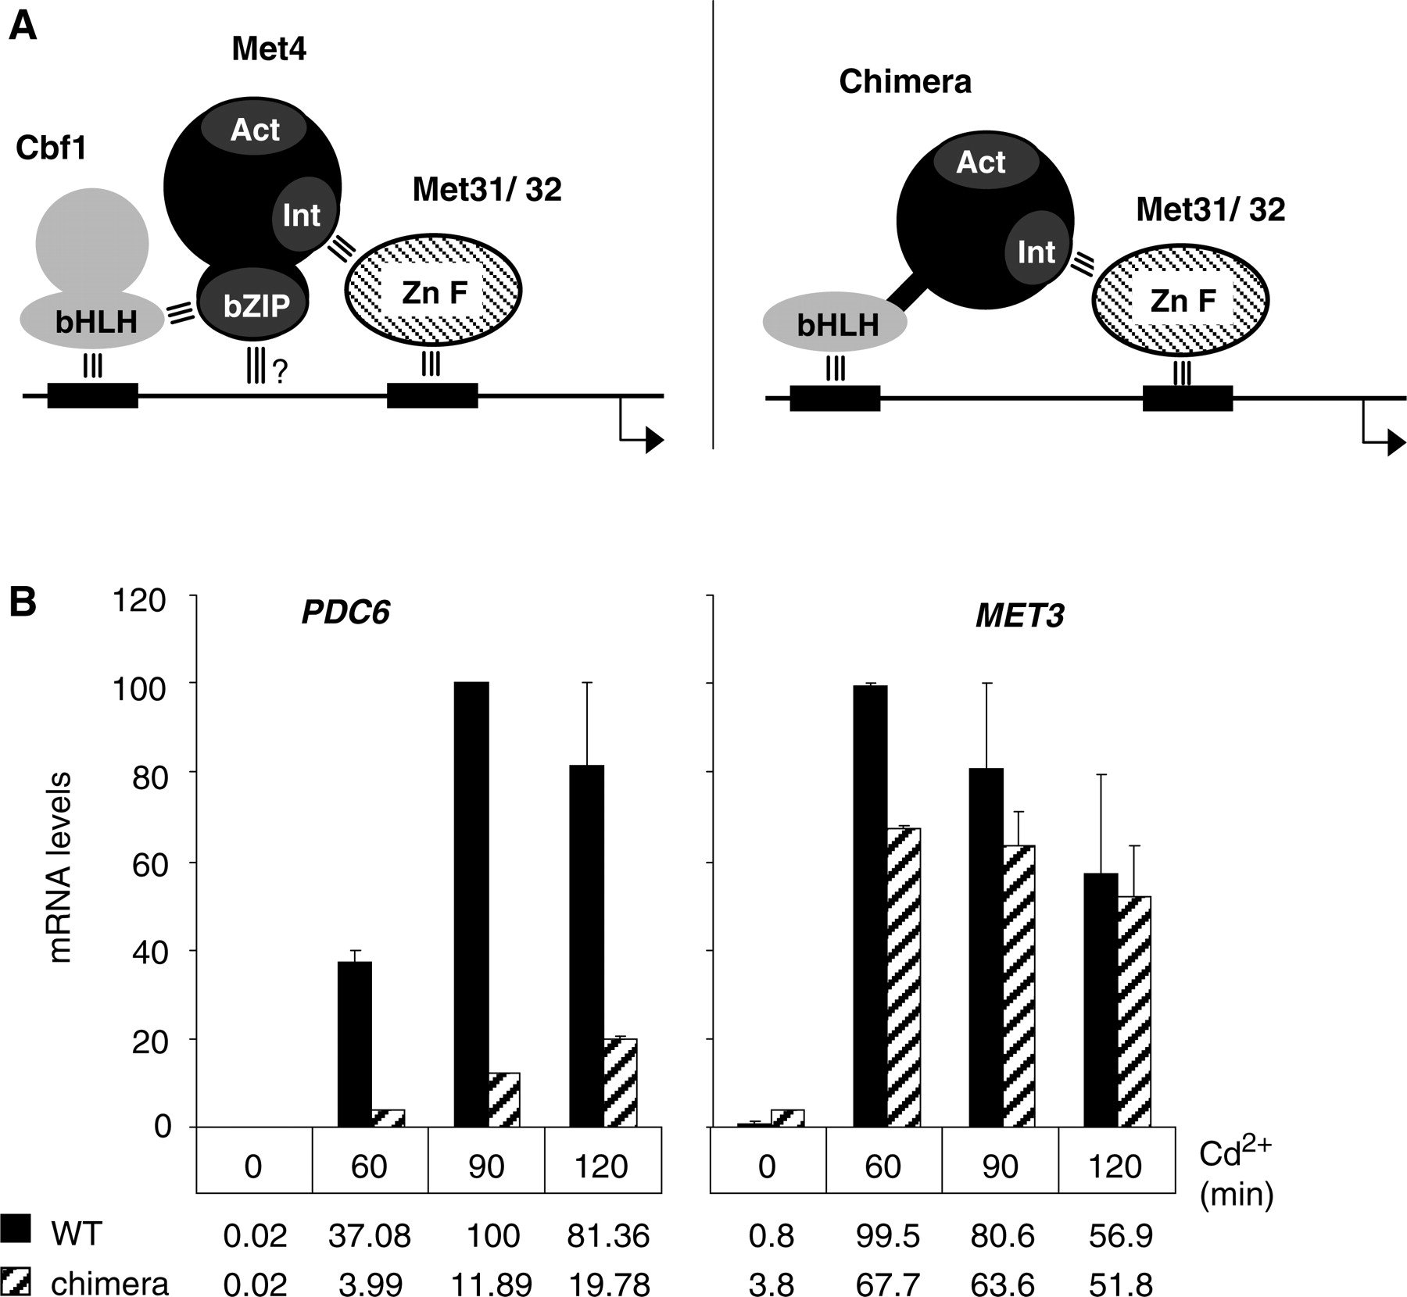
Figure 7. Replacement of Met4 bZIP by Cbf1 bHLH. ( A ) Model scheme for association to MET promoters of Met4 and a ...
Notes:
Figure 7. Replacement of Met4 bZIP by Cbf1 bHLH. ( A ) Model scheme for association to MET promoters of Met4 and a Met4-Cbf1 chimera containing residues 1–590 of Met4 fused to residues 210–351 of Cbf1. ‘Act’ represents Met4 activation domain and ‘Int’ represents Met4 interaction domain with Met31/32. The three parallel bars represent known protein–protein and protein–DNA interactions. ( B ) Transcription analysis in WT and cbf1Δ cells expressing the Met4-Cbf1 derivative described in (A) from MET4 endogenous promoter. Cells were cultivated, exposed to cadmium, and RNA levels were quantified by RT real-time PCR as in Figure 1 A. For comparison, the maximum level for each gene was set to 100. Error bars indicate average deviations from two independent experiments.
Unless provided in the caption above, the following copyright applies to the content of this slide: © The Author(s) 2010. Published by Oxford University Press.This is an Open Access article distributed under the terms of the Creative Commons Attribution Non-Commercial License (http://creativecommons.org/licenses/by-nc/2.5), which permits unrestricted non-commercial use, distribution, and reproduction in any medium, provided the original work is properly cited.

Slide 8
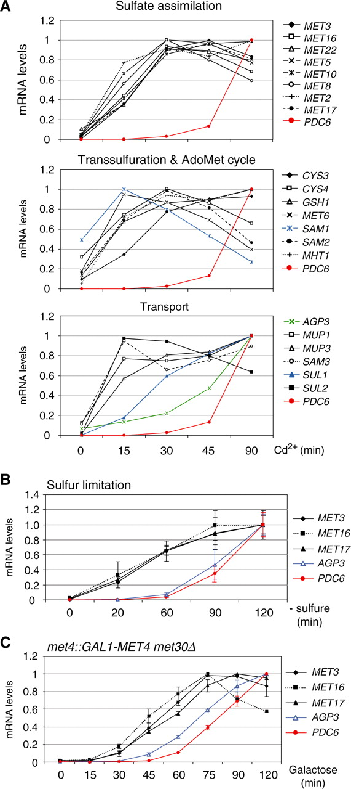
Figure 8. Transcriptional kinetics of PDC6 versus MET genes. ( A ) In response to cadmium . wild-type cells ...
Notes:
Figure 8. Transcriptional kinetics of PDC6 versus MET genes. ( A ) In response to cadmium . wild-type cells were grown to early log phase in YPD medium and exposed to 0.5 mM Cd 2+ . Total RNA was extracted from samples taken at the time points indicated. RNA levels were quantified by RT-real time PCR and normalized to 25S ribosomal RNA. For direct comparison among genes, the maximum value for each gene was set up to 1. Data represent the average of two independent experiments and average deviations were 25% at maximum (error bars were omitted for clarity). Numbers are given in Supplementary Table S1 . ( B ) In response to sulfur limitation. Cells were cultivated and RNA was analyzed as in Figure 2 A. ( C ) In the GAL1-MET4 met30Δ strain. Cells were cultivated and RNA was analyzed as in Figure 2 B.
Unless provided in the caption above, the following copyright applies to the content of this slide: © The Author(s) 2010. Published by Oxford University Press.This is an Open Access article distributed under the terms of the Creative Commons Attribution Non-Commercial License (http://creativecommons.org/licenses/by-nc/2.5), which permits unrestricted non-commercial use, distribution, and reproduction in any medium, provided the original work is properly cited.

Slide 9
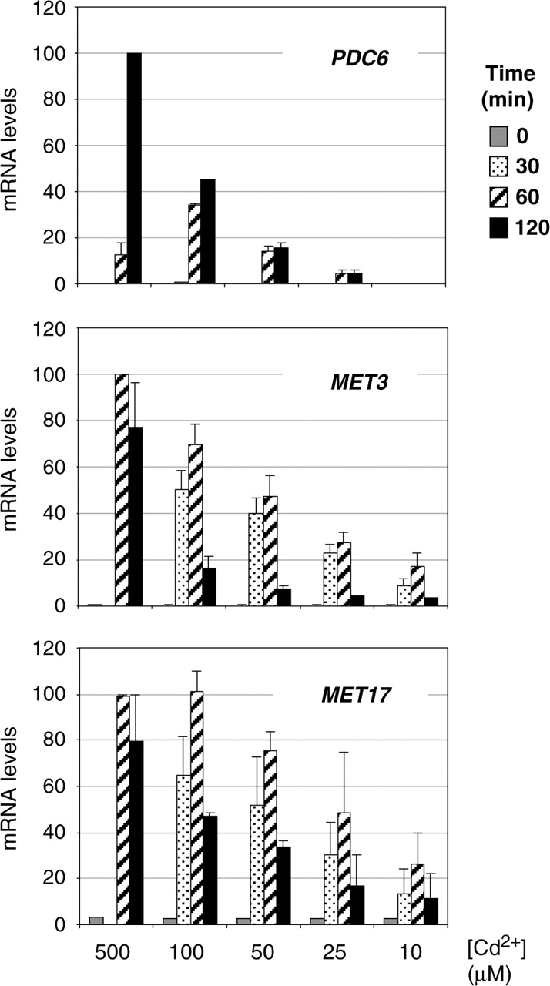
Figure 9. Dose–response relations between cadmium concentrations and transcription levels. WT cells grown to early log ...
Notes:
Figure 9. Dose–response relations between cadmium concentrations and transcription levels. WT cells grown to early log phase in YPD medium were exposed to various concentrations of Cd 2+ . Total RNA was extracted from samples taken at the time points indicated (no sample was taken at 30 min in the culture exposed to 500 µM Cd 2+ ). RNA levels for PDC6 , MET3 and MET17 were quantified by RT-real time PCR and normalized to 25S ribosomal RNA. Maximum values for each gene were set to 100 to facilitate comparisons. Error bars indicate average deviations from two independent experiments.
Unless provided in the caption above, the following copyright applies to the content of this slide: © The Author(s) 2010. Published by Oxford University Press.This is an Open Access article distributed under the terms of the Creative Commons Attribution Non-Commercial License (http://creativecommons.org/licenses/by-nc/2.5), which permits unrestricted non-commercial use, distribution, and reproduction in any medium, provided the original work is properly cited.

Slide 10
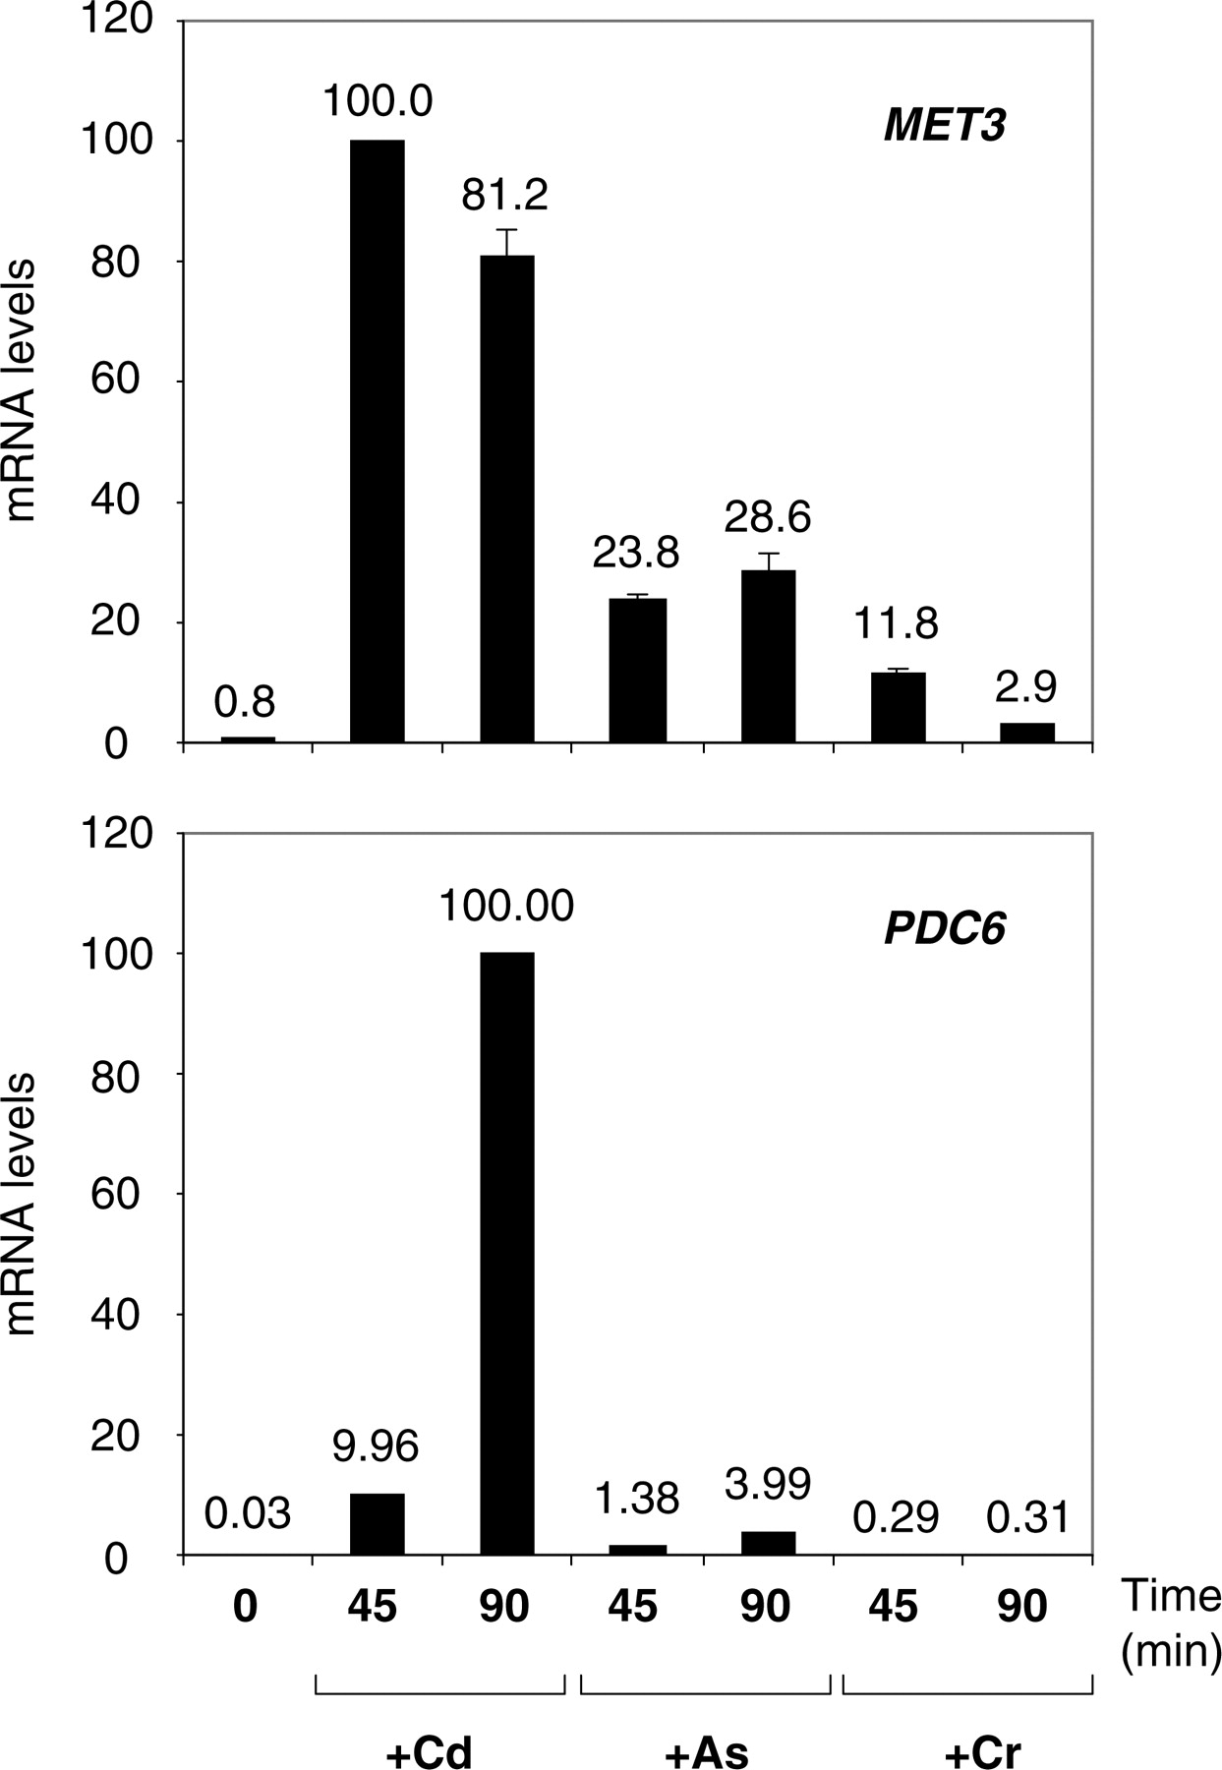
Figure 10. Response to cadmium versus arsenic and chromium. WT cells grown to early log phase in YPD medium were ...
Notes:
Figure 10. Response to cadmium versus arsenic and chromium. WT cells grown to early log phase in YPD medium were exposed to 0.5 mM Cd(CH 3 COO) 2 , 2.5 mM NaAsO 2 or 5 mM CrO 3 . Total RNA was extracted from samples taken before or 45 and 90 min after exposure. RNA levels for MET3 and PDC6 were quantified by RT-real time PCR and normalized to 25S ribosomal RNA. Maximum values for each gene were set to 100 to facilitate comparisons. Error bars indicate average deviations from two independent experiments.
Unless provided in the caption above, the following copyright applies to the content of this slide: © The Author(s) 2010. Published by Oxford University Press.This is an Open Access article distributed under the terms of the Creative Commons Attribution Non-Commercial License (http://creativecommons.org/licenses/by-nc/2.5), which permits unrestricted non-commercial use, distribution, and reproduction in any medium, provided the original work is properly cited.

Slide 11
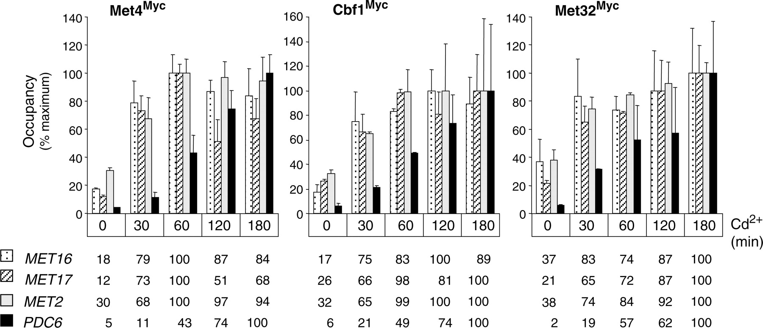
Figure 11. Association of Met4, Cbf1 and Met32 with promoters in response to Cd ²⁺ . Isogenic strains ...
Notes:
Figure 11. Association of Met4, Cbf1 and Met32 with promoters in response to Cd 2+ . Isogenic strains expressing Myc-tagged versions of Met4, Cbf1 or Met32 were grown to early log phase in YPD medium and exposed to 0.5 mM Cd 2+ . ChIPs were performed on samples crosslinked with formaldehyde at the time points indicated using Myc antibodies. DNA fragments were quantified by real-time PCR using primers for the indicated promoters and for IME2 ORF as a control. Occupancy levels were calculated as in Figure 1 B but are given for each gene as a percentage of the maximum value obtained in the time course. Error bars indicate average deviations from two independent experiments.
Unless provided in the caption above, the following copyright applies to the content of this slide: © The Author(s) 2010. Published by Oxford University Press.This is an Open Access article distributed under the terms of the Creative Commons Attribution Non-Commercial License (http://creativecommons.org/licenses/by-nc/2.5), which permits unrestricted non-commercial use, distribution, and reproduction in any medium, provided the original work is properly cited.

Slide 12
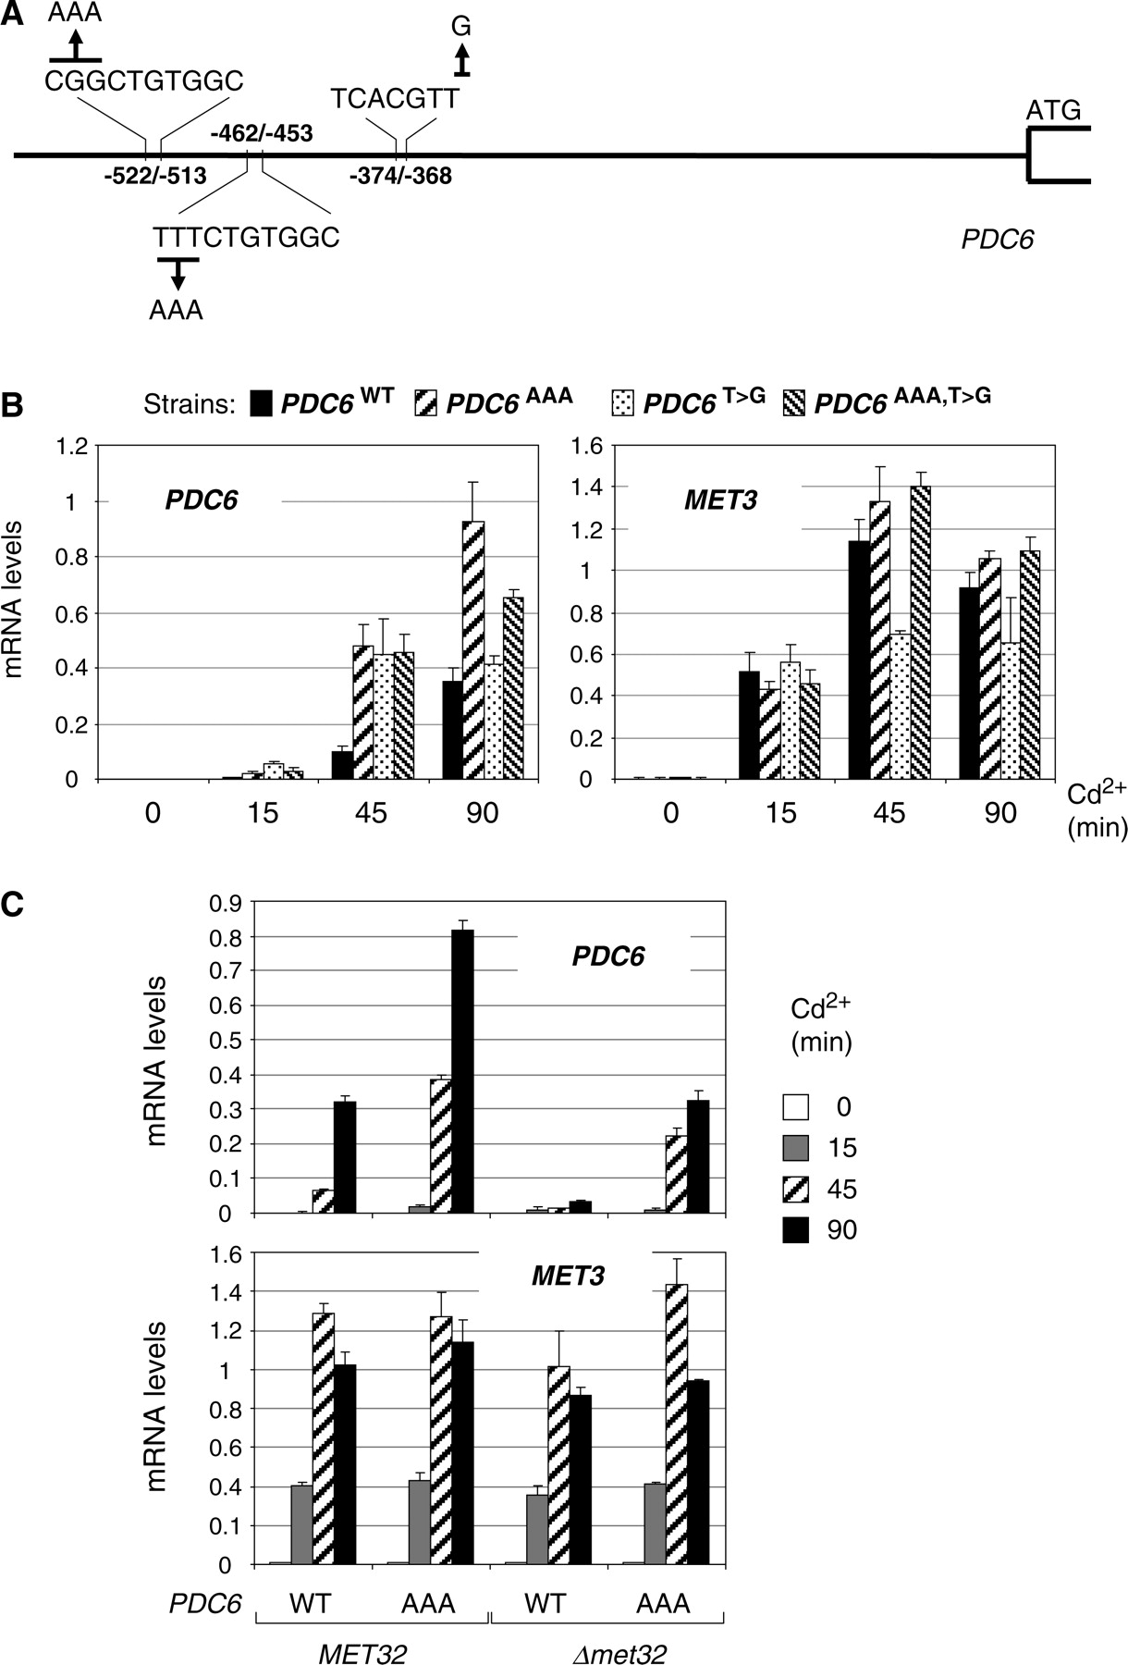
Figure 12. Mutagenesis of PDC6 promoter. ( A ) Schematic diagram showing base changes introduced in PDC6 promoter. ( B ...
Notes:
Figure 12. Mutagenesis of PDC6 promoter. ( A ) Schematic diagram showing base changes introduced in PDC6 promoter. ( B ) pdc6Δ strains containing at the URA3 locus a WT allele of PDC6 or mutant derivatives containing either a A-triplet upstream the two CTGTGGC motifs, or TCACGTG instead of TCACGTT, or both changes, were grown to early log phase in YPD medium and exposed to 0.5 mM Cd 2+ . Total RNA was extracted from samples taken at the time points indicated. RNA levels for PDC6 and MET3 were quantified by RT-real time PCR and normalized to 25S ribosomal RNA. Values represent the average of two independent experiments and error bars indicate average deviations. ( C ) MET32 and met32Δ strains containing the WT allele of PDC6 or the derivative with the AAACTGTGGC motifs were manipulated as in (B).
Unless provided in the caption above, the following copyright applies to the content of this slide: © The Author(s) 2010. Published by Oxford University Press.This is an Open Access article distributed under the terms of the Creative Commons Attribution Non-Commercial License (http://creativecommons.org/licenses/by-nc/2.5), which permits unrestricted non-commercial use, distribution, and reproduction in any medium, provided the original work is properly cited.

Slide 13
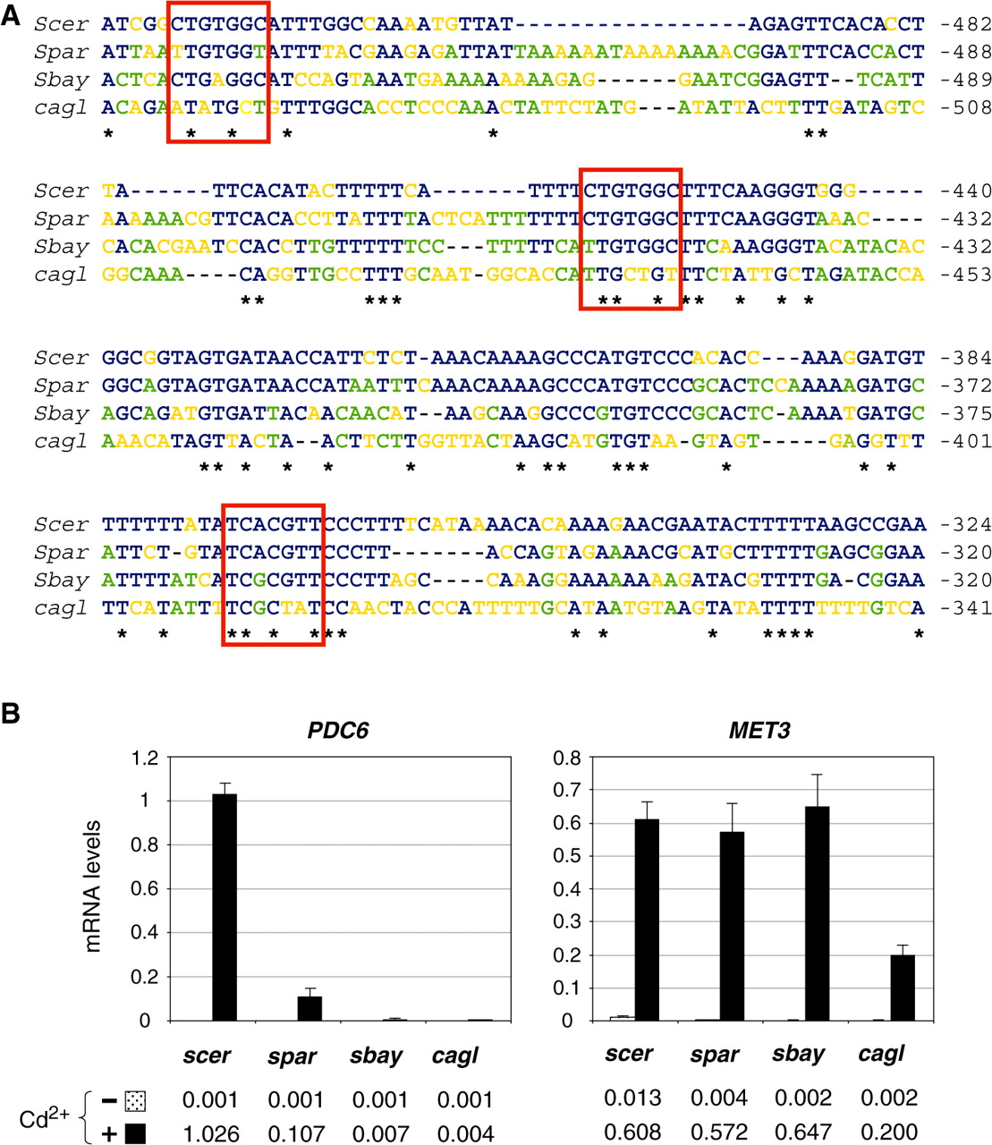
Figure 13. Transcriptional regulation of PDC6 in S. cerevisiae relatives. ( A ) Sequence alignment. PDC6 orthologs in ...
Notes:
Figure 13. Transcriptional regulation of PDC6 in S. cerevisiae relatives. ( A ) Sequence alignment. PDC6 orthologs in S. cerevisiae (YGR087C), S. paradoxus (spar6-g11.1), S. bayanus (sbayc642-g17.1) and C. glabrata (CAGL02937) were aligned with Clustal W. Fully conserved positions are marked by an asterisk. Positions conserved among S. cerevisiae and at least one other species are marked in blue. Positions conserved among several species except S. cerevisiae are marked in green. Positions occupied by different nucleotides are marked in orange. Binding sites for Met31/32 and Cbf1 are marked by red boxes. ( B ) Saccharomyces cerevisiae (W303-1A), S. paradoxus (CLIB228), S. bayanus (CLIB181) and C. glabrata (CLIB298) strains were grown to early log phase in YPD medium and exposed to 0.5 mM Cd 2+ . Total RNA was extracted from samples taken just before (−) or 120 min (+) after the addition of cadmium. RNA levels for PDC6 and MET3 orthologs were quantified by RT real-time PCR and normalized to 25S ribosomal RNA. Values represent the average of three independent experiments and error bars indicate average deviations.
Unless provided in the caption above, the following copyright applies to the content of this slide: © The Author(s) 2010. Published by Oxford University Press.This is an Open Access article distributed under the terms of the Creative Commons Attribution Non-Commercial License (http://creativecommons.org/licenses/by-nc/2.5), which permits unrestricted non-commercial use, distribution, and reproduction in any medium, provided the original work is properly cited.

Slide 14
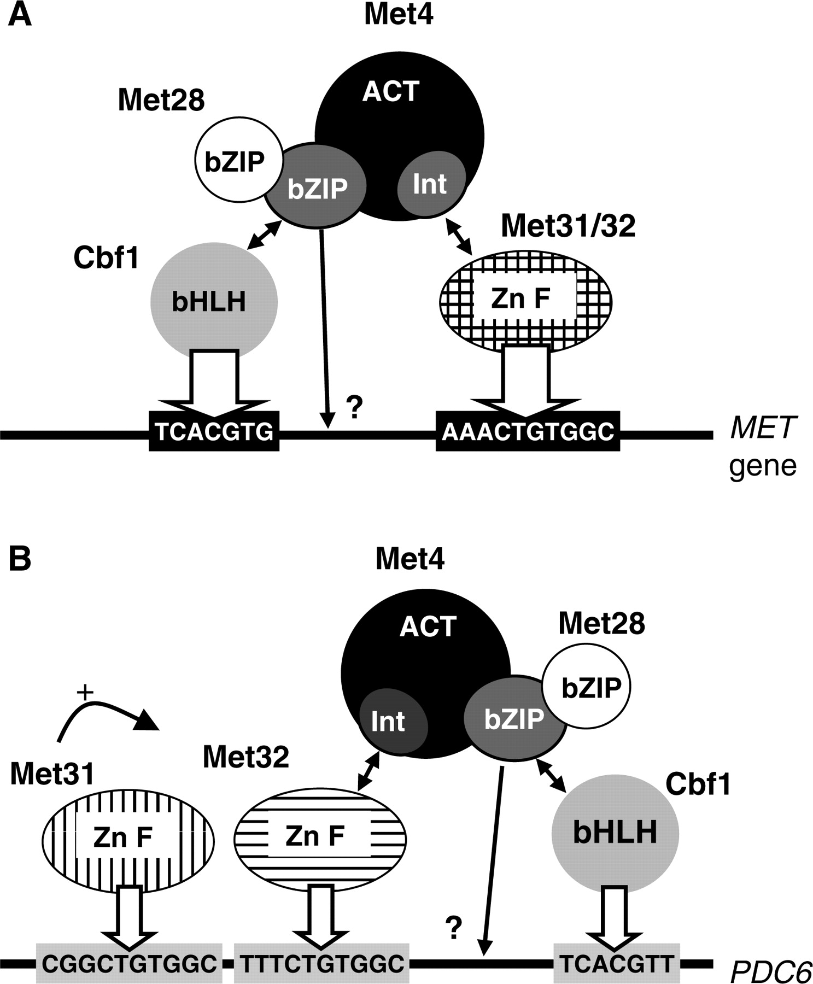
Figure 14. Models for Met4 recruitment to MET ( A ) versus PDC6 ( B ) promoters. Met4 recruitment involves direct ...
Notes:
Figure 14. Models for Met4 recruitment to MET ( A ) versus PDC6 ( B ) promoters. Met4 recruitment involves direct interactions with Cbf1 (through the bZIP domain) and Met31 or Met32 (through the ‘Int’ domain). Met28 associates with Met4 bZIP and participates in Met4 recruitment through stabilization of the Met4–Cbf1–DNA complex (see text for details and references). The question marks at the extremity of the arrows originating from Met4 bZIP indicate that, even though direct interactions with promoter DNA are likely [see ref. ( 16 )], the precise points of contact remain to be established. At PDC6 promoter, Met31 and Met32 bind to two distinct sites. Met4 recruitment to this promoter requires interaction with Met32 specifically, and Met31 participates by assisting Met32 association with its binding site. The width of the arrows pointing toward Cbf1 and Met31/32 DNA binding sites translate the strength of the interaction, which differs between MET and PDC6 promoters.
Unless provided in the caption above, the following copyright applies to the content of this slide: © The Author(s) 2010. Published by Oxford University Press.This is an Open Access article distributed under the terms of the Creative Commons Attribution Non-Commercial License (http://creativecommons.org/licenses/by-nc/2.5), which permits unrestricted non-commercial use, distribution, and reproduction in any medium, provided the original work is properly cited.

