Slide 1
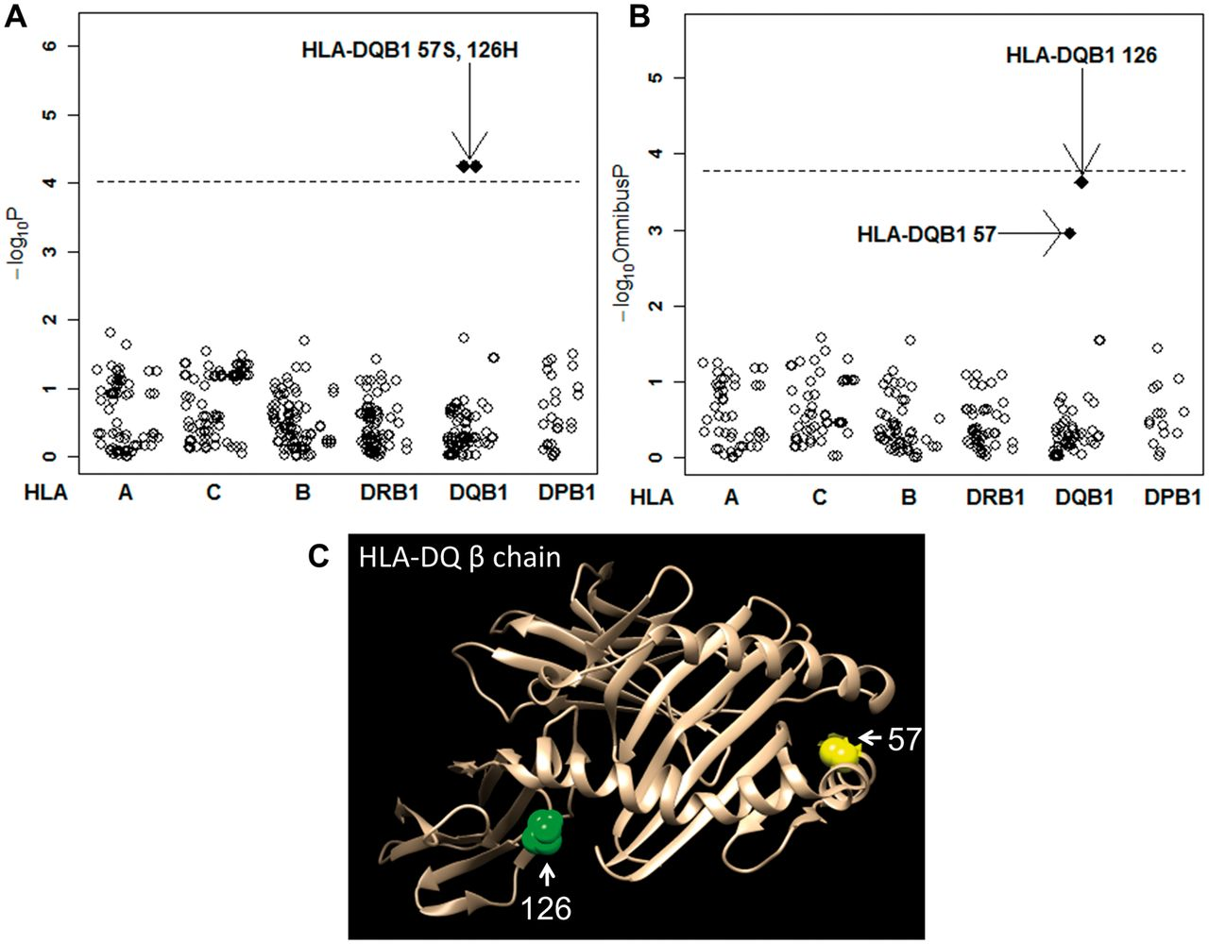
F ig . 1 Suggestive involvement of amino acid position 57 or 126 in the HLA-DQB1 protein with RPC Results for amino ...
Notes:
F ig . 1 Suggestive involvement of amino acid position 57 or 126 in the HLA-DQB1 protein with RPC Results for amino acid analyses of residues ( A ) and positions ( B ) are indicated. Each plot represents each amino acid residue variation ( A ) and position ( B ). The dashed horizontal lines indicate significant levels based on Bonferroni’s correction (P = 0.00010 and 0.00017 for alleles and amino acid positions, respectively.) ( C ) Three dimensional structure of HLA-DQB1 and the amino acid positions 57 and 126 are indicated.
Unless provided in the caption above, the following copyright applies to the content of this slide: © The Author 2016. Published by Oxford University Press on behalf of the British Society for Rheumatology. All rights reserved. For Permissions, please email: journals.permissions@oup.com

