Slide 1
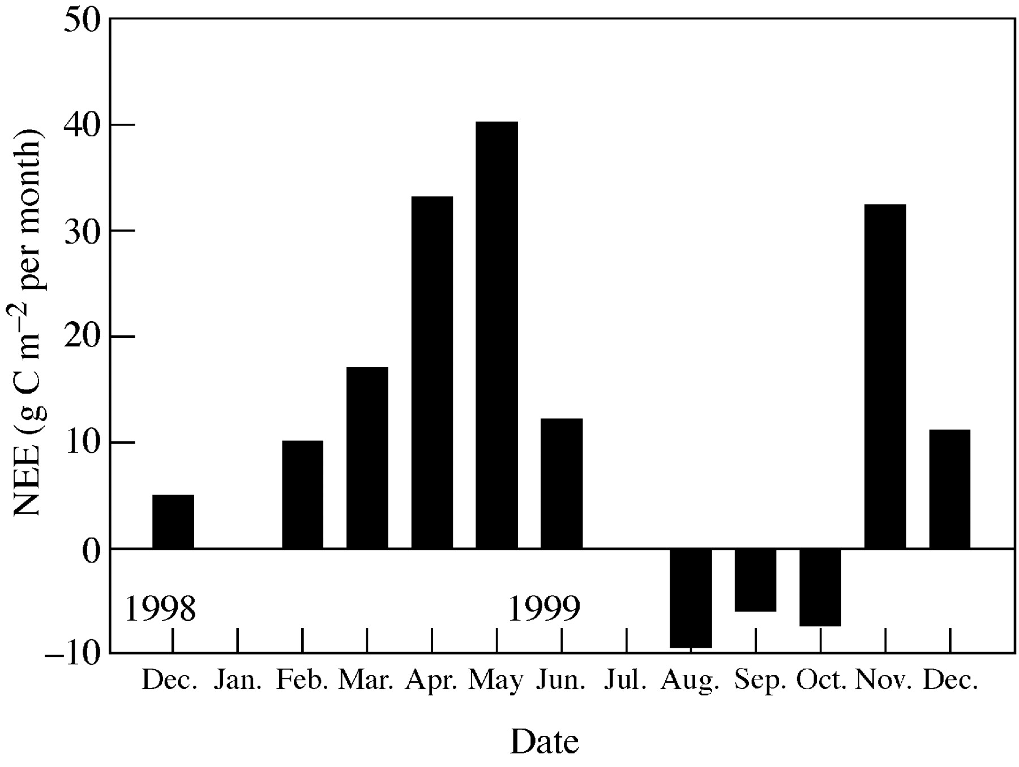
Fig. 1. Net ecosystem exchange (NCE) (in g m^{–2} per month) by the ecosystem consisting of an ...
Notes:
Fig. 1. Net ecosystem exchange (NCE) (in g m–2 per month) by the ecosystem consisting of an evergreen oak woodland (‘montado’) in Évora, southern Portugal, from December 1998 to December 1999. Measurements were done by the eddy covariance method (M. Rayment et al. unpubl. res.).
Unless provided in the caption above, the following copyright applies to the content of this slide:

Slide 2
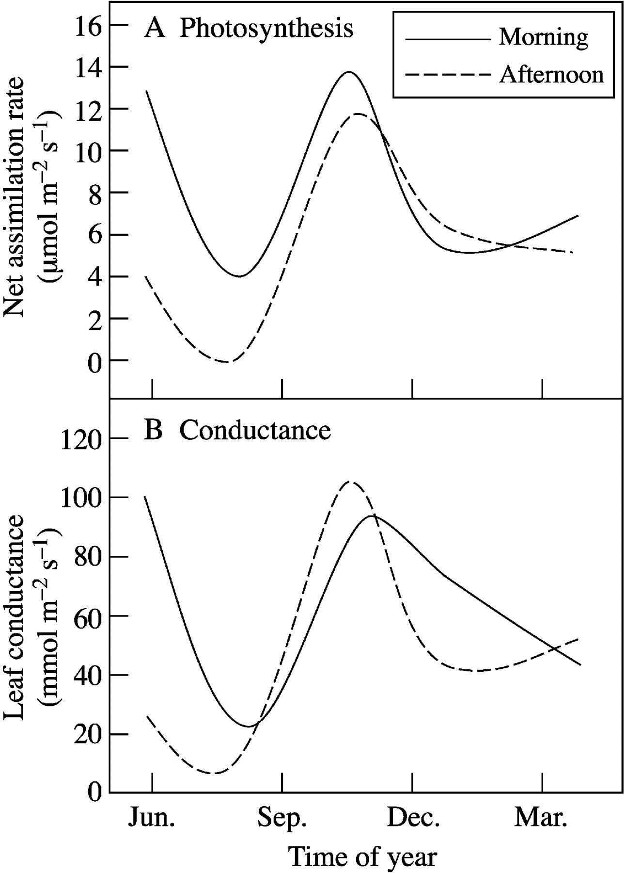
Fig. 2. Seasonal variation in net photosynthetic rate (A) and in leaf conductance (B) of Quercus suber, ...
Notes:
Fig. 2. Seasonal variation in net photosynthetic rate (A) and in leaf conductance (B) of Quercus suber, measured in the morning and afternoon, in southern Portugal.
Unless provided in the caption above, the following copyright applies to the content of this slide:

Slide 3
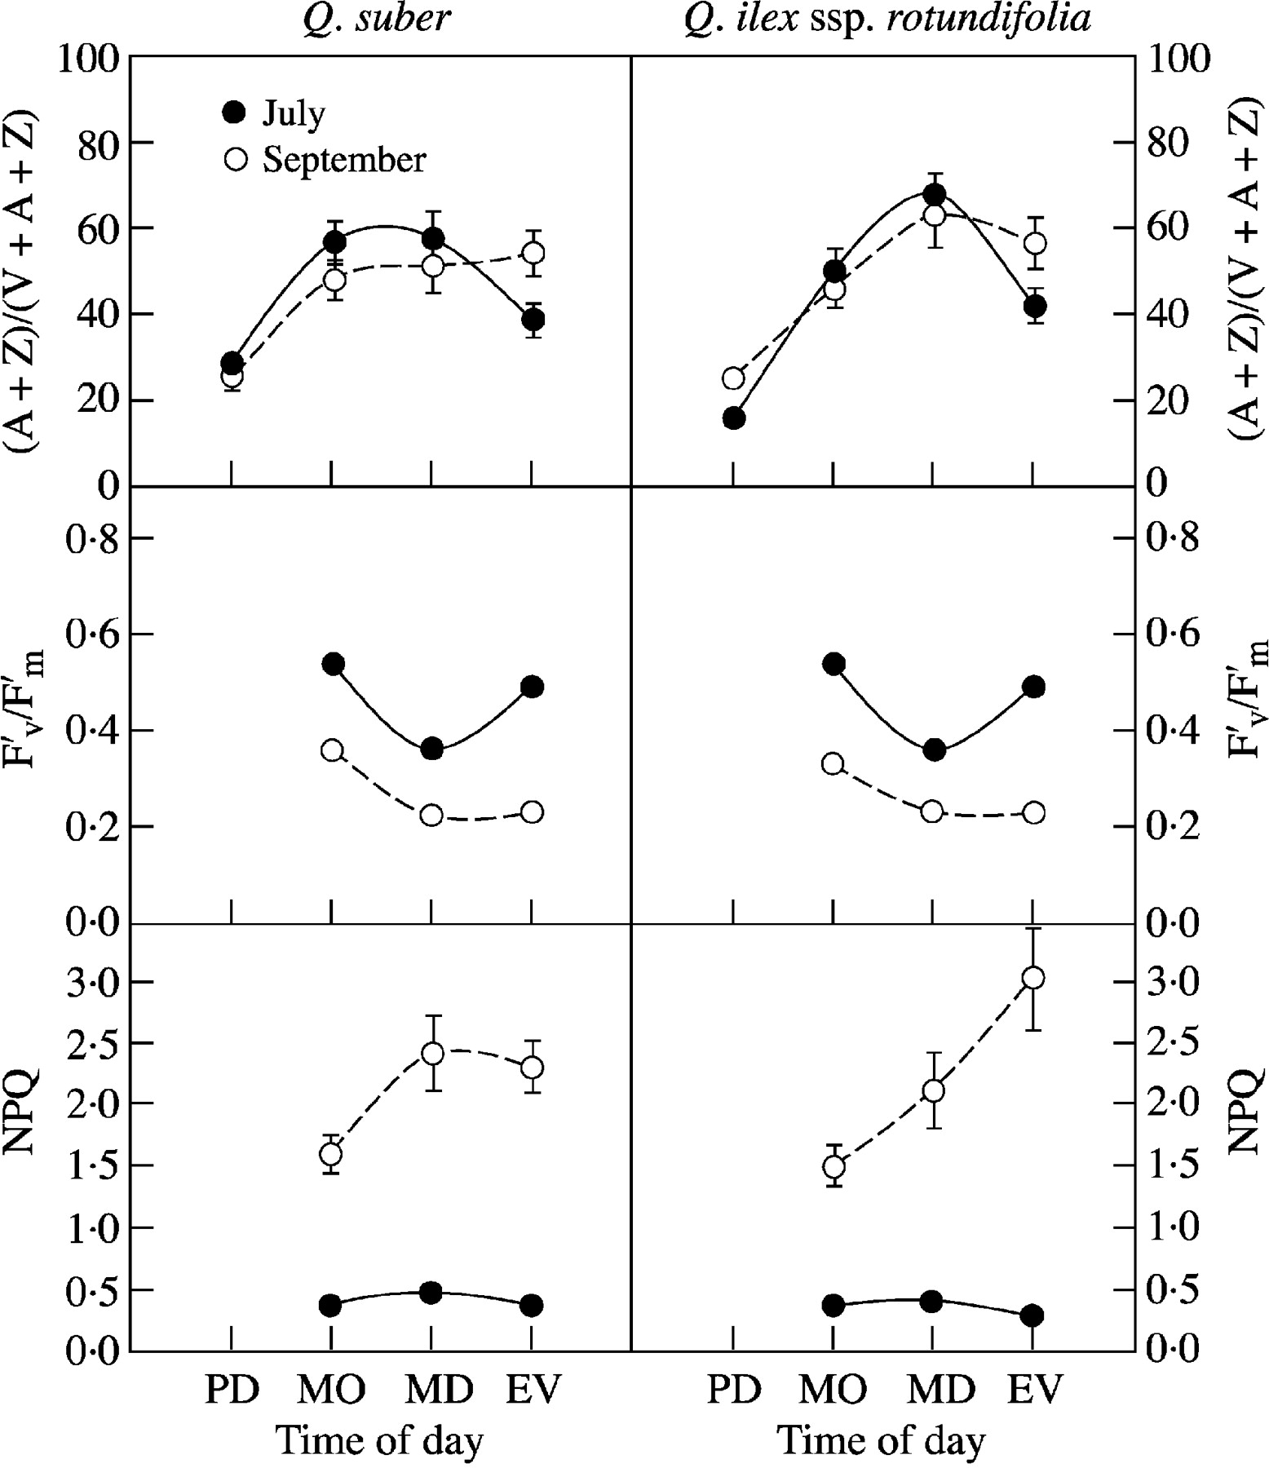
Fig. 3. Diurnal time course of the ratio of xanthophylls (A + Z)/(V + A + Z), PSII efficiency ...
Notes:
Fig. 3. Diurnal time course of the ratio of xanthophylls (A + Z)/(V + A + Z), PSII efficiency (F′v/F′m) and non‐photochemical quenching of chlorophyll a fluorescence (NPQ) in sun leaves of Quercus suber and Quercus ilex ssp. rotundifolia in early July (closed symbols) and September (open symbols). The data are means ± s.e. of 12 leaves from three different trees with comparable exposure. A, antheraxanthin; Z, zeaxanthin; V, violaxanthin; PD, pre‐dawn; MO, morning; MD, midday; EV, evening. (Adapted from Faria et al., 1998.)
Unless provided in the caption above, the following copyright applies to the content of this slide:

Slide 4
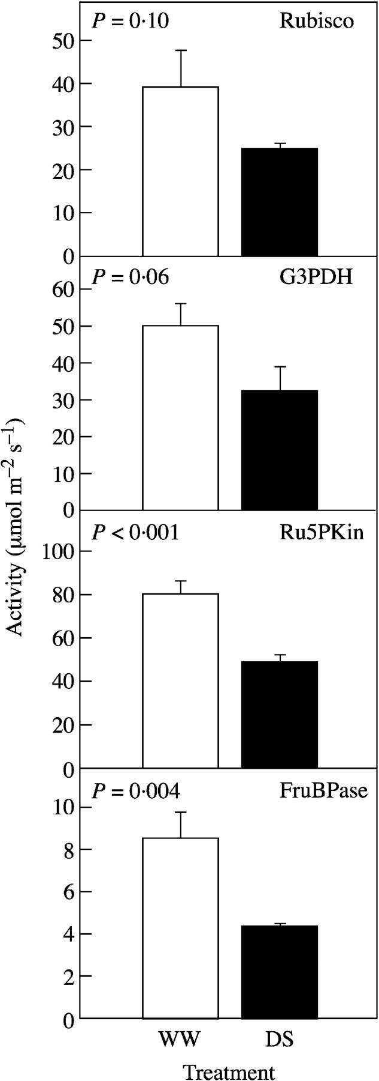
Fig. 4.In vitro activities of key enzymes of C metabolism; Rubisco, G3PDH, Ru5Pkin and FruBPase in ...
Notes:
Fig. 4.In vitro activities of key enzymes of C metabolism; Rubisco, G3PDH, Ru5Pkin and FruBPase in well‐watered (open bars) and drought‐stressed grapevine (closed bars) in the middle of the summer in Évora, Portugal. Values are means ± s.e. (From Maroco et al., 2002).
Unless provided in the caption above, the following copyright applies to the content of this slide:

Slide 5
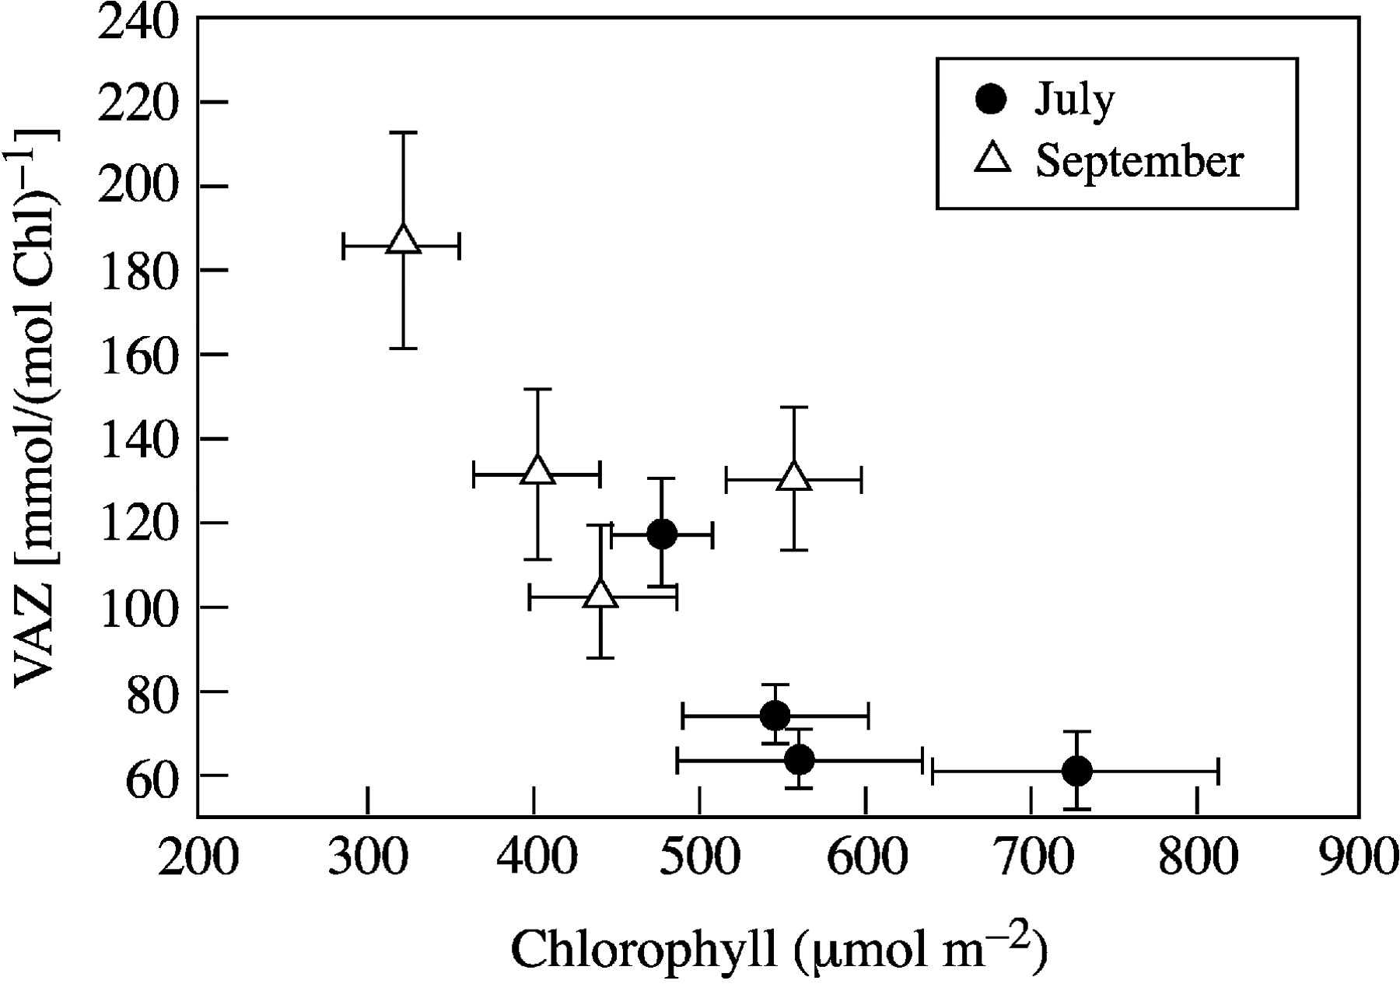
Fig. 5. Relationship between the amount of VAZ (violaxanthin, antheraxanthin and zeaxanthin) pool compounds ...
Notes:
Fig. 5. Relationship between the amount of VAZ (violaxanthin, antheraxanthin and zeaxanthin) pool compounds and total chlorophyll in sun leaves of Quercus suber, Quercus ilex ssp. rotundifolia, Olea europaea and Eucalyptusglobulus trees in early July (closed symbols) and September (open symbols) (r2 = 0·67). Data are means ± s.e. for six leaves from three different trees with comparable exposure. (Adapted from Faria et al., 1998.)
Unless provided in the caption above, the following copyright applies to the content of this slide:

Slide 6
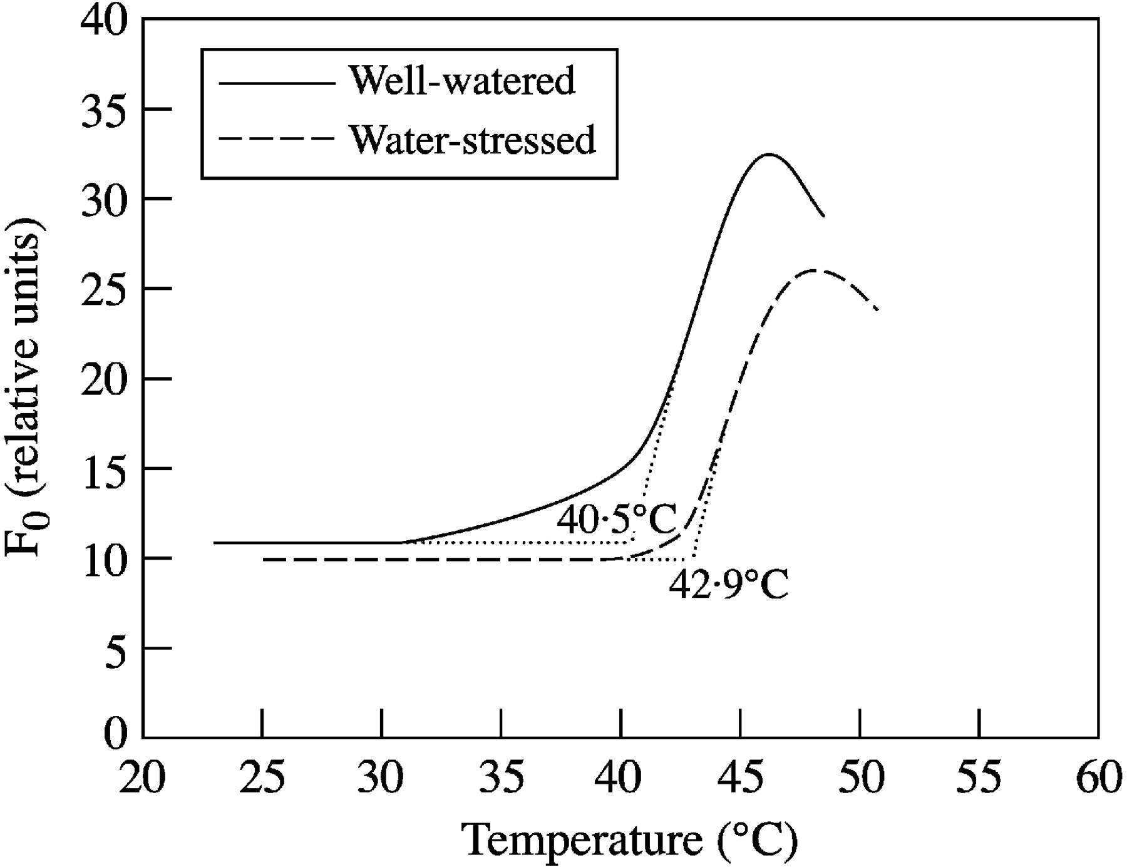
Fig. 6. Response of basal chlorophyll a fluorescence (F₀) to leaf temperature in well‐watered and ...
Notes:
Fig. 6. Response of basal chlorophyll a fluorescence (F0) to leaf temperature in well‐watered and water‐stressed Lupinus albus L.
Unless provided in the caption above, the following copyright applies to the content of this slide:

Slide 7
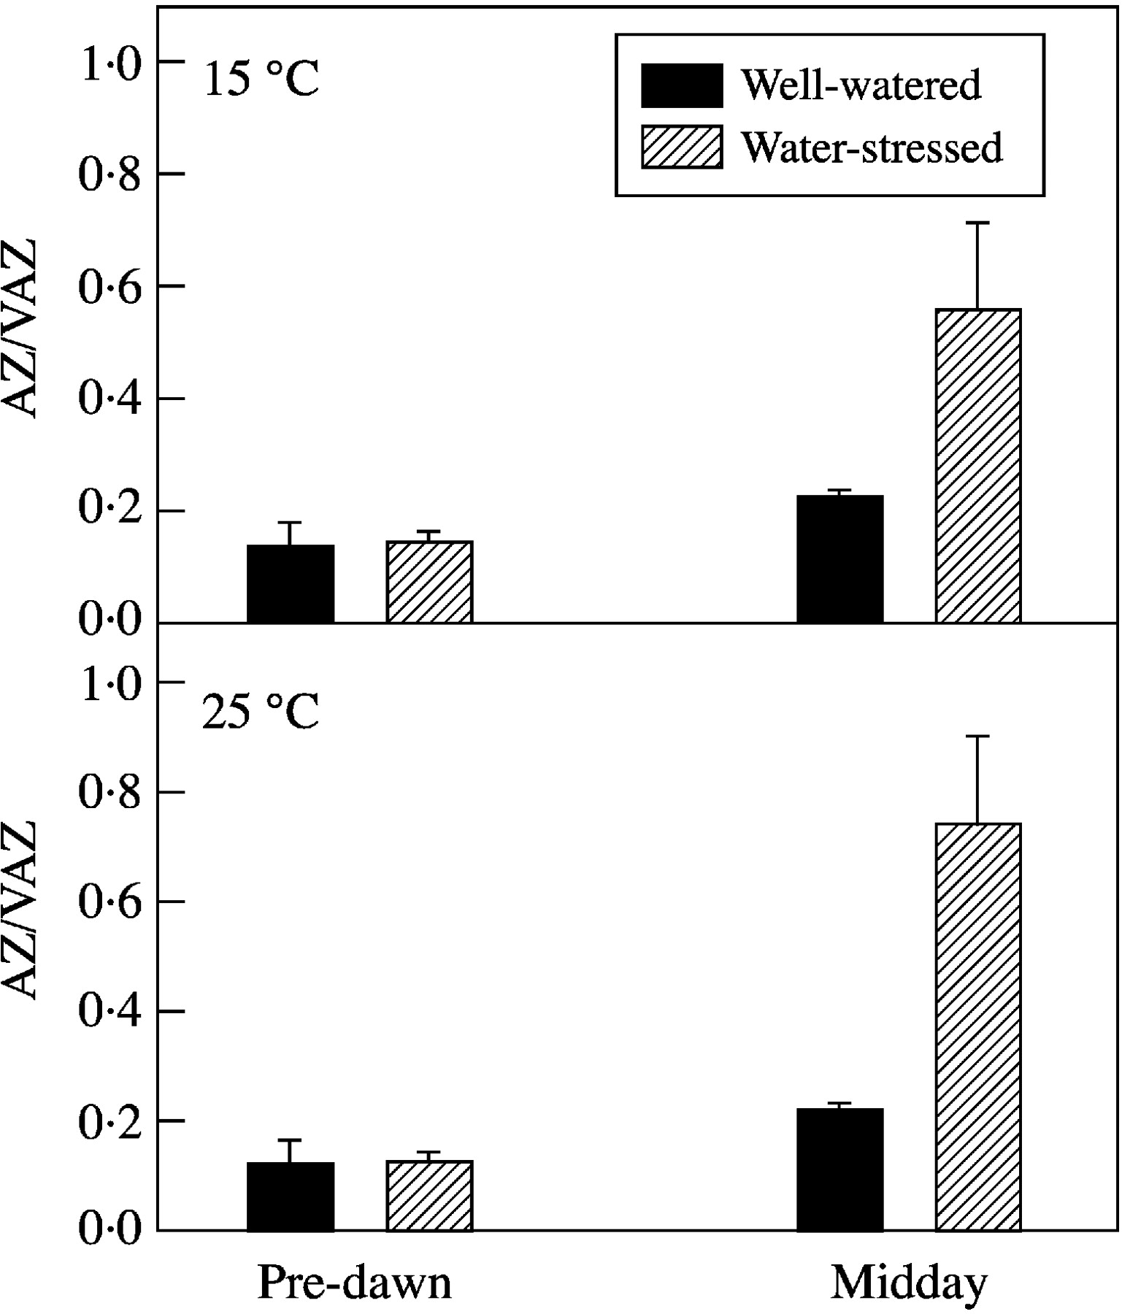
Fig. 7. Ratio of concentrations of the xanthophyll pigments antheraxanthin + zeaxanthin (AZ) to the total ...
Notes:
Fig. 7. Ratio of concentrations of the xanthophyll pigments antheraxanthin + zeaxanthin (AZ) to the total xanthophyll pool (violaxanthin + antheraxanthin + zeaxanthin, VAZ), measured pre‐dawn and at midday in well‐watered and water‐stressed Lupinus albus L. grown at 15/10 °C and 25/20 °C (day/night).
Unless provided in the caption above, the following copyright applies to the content of this slide:

Slide 8
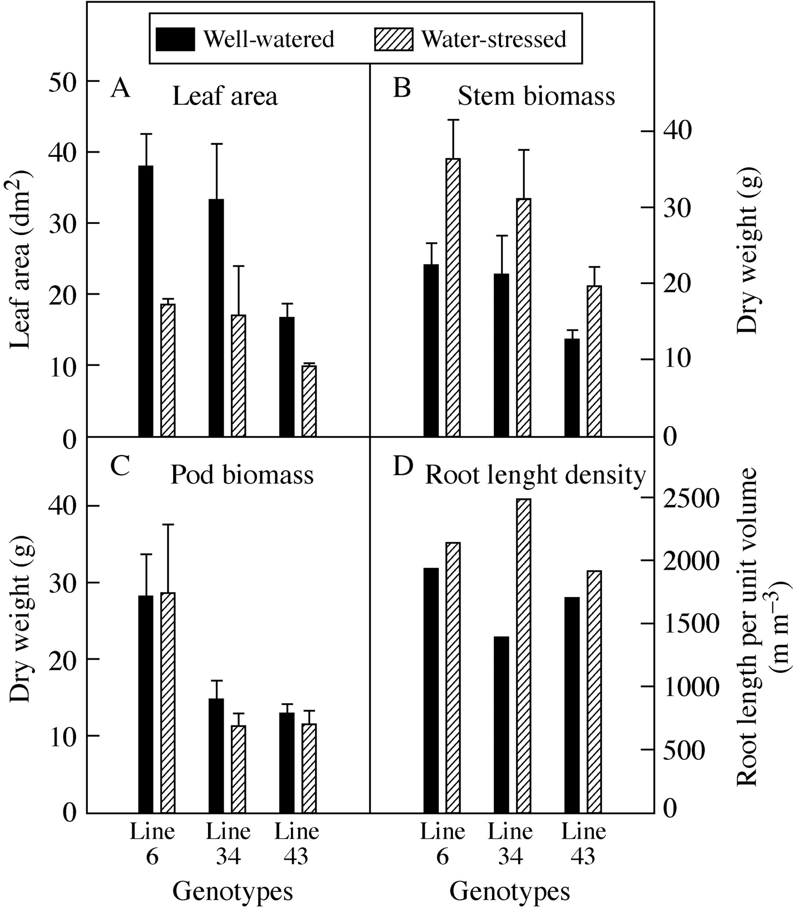
Fig. 8. Leaf area, stem and pod dry weight, and root length per unit soil volume per plant in well‐watered ...
Notes:
Fig. 8. Leaf area, stem and pod dry weight, and root length per unit soil volume per plant in well‐watered and water‐stressed Lupinus albus L. lines (lines 6, 34 and 43). The drought period of 15 d was imposed at the end of flowering. By the end of the drying period well‐watered and water‐stressed plants exhibited ψpd values around –0·1 MPa and –0·6 MPa, respectively. Each value represents the mean (± s.e. except root length) of four plants. (Adapted from Rodrigues et al., 1995.)
Unless provided in the caption above, the following copyright applies to the content of this slide:

Slide 9
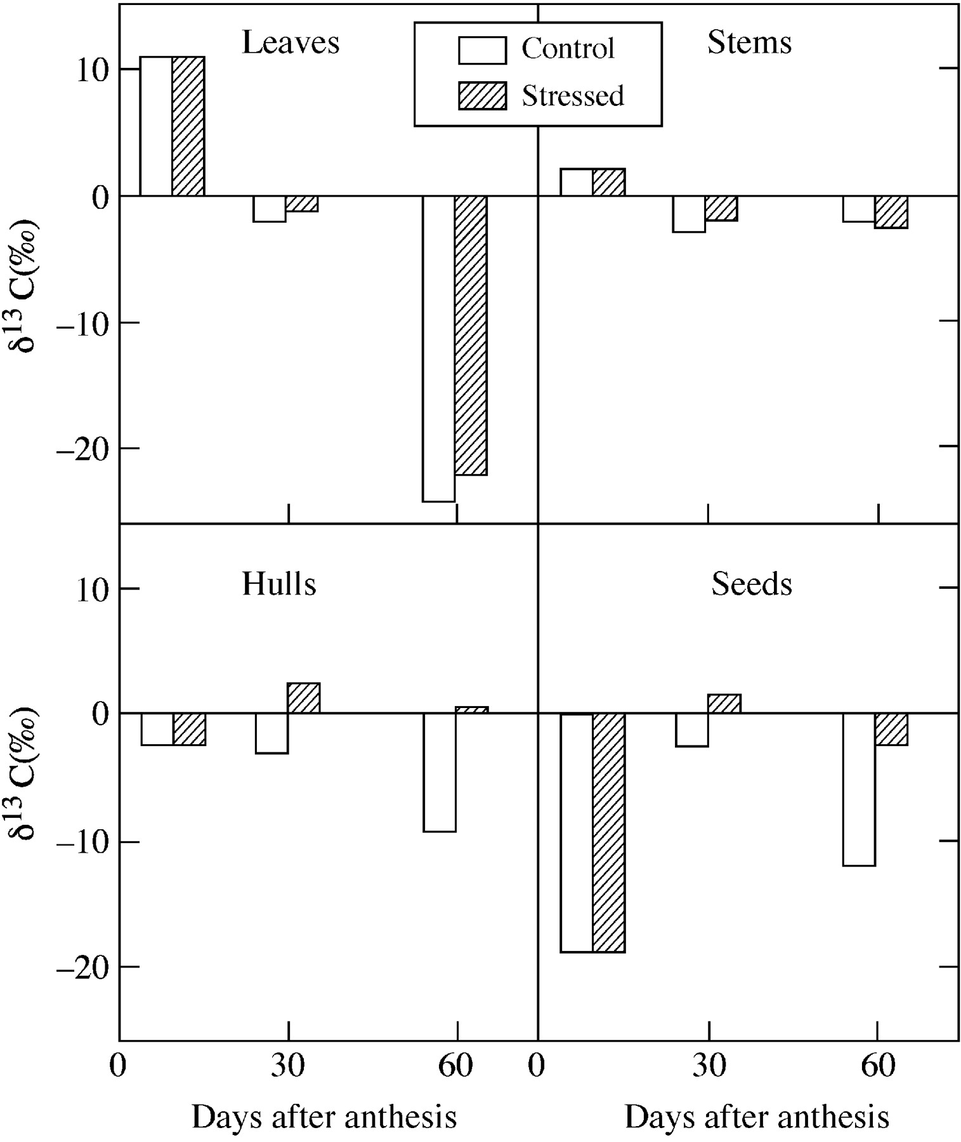
Fig. 9. Discrimination of ¹³C in the different tissues of well‐watered (open bars) and ...
Notes:
Fig. 9. Discrimination of 13C in the different tissues of well‐watered (open bars) and water‐stressed (hatched bars) Lupinus albus plants at three different times: 10, 30 and 60 d after anthesis. Water was withheld 10 d after anthesis. Mean values of four replicates.
Unless provided in the caption above, the following copyright applies to the content of this slide:

