Slide 1
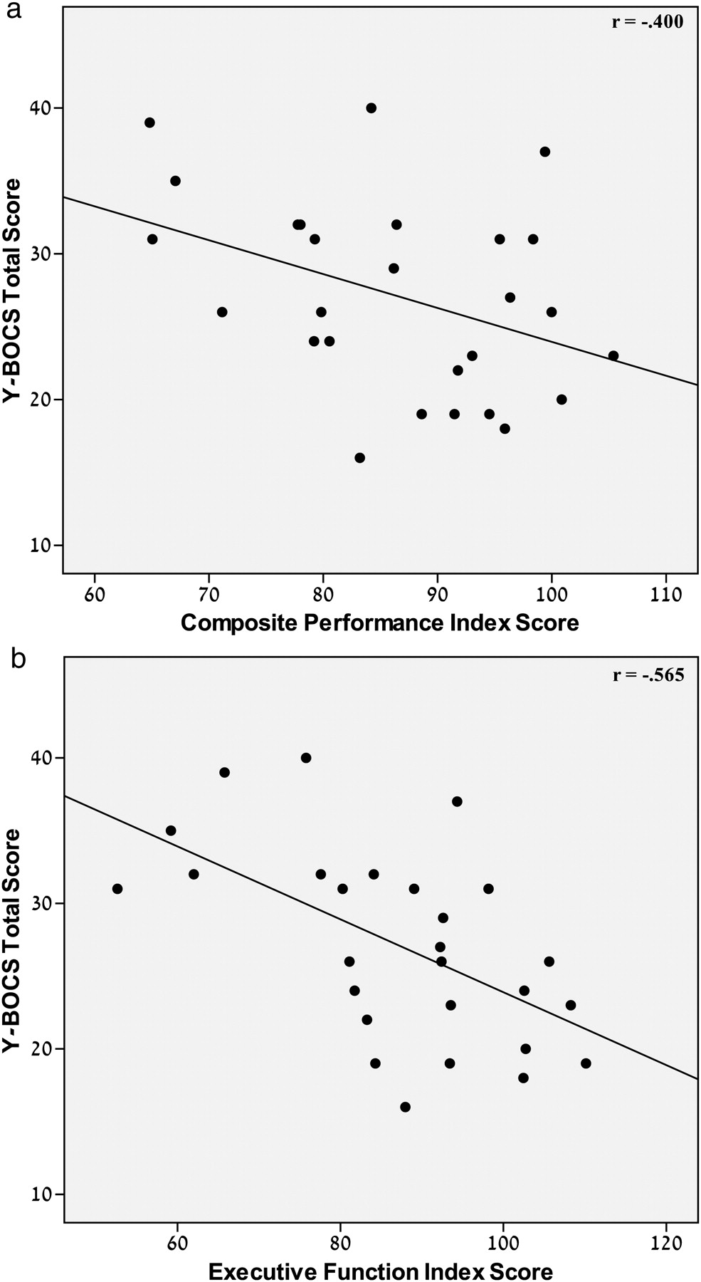
Fig. 1. Association of the Y-BOCS total score with (a) the Composite Neuropsychological Performance index score and ...
Notes:
Fig. 1. Association of the Y-BOCS total score with (a) the Composite Neuropsychological Performance index score and (b) the Executive Functions index score within the OCD group.
Unless provided in the caption above, the following copyright applies to the content of this slide: © The Author 2011. Published by Oxford University Press. All rights reserved. For permissions, please e-mail: journals.permissions@oup.com.

