Slide 1
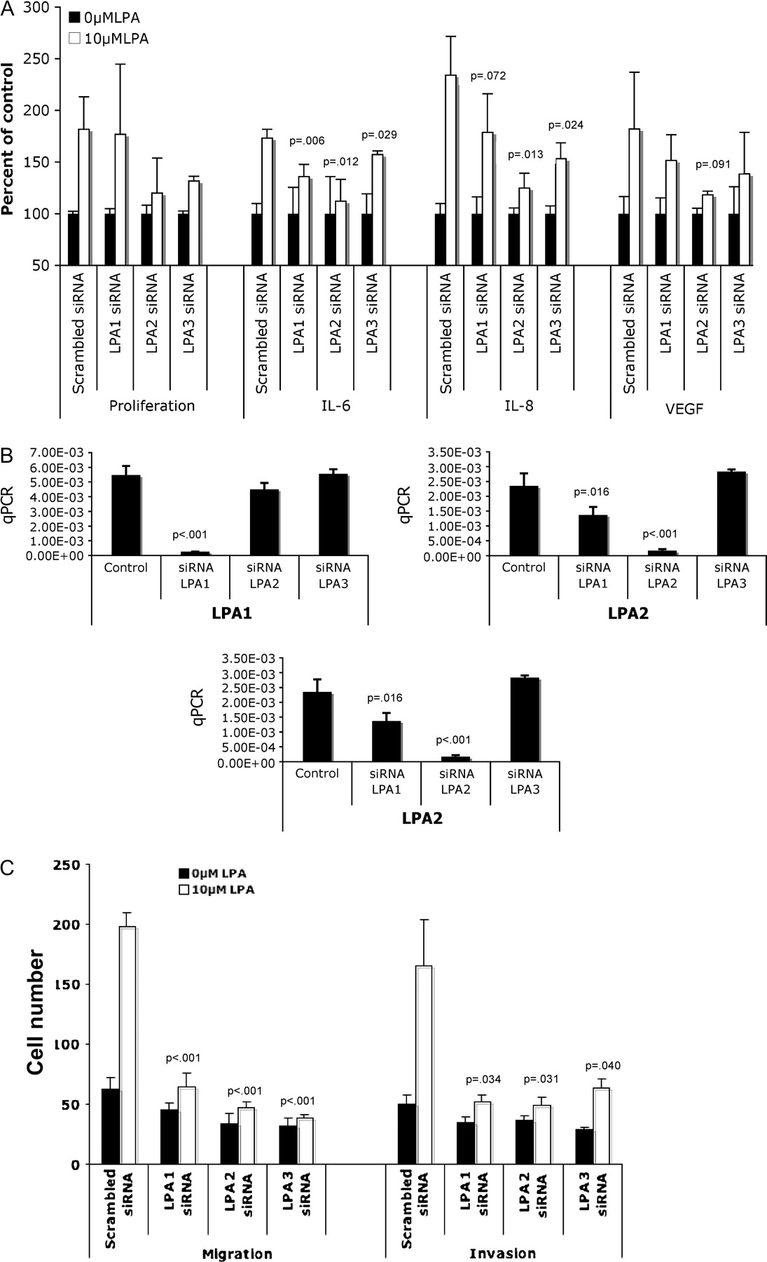
Figure 1 Assessment of the role of individual lysophosphatidic acid (LPA) receptors in LPA-induced cell ...
Notes:
Figure 1 Assessment of the role of individual lysophosphatidic acid (LPA) receptors in LPA-induced cell proliferation; interleukin 6 (IL-6), interleukin 8 (IL-8), and vascular endothelial growth factor (VEGF) production; and cell migration and invasion in ovarian cancer cells. A ) SKOV-3 cells were transfected with small interfering RNAs (siRNAs) against LPA1, LPA2, or LPA3, or with nontargeting (scrambled) siRNA control. After incubation with 10 μM LPA for 48 h, cells were stained with crystal violet and counted to determine cell proliferation. For the determination of IL-6, IL-8, and VEGF cytokine production, culture supernatants were collected, clarified, and analyzed by enzyme-linked immunosorbent assay. Results are presented as percent of control cells (treated with 0.5% bovine serum albumin in phosphate-buffered saline). Mean values are presented with 95% confidence intervals (CIs). Differences between groups were assessed using Student t test. B ) Cells were transfected with siRNA, and after 24 h, mRNA was extracted and real-time PCR was performed to confirm the efficiency of gene knockdown by the specific siRNAs. The results are given in arbitrary units, and P values from Student t test comparing LPA receptor siRNA values with controls are indicated. C ) SKOV-3 cells were transfected with siRNAs, and, 24 h after siRNA delivery, cells were seeded in the upper chamber of transwells coated with Matrigel (for invasion assay) or uncoated (for migration assay). Mean cell counts are given with error bars representing 95% CIs for the mean. Statistically significant P values are indicated. q PCR = quantitative polymerase chain reaction.
Unless provided in the caption above, the following copyright applies to the content of this slide: © The Author 2008. Published by Oxford University Press.

Slide 2
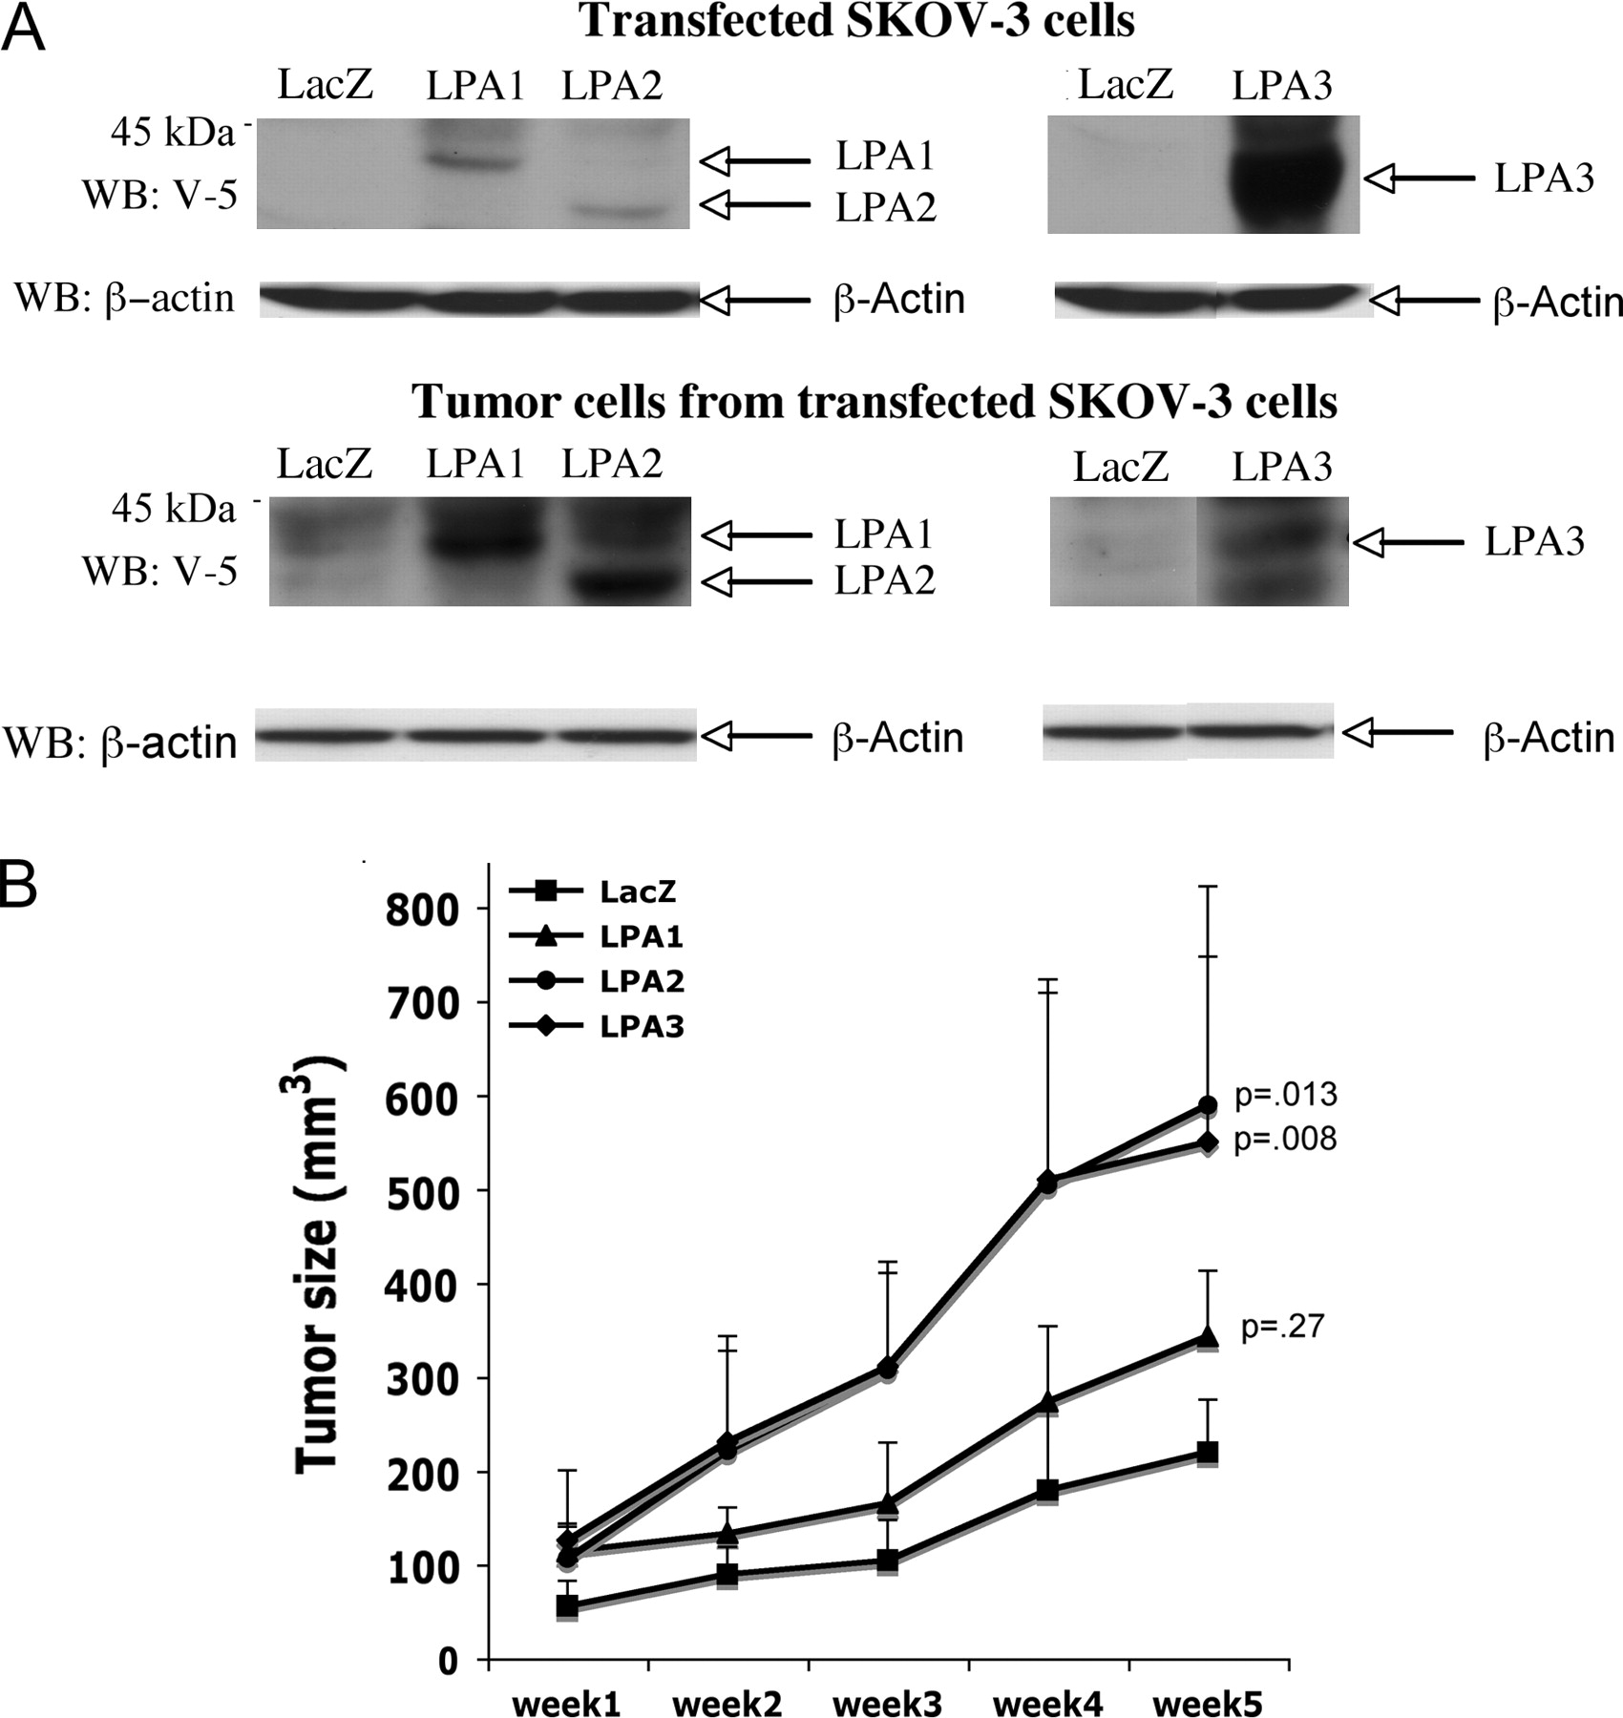
Figure 2 Tumorgenicity of SKOV-3 cells expressing exogenous lysophosphatidic acid (LPA) receptors. A ) SKOV-3 cells ...
Notes:
Figure 2 Tumorgenicity of SKOV-3 cells expressing exogenous lysophosphatidic acid (LPA) receptors. A ) SKOV-3 cells were infected with recombinant lentivirus carrying LacZ, LPA1, LPA2, or LPA3 proteins tagged with the V-5 epitope. Expression of LacZ and LPA receptors was analyzed by immunoblotting with anti–V-5 antibody. The blot was reprobed with anti–β-actin antibody to confirm equal amounts of protein loading among samples. B ) Female nude mice (4–6 weeks old, 8–9 mice for each group) were injected subcutaneously with 1 × 10 6 SKOV-3 cells expressing LacZ, LPA1, LPA2, or LPA3. The formation of subcutaneous tumors was monitored and measured with a digital caliper. Error bars represent 95% confidence intervals for the mean tumor volume and P values are from Student t test, comparing tumor sizes at week 5 with those in mice injected with cells expressing LacZ or LPA.
Unless provided in the caption above, the following copyright applies to the content of this slide: © The Author 2008. Published by Oxford University Press.

Slide 3
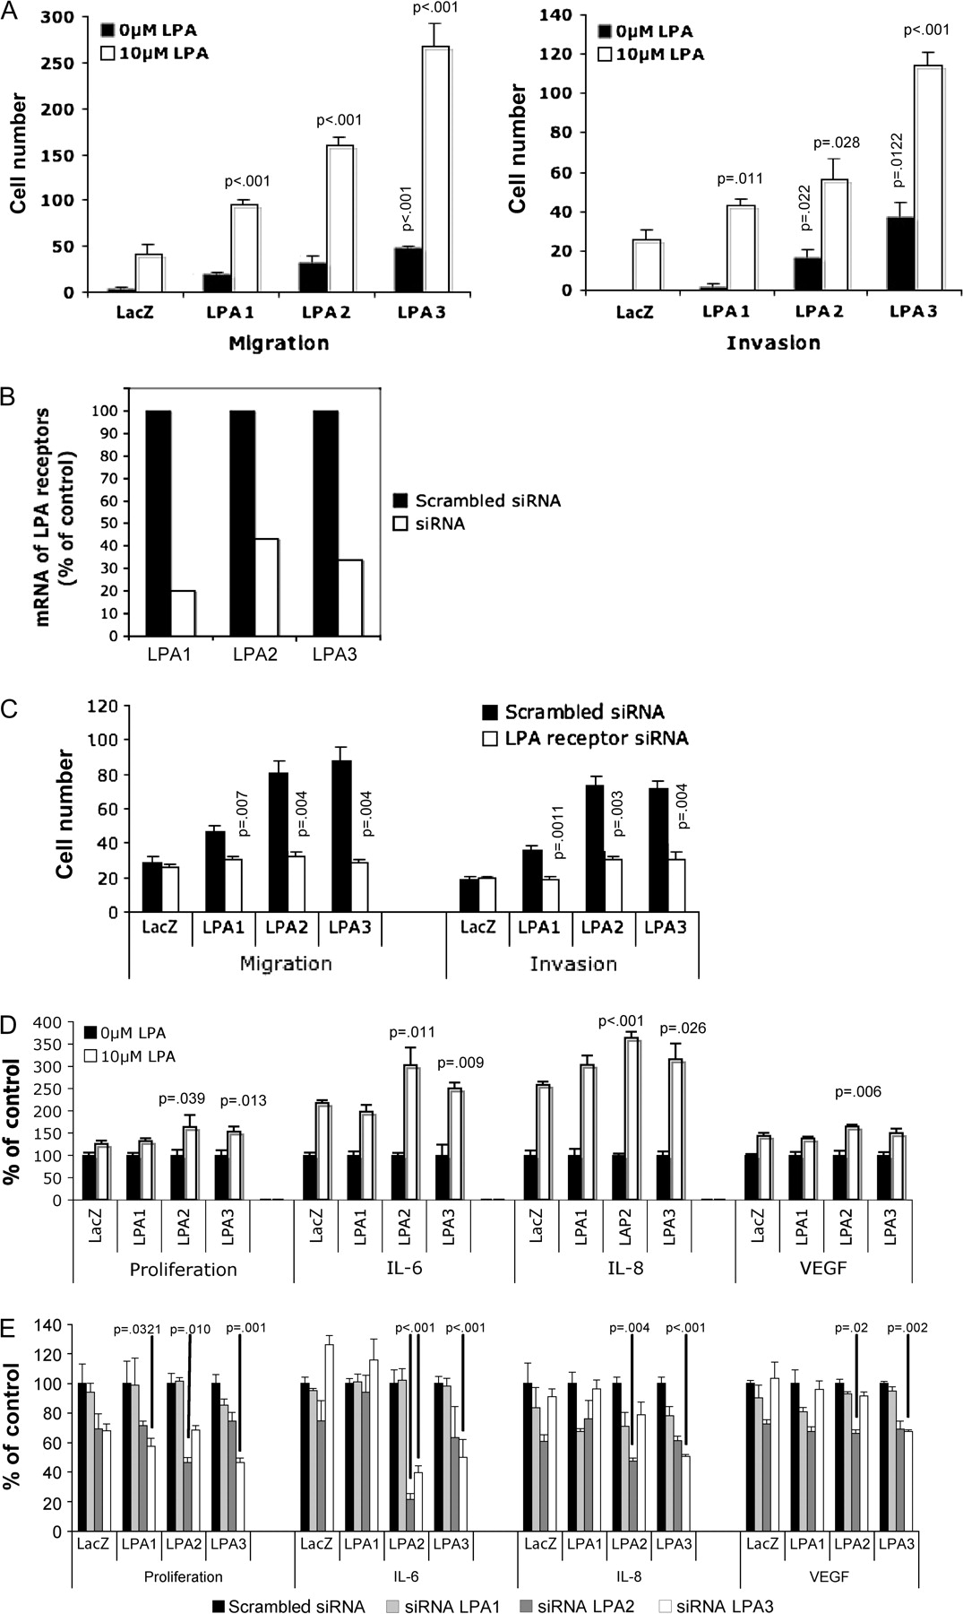
Figure 3 Evaluation of migration/invasion, cell proliferation, and interleukin 8 (IL-8) production in response to ...
Notes:
Figure 3 Evaluation of migration/invasion, cell proliferation, and interleukin 8 (IL-8) production in response to lysophosphatidic acid (LPA) in SKOV-3 cells derived from tumors that expressed exogenous LPA receptors. A ) Tumor cells derived from subcutaneous xenografts were seeded in uncoated (for migration) or Matrigel-coated (for invasion) transwells. Cells that migrated or invaded were stained, photographed, and counted. Mean cell numbers of triplicate samples and 95% confidence intervals (CIs) of a representative experiment are shown. P values are from comparisons with either untreated control ( white bars ) or treated control ( black bars ) using the Student t test. B ) In a separate assay using the same tumor-derived cells, overexpression of the LPA receptors was blocked by specific small interfering RNAs (siRNAs). The expression of LPA receptor mRNA was measured by real-time PCR to verify the efficiency of gene knockdown. C ) siRNA-treated tumor-derived cells were treated with 10 μM LPA for migration (24 h) and invasion (48 h) before comparison with control cells treated with scrambled siRNA ( black bars ) or siRNA targeting LPA receptors ( white bars ). Data are presented as cell numbers counted in three microscopic fields at ×200 magnification D ) Tumor-derived cells overexpressing LacZ, LPA1, LPA2, or LPA3 were cultured, incubated with 10 μM LPA for 48 h, and stained with crystal violet, and the dye was extracted to determine proliferation. Data are presented as percent of control (cells not treated with LPA). For determination of cytokine production, tumor-derived cells overexpressing LacZ, LPA1, LPA2, or LPA3 were cultured and incubated with LPA prior to collection of culture supernatants and analysis for IL-8, interleukin 6 (IL-6), or vascular endothelial growth factor (VEGF) concentration by enzyme-linked immunosorbent assay. P values listed were obtained from Student t tests comparing LPA-treated LacZ controls with cells expressing LPA receptors. Data in graphs are means of a representative experiment, repeated (n = 2) with 95% CIs E ) Expression of LPA receptors was blocked by the correspondent specific siRNAs in tumor-derived cells. LPA (10 μM)-induced cell proliferation and cytokine production in scrambled nontargeting siRNA–treated or LPA receptor siRNA–treated cells were measured as described in D. P values and 95% CIs are listed for comparisons of LPA receptor siRNA groups vs scrambled siRNA controls.
Unless provided in the caption above, the following copyright applies to the content of this slide: © The Author 2008. Published by Oxford University Press.

Slide 4
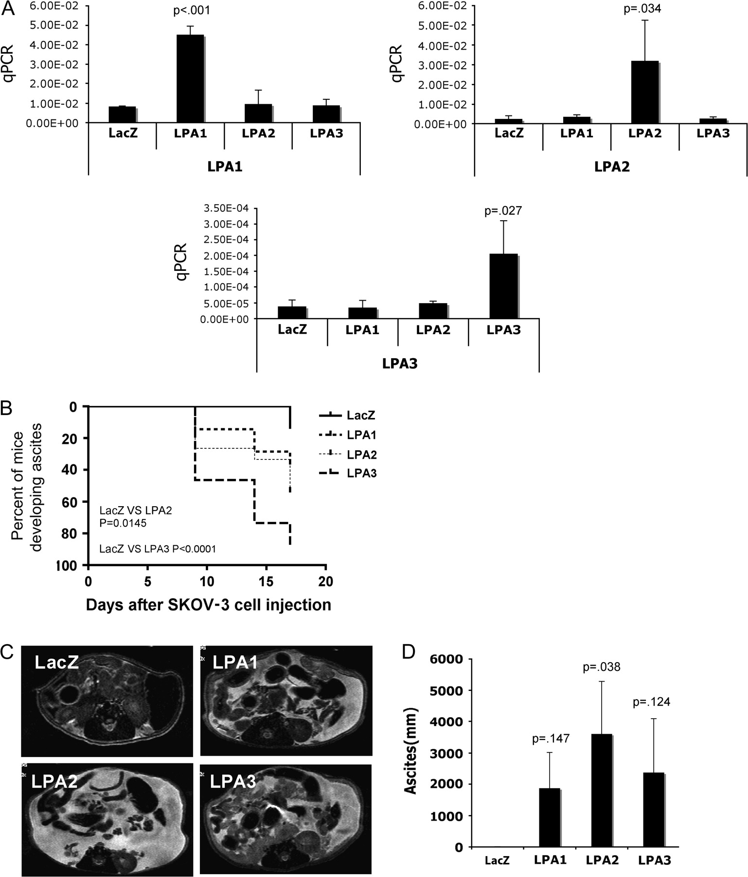
Figure 4 Intraperitoneal tumor formation and ascites formation by SKOV-3 cells expressing transduced lysophosphatidic ...
Notes:
Figure 4 Intraperitoneal tumor formation and ascites formation by SKOV-3 cells expressing transduced lysophosphatidic acid (LPA) receptors. A ) Lentivirus-transduced SKOV-3 cells were harvested and mRNA was extracted and amplified with real-time PCR to confirm the expression of LPA receptors. Mean values, with 95% confidence intervals, represent the amount of amplified product in arbitrary units. B ) Female nude mice were injected intraperitoneally with the lentivirus-transduced SKOV-3 cells (1 × 10 6 per mouse) that expressed LacZ, LPA1, LPA2, or LPA3 (15 mice per group). Mice were monitored beginning 8 days after injection and abdominal circumference and body weight were measured every 3 days to determine the ascites formation. Results are presented as the percentage of mice with ascites. P values were derived from Student t test with comparisons of LPA receptor groups with LacZ control. C ) Magnetic resonance imaging (MRI) was performed to further verify the development of ascites in these mice. Representative MRI images are demonstrating the formation of ascites, which appears as white-colored fluid throughout the cavity. D ) Volumes of ascites were estimated by MRI and presented as mean volume from three representative live mice in each group. Measurement was performed from femoral neck to the level of upper pole of right kidney. Data in the bar graph represent the means of three mice for which MRI imaging was performed; P value was derived from Student t tests comparing LPA receptor expressing tumors with LacZ control. q PCR = quantitative polymerase chain reaction.
Unless provided in the caption above, the following copyright applies to the content of this slide: © The Author 2008. Published by Oxford University Press.

Slide 5
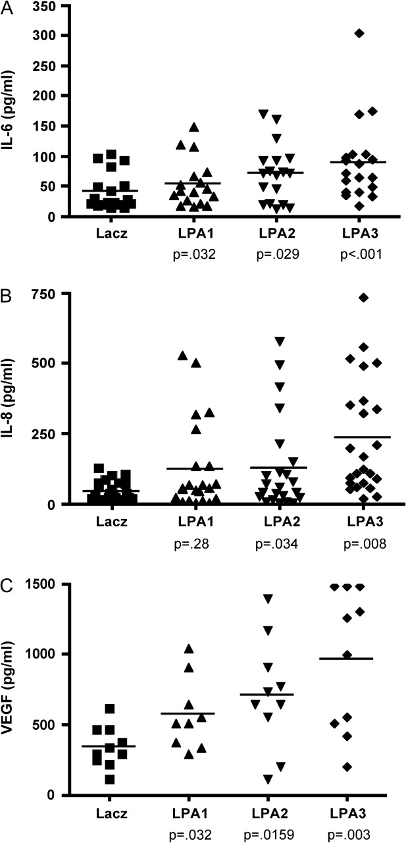
Figure 5 Serum levels of interleukin 6 (IL-6), interleukin 8 (IL-8), and vascular endothelial growth factor (VEGF) ...
Notes:
Figure 5 Serum levels of interleukin 6 (IL-6), interleukin 8 (IL-8), and vascular endothelial growth factor (VEGF) from mice intraperitoneally injected with SKOV-3 cells expressing lysophosphatidic acid (LPA) receptors. Female nude mice were injected intraperitoneally with the lentivirus-transduced SKOV-3 cells (10 × 10 6 per mouse) that express LPA1, LPA2, or LPA3 receptors. Three weeks later, blood was collected from the tail vein to determine concentrations of IL-6 ( A ), IL-8 ( B ), and VEGF ( C ) in serum. Each data point corresponds to IL-8 or IL-6 in individual mouse serum (LacZ [n = 23], LPA1 [n = 22], LPA2 [n = 23], or LPA3 [n = 24]) or VEGF in mouse serum (LacZ [n = 10], LPA1 [n = 9], LPA2 [n = 10], or LPA3 [n = 10]). Data points represent concentrations determined by enzyme-linked immunosorbent assay. P values are derived from comparisons with LacZ controls using Student t test, and horizontal lines represent the mean of values.
Unless provided in the caption above, the following copyright applies to the content of this slide: © The Author 2008. Published by Oxford University Press.

Slide 6
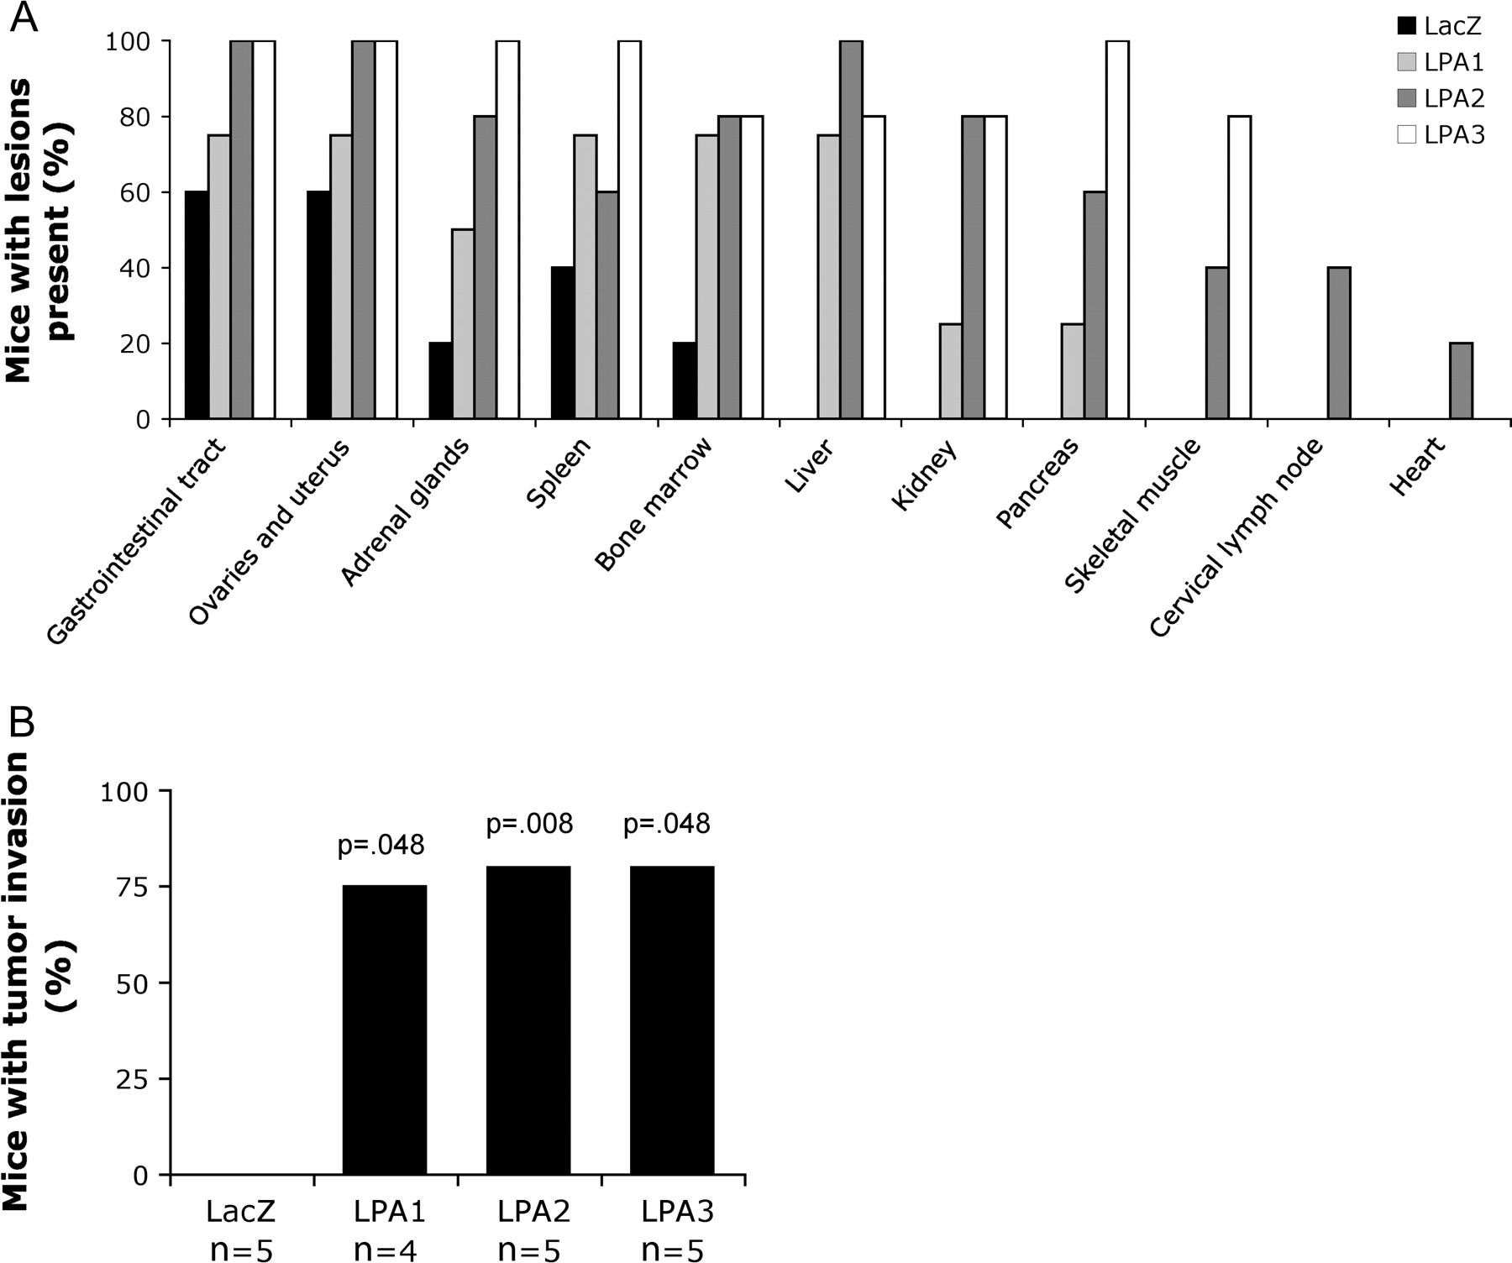
Figure 6 Enhanced tumor invasion by cells that overexpress lysophosphatidic acid (LPA) receptors. Female nude mice ...
Notes:
Figure 6 Enhanced tumor invasion by cells that overexpress lysophosphatidic acid (LPA) receptors. Female nude mice were injected intraperitoneally with lentivirus-transduced SKOV-3 cells (10 × 10 6 per mouse) expressing LacZ (n = 5), LPA1 (n = 4), LPA2 (n = 5), or LPA3 (n = 5) receptor. Seventeen days after injection, tumor-bearing mice were sacrificed and subjected to necropsy, and the organs were processed for hematoxylin and eosin staining. Pathological sections were examined for the presence of tumor invasion. Data are presented as the percentage of mice with invaded lesions ( A ) and the overall percentage of mice with tumor invasion in the peritoneal cavity ( B ). LPA receptor groups and the LacZ control were compared using the Student t test.
Unless provided in the caption above, the following copyright applies to the content of this slide: © The Author 2008. Published by Oxford University Press.

