Slide 1
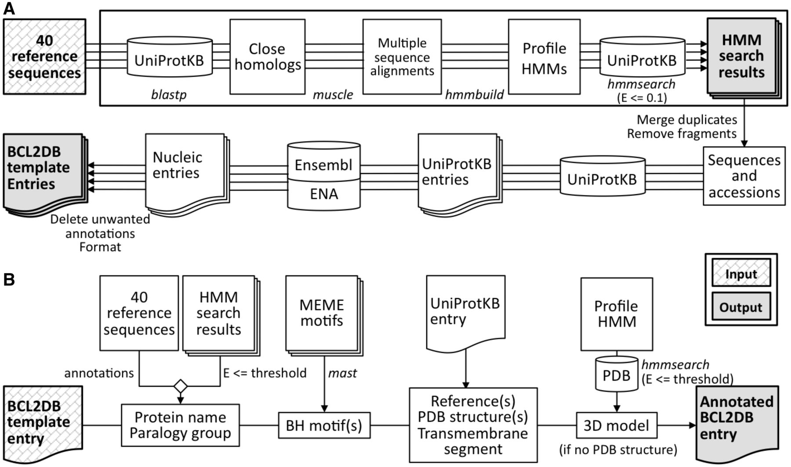
Figure 1. Description of the FindBCL2 and AnnotateBCL2 processes used to generate BCL2DB. External programs used by ...
Notes:
Figure 1. Description of the FindBCL2 and AnnotateBCL2 processes used to generate BCL2DB. External programs used by the processes are indicated in italics. ( A ) The upper part of the panel (boxed) describes the discovery mode of the FindBCL2 program. The results are the profile HMMs and their associated classification E-value thresholds deduced after a HMM search against UniProtKB. The production mode used to generate the BCL2DB entry templates is described in the bottom part. After an hmmsearch on UniProtKB with the computed profile HMMs, the Ensembl or ENA entries are retrieved from cross-references or BLAST searches with nonfragment protein sequences and after removing duplicated sequences. Then, the entries are cleared of unwanted annotations and merged into a single one if they refer to the same Ensembl, Ensembl Genomes or ENA entry. ( B ) The AnnotateBCL2 process enriches each BCL2DB entry template with annotations from reference sequences, sequence classification information (protein/gene name and orthology group/cluster), location of BH motifs and structural data retrieved from the PDB.
Unless provided in the caption above, the following copyright applies to the content of this slide: © The Author(s) 2014. Published by Oxford University Press.This is an Open Access article distributed under the terms of the Creative Commons Attribution License (http://creativecommons.org/licenses/by/3.0/), which permits unrestricted reuse, distribution, and reproduction in any medium, provided the original work is properly cited.

Slide 2
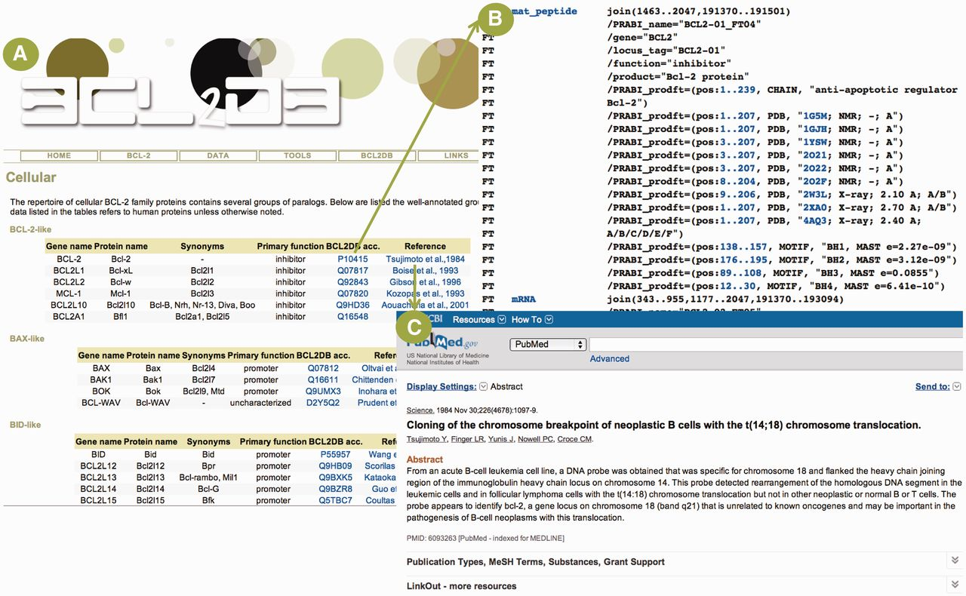
Figure 2. Example of general information available for BCL2DB reference sequences. ( A ) Cellular BCL-2 homologous ...
Notes:
Figure 2. Example of general information available for BCL2DB reference sequences. ( A ) Cellular BCL-2 homologous reference sequences general information ordered by main clades (BCL-2-like, BAX-like and BID-like) and organized as tables. For each reference sequence, two links are provided to view the BCL2DB entry and the PubMed entry of the article describing the protein discovery. ( B ) Partial view of the feature table corresponding to the BCL2DB entry P10415. Links are provided to retrieve nucleotide (e.g. mRNA or mat_peptide) and protein sequences (e.g. PRABI_prodft), as well as to view entries of cross-referenced database (e.g. PDB or GO). ( C ) PubMed entry of the article by Tsujimoto et al. reporting the discovery of the BCL-2 gene.
Unless provided in the caption above, the following copyright applies to the content of this slide: © The Author(s) 2014. Published by Oxford University Press.This is an Open Access article distributed under the terms of the Creative Commons Attribution License (http://creativecommons.org/licenses/by/3.0/), which permits unrestricted reuse, distribution, and reproduction in any medium, provided the original work is properly cited.

Slide 3
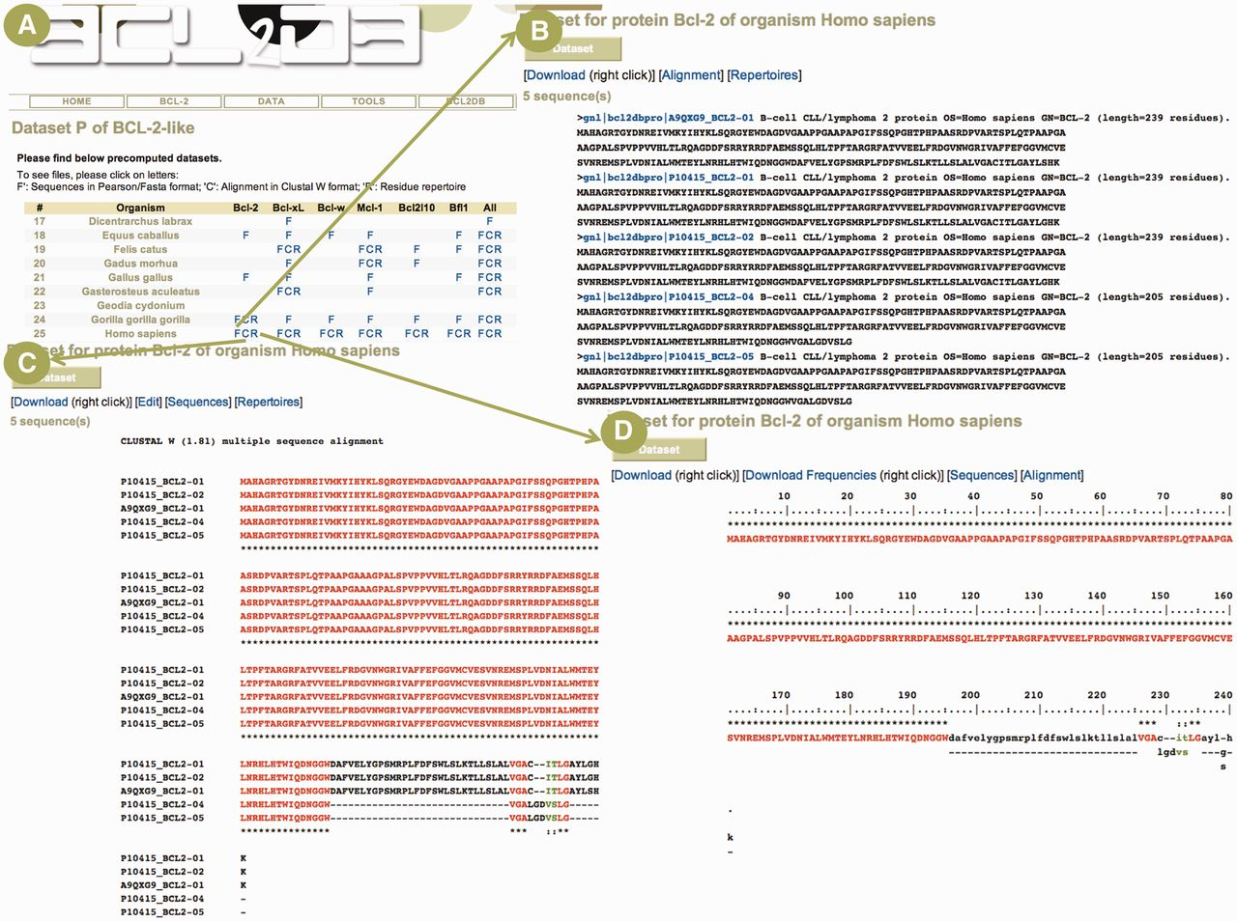
Figure 3. Example of a protein sequence data set. ( A ) Partial view of the page giving access to cellular BCL-2 ...
Notes:
Figure 3. Example of a protein sequence data set. ( A ) Partial view of the page giving access to cellular BCL-2 homologous protein data sets. The table lists available data sets for the diverse species and proteins in the BCL-2-like clade. The user can access sequences in Fasta/Pearson format (F letter), multiple sequence alignment in Clustal W format (C letter) and residue repertoire (R letter). ( B ) The Fasta/Pearson file for Homo sapiens BCL-2 protein sequences. The sequence identifiers are built with the primary accession number, the protein name and an isoform number. A link is provided on sequence identifier to view the BCL2DB entry ( Figure 2 B). ( C ) The multiple sequence alignment computed with MUSCLE and displayed in Clustal W format. The color code used is red, green, black for residues that are conserved, strongly similar, weakly similar and variable in the alignment column, respectively, as defined by Clustal W. Dashes indicate gaps. ( D ) Residue repertoire computed from the previous alignment with the same color code.
Unless provided in the caption above, the following copyright applies to the content of this slide: © The Author(s) 2014. Published by Oxford University Press.This is an Open Access article distributed under the terms of the Creative Commons Attribution License (http://creativecommons.org/licenses/by/3.0/), which permits unrestricted reuse, distribution, and reproduction in any medium, provided the original work is properly cited.

Slide 4
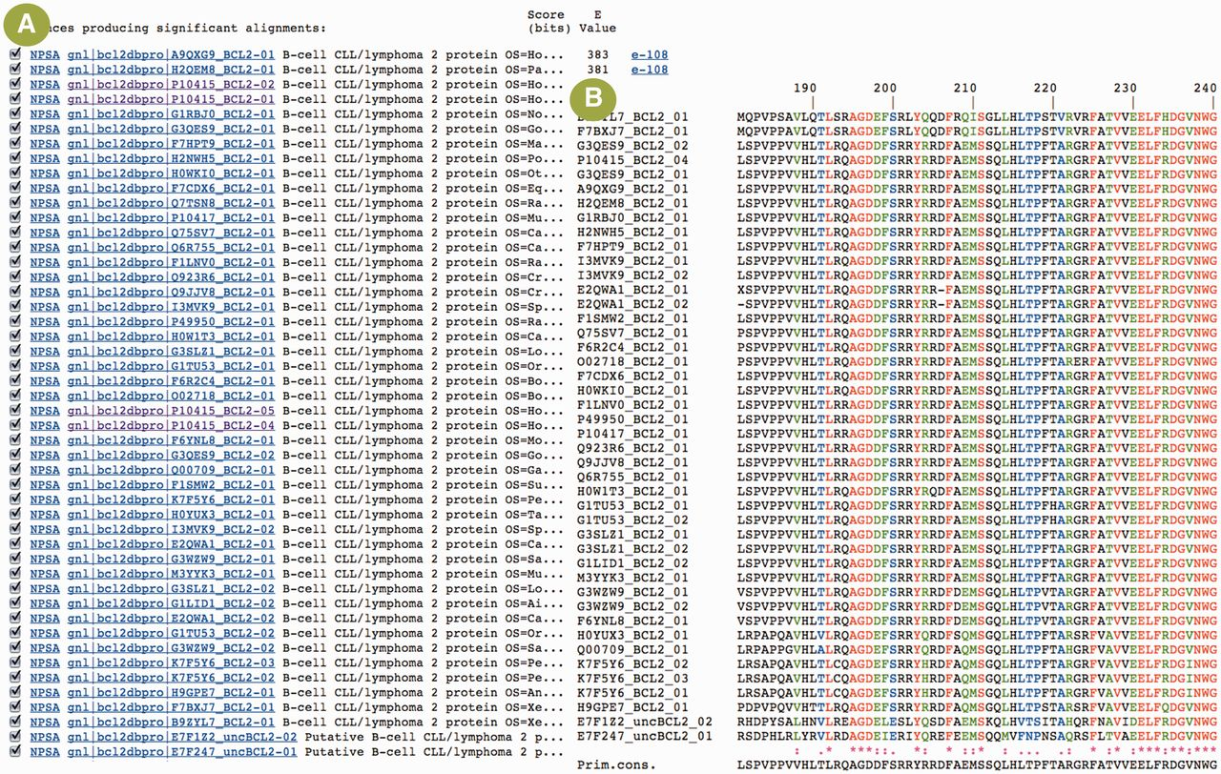
Figure 4. Example of sequence analysis with BCL2DB sequences and the NPS@ server. ( A ) Results of a blastp search ...
Notes:
Figure 4. Example of sequence analysis with BCL2DB sequences and the NPS@ server. ( A ) Results of a blastp search with the BCL-2 protein sequence (P10415) against the BCL2DB protein sequences. A first link (NPSA) is provided to extract the matching sequence from the sequence databank and perform further analyses with the set of tools available in NPS@. The second link on the sequence identifier is provided to view the BCL2DB entry ( Figure 2 B). The pairwise sequence alignment between the query sequence and the matching sequence can be viewed, thanks to the link on the E-value. ( B ) Partial view of the multiple sequence alignment of BCL2DB BCL-2 proteins in the region of the BH3 motif. The alignment was computed with sequences selected and extracted from the blastp results. The color code used is red, green, black for residues that are conserved, strongly similar, weakly similar and variable in the alignment column, respectively, as defined by Clustal W. Dashes indicate gaps.
Unless provided in the caption above, the following copyright applies to the content of this slide: © The Author(s) 2014. Published by Oxford University Press.This is an Open Access article distributed under the terms of the Creative Commons Attribution License (http://creativecommons.org/licenses/by/3.0/), which permits unrestricted reuse, distribution, and reproduction in any medium, provided the original work is properly cited.

Slide 5
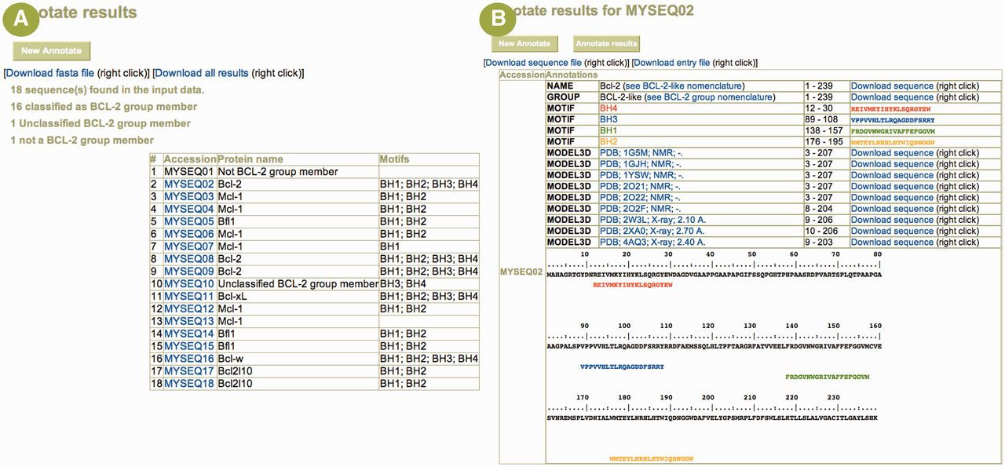
Figure 5. Example of user sequence annotation with the Annotate tool. ( A ) The main result page summarizes the ...
Notes:
Figure 5. Example of user sequence annotation with the Annotate tool. ( A ) The main result page summarizes the submitted data and offers a table listing each input sequence (here, 18 sequences were uploaded) with its predicted protein name and its BH motif composition. A link to a detailed result page is provided on each sequence identifier when the sequence is annotated as belonging to the BCL-2 protein group. ( B ) The detailed result page for sequence MySeq02 displays the predicted protein name, the classification, the BH motif composition and the homologous known 3D structures. Numerous links allow the user to (i) download the sequences corresponding to the various annotations, (ii) download a UniProtKB formatted entry of the annotated sequence and (iii) browse structure entry at the PDB Web site. The submitted sequence is also displayed with colored BH motifs for easy cut-and-paste to other programs.
Unless provided in the caption above, the following copyright applies to the content of this slide: © The Author(s) 2014. Published by Oxford University Press.This is an Open Access article distributed under the terms of the Creative Commons Attribution License (http://creativecommons.org/licenses/by/3.0/), which permits unrestricted reuse, distribution, and reproduction in any medium, provided the original work is properly cited.

