Slide 1
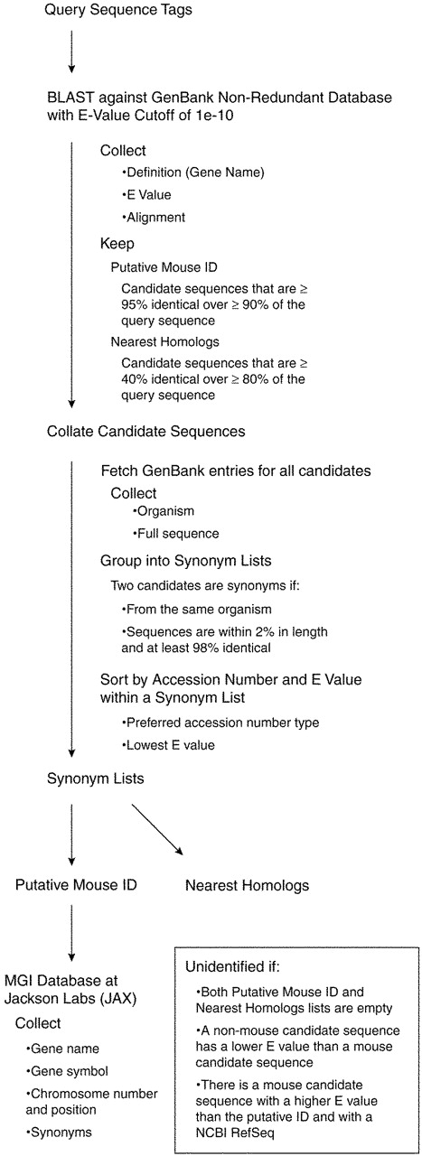
Figure 1. A schematic of our automated protocol for annotating cell line sequence tags.
Notes:
Figure 1. A schematic of our automated protocol for annotating cell line sequence tags.
Unless provided in the caption above, the following copyright applies to the content of this slide:

