Slide 1
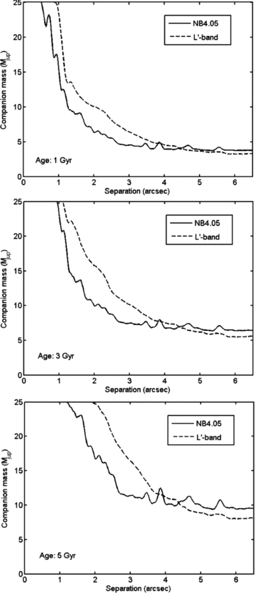
Figure 3 Comparison between L′ (dashed line) and NB4.05 (solid line) imaging for high-contrast purposes, for 1 Gyr ...
Notes:
Figure 3 Comparison between L′ (dashed line) and NB4.05 (solid line) imaging for high-contrast purposes, for 1 Gyr (top panel), 3 Gyr (middle panel) and 5 Gyr (bottom panel). As expected, NB4.05 provides a better performance than L′ in the inner image range, and the opposite is true in the outer range. The comparison is based on sets B1 and B2, note that the A1+A2 detection limits are better.
Unless provided in the caption above, the following copyright applies to the content of this slide: © 2009 The Authors. Journal compilation © 2009 RAS

Slide 2
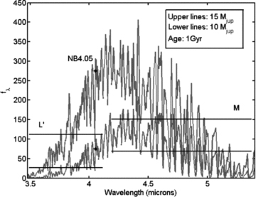
Figure 2 Example of two model spectra from Burrows et al. (2003), and the corresponding flux densities in filters L′, ...
Notes:
Figure 2 Example of two model spectra from Burrows et al. (2003), and the corresponding flux densities in filters L′, NB4.05 and M. Upper lines: a 15 Mjup object. Lower lines: a 10 Mjup object. The age is 1 Gyr in both cases.
Unless provided in the caption above, the following copyright applies to the content of this slide: © 2009 The Authors. Journal compilation © 2009 RAS

Slide 3
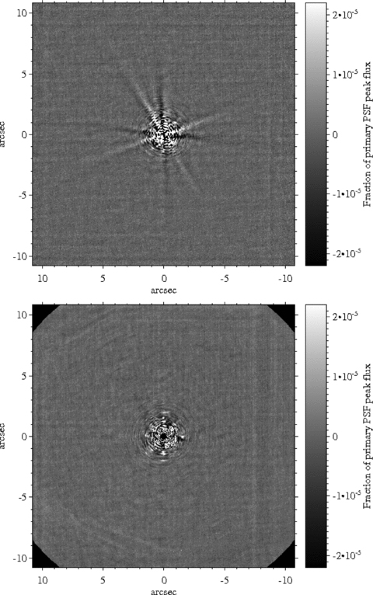
Figure 1 Final output images for aADI (top) and PSFR+aADI (bottom) to the same flux scale, for the images A1+A2. The ...
Notes:
Figure 1 Final output images for aADI (top) and PSFR+aADI (bottom) to the same flux scale, for the images A1+A2. The most obvious difference between the methods is in the treatment of the spiders.
Unless provided in the caption above, the following copyright applies to the content of this slide: © 2009 The Authors. Journal compilation © 2009 RAS

Slide 4
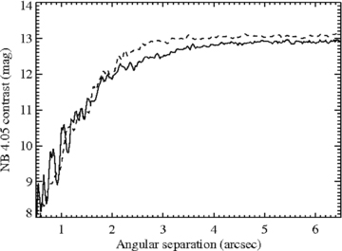
Figure 4 Comparison of contrast for aADI (solid line) and PSRF+aADI (dashed line). The performance is generally very ...
Notes:
Figure 4 Comparison of contrast for aADI (solid line) and PSRF+aADI (dashed line). The performance is generally very similar.
Unless provided in the caption above, the following copyright applies to the content of this slide: © 2009 The Authors. Journal compilation © 2009 RAS

Slide 5
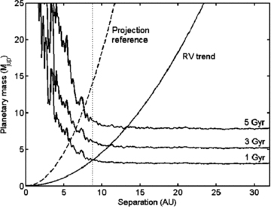
Figure 5 Detection limits at 1, 3 and 5 Gyr for ε Ind A. The solid line that increases outwards is the mass as a ...
Notes:
Figure 5 Detection limits at 1, 3 and 5 Gyr for ε Ind A. The solid line that increases outwards is the mass as a function of semimajor axis corresponding to the 2.6 m s−1 yr−1 slope of the observed RV trend, and the dashed line is the reference for minimum projected separation at a typical inclination of 60°, both under the assumption of a circular orbit. The dotted vertical line is the minimum semimajor axis from the RV baseline at q= 2.
Unless provided in the caption above, the following copyright applies to the content of this slide: © 2009 The Authors. Journal compilation © 2009 RAS

Slide 6
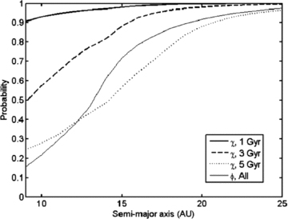
Figure 6 Detection probability in our images as a function of semimajor axis for 1, 3 and 5 Gyr.Also plotted is φ, the ...
Notes:
Figure 6 Detection probability in our images as a function of semimajor axis for 1, 3 and 5 Gyr.Also plotted is φ, the fraction of orbits at a given semimajor axis that are consistent with the linear RV trend, denoted with the subscript ‘All’ to signify that it is independent of age, in contrast to χ.
Unless provided in the caption above, the following copyright applies to the content of this slide: © 2009 The Authors. Journal compilation © 2009 RAS

