Slide 1
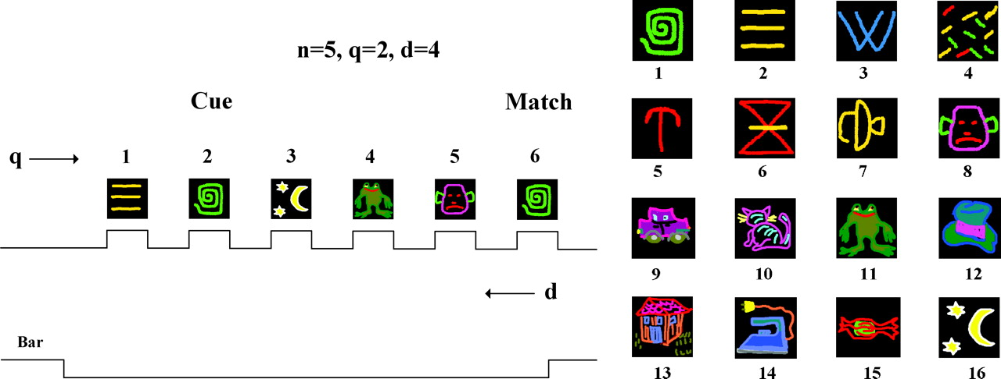
Figure 1. Task protocol and stimuli. Left: example of image presentation sequence, defining the three variables: n, ...
Notes:
Figure 1. Task protocol and stimuli. Left: example of image presentation sequence, defining the three variables: n, sequence length prior to match; q, position of cue, i.e. image to be repeated; d, cue-to-match separation. These variables are related by the equation q + d = n + 1. Right: the full 16-image set used in these experiments. Images 7–14 constituted the initial eight-image set. The numerical labels are fixed for each image across all experiments.
Unless provided in the caption above, the following copyright applies to the content of this slide: Cerebral Cortex V 15 N 5 © Oxford University Press 2004; all rights reserved

Slide 2
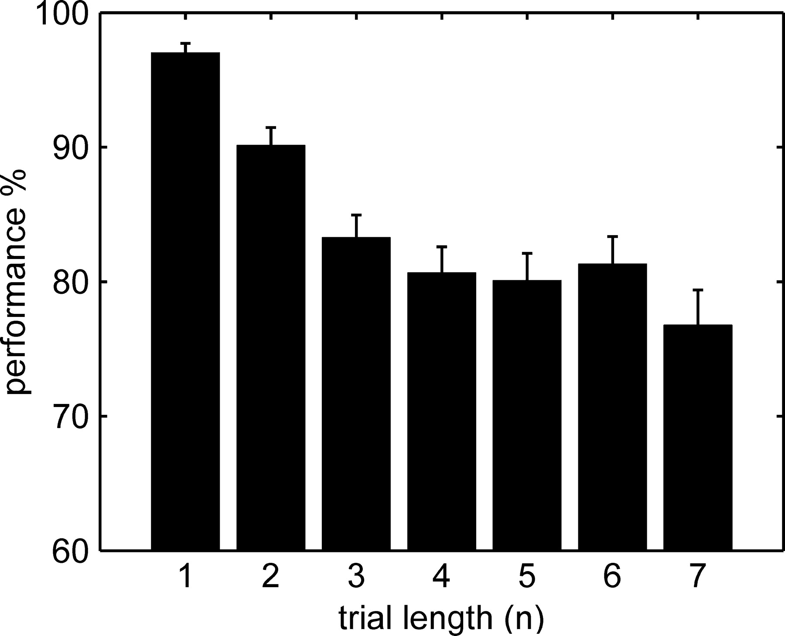
Figure 2. Overall performance dependence on trial length. Data include all trials of sequence length n, irrespective of ...
Notes:
Figure 2. Overall performance dependence on trial length. Data include all trials of sequence length n, irrespective of the length of the inter-stimulus delay interval (1–3 s) or image set size (8, 16), for both monkeys and over the entire task training history with the given set of images. Performance significantly decreases with trial length, from the shortest (97%) to the longest (77%). For Figures 2–5 performance is hits relative to hits and misses. False positives are considered in Figures 6–9. Error bars in all figures are confidence intervals.
Unless provided in the caption above, the following copyright applies to the content of this slide: Cerebral Cortex V 15 N 5 © Oxford University Press 2004; all rights reserved

Slide 3
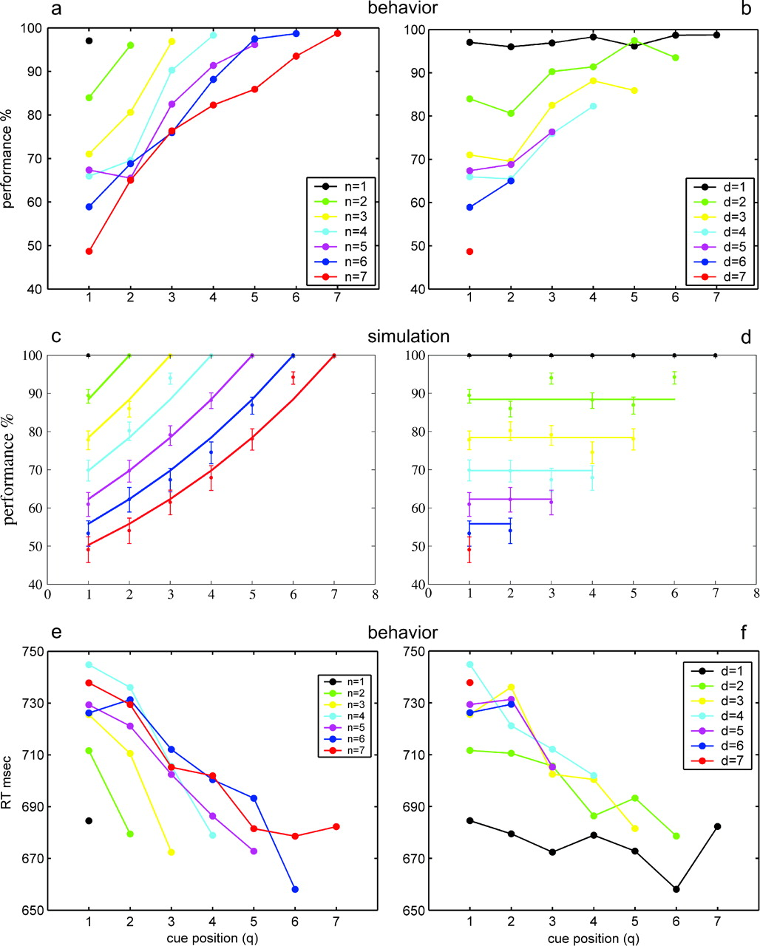
Figure 3. Performance (a, b) and reaction time (RT; e, f) versus cue position q for each sequence length n and ...
Notes:
Figure 3. Performance (a, b) and reaction time (RT; e, f) versus cue position q for each sequence length n and cue-to-match separation d for the behavioral experiment, as well as simulation results (c, d) for comparison to behavioral performance (a, b). Each performance point is the ratio of the number of correct responses (Hits) and the total number of trials with given q and n or d (Hits + Misses). (a, c, e) Points connected have the same sequence length n; thus, d decreases as q increases (d = n − q + 1). (b, d, f) The same data, with points connected for fixed cue-to-match separation d; thus, n increases with q. (a, b) Behavioral performance significantly decreases with sequence length n (a) or cue-to-match separation d (b) at fixed cue position q. Alternatively, performance significantly increases with cue position, q for fixed sequence length — and thus decreasing d (a) or fixed cue-to-match separation — and thus increasing n (b). The latter is equivalent to the surprising finding that performance increases with the addition of stimuli in the sequence before the cue. For clarity of presentation, we do not show confidence intervals for each performance level in the figures; they are given in Table 2. (c, d) Theoretical (simplified model) hit–miss performance. Simulation performance decreases significantly with sequence length and with cue–match separation, as found for experimental performance data; there is no increase with sequence length, at fixed cue–match separation, because of the assumed fixed transition probability (see Appendix). (e, f) RT (shown only for correct responses) significantly increases with increasing sequence length n or with increasing cue–match separation d, for each fixed cue position q. RT follows performance, inversely: the better the performance, the shorter the reaction time. For clarity of presentation, we do not show standard errors for each RT level in the figures; they are given in Table 3.
Unless provided in the caption above, the following copyright applies to the content of this slide: Cerebral Cortex V 15 N 5 © Oxford University Press 2004; all rights reserved

Slide 4
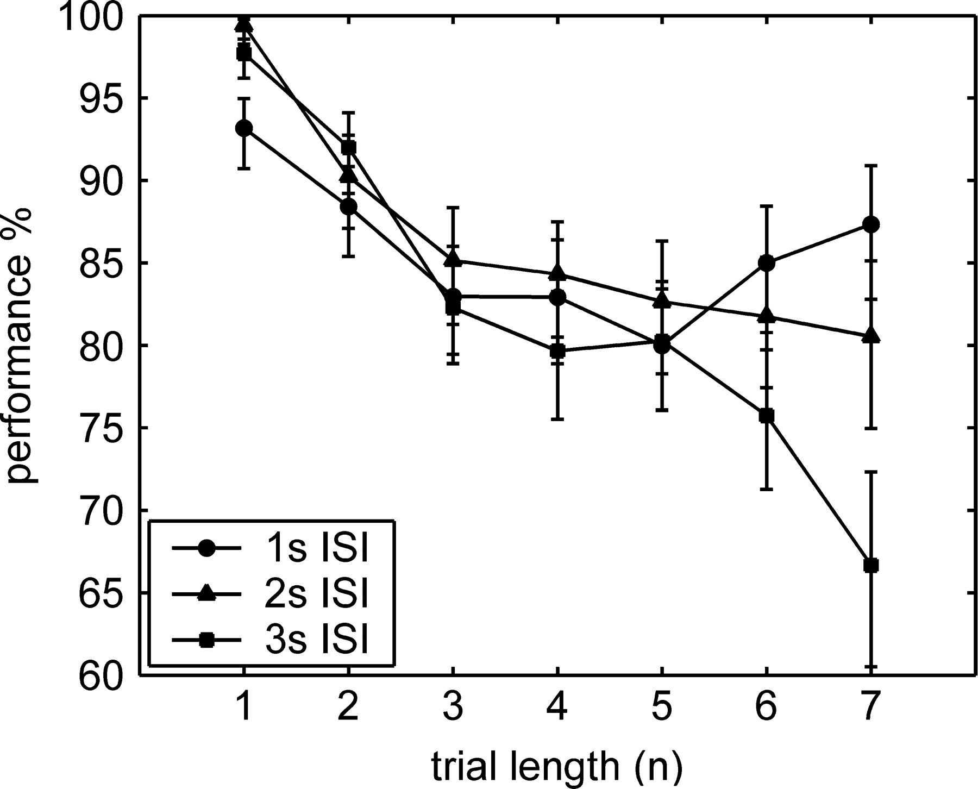
Figure 4. Performance independence of inter-stimulus delay interval. Performance versus sequence length n for three ...
Notes:
Figure 4. Performance independence of inter-stimulus delay interval. Performance versus sequence length n for three delay intervals — 1, 2 or 3 s. Overall, differences are small and non-significant. For sequences of n = 1, performance is significantly better for the longer delays, while for n = 7, large differences appear, which may be ascribed to a particularly fragile WM near saturation.
Unless provided in the caption above, the following copyright applies to the content of this slide: Cerebral Cortex V 15 N 5 © Oxford University Press 2004; all rights reserved

Slide 5
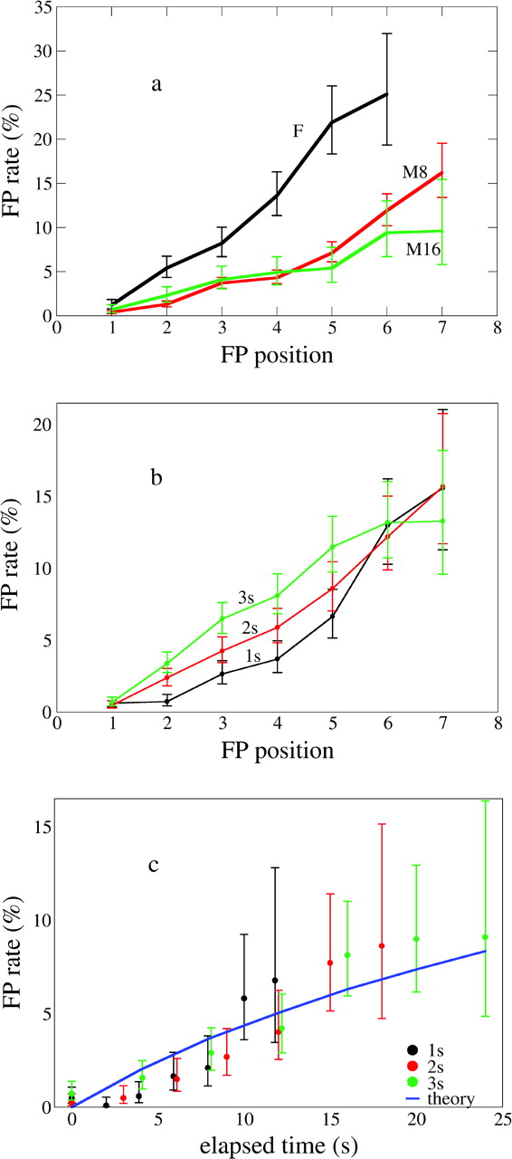
Figure 5. False positive (FP) rate versus FP position (i.e. length of sequence; a, b) or time elapsed to FP (c) for ...
Notes:
Figure 5. False positive (FP) rate versus FP position (i.e. length of sequence; a, b) or time elapsed to FP (c) for monkeys F and M as a function of inter-stimulus interval length (ISI = 1, 2 or 3 s), monkey (F, M) and image set size (8, 16). (a) FP rate increases significantly with increasing sequence length, for all three cases: monkey F and monkey M with eight-image (M8) and 16-image (M16) sets. The last two cases (for monkey M) were not significantly different, except for FP position 7, suggesting that there is no dependence of FP rate on image set size. The effect at position 7 may be related to WM saturation, see text. (b) FP rates are separated by ISI and turn out to be significantly higher for longer ISI's, except for FP position 1, for which we do not expect any difference, and 6, 7, where a saturation effect may begin (see text). We conclude that in-jump transitions depend on elapsed time rather than number of image presentations. (c) FP rates are separated by ISI and plotted against elapsed time, taking into account only trials where the FP was not for an image that was present in the preceding trial (see Fig. 6 and text). The full curve is the analytic prediction of the model, Pfp in Appendix, with the parameters given there and used in Figure 3c,d. The congruence of the trends of the points for different ISI, and even more the overlap with the model prediction, corroborate the conclusion that jump-ins depend on elapsed time rather than number of image presentations.
Unless provided in the caption above, the following copyright applies to the content of this slide: Cerebral Cortex V 15 N 5 © Oxford University Press 2004; all rights reserved

Slide 6
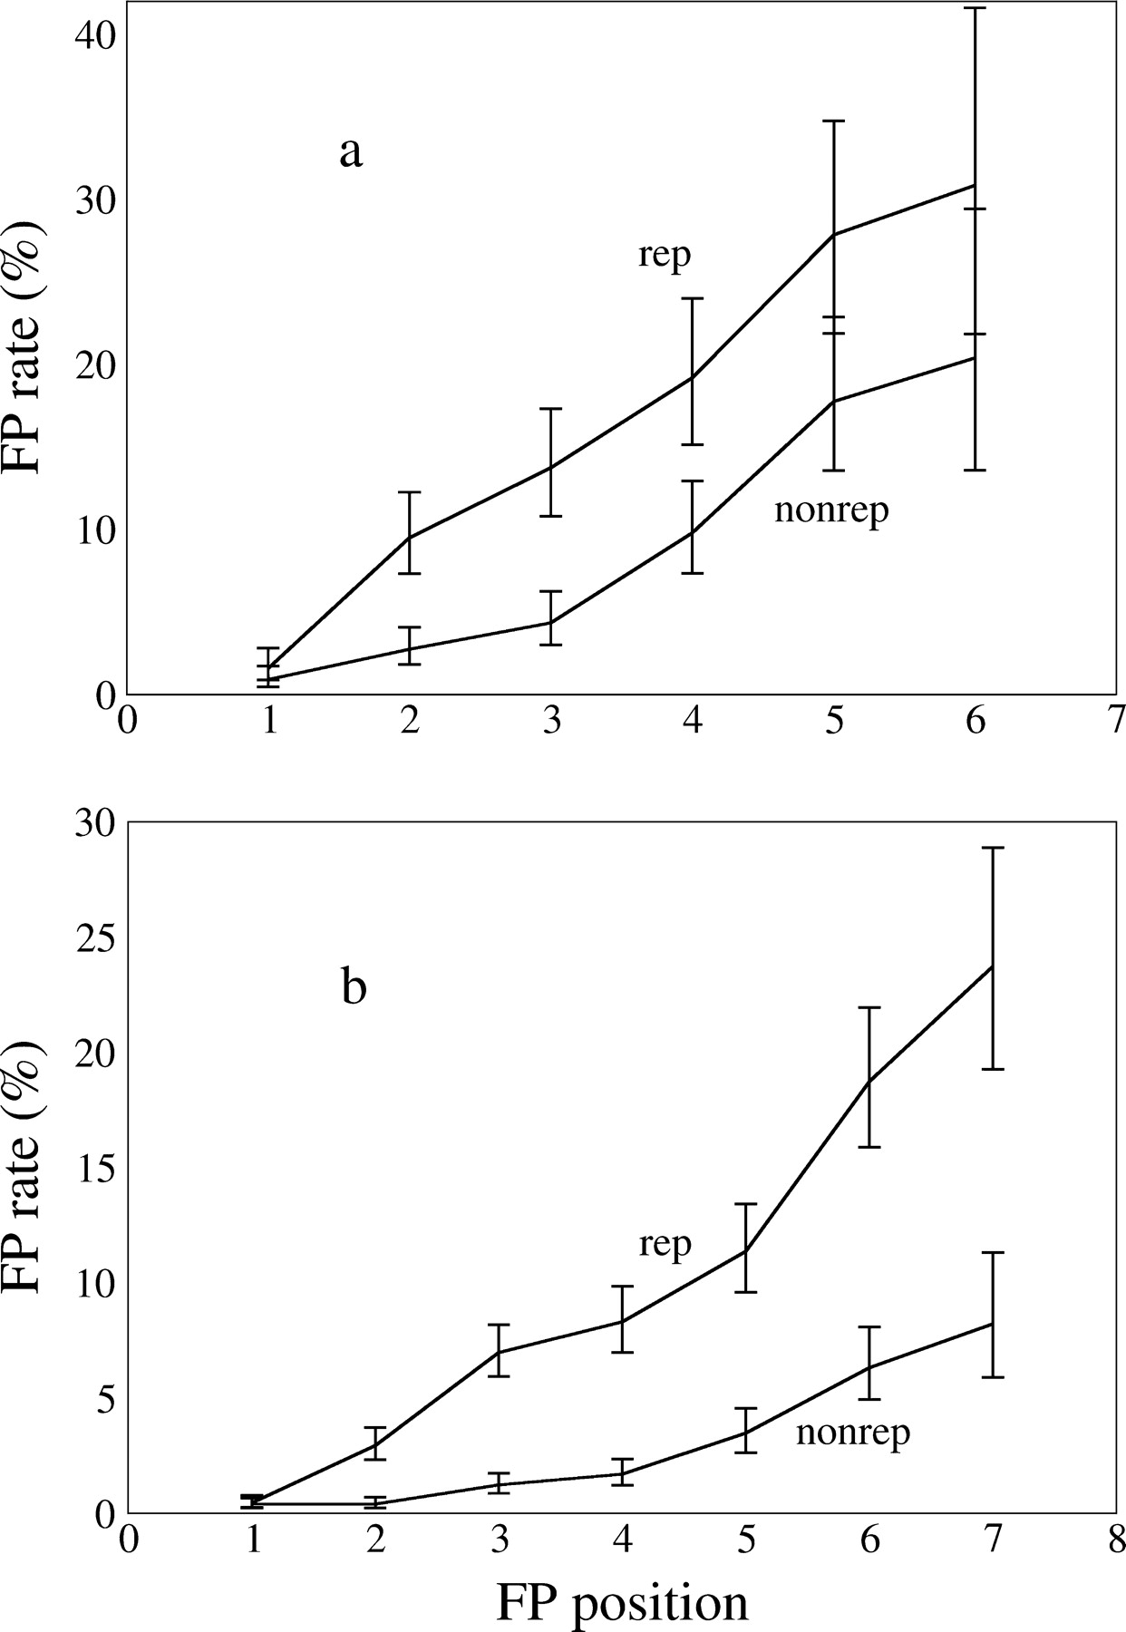
Figure 6. False Positives due to image in preceding trial. FP rate versus FP position in current sequence when FP image ...
Notes:
Figure 6. False Positives due to image in preceding trial. FP rate versus FP position in current sequence when FP image appears in the sequence of the preceding trial (‘rep’) or does not appear there (‘nonrep’) for monkey F (a) and M (b; summing over eight and 16 image sets). The curves are quite similar to those of Figure 5a. Except for position 1, there is an ∼10% difference between the two cases, which is interpreted as the presence in WM during the current trial of items remaining from the preceding trial. Data are cumulative for image presentation position in the sequence of the preceding trial. The absence of the effect for position 1 is interpreted as reflecting the monkeys' learning the fact that when performing the task, a reward is never given for choosing to respond to the first stimulus. See Discussion for possible mechanisms of increasing rep-nonrep difference for monkey M.
Unless provided in the caption above, the following copyright applies to the content of this slide: Cerebral Cortex V 15 N 5 © Oxford University Press 2004; all rights reserved

Slide 7
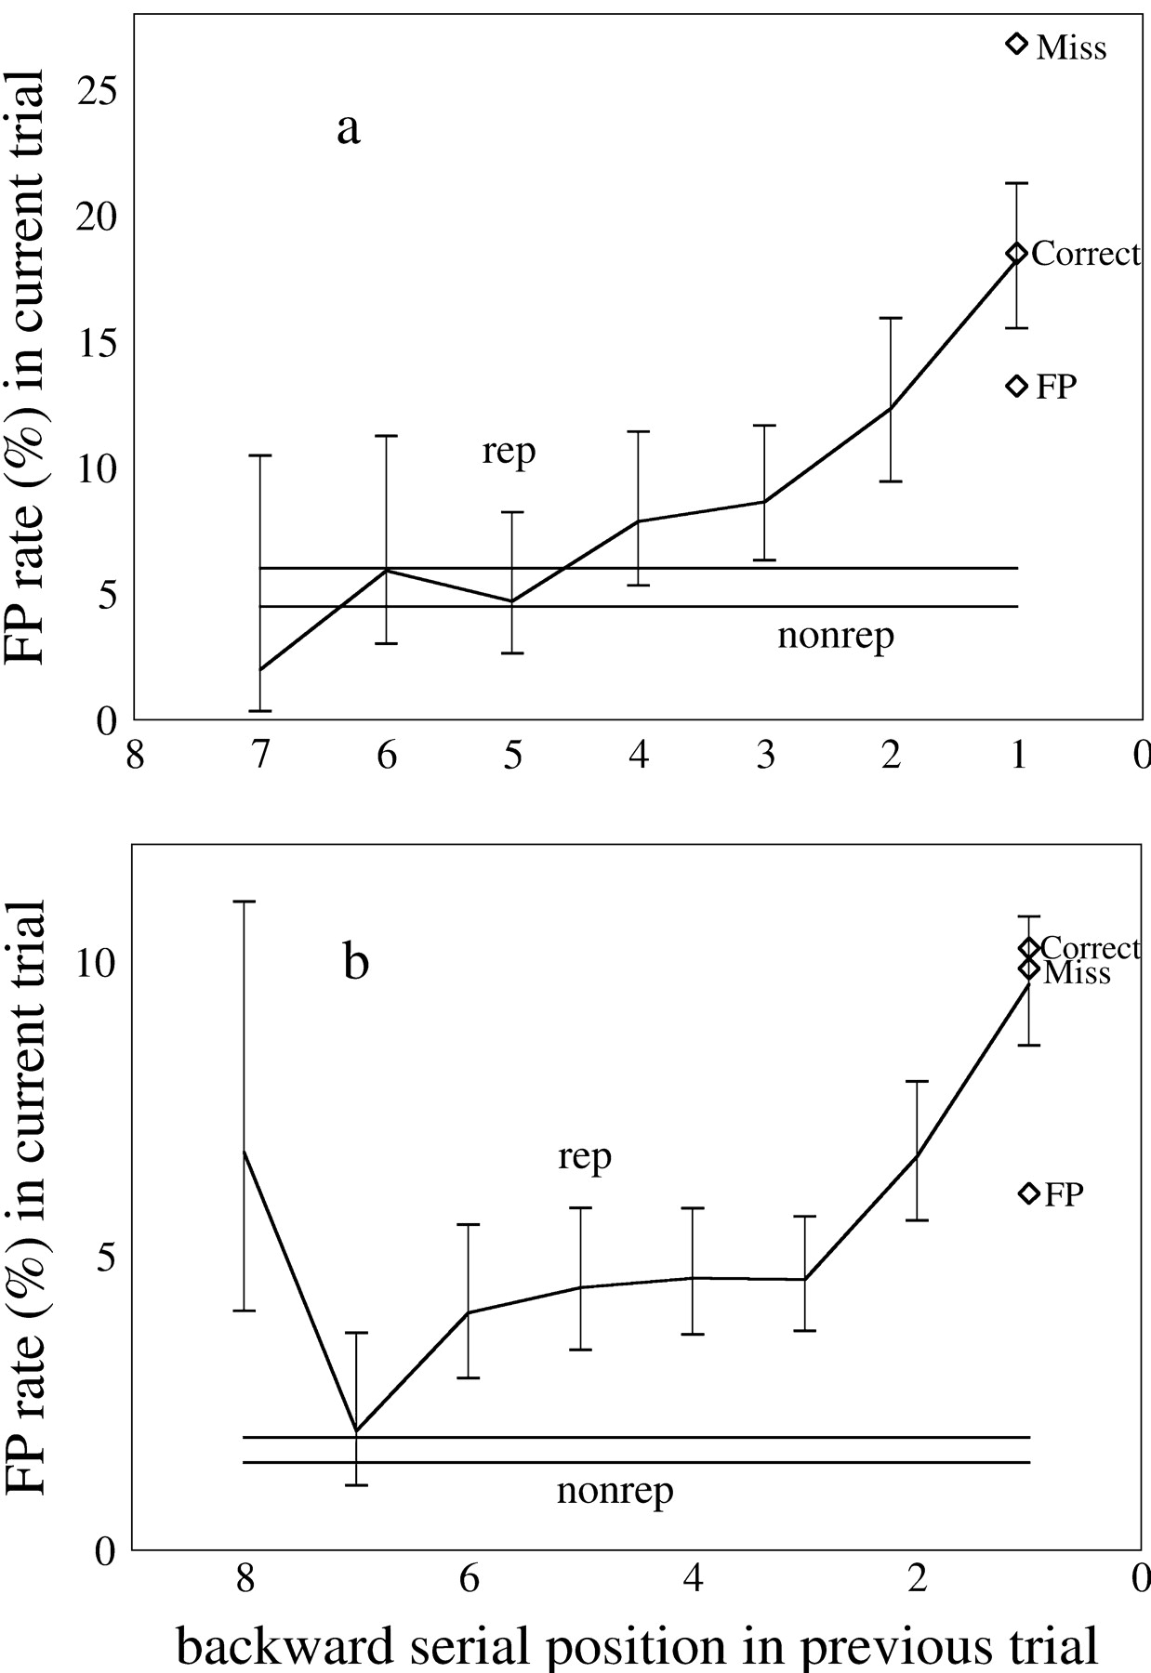
Figure 7. False Positive rate dependence on backward serial position (distance from end of sequence) in preceding trial ...
Notes:
Figure 7. False Positive rate dependence on backward serial position (distance from end of sequence) in preceding trial (rep). Data averaged over FP-positions in the current trial. Horizontal lines: confidence interval for FP rates of images not present in preceding trial (nonrep). (a) Monkey F: FP rate decreases with backward serial position, indicating that older items are less likely to remain in WM during the next trial. Images further than four away from the end of the preceding trial no longer affect the FP rate: the FP rate reaches the ‘nonrep’, horizontal lines. The FP rate for the last image (backward position 1) in the preceding trial depends on the result in the preceding trial: higher for miss trials than correct trials and higher for correct trials than FP trials. (b) Monkey M: decreasing trend of FP rate in current trial with preceding trial backward serial position, except for the oldest image of the preceding trial. FP rate maintains the effect of previous images much further into the past than for monkey F. For backward position 1, the last image of the preceding trial, FP rate depends on the behavioral score in the preceding trial: it is higher for correct and miss trials than for FP trials. The error bar on the first point is for the FP rate without separation according to the result in the previous trial. The significance of the differences is reported in detail in the text.
Unless provided in the caption above, the following copyright applies to the content of this slide: Cerebral Cortex V 15 N 5 © Oxford University Press 2004; all rights reserved

Slide 8
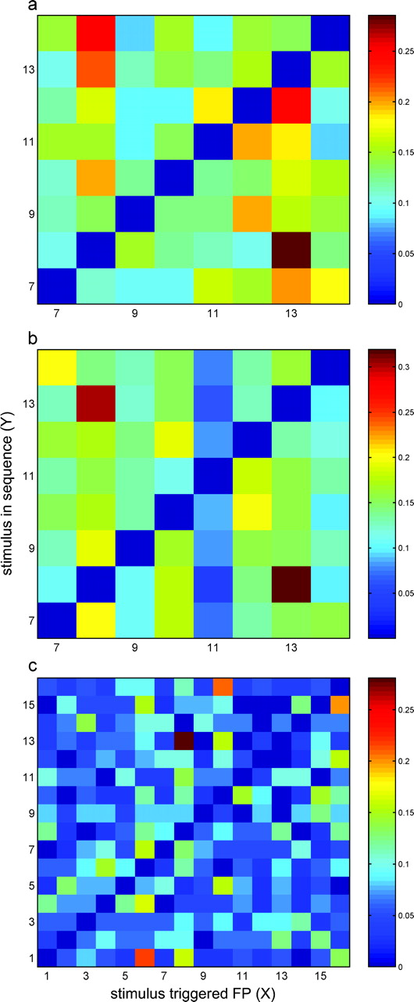
Figure 8. Perceived similarity test: conditional probability matrices for (a) monkey F, eight-image set, (b) monkey M, ...
Notes:
Figure 8. Perceived similarity test: conditional probability matrices for (a) monkey F, eight-image set, (b) monkey M, eight-image set and (c) monkey M, 16 image set. The eight-image sets are the same subset of the 16-image set (see Fig. 1b). Perceived similarity between X and Y should produce high probabilities for symmetric conditions: P(X|Y) and P(Y|X). The high conditional probabilities (in brown/red) for the pair (8,13) are evident and symmetric for both monkeys when using the eight-image set (plots a and b). For the 16-image set (c), P(8|13) is significantly in excess, but P(13|8) is larger than average but not significantly so.
Unless provided in the caption above, the following copyright applies to the content of this slide: Cerebral Cortex V 15 N 5 © Oxford University Press 2004; all rights reserved

