Slide 1
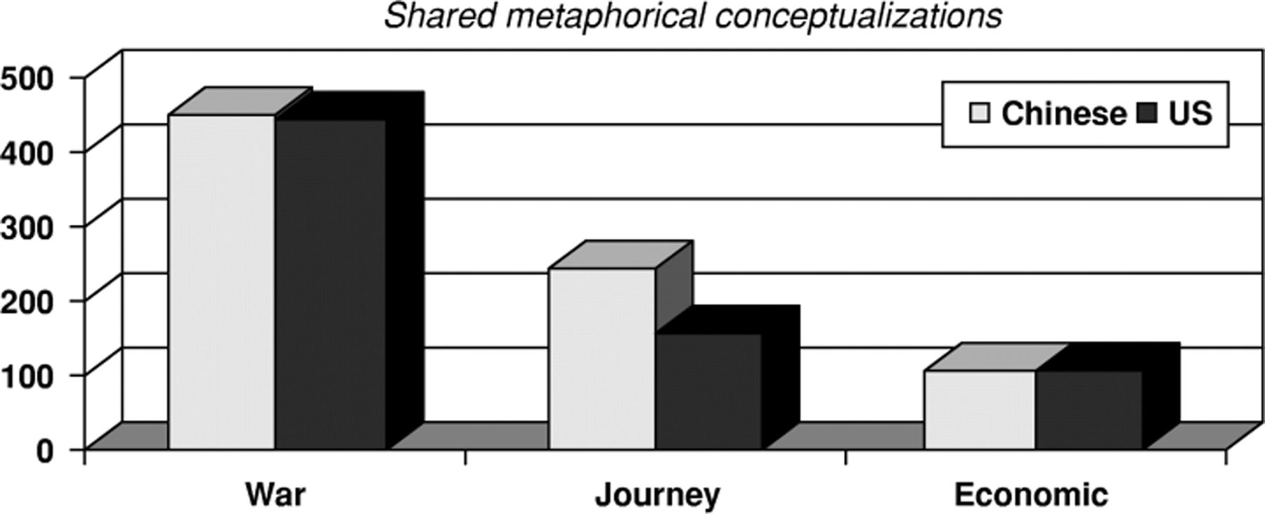
1 Comparison of Chinese and U.S. Totals for Salient Shared Coding Families
Notes:
1 Comparison of Chinese and U.S. Totals for Salient Shared Coding Families
Unless provided in the caption above, the following copyright applies to the content of this slide: © 2007 International Studies Association

Slide 2
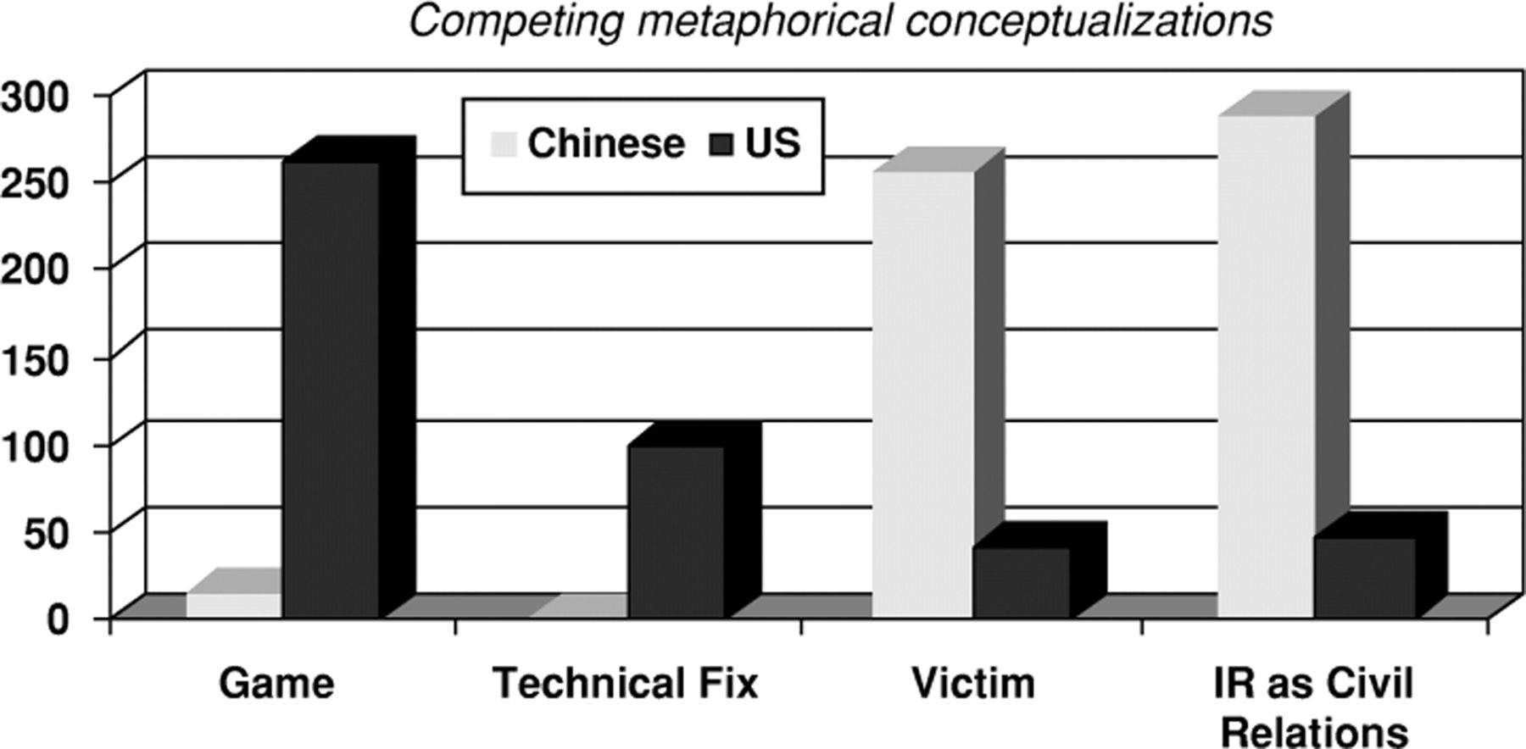
2 Comparison of Chinese and U.S. Totals for Salient Competing Coding Families
Notes:
2 Comparison of Chinese and U.S. Totals for Salient Competing Coding Families
Unless provided in the caption above, the following copyright applies to the content of this slide: © 2007 International Studies Association

