Slide 1
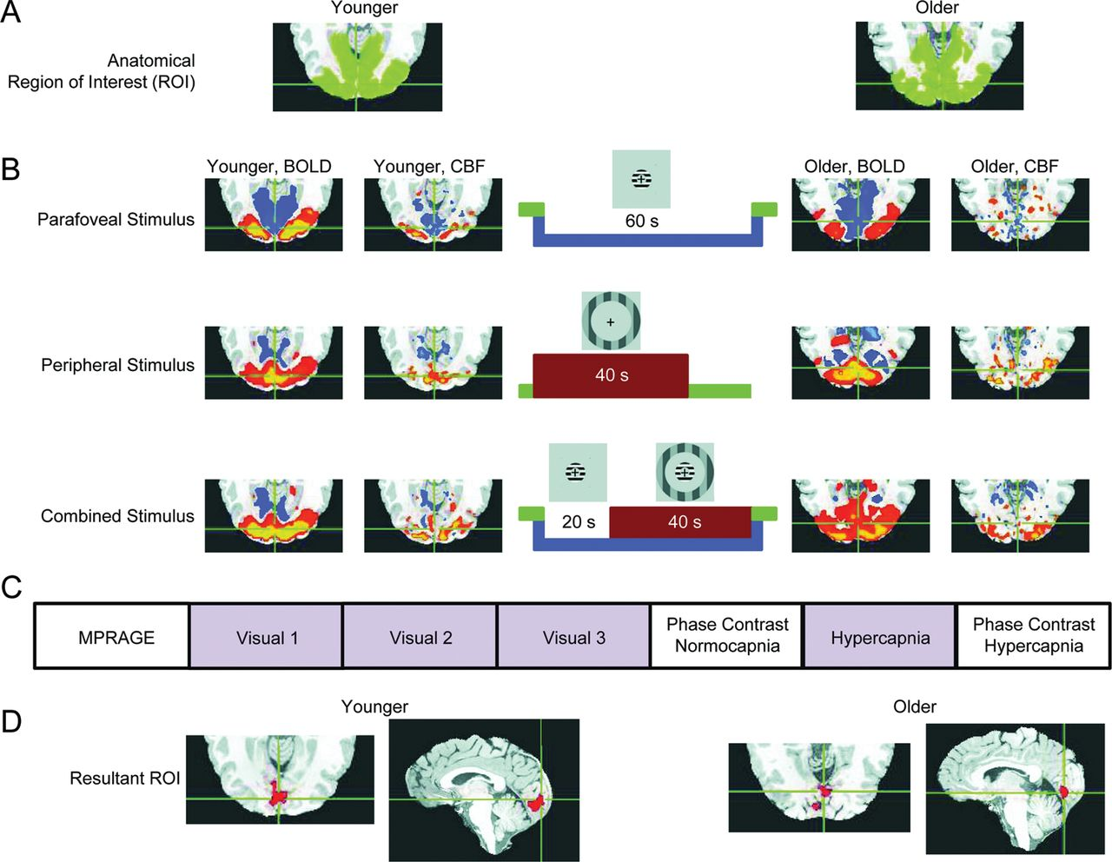
Figure 2. Regions of interest and the experimental paradigm. (A) Representative younger and older anatomical regions of ...
Notes:
Figure 2. Regions of interest and the experimental paradigm. (A) Representative younger and older anatomical regions of interest (ROIs) based on Brodmann areas (BAs) 17, 18, and 19, which encompass visual cortex. (B) Representative younger and older responses to visual stimulation (CBF and BOLD) depicted under different stimulus conditions (parafoveal, peripheral, and combined response; axial view, visual cortex; cf. Pasley et al. 2007). Cool colors indicate negative activations compared with fixation; warm colors indicate positive activations compared with fixation, all corrected P < .05. The time course of the visual stimulation is shown along with the corresponding stimulus. For the time course, green represents fixation, blue represents parafoveal stimulation, and red represents peripheral stimulation. (C) The order of scans. Scans shaded in purple were dual-echo arterial spin labeling (ASL) scans, during which both CBF and BOLD signals were acquired. (D) The ROI resulting from the combination of the anatomical ROI and functional activation requirements from the visual task. To be retained in the final ROI, a voxel had to be contained within the anatomical ROI and have a negative response to the parafoveal stimulus but a positive response to both the peripheral and combined stimuli. All statistics were computed on the resultant ROI.
Unless provided in the caption above, the following copyright applies to the content of this slide: © The Author 2012. Published by Oxford University Press.This is an Open Access article distributed under the terms of the Creative Commons Attribution Non-Commercial License (http://creativecommons.org/licenses/by-nc/3.0), which permits unrestricted non-commercial use, distribution, and reproduction in any medium, provided the original work is properly cited.

Slide 2
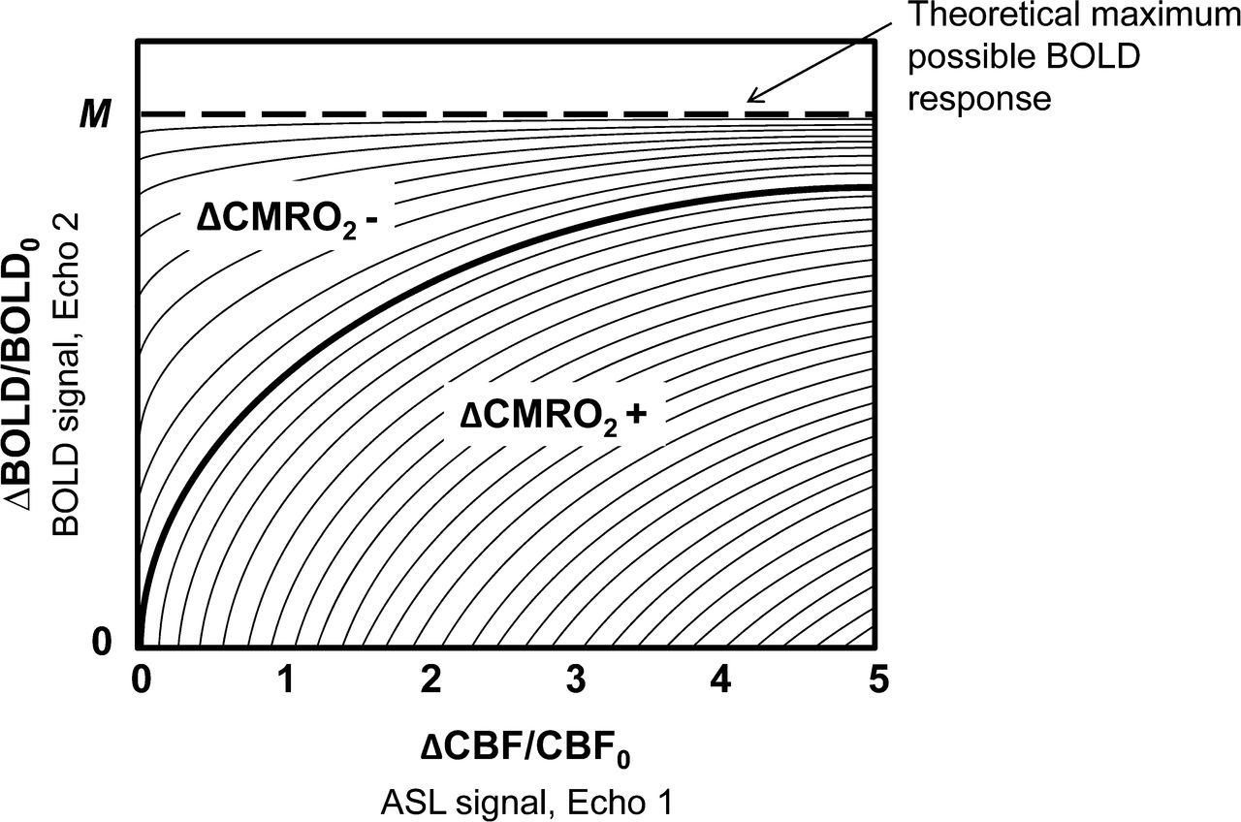
Figure 1. The complex relationship between ΔCBF, ΔCMRO₂, M, and BOLD. Age-related changes in ΔCBF and ...
Notes:
Figure 1. The complex relationship between ΔCBF, ΔCMRO2, M, and BOLD. Age-related changes in ΔCBF and ΔCMRO2, and the ratio between these physiological processes, can yield age-equivalence or age-difference in the BOLD response. For a given level of ΔCBF, increases in ΔCMRO2 lead to decreases in the BOLD response (region ΔCMRO2+). Likewise, decreases in ΔCMRO2 lead to increases in the BOLD response (region ΔCMRO2-). Each point along an iso-ΔCMRO2 contour represents a unique ΔCBF/ΔCMRO2 ratio. (Figure from Hoge et al. 1999a, with permission.)
Unless provided in the caption above, the following copyright applies to the content of this slide: © The Author 2012. Published by Oxford University Press.This is an Open Access article distributed under the terms of the Creative Commons Attribution Non-Commercial License (http://creativecommons.org/licenses/by-nc/3.0), which permits unrestricted non-commercial use, distribution, and reproduction in any medium, provided the original work is properly cited.

Slide 3
Figure 3. CBF and BOLD responses to visual stimulation. (A) BOLD percent signal change (mean ± SEM) for younger and ...
Notes:
Figure 3. CBF and BOLD responses to visual stimulation. (A) BOLD percent signal change (mean ± SEM) for younger and older groups based on visual stimulation shown by stimulus condition. Significant differences between groups are indicated by asterisks: *P < 0.04, **P < 0.004. (B) CBF percent signal change (mean ± SEM) for younger and older groups based on visual stimulation shown by stimulus condition. (Comparison of the combined condition to parafoveal stimulation, shown in the rightmost bars of Fig. 3A,B, is aggregated from the parafoveal and combined stimulus conditions for both BOLD and CBF—that is, the effects are additive. Although this is not an independent measurement, it is shown here for illustrative purposes).
Unless provided in the caption above, the following copyright applies to the content of this slide: © The Author 2012. Published by Oxford University Press.This is an Open Access article distributed under the terms of the Creative Commons Attribution Non-Commercial License (http://creativecommons.org/licenses/by-nc/3.0), which permits unrestricted non-commercial use, distribution, and reproduction in any medium, provided the original work is properly cited.

Slide 4
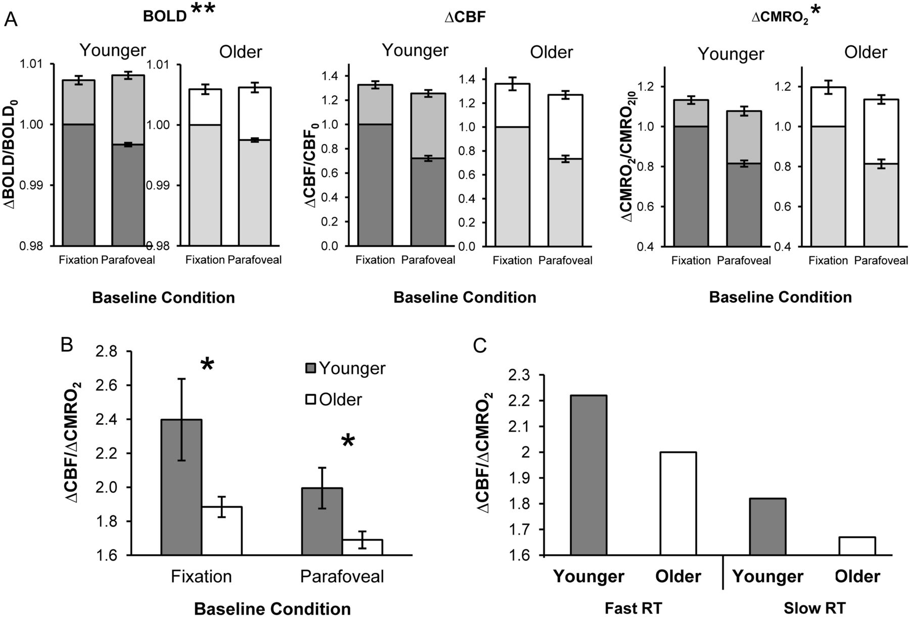
Figure 4. ΔCBF/ΔCMRO₂ Ratios for Younger and Older Groups. (A) Ratios comparing evoked responses (lighter, ...
Notes:
Figure 4. ΔCBF/ΔCMRO2 Ratios for Younger and Older Groups. (A) Ratios comparing evoked responses (lighter, upper bars) from fixation and parafoveal stimulation conditions (darker, lower bars) for BOLD, ΔCBF, and ΔCMRO2, normalized to fixation condition levels. Incremental evoked BOLD, ΔCBF, and ΔCMRO2 responses (mean ± SEM) were greater from parafoveal stimulation than from fixation. Significant differences from fixation between groups are indicated by asterisks: *P≤0.04, **P < 0.004. (B) ΔCBF/ΔCMRO2 (mean ± SEM) shown by group membership and condition. Older participants had lower ΔCBF/ΔCMRO2 ratios, which were associated with a lower BOLD response. Significant differences between groups are indicated by an asterisk: *P ≤0.04. (C) Younger and older participants were designated as fast or slow responders based on median reaction time (RT) within each group. The resulting median ΔCBF/ΔCMRO2 ratios for each group from fixation illustrate the significant association between ΔCBF/ΔCMRO2 and RT, which was calculated across groups.
Unless provided in the caption above, the following copyright applies to the content of this slide: © The Author 2012. Published by Oxford University Press.This is an Open Access article distributed under the terms of the Creative Commons Attribution Non-Commercial License (http://creativecommons.org/licenses/by-nc/3.0), which permits unrestricted non-commercial use, distribution, and reproduction in any medium, provided the original work is properly cited.

Slide 5
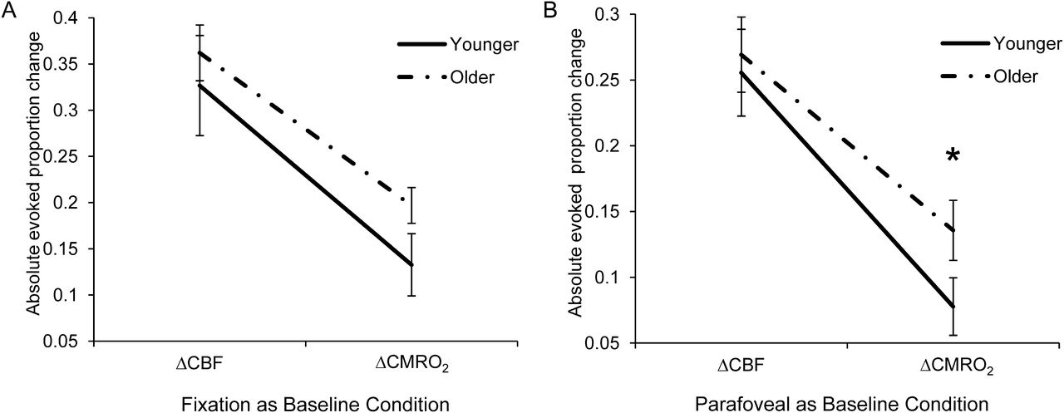
Figure 5. ΔCBF and ΔCMRO₂ evoked responses for younger and older groups. ΔCBF and ΔCMRO₂ evoked ...
Notes:
Figure 5. ΔCBF and ΔCMRO2 evoked responses for younger and older groups. ΔCBF and ΔCMRO2 evoked responses (mean ± SEM) are shown to compare age-related differences for these constituents of the BOLD response. Data are shown from both (A) fixation (ΔCBF: younger mean = 0.33 ± 0.03, older mean = 0.36 ± 0.05; ΔCMRO2: younger mean = 0.13 ± 0.02, older mean = 0.20 ± 0.03) and (B) parafoveal stimulation (ΔCBF: younger mean = 0.26 ± 0.03; older mean = 0.27 ± 0.03; ΔCMRO2: younger mean = 0.08 ± 0.02, older mean = 0.14 ± 0.02). Significant differences between groups are indicated by an asterisk: *P ≤0.04.
Unless provided in the caption above, the following copyright applies to the content of this slide: © The Author 2012. Published by Oxford University Press.This is an Open Access article distributed under the terms of the Creative Commons Attribution Non-Commercial License (http://creativecommons.org/licenses/by-nc/3.0), which permits unrestricted non-commercial use, distribution, and reproduction in any medium, provided the original work is properly cited.

