Slide 1
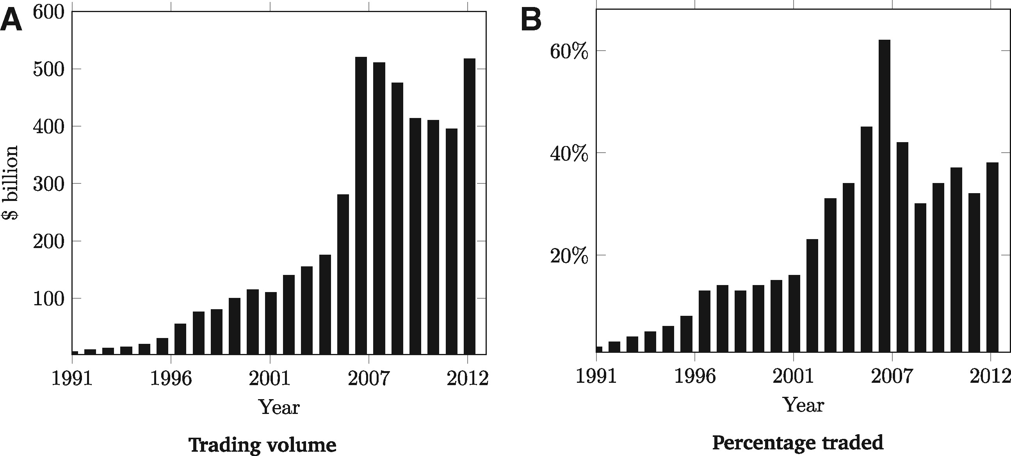
Figure 1 Trading volume in the secondary corporate loan market between 1991 and 2013 This figure demonstrates the ...
Notes:
Figure 1 Trading volume in the secondary corporate loan market between 1991 and 2013 This figure demonstrates the total dollar value of loans traded in the secondary corporate loan market from 1991 to 2013 in the United States (A) and the percentage of outstanding loans traded in the secondary market each year between 1991 and 2013 (B). Source: Shared National Credits Program 2013 Review available at www.federalreserve.gov and the LSTA Trade Data Study avaiable at www.lsta.org.
Unless provided in the caption above, the following copyright applies to the content of this slide: © The Author 2017. Published by Oxford University Press on behalf of The Society for Financial Studies. All rights reserved. For Permissions, please email: journals.permissions@oup.com

Slide 2
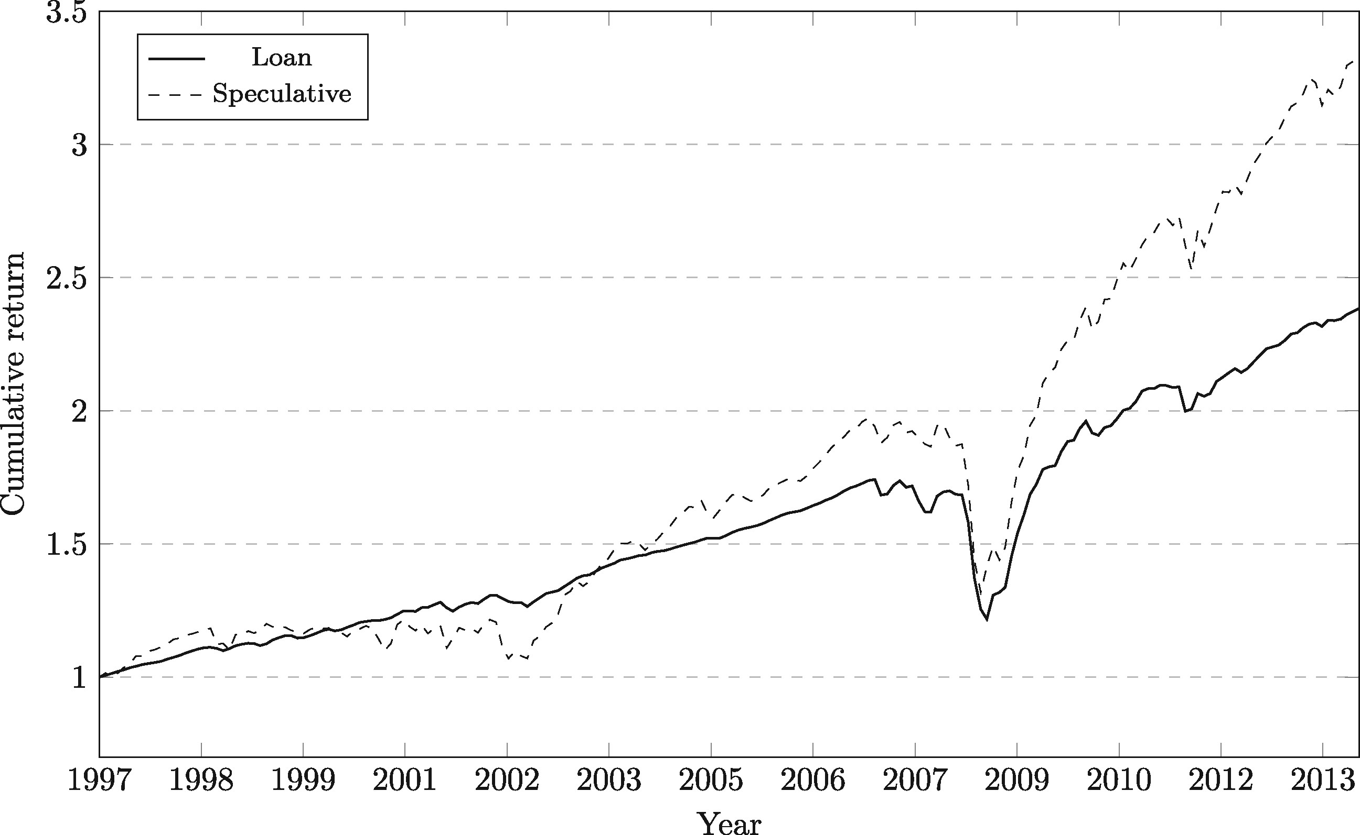
Figure 2 Cumulative returns on loans and speculative bonds between 1997 and 2013 This graph displays the cumulative ...
Notes:
Figure 2 Cumulative returns on loans and speculative bonds between 1997 and 2013 This graph displays the cumulative returns on a dollar invested in the secondary loan market and B of A Merrill Lynch US High Yield Master II Total Return Index for the period of January-1997 to December-2013
Unless provided in the caption above, the following copyright applies to the content of this slide: © The Author 2017. Published by Oxford University Press on behalf of The Society for Financial Studies. All rights reserved. For Permissions, please email: journals.permissions@oup.com

Slide 3
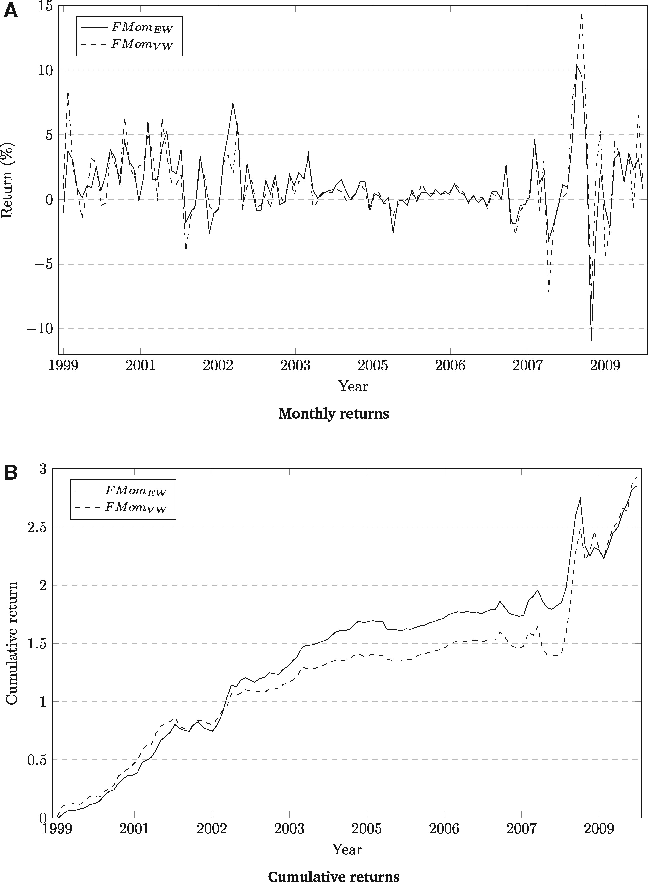
Figure 3 Cumulative and monthly returns of the momentum factor The figure displays the monthly returns of the equal- ...
Notes:
Figure 3 Cumulative and monthly returns of the momentum factor The figure displays the monthly returns of the equal- and value-weighted portfolios that buy portfolio 10 and shorts portfolio 1 (A). Portfolios are rebalanced every month. The figure also shows the time series for cumulative returns for the momentum factor (B). The sample period runs from September 1999 to December 2009.
Unless provided in the caption above, the following copyright applies to the content of this slide: © The Author 2017. Published by Oxford University Press on behalf of The Society for Financial Studies. All rights reserved. For Permissions, please email: journals.permissions@oup.com

Slide 4
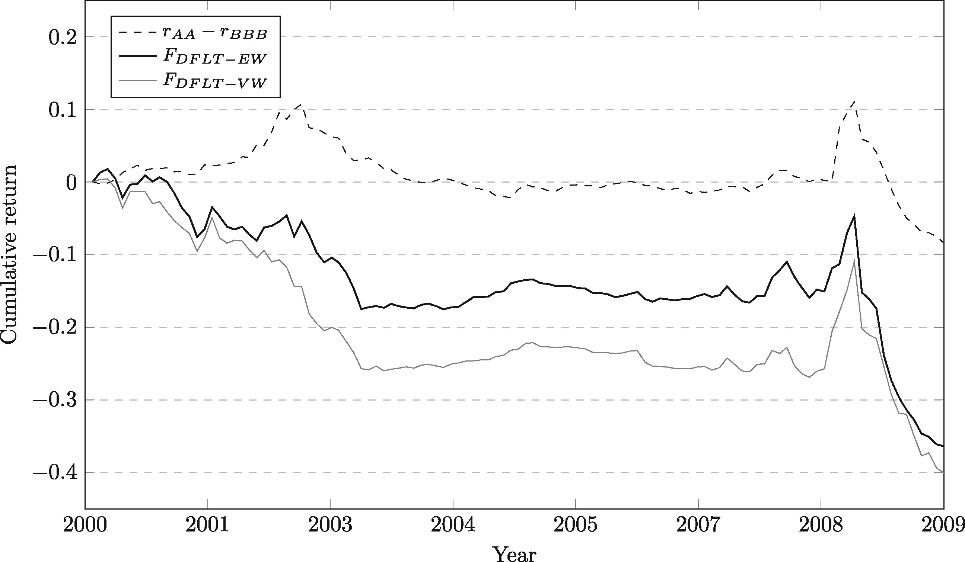
Figure 4 Cumulative returns on the default risk factor and the default-mimicking factors between July 2000 and ...
Notes:
Figure 4 Cumulative returns on the default risk factor and the default-mimicking factors between July 2000 and December 2009 The dashed line plots the cumulative returns on a portfolio with a long position in AA grade bonds and a short position in BBB bonds. The two solid lines plot the cumulative returns for the equal- and value-weighted default-mimicking factors.
Unless provided in the caption above, the following copyright applies to the content of this slide: © The Author 2017. Published by Oxford University Press on behalf of The Society for Financial Studies. All rights reserved. For Permissions, please email: journals.permissions@oup.com

Slide 5
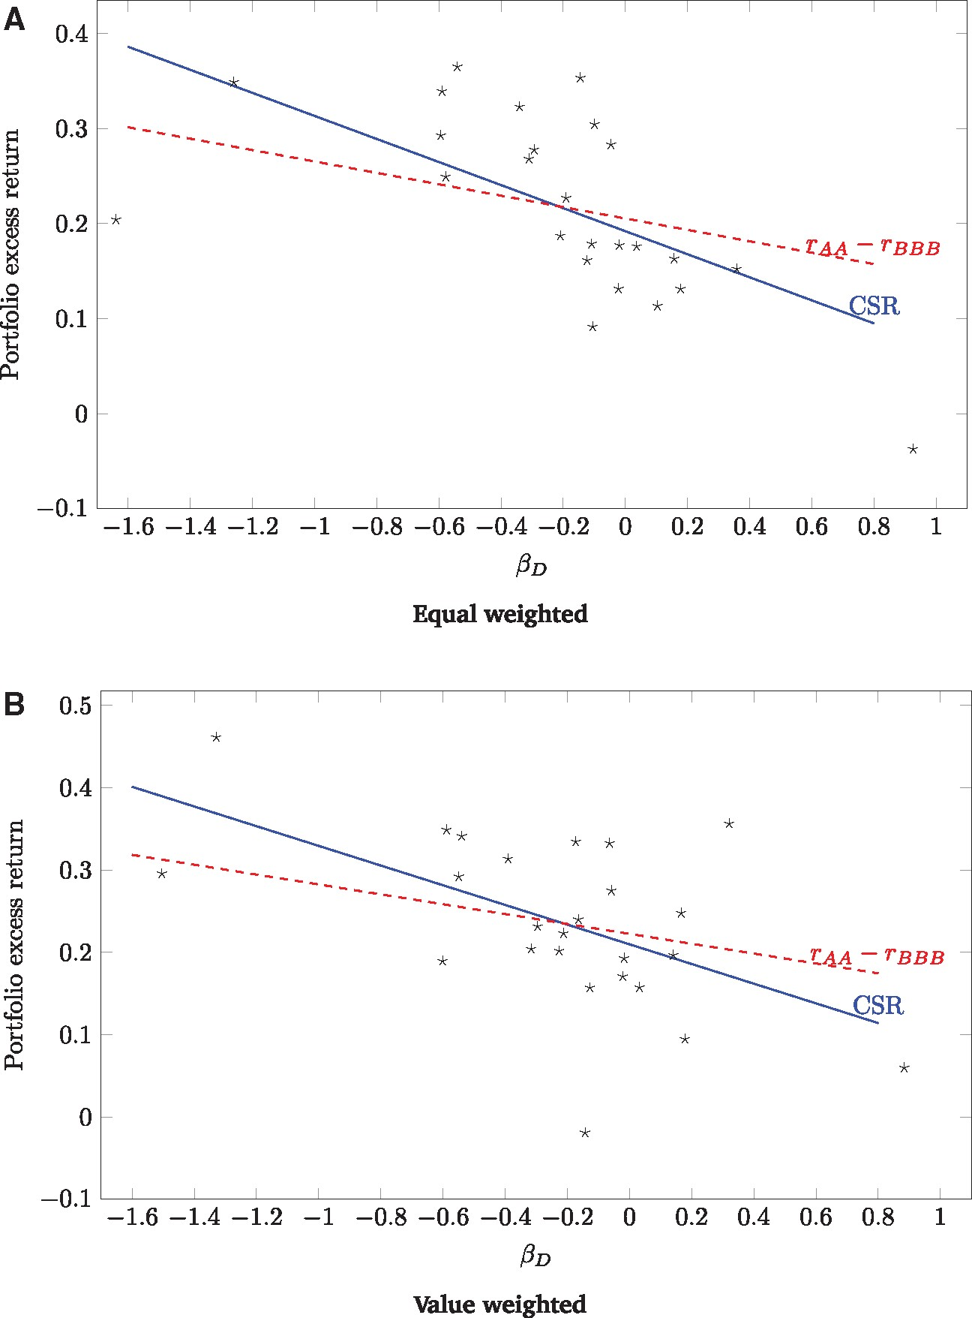
Figure 5 Default risk lines for loan returns The figures plot the return - default beta line where the slope is ...
Notes:
Figure 5 Default risk lines for loan returns The figures plot the return - default beta line where the slope is restricted to equal the time-series average of the rating-based factor (dashed lines), or is estimated from cross-sectional OLS regressions for equal weighted (A) and value-weighted (B) loan portfolio excess returns (Table 7). The cross-section contains 25 portfolios sorted on loan level pre-ranking term and default betas. The post-ranking beta for each portfolio is obtained from a single time-series regression of excess daily returns over the sample period.
Unless provided in the caption above, the following copyright applies to the content of this slide: © The Author 2017. Published by Oxford University Press on behalf of The Society for Financial Studies. All rights reserved. For Permissions, please email: journals.permissions@oup.com

