Slide 1
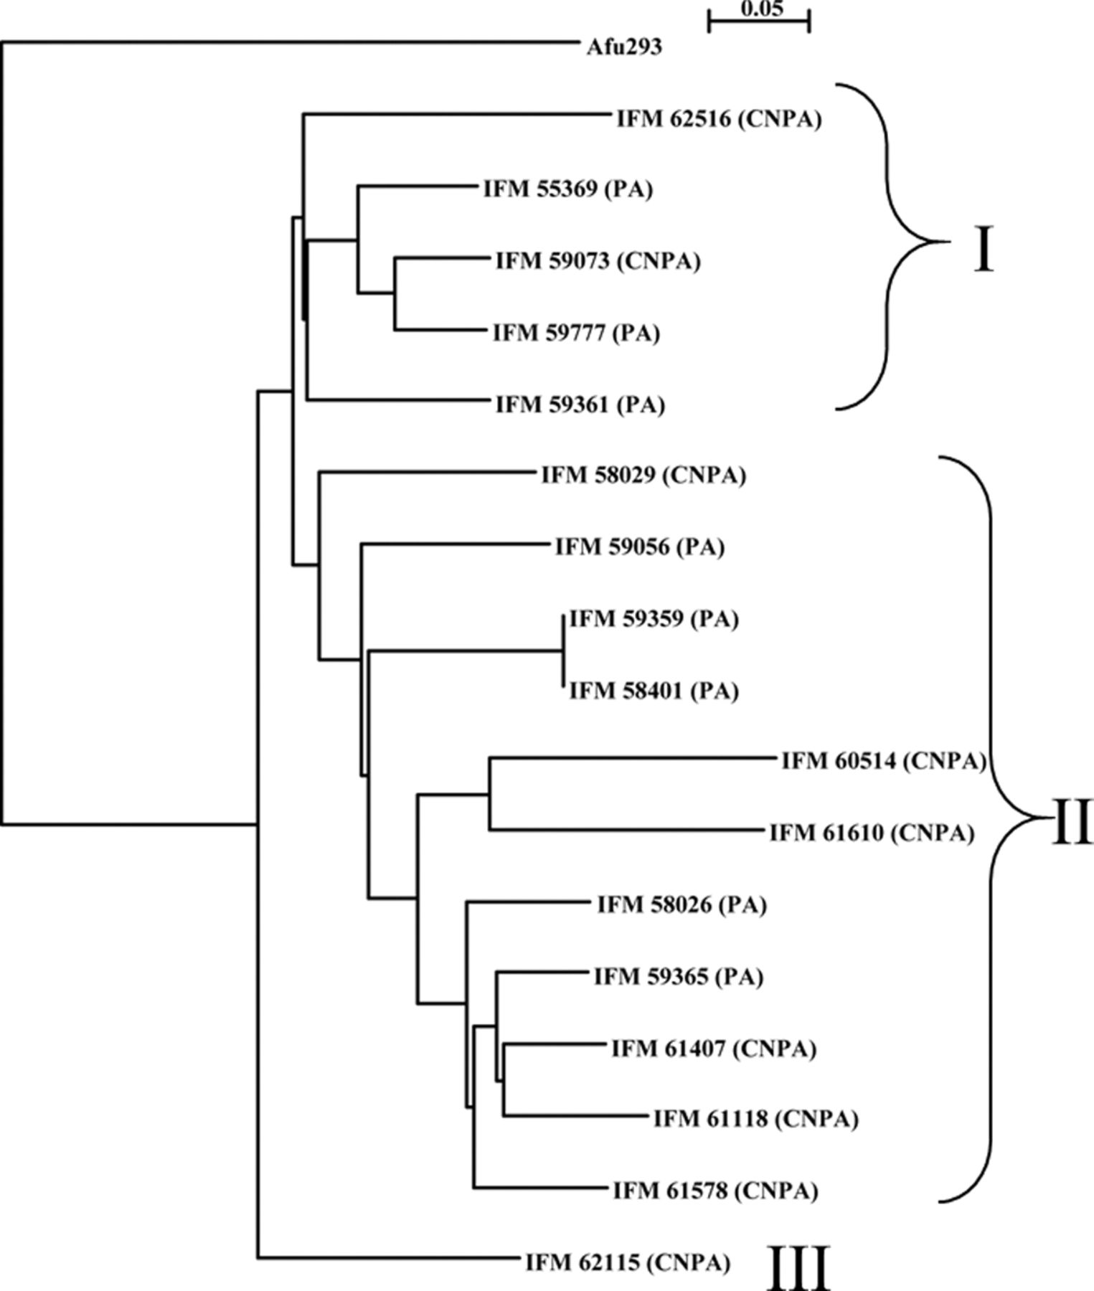
Figure 1. Phylogenetic analysis based on the sequences of concatenated 42,345 nucleotides. PA and CNPA correspond to ...
Notes:
Figure 1. Phylogenetic analysis based on the sequences of concatenated 42,345 nucleotides. PA and CNPA correspond to pathological conditions.
Unless provided in the caption above, the following copyright applies to the content of this slide: © The Author 2015. Published by Oxford University Press on behalf of The International Society for Human and Animal Mycology. All rights reserved. For permissions, please e-mail: journals.permissions@oup.com

Slide 2
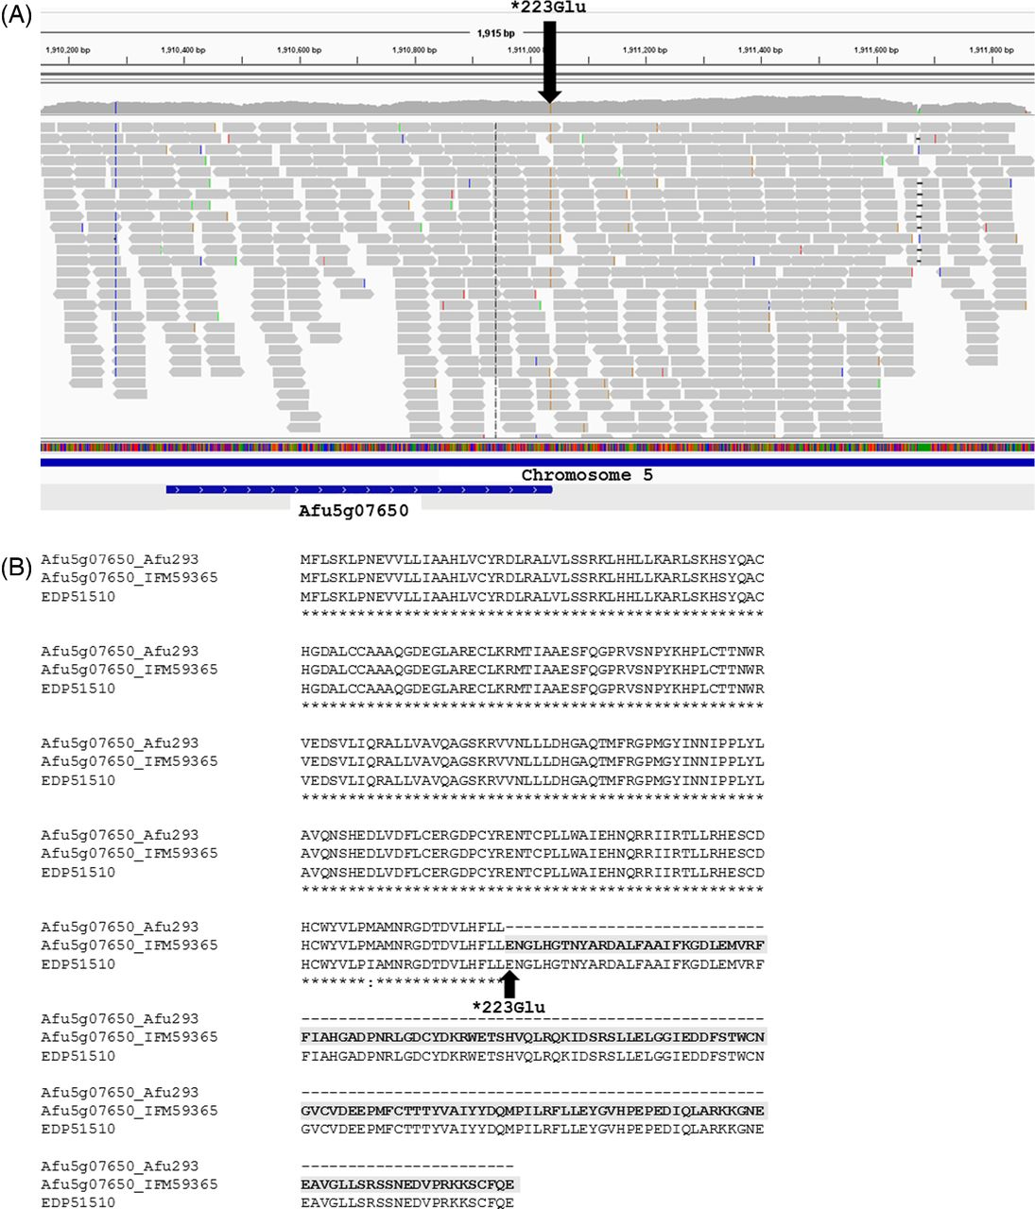
Figure 2. Afu5g07650 of IFM 59365. (A) The expression profile of Afu5g07650 by RNA-Seq visualized by Integrative ...
Notes:
Figure 2. Afu5g07650 of IFM 59365. (A) The expression profile of Afu5g07650 by RNA-Seq visualized by Integrative Genomics Viewer. The gene was transcribed after 1,911,036 on chromosome 5, where the substitution from stop codon was observed. The reads derived from mRNA covered the region of Afu5g07650. (B) The multiple alignment of amino acid sequences by ClustalW in GenomeNet (http://www.genome.jp/tools/clustalw/). Afu5g07650_IFM59365 was the predicted sequence by substitution of *223Glu. This Figure is reproduced in color in the online version of Medical Mycology.
Unless provided in the caption above, the following copyright applies to the content of this slide: © The Author 2015. Published by Oxford University Press on behalf of The International Society for Human and Animal Mycology. All rights reserved. For permissions, please e-mail: journals.permissions@oup.com

