Slide 1
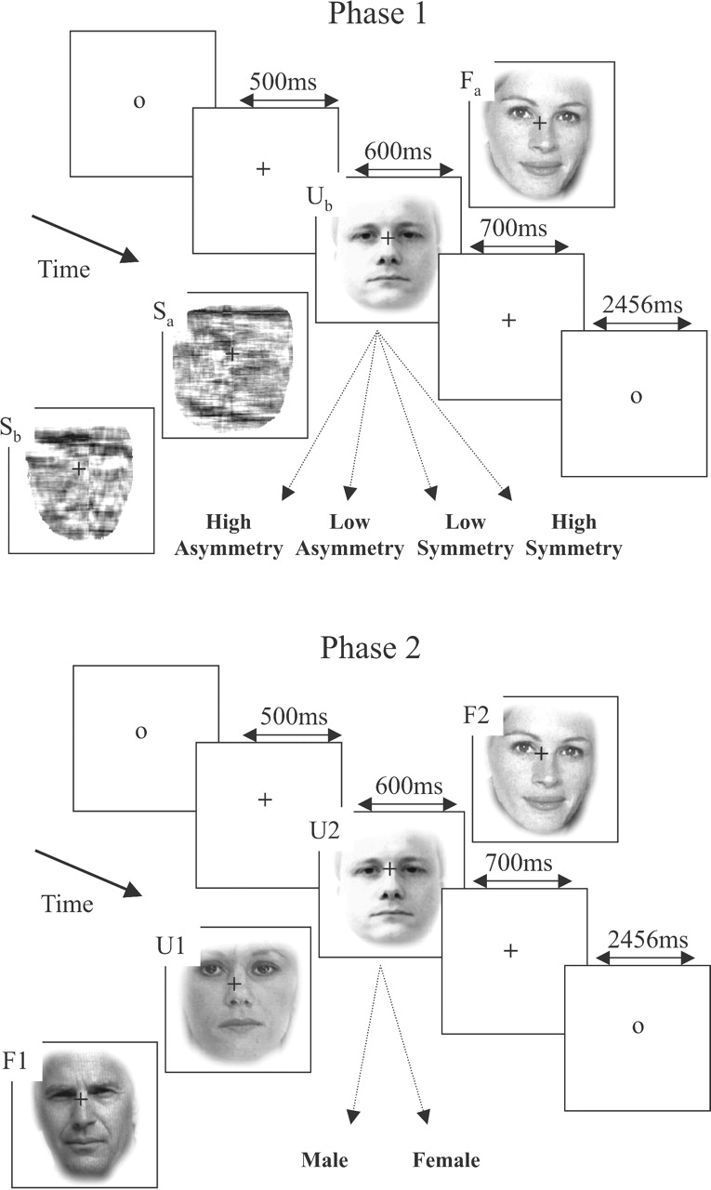
Figure 1. Trial format in Phase 1 and Phase 2, together with examples of Unfamiliar (U), Familiar (F) and Scrambled (S) ...
Notes:
Figure 1. Trial format in Phase 1 and Phase 2, together with examples of Unfamiliar (U), Familiar (F) and Scrambled (S) faces in Phase 1, and first (F1 and U1) and second (F2 and U2) presentations of familiar/unfamiliar faces in Phase 2. Each face in Phase 1 (e.g. Fa and Ub) had a corresponding scrambled version (i.e. Sa and Sb).
Unless provided in the caption above, the following copyright applies to the content of this slide: © Oxford University Press

Slide 2
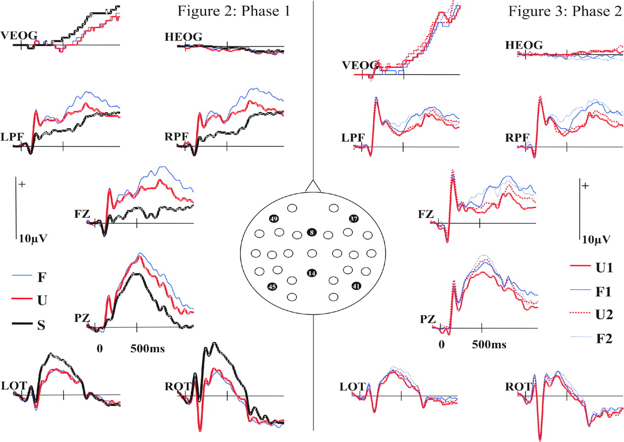
Figure 2. ERPs in Phase 1 at selected electrodes from the montage (inset): vertical (VEOG) and horizontal (HEOG) ...
Notes:
Figure 2. ERPs in Phase 1 at selected electrodes from the montage (inset): vertical (VEOG) and horizontal (HEOG) electro-occulograms, left and right prefrontal (LPF/RPF, Easycap sites 49/37), frontocentral (Fz), parietocentral (Pz) and left and right occipitotemporal (LOT/ROT, Easycap sites 45/41). Note that the relatively poor resolution of VEOG amplitude reflects the lower gain at which this channel was amplified, to avoid blink-related saturation.
Unless provided in the caption above, the following copyright applies to the content of this slide: © Oxford University Press

Slide 3
Figure 3. ERPs in Phase 2. See Figure 2 legend for more details.
Notes:
Figure 3. ERPs in Phase 2. See Figure 2 legend for more details.
Unless provided in the caption above, the following copyright applies to the content of this slide: © Oxford University Press

Slide 4
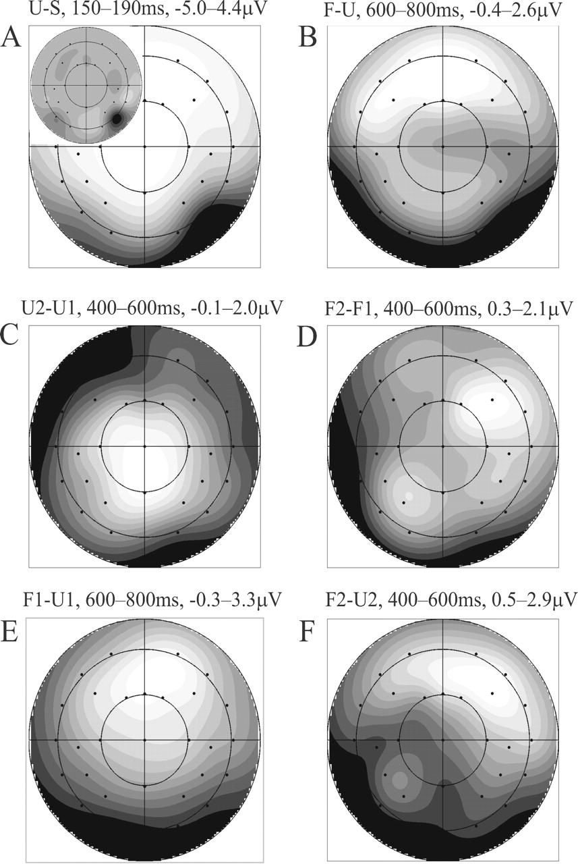
Figure 4. Scalp potential difference maps for (A) unfamiliar versus scrambled faces 150–190ms, with Current Source ...
Notes:
Figure 4. Scalp potential difference maps for (A) unfamiliar versus scrambled faces 150–190ms, with Current Source Density (CSD) map inset, (B) familiar versus unfamiliar faces in Phase 1, 600–800ms, (C) second versus first presentations of unfamiliar faces in Phase 2, 400–600ms, (D) second versus first presentations of familiar faces in Phase 2, 400–600ms, (E) first presentations of familiar versus unfamiliar faces in Phase 2, 600–800ms, (F) second presentations of familiar versus unfamiliar faces in Phase 2, 400–600ms. Greys scaled to max/min of differences, light = positive, dark = negative. Note that CSDs for the effects in (B)–(F) did not add any information, and are therefore not shown.
Unless provided in the caption above, the following copyright applies to the content of this slide: © Oxford University Press

Slide 5
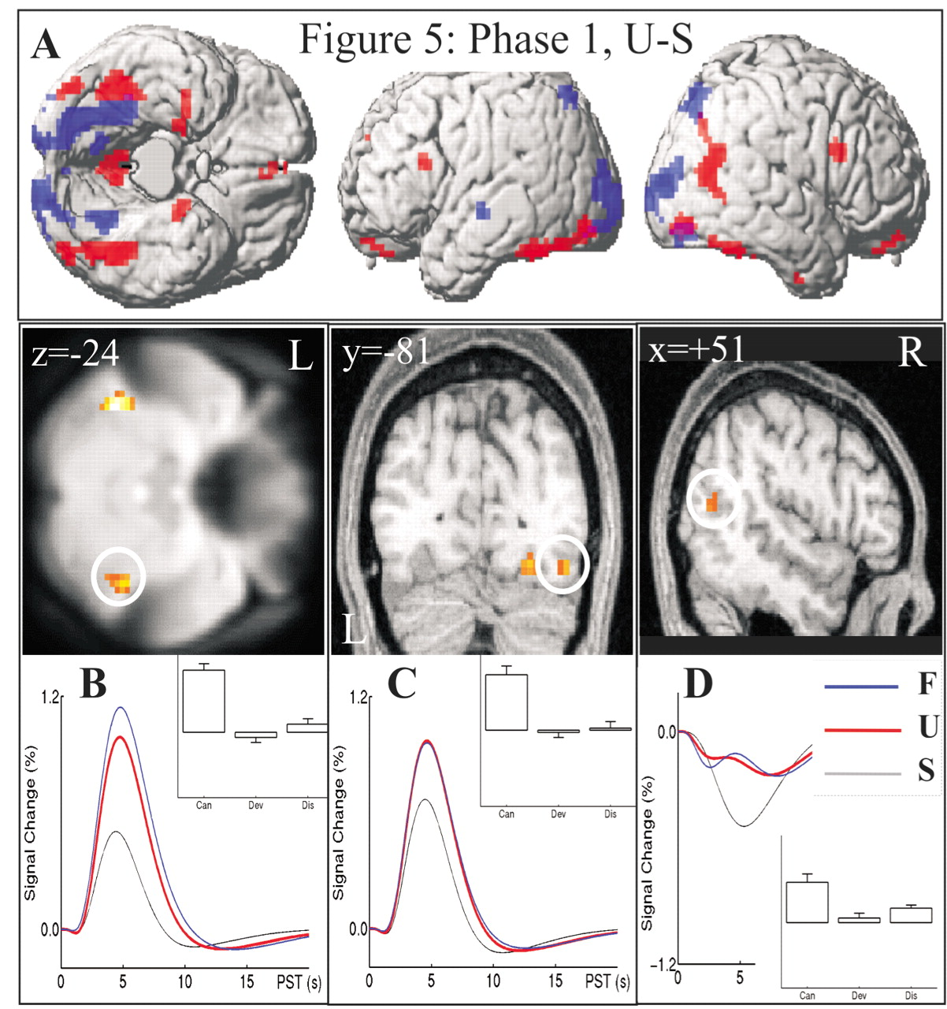
Figure 5. Face perception: regions showing differential responses to unfamiliar (U) and scrambled (S) faces. (A) ...
Notes:
Figure 5. Face perception: regions showing differential responses to unfamiliar (U) and scrambled (S) faces. (A) Regions of at least 10 voxels surviving P<0.001 uncorrected in F-tests are rendered on a canonical normalized brain (with cerebellum artificially removed). Red indicates greater responses to unfamiliar faces; blue indicates greater responses to scrambled faces. (B) Regions showing significant differences at P<0.05 whole-brain corrected displayed in orange on a transverse section at z=−24mm through the mean normalized EPI across participants, together with plots from the maximum in the right LMF region circled (+42 −45 −27). The best-fitting event-related responses show % signal change, relative to grand mean over voxels, against post-stimulus time (PST) for familiar (blue), unfamiliar (red) and scrambled (black) faces. Inset are the U–S differences in parameter estimates, with standard error, for the canonical HRF (Can), its temporal derivative (Dev) and dispersion derivative (Dis) that parameterise the shape of the difference (which loads mainly on the canonical HRF parameter, indicating a difference in peak height). (C) The same group differences as in B, now displayed in coronal section at y=−81mm through a randomly selected normalized T1 image of one participant, with plots from the circled lateral occipital region (+42 −81 −15). Note that the more medial occipital region showed greater responses to scrambled faces (not shown). (D) Sagittal section at x=+51mm through the normalized T1 image in B, with plots from the right STS region (+51 −66 +12). Note that the main effect versus interstimulus baseline (i.e. offsets relative to zero in the event-related responses) cannot be estimated reliably in this short SOA design (Josephs and Henson, 1999).
Unless provided in the caption above, the following copyright applies to the content of this slide: © Oxford University Press

Slide 6
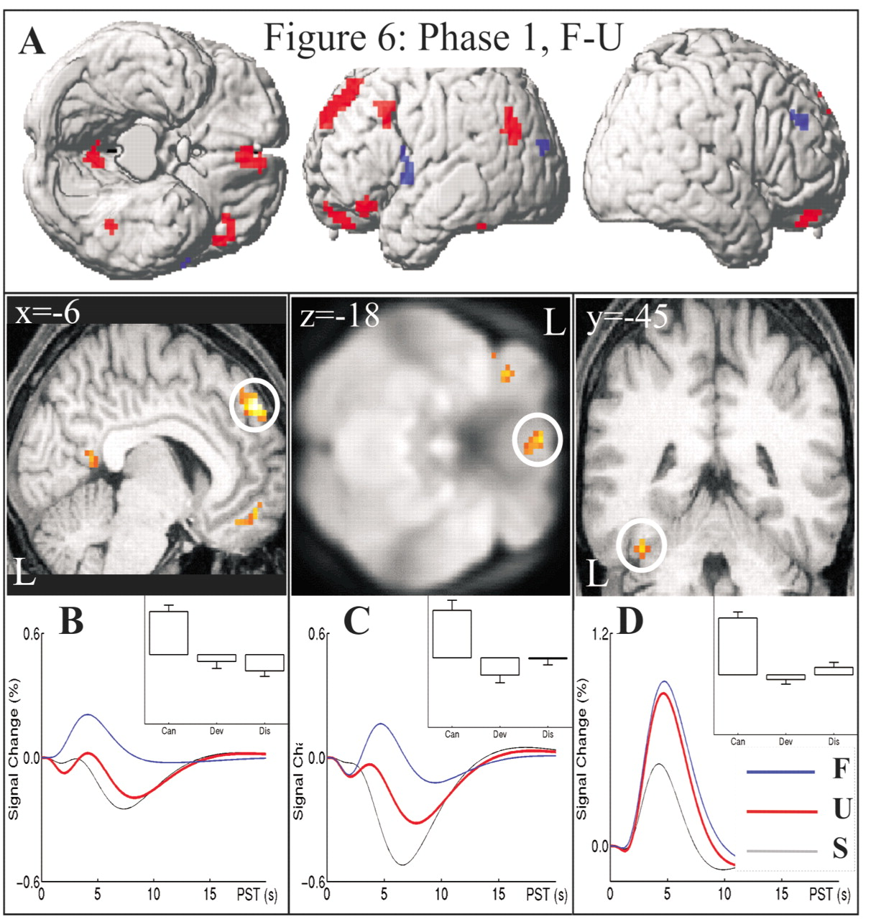
Figure 6. Face recognition: regions showing differential responses to familiar (F) and unfamiliar (U) faces in Phase 1. ...
Notes:
Figure 6. Face recognition: regions showing differential responses to familiar (F) and unfamiliar (U) faces in Phase 1. (A) Regions of at least 10 voxels surviving P<0.001 uncorrected in F-tests are rendered on a canonical normalized brain. (B) Sagittal section at x=−6mm through a T1 normalized structural showing medial superior frontal, orbitofrontal and posterior cingulate regions, with event-related responses and F–U differences in parameter estimates from the superior frontal region (−6 +54 +39). (C) Transverse section at z=−18mm through the mean normalized EPI, showing medial and lateral orbitofrontal regions, with plots from medial region (−3 +45 −24). (D) Coronal section at y=−45mm through the normalized T1 image, with plots from left LMF region (−39 −45 −24). See Figure 5 legend for more details.
Unless provided in the caption above, the following copyright applies to the content of this slide: © Oxford University Press

Slide 7
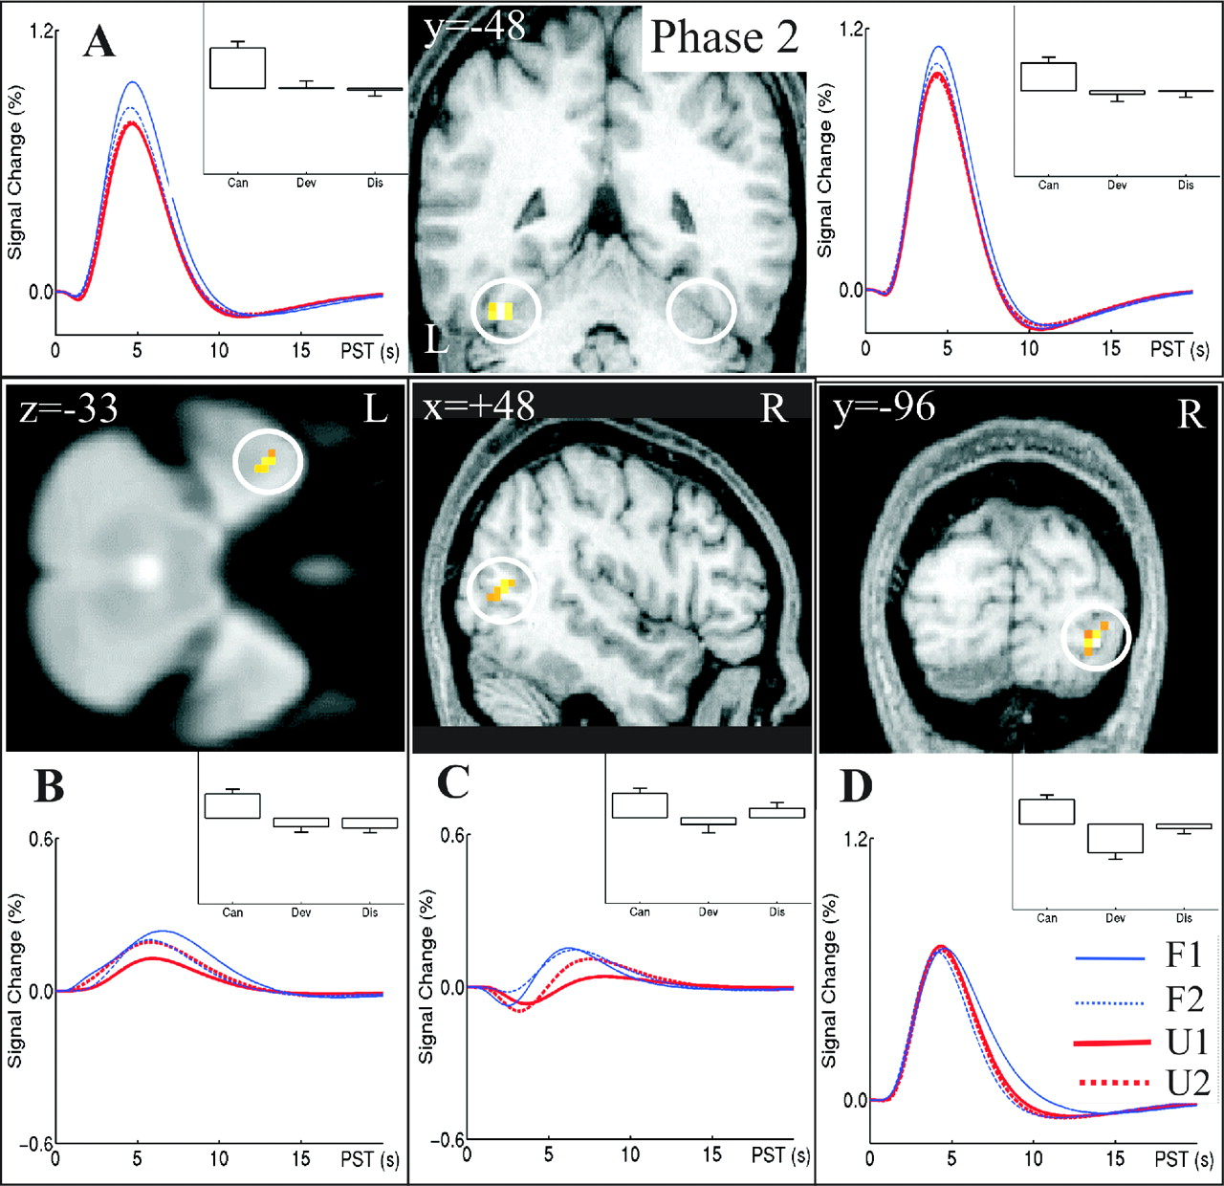
Figure 7. Face recognition and priming: regions showing differential responses to first and second presentations of ...
Notes:
Figure 7. Face recognition and priming: regions showing differential responses to first and second presentations of familiar (F1 and F2) and unfamiliar (U1 and U2) faces in Phase 2. (A) Coronal section at y=−48mm through a T1 normalized structural showing left and right LMF regions (±39 −48 −24), with event-related responses and F1–F2 parameter estimate differences. (B) Transverse section at z=−33mm through the mean normalized EPI, showing event-related responses and F1–U1 parameter estimate differences from a left temporal pole region (−42 +9 −33). (C) Sagittal section at x=+48 through a T1 normalized image showing event-related responses and F1–U1 parameter estimate differences from a right STS region (+48 −66 +9). (D) Coronal section at y=−96 through the T1 normalized image showing the event-related responses and F1–F2 parameter estimate differences in a right posterior inferior occipital region (+30 −96 −9). See Figure 5 legend for more details.
Unless provided in the caption above, the following copyright applies to the content of this slide: © Oxford University Press

