Slide 1
1 Reductive catabolism of pyrimidines: the second and third reaction as found in humans. DHPase converts ...
Notes:
1 Reductive catabolism of pyrimidines: the second and third reaction as found in humans. DHPase converts dihydrouracil to β-ureidopropionic acid. Subsequently, βASase converts β-ureidopropionic acid to β-alanine. These two steps are identical in humans and yeast. However, Saccharomyces kluyveri cannot degrade uracil to dihydrouracil like humans do, but degrades uracil using a completely different pathway (Andersen, 2008b).
Unless provided in the caption above, the following copyright applies to the content of this slide: © 2008 Federation of European Microbiological Societies Published by Blackwell Publishing Ltd. All rights reserved

Slide 2
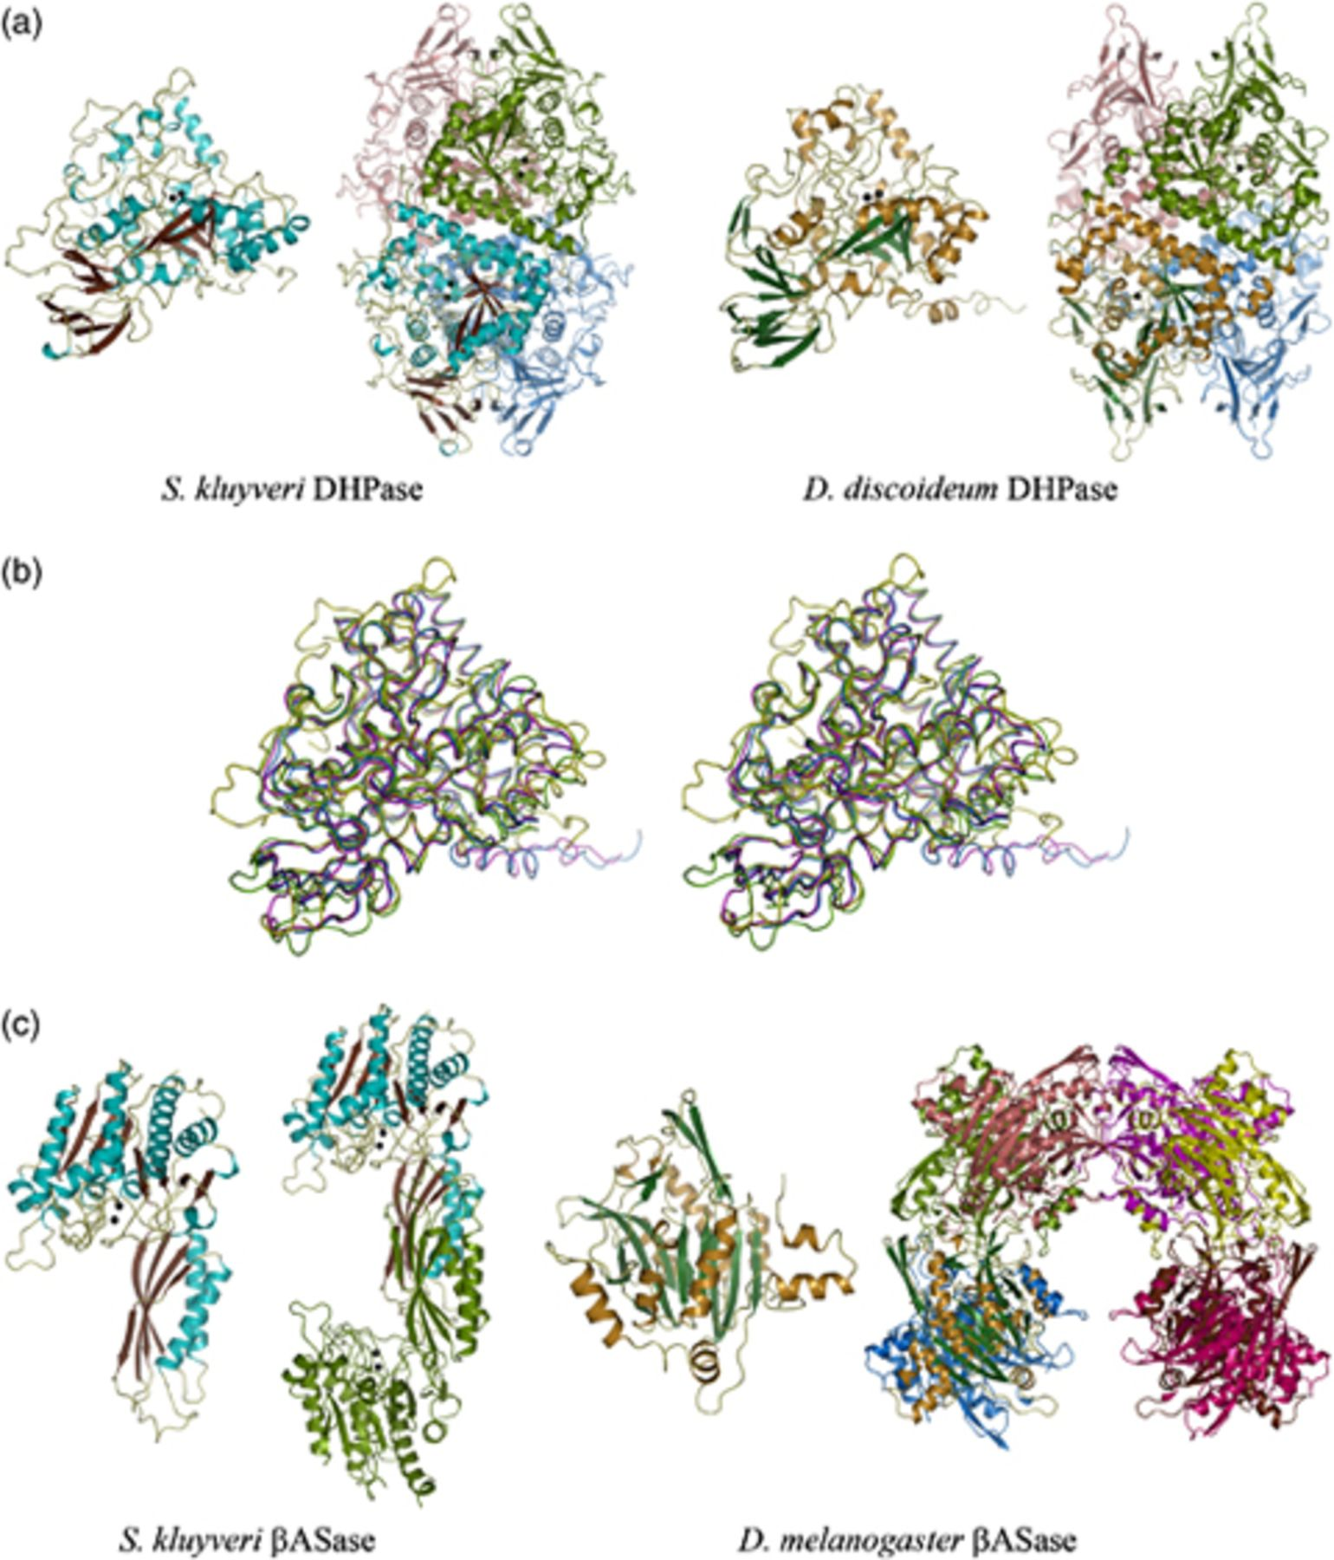
2 DHPase and βASase crystal structures. (a) Schematic views of subunit and tetramers of DHPase from ...
Notes:
2 DHPase and βASase crystal structures. (a) Schematic views of subunit and tetramers of DHPase from Saccharomyces kluyveri and Dictyostelium discoideum. For the subunit of the yeast enzyme, helices are shown in cyan and β-strands in brown. The same color code is used for one of the subunits in the tetramer, while the other three are colored green, salmon and blue, respectively. The same color scheme applies to the slime mold enzyme, except that the single subunit is depicted with helices in orange and β-strands in dark green. Zinc ions are shown as black spheres. (b) Stereoview of the superimposed subunit backbones of Sk DHPase (yellow), Dd DHPase (magenta), and of the model of human DHPase (green), which was generated based on the structures of these two enzymes. For comparison, the subunit backbone of the recently determined crystal structure of human DHPase is also shown (blue). (c) Schematic views of subunit and physiologically relevant oligomers of βASase from S. kluyveri and Drosophila melanogaster. The same color coding as for Sk DHPase is used for the subunit of yeast βASase. The second subunit in the homodimer is shown in green. Black spheres represent zinc ions. One subunit of the fruit fly enzyme is depicted with helices in orange and β-strands in dark green, while the remaining seven subunits of the octamer are shown in blue, green, salmon, yellow, magenta, brown and dark pink. All figures were generated with pymol (DeLano et al., 2002).
Unless provided in the caption above, the following copyright applies to the content of this slide: © 2008 Federation of European Microbiological Societies Published by Blackwell Publishing Ltd. All rights reserved

