Slide 1
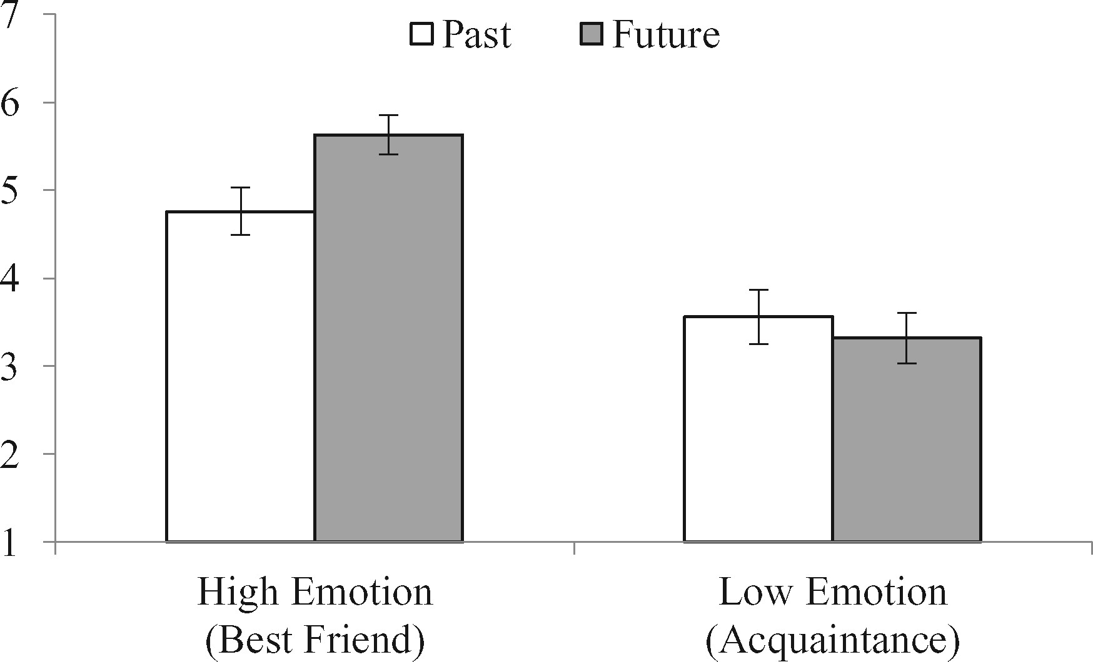
FIGURE 1 EVENT EMOTIONALITY MODERATES TIME’S IMPACT ON SHARING
Notes:
FIGURE 1 EVENT EMOTIONALITY MODERATES TIME’S IMPACT ON SHARING
Unless provided in the caption above, the following copyright applies to the content of this slide: © The Author 2017. Published by Oxford University Press on behalf of Journal of Consumer Research, Inc. All rights reserved. For permissions, please e-mail: journals.permissions@oup.comThis article is published and distributed under the terms of the Oxford University Press, Standard Journals Publication Model (https://academic.oup.com/journals/pages/about_us/legal/notices)

Slide 2
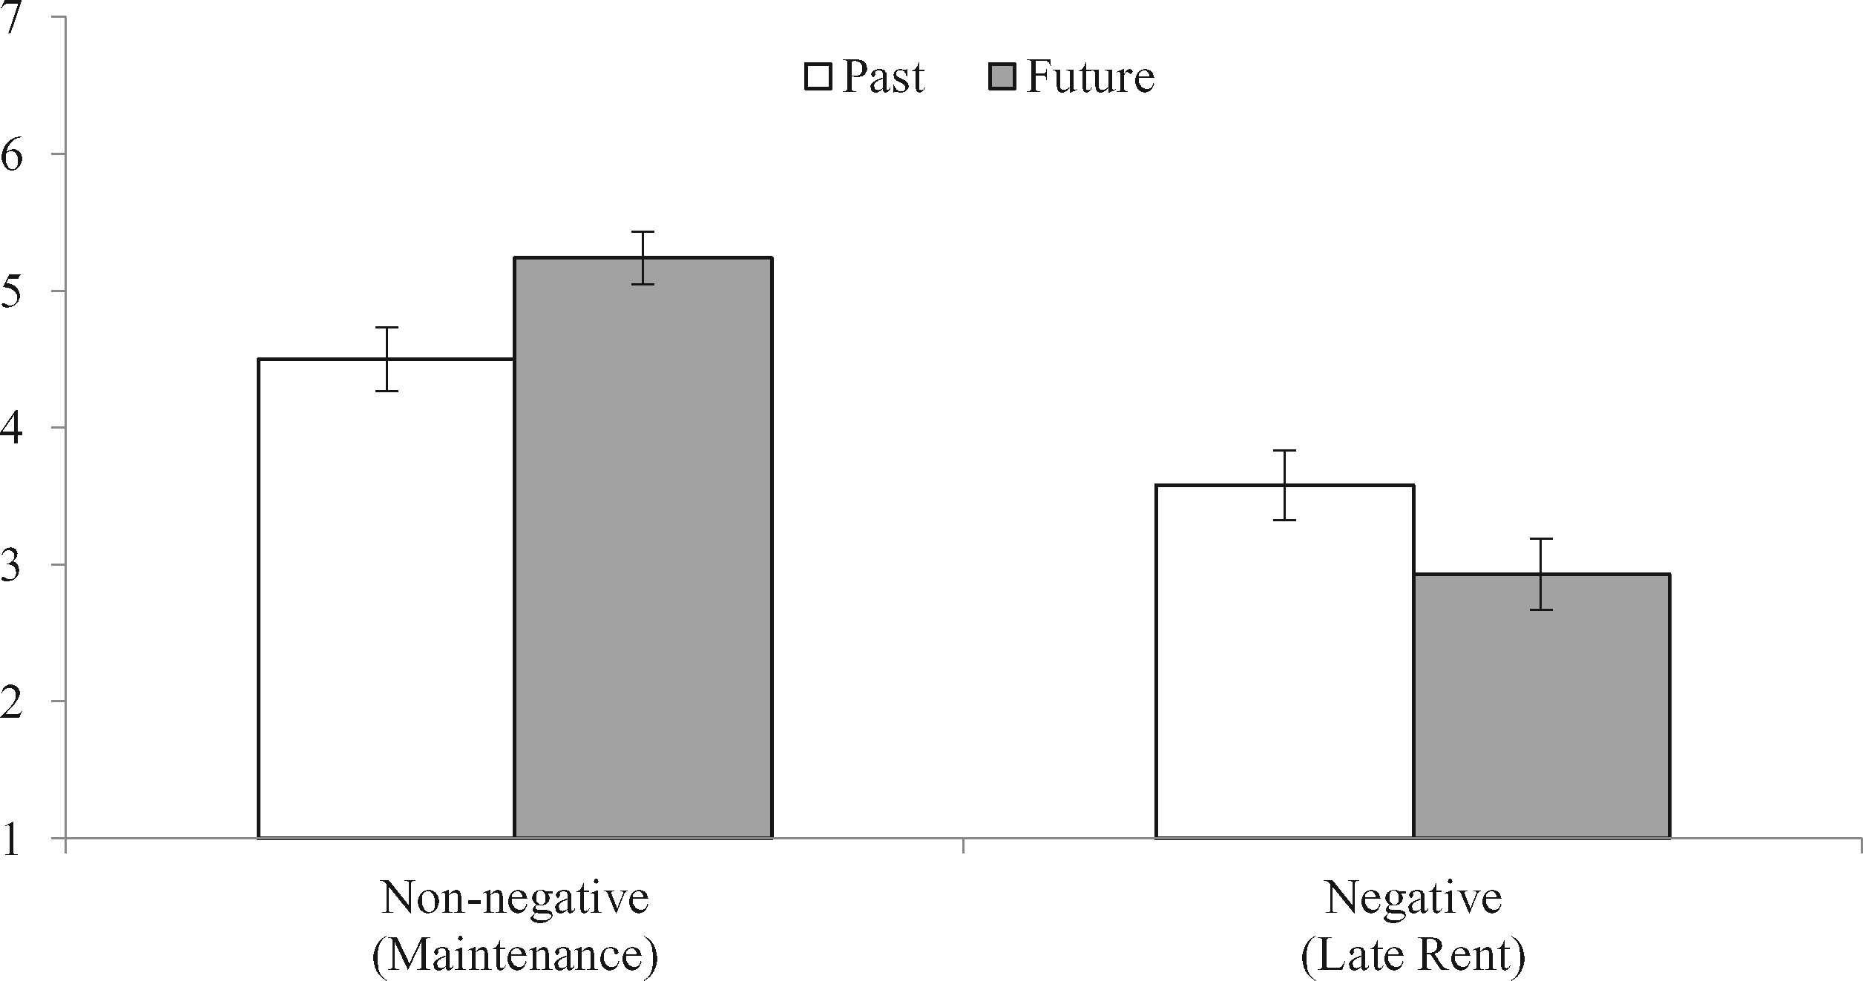
FIGURE 2 SELF-PRESENTATION MODERATES TIME’S IMPACT ON SHARING
Notes:
FIGURE 2 SELF-PRESENTATION MODERATES TIME’S IMPACT ON SHARING
Unless provided in the caption above, the following copyright applies to the content of this slide: © The Author 2017. Published by Oxford University Press on behalf of Journal of Consumer Research, Inc. All rights reserved. For permissions, please e-mail: journals.permissions@oup.comThis article is published and distributed under the terms of the Oxford University Press, Standard Journals Publication Model (https://academic.oup.com/journals/pages/about_us/legal/notices)

Slide 3
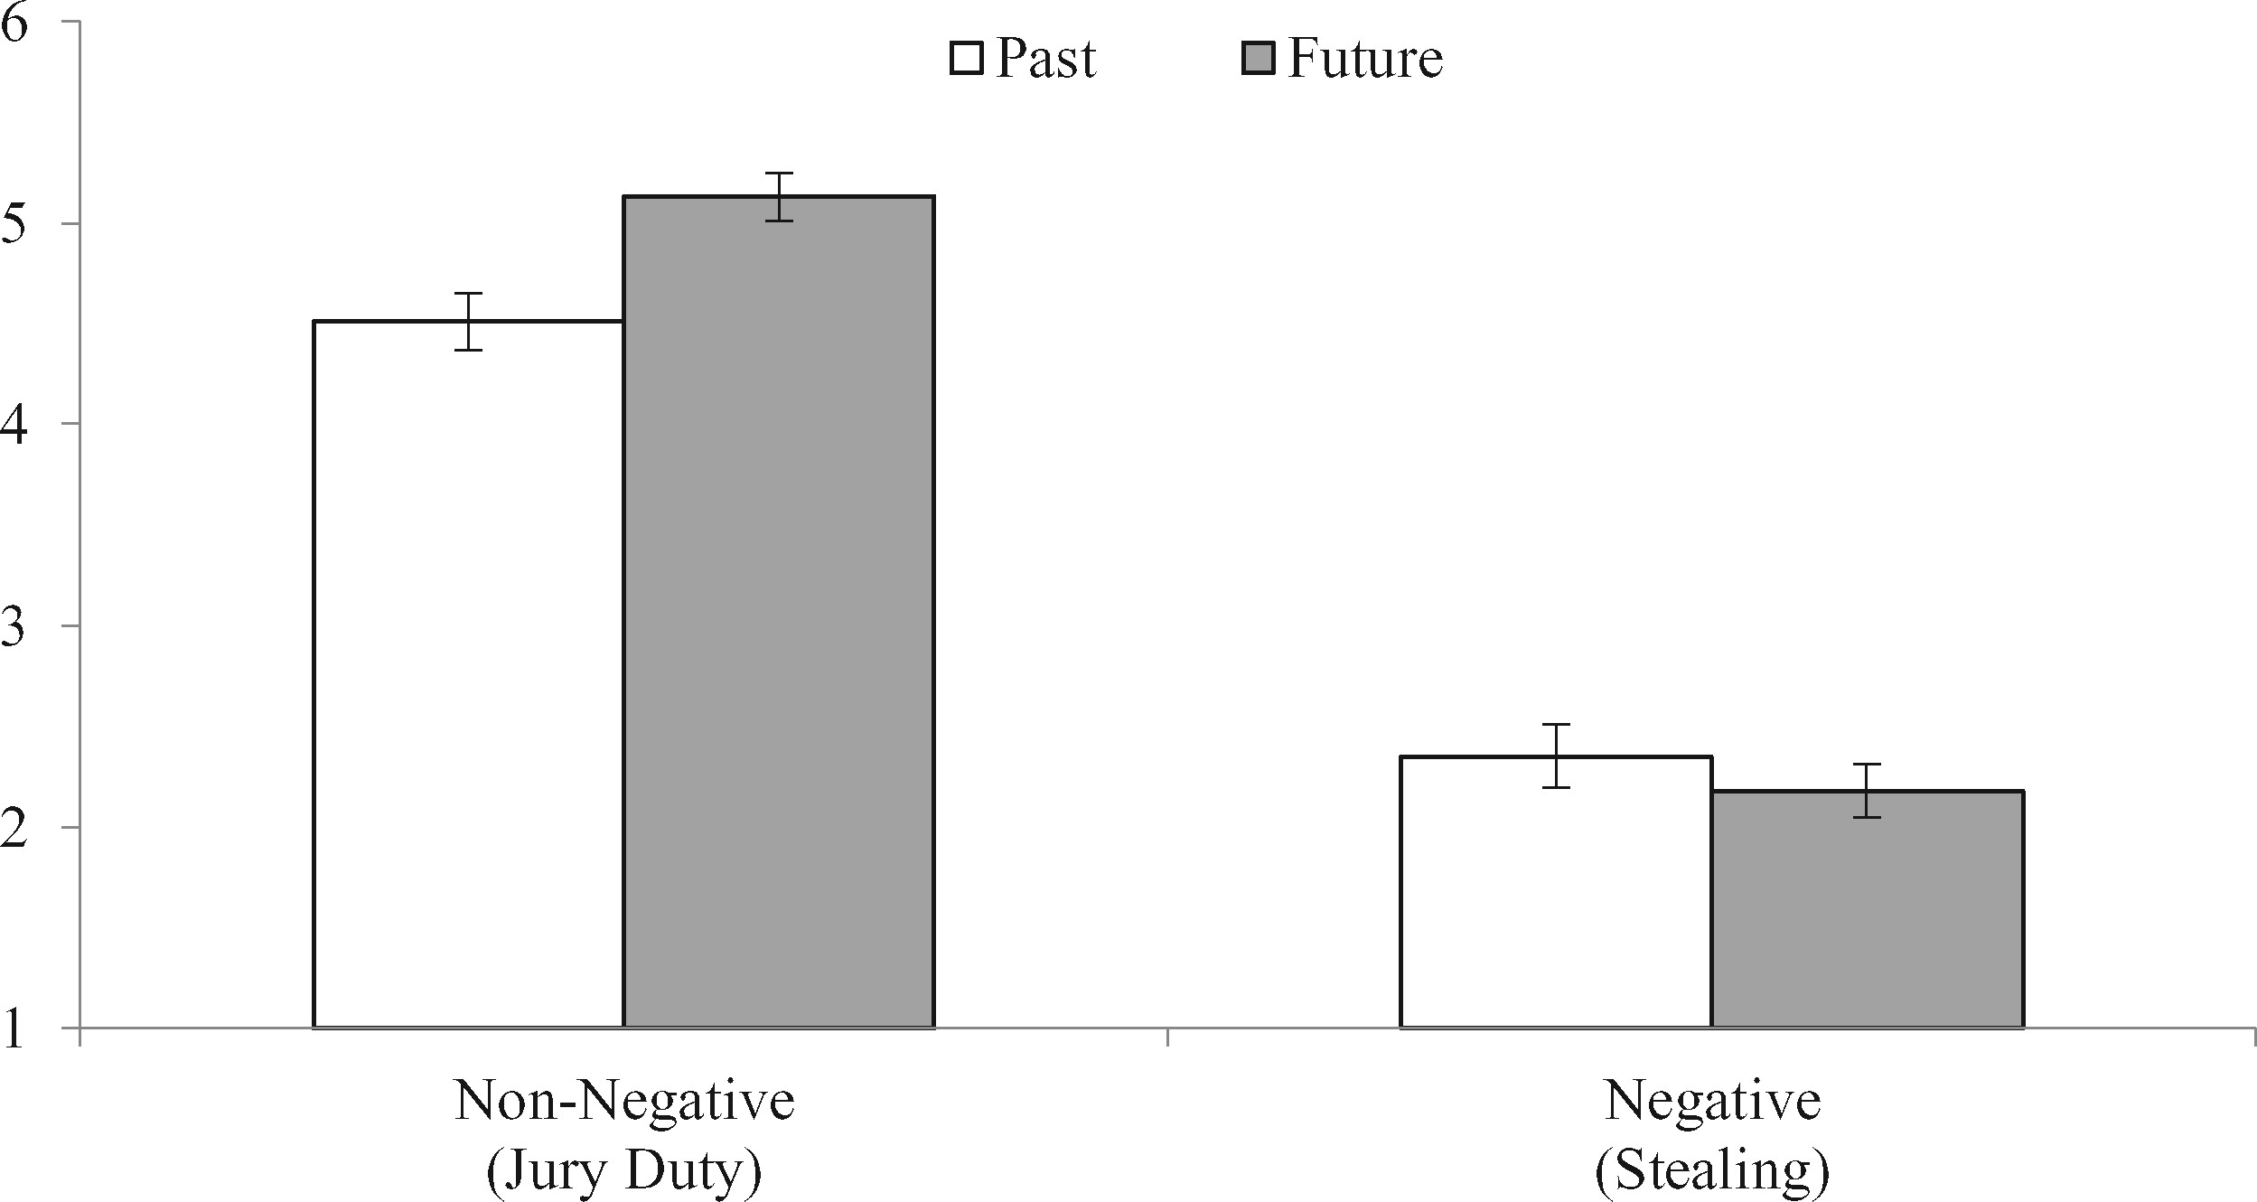
FIGURE 3 SELF-PRESENTATION MODERATES TIME’S IMPACT ON SHARING
Notes:
FIGURE 3 SELF-PRESENTATION MODERATES TIME’S IMPACT ON SHARING
Unless provided in the caption above, the following copyright applies to the content of this slide: © The Author 2017. Published by Oxford University Press on behalf of Journal of Consumer Research, Inc. All rights reserved. For permissions, please e-mail: journals.permissions@oup.comThis article is published and distributed under the terms of the Oxford University Press, Standard Journals Publication Model (https://academic.oup.com/journals/pages/about_us/legal/notices)

Slide 4
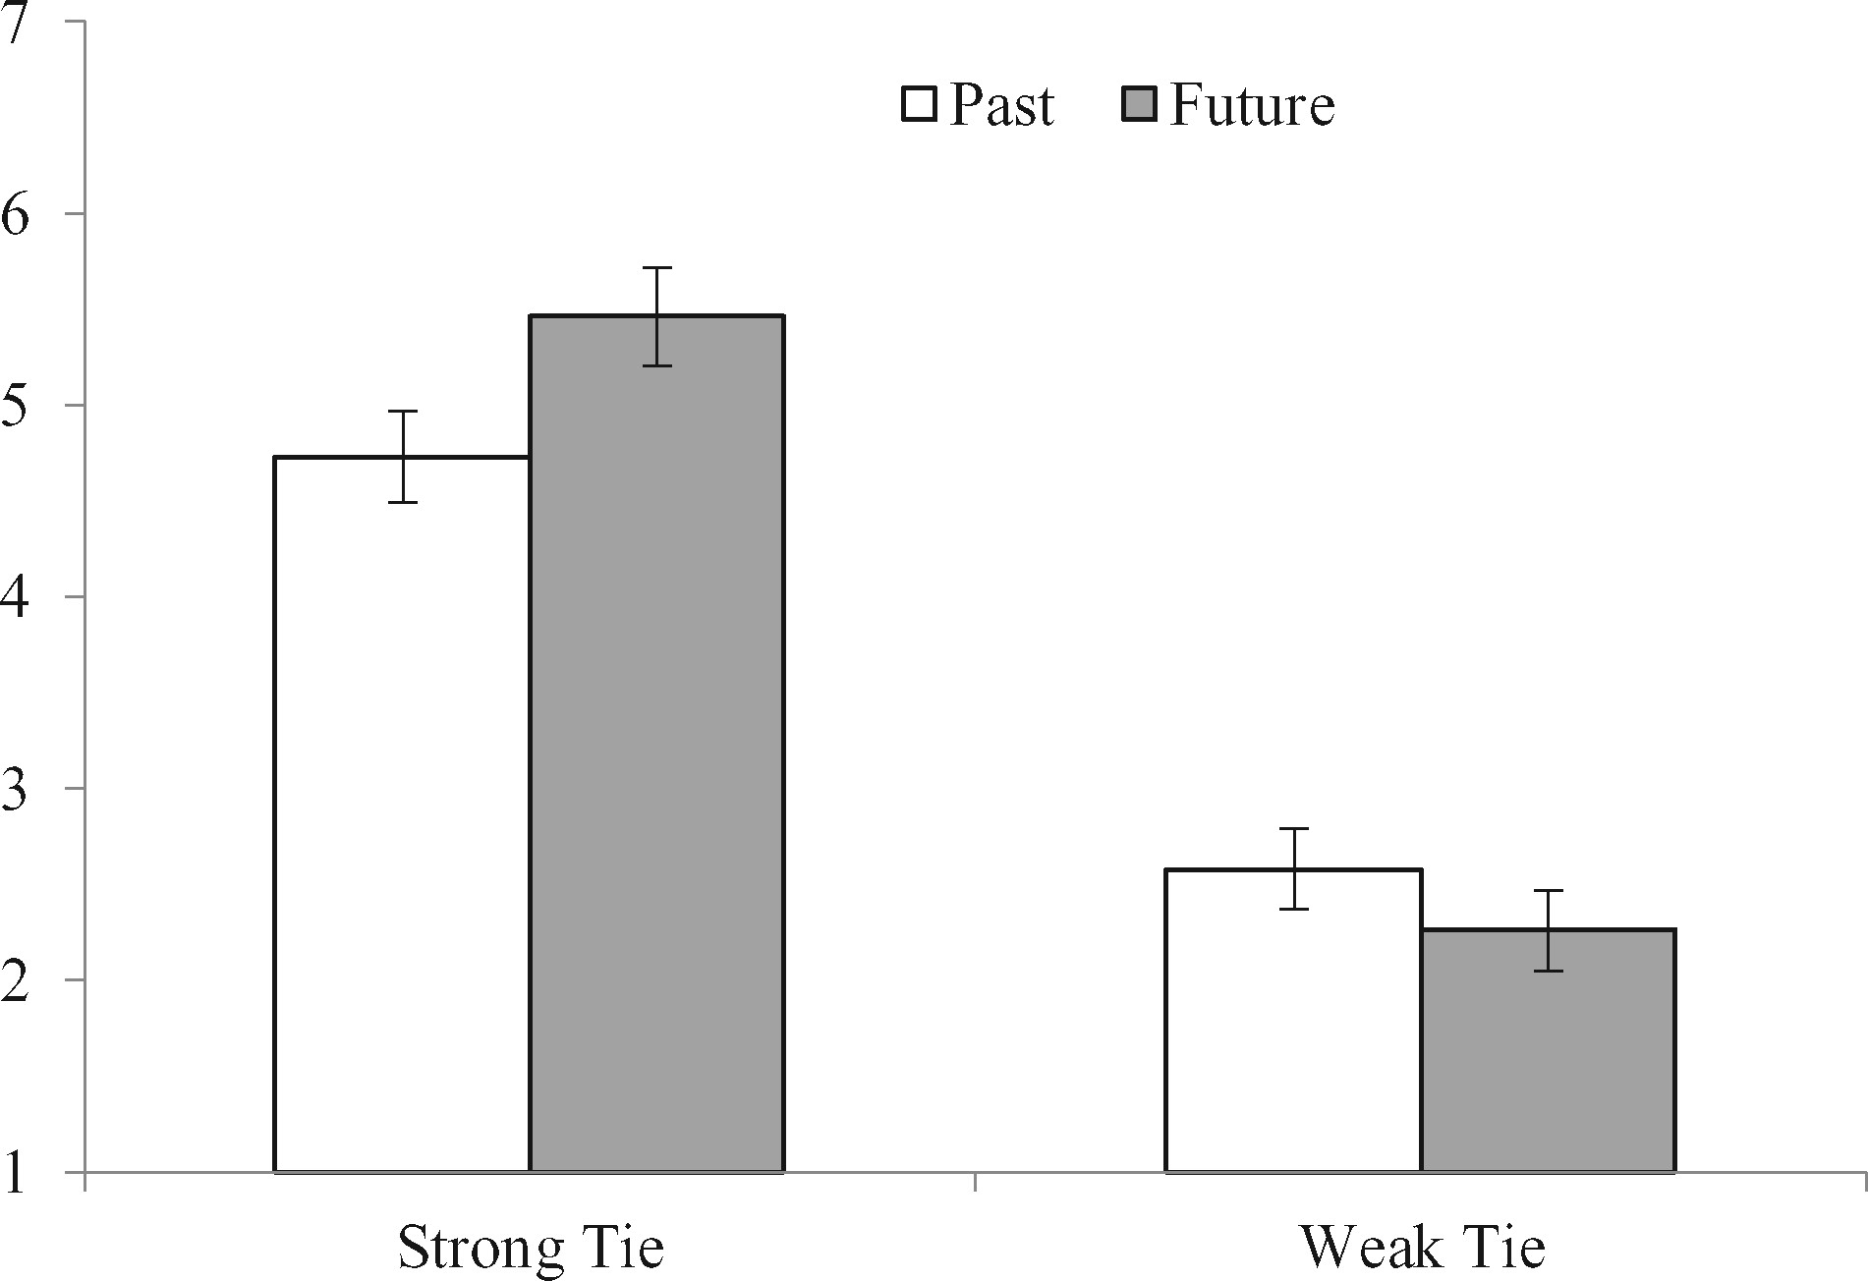
FIGURE 4 SHARING TARGET MODERATES TIME’S IMPACT ON SHARING FOR EVENTS THAT MAKE THE SHARER LOOK BAD
Notes:
FIGURE 4 SHARING TARGET MODERATES TIME’S IMPACT ON SHARING FOR EVENTS THAT MAKE THE SHARER LOOK BAD
Unless provided in the caption above, the following copyright applies to the content of this slide: © The Author 2017. Published by Oxford University Press on behalf of Journal of Consumer Research, Inc. All rights reserved. For permissions, please e-mail: journals.permissions@oup.comThis article is published and distributed under the terms of the Oxford University Press, Standard Journals Publication Model (https://academic.oup.com/journals/pages/about_us/legal/notices)

