Slide 1
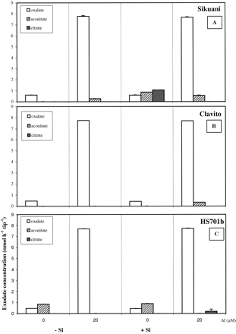
Fig. 9. Root exudation of oxalate, aconitate and citrate (nmol h⁻¹ tip⁻¹, ±SE) from roots of ...
Notes:
Fig. 9. Root exudation of oxalate, aconitate and citrate (nmol h−1 tip−1, ±SE) from roots of (a) Sikuani, (b) Clavito and (c) HS701b varieties. Plants, pretreated with or without 1000 μM Si, were grown in CaCl2 nutrient solutions (LSS) with Al (0–20 μM) for 24 h.
Unless provided in the caption above, the following copyright applies to the content of this slide: © Society for Experimental Biology

Slide 2
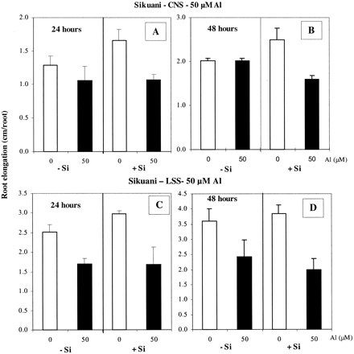
Fig. 8. Root elongation (cm, ±SE) of Zea mays L. var. Sikuani exposed to 0 or 50 μM Al after pretreatment with or ...
Notes:
Fig. 8. Root elongation (cm, ±SE) of Zea mays L. var. Sikuani exposed to 0 or 50 μM Al after pretreatment with or without 1000 μM Si. Plants were grown in complete nutrient solutions (CNS; A, B) or in CaCl2 solutions (LSS; C, D). Root elongation is shown after 24 h (A, C) and 48 h (B, D) of Al treatment.
Unless provided in the caption above, the following copyright applies to the content of this slide: © Society for Experimental Biology

Slide 3
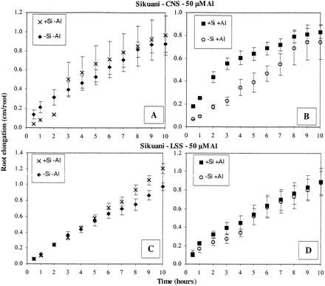
Fig. 7. Root elongation (cm, ±SE) of Zea mays L. var. Sikuani exposed to 0 or 50 μM Al after pretreatment with or ...
Notes:
Fig. 7. Root elongation (cm, ±SE) of Zea mays L. var. Sikuani exposed to 0 or 50 μM Al after pretreatment with or without 1000 μM Si. Plants were grown in complete nutrient solutions (CNS; A, B) or in CaCl2 solutions (LSS; C, D). Root elongation is shown over the first 10 h of Al treatment.
Unless provided in the caption above, the following copyright applies to the content of this slide: © Society for Experimental Biology

Slide 4
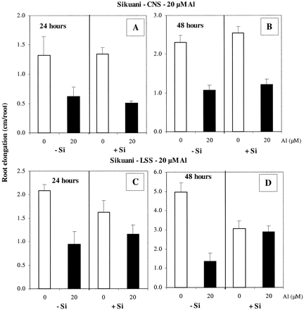
Fig. 6. Root elongation (cm, ±SE) of Zea mays L. var. Sikuani exposed to 0 or 20 μM Al after pretreatment with or ...
Notes:
Fig. 6. Root elongation (cm, ±SE) of Zea mays L. var. Sikuani exposed to 0 or 20 μM Al after pretreatment with or without 1000 μM Si. Plants were grown in complete nutrient solutions (CNS; A, B) or in CaCl2 solutions (LSS; C, D). Root elongation is shown after 24 h (A, C) and 48 h (B, D) of Al treatment.
Unless provided in the caption above, the following copyright applies to the content of this slide: © Society for Experimental Biology

Slide 5
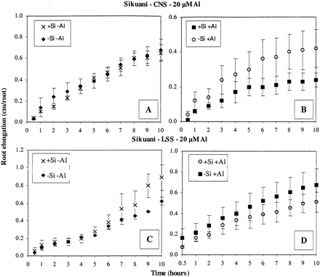
Fig. 5. Root elongation (cm, ±SE) of Zea mays L. var. Sikuani exposed to 0 or 20 μM Al after pretreatment with or ...
Notes:
Fig. 5. Root elongation (cm, ±SE) of Zea mays L. var. Sikuani exposed to 0 or 20 μM Al after pretreatment with or without 1000 μM Si. Plants were grown in complete nutrient solutions (CNS; A, B) or in CaCl2 solutions (LSS; C, D). Root elongation is shown over the first 10 h of Al treatment.
Unless provided in the caption above, the following copyright applies to the content of this slide: © Society for Experimental Biology

Slide 6
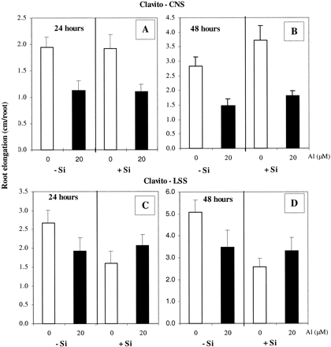
Fig. 4. Root elongation (cm, ±SE) of Zea mays L. var. Clavito exposed to 0 or 20 μM Al after pretreatment with or ...
Notes:
Fig. 4. Root elongation (cm, ±SE) of Zea mays L. var. Clavito exposed to 0 or 20 μM Al after pretreatment with or without 1000 μM Si. Plants were grown in complete nutrient solutions (CNS; A, B) or in CaCl2 solutions (LSS; C, D). Root elongation is shown after 24 h (A, C) and 48 h (B, D) of Al treatment.
Unless provided in the caption above, the following copyright applies to the content of this slide: © Society for Experimental Biology

Slide 7
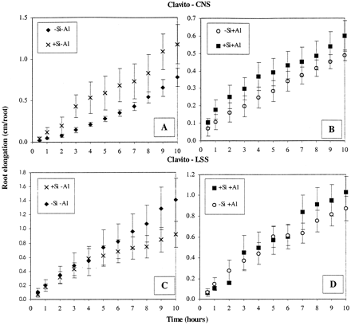
Fig. 3. Root elongation (cm, ±SE) of Zea mays L. var. Clavito exposed to 0 or 20 μM Al after pretreatment with or ...
Notes:
Fig. 3. Root elongation (cm, ±SE) of Zea mays L. var. Clavito exposed to 0 or 20 μM Al after pretreatment with or without 1000 μM Si. Plants were grown in complete nutrient solutions (CNS; A, B) or in CaCl2 solutions (LSS; C, D). Root elongation is shown over the first 10 h of Al treatment.
Unless provided in the caption above, the following copyright applies to the content of this slide: © Society for Experimental Biology

Slide 8
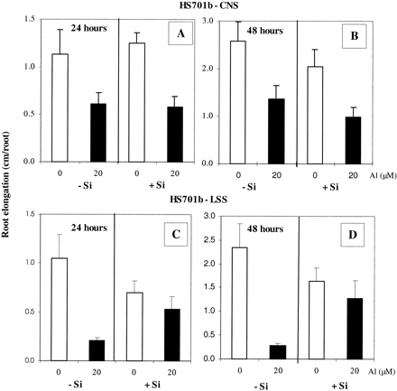
Fig. 2. Root elongation (cm, ±SE) of Zea mays L. var. HS701b exposed to 0 or 20 μM Al after pretreatment with or ...
Notes:
Fig. 2. Root elongation (cm, ±SE) of Zea mays L. var. HS701b exposed to 0 or 20 μM Al after pretreatment with or without 1000 μM Si. Plants were grown in complete nutrient solutions (CNS; A, B) or in CaCl2 solutions (LSS; C, D). Root elongation is shown after 24 h (A, C) and 48 h (B, D) of Al treatment.
Unless provided in the caption above, the following copyright applies to the content of this slide: © Society for Experimental Biology

Slide 9
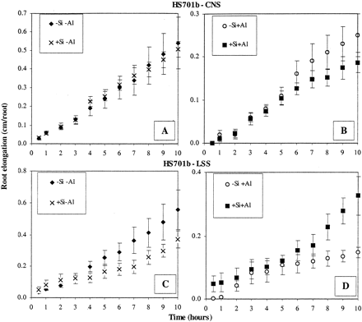
Fig. 1. Root elongation (cm, ±SE) of Zea mays L. var. HS701b exposed to 0 or 20 μM Al after pretreatment with or ...
Notes:
Fig. 1. Root elongation (cm, ±SE) of Zea mays L. var. HS701b exposed to 0 or 20 μM Al after pretreatment with or without 1000 μM Si. Plants were grown in complete nutrient solutions (CNS; A, B) or in CaCl2 solutions (LSS; C, D). Root elongation is shown over the first 10 h of Al treatment.
Unless provided in the caption above, the following copyright applies to the content of this slide: © Society for Experimental Biology

Slide 10
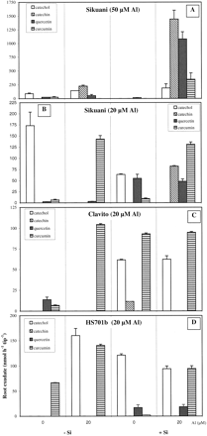
Fig. 10. Root exudation of phenolics (nmol h⁻¹ tip⁻¹,±SE) from roots of (A, B) Sikuani, (C) ...
Notes:
Fig. 10. Root exudation of phenolics (nmol h−1 tip−1,±SE) from roots of (A, B) Sikuani, (C) Clavito and (D) HS701b varieties. Plants, pretreated with or without 1000 μM Si, were grown in complete nutrient solutions (CNS) with Al (0–50 μM) for 24 h.
Unless provided in the caption above, the following copyright applies to the content of this slide: © Society for Experimental Biology

