Slide 1
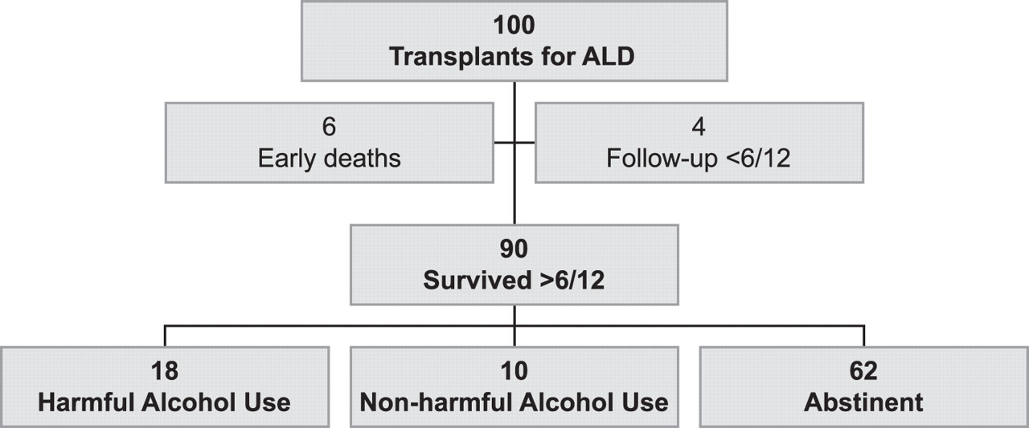
Fig. 1. Overview of study results.
Notes:
Fig. 1. Overview of study results.
Unless provided in the caption above, the following copyright applies to the content of this slide: © The Author 2006. Published by Oxford University Press on behalf of the Medical Council on Alcohol. All rights reserved

Slide 2
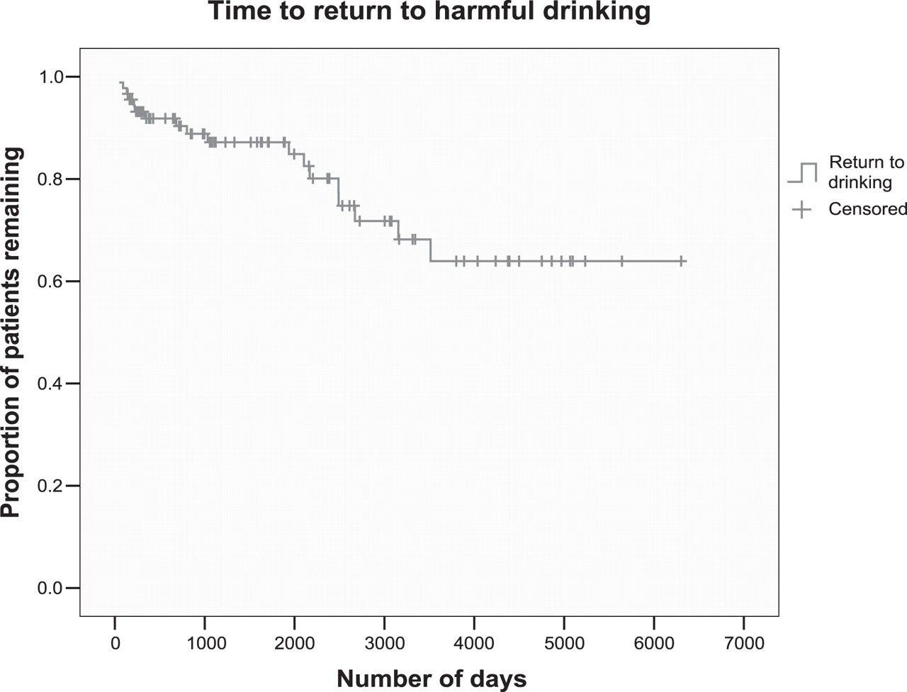
Fig. 2. Cumulative survival to time to first record of harmful drinking following transplant (days).
Notes:
Fig. 2. Cumulative survival to time to first record of harmful drinking following transplant (days).
Unless provided in the caption above, the following copyright applies to the content of this slide: © The Author 2006. Published by Oxford University Press on behalf of the Medical Council on Alcohol. All rights reserved

