Slide 1
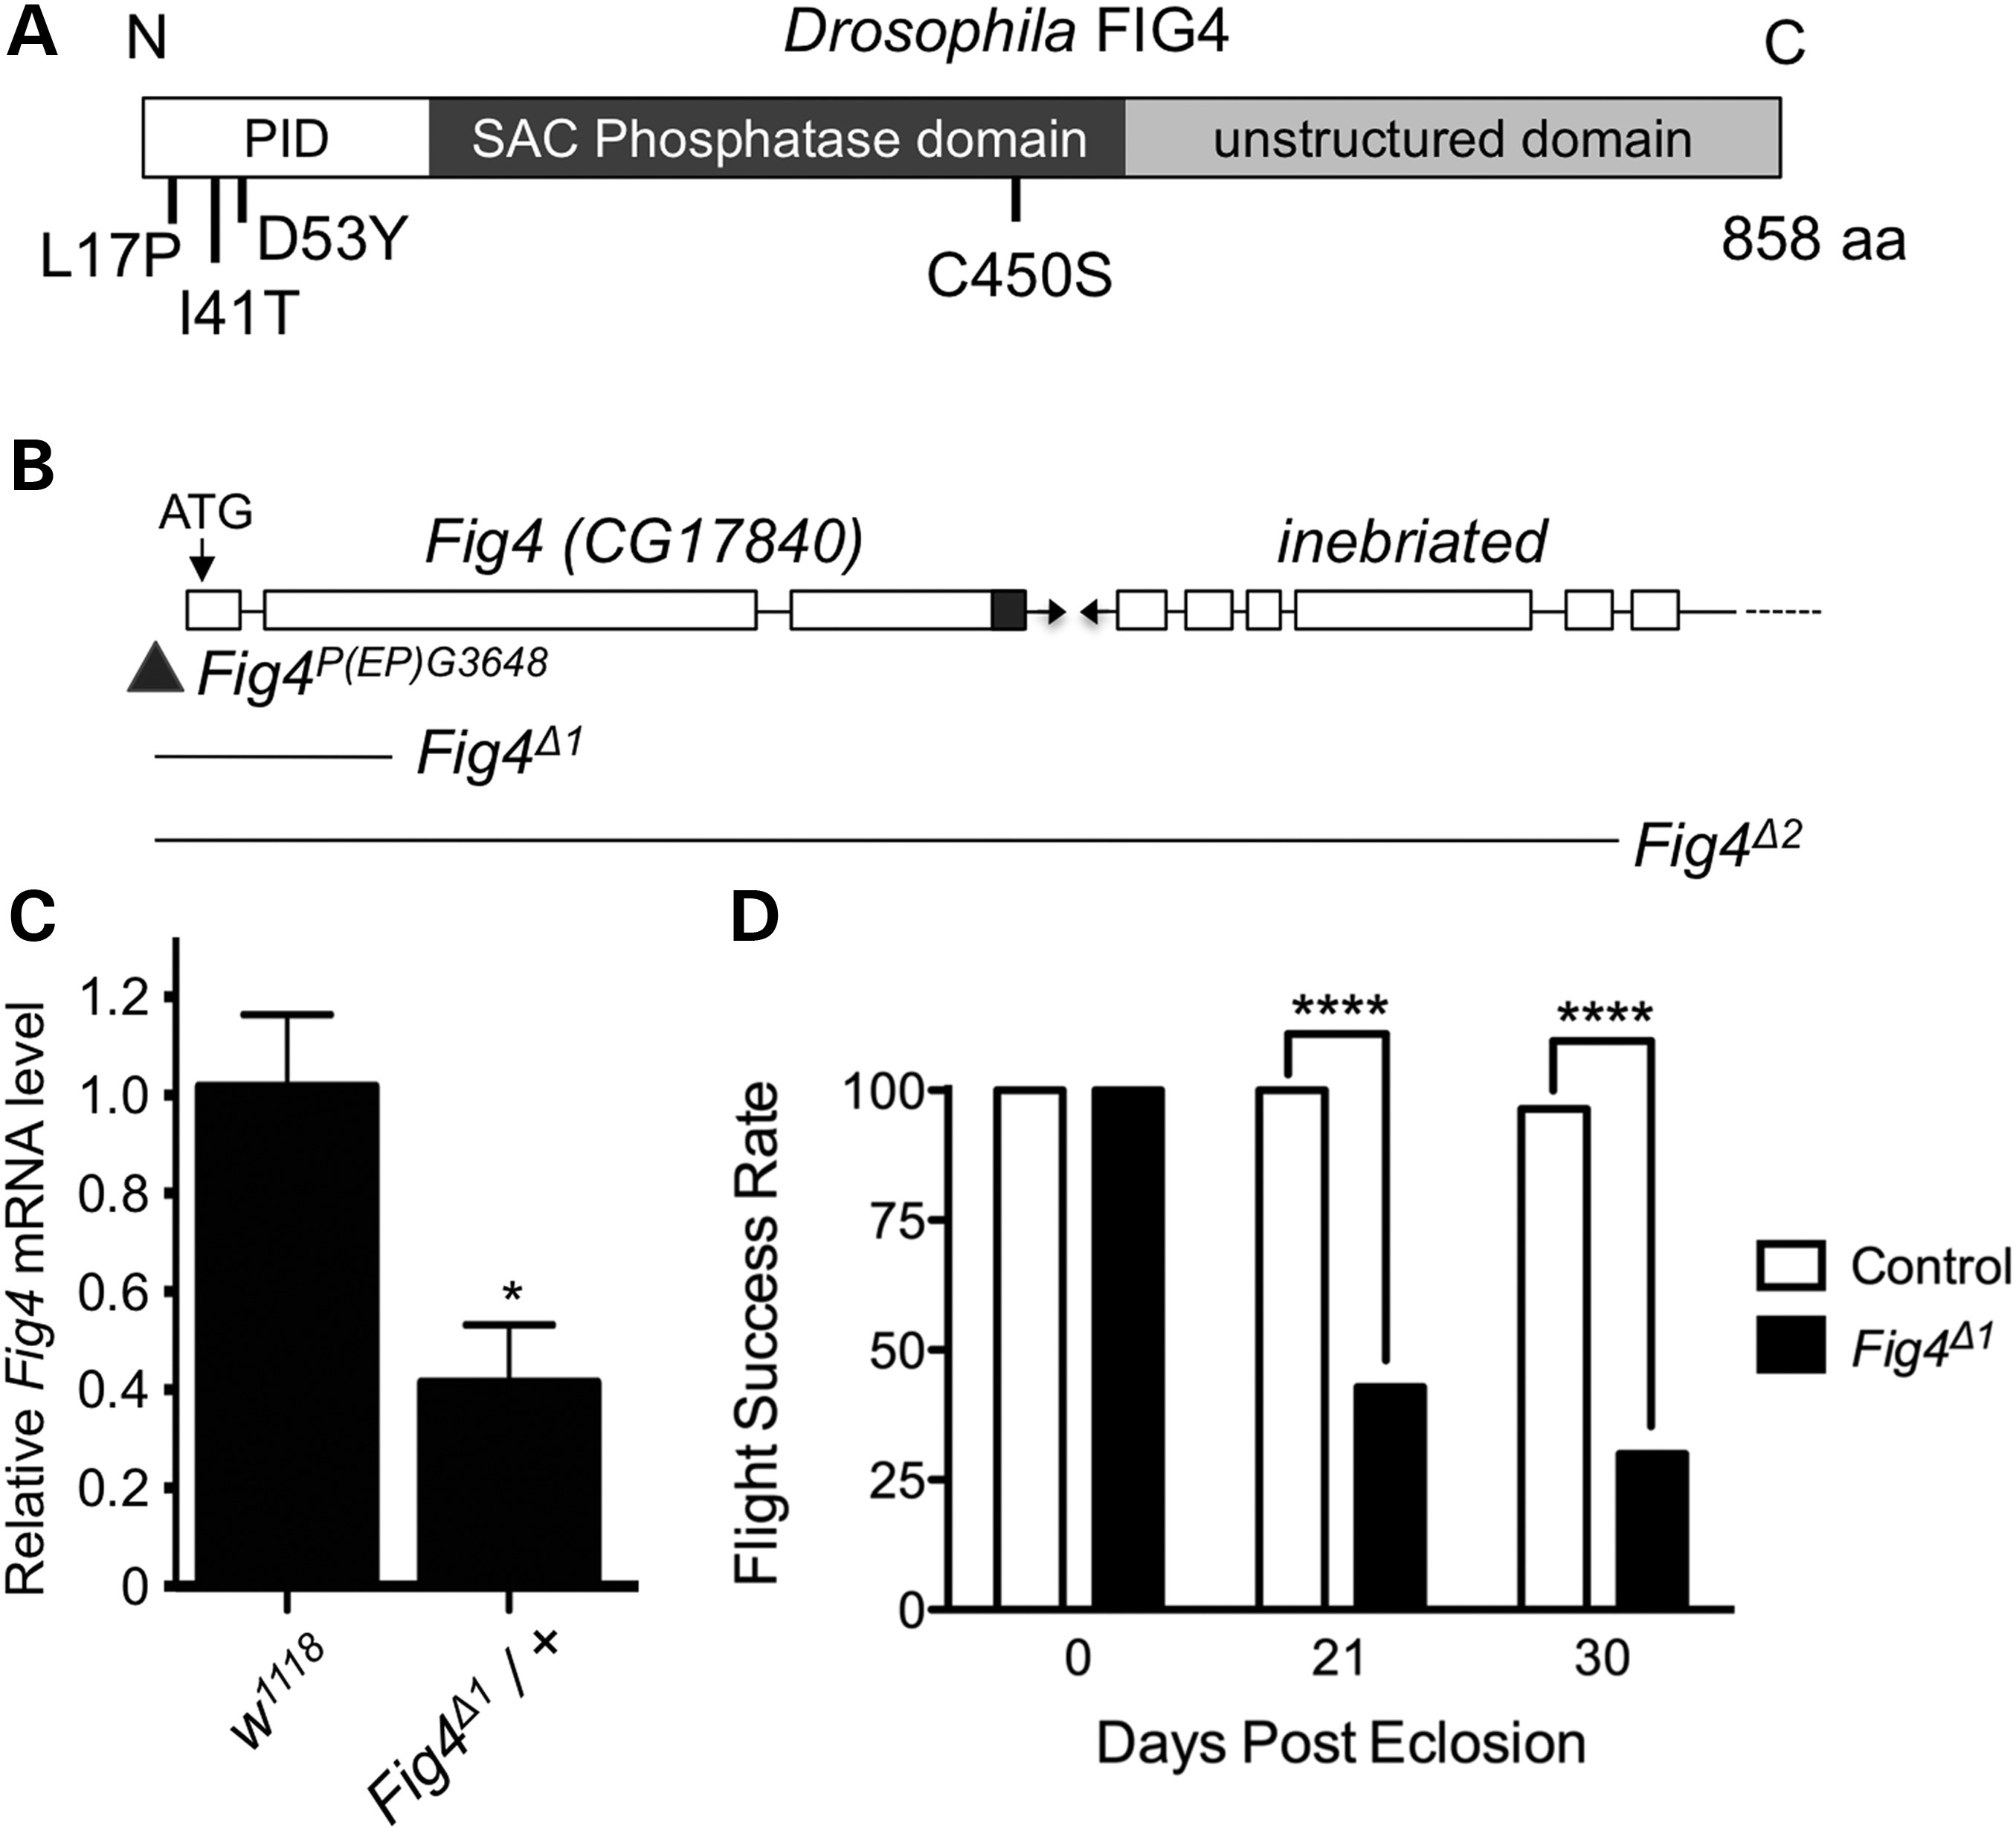
Figure 1. Generation and characterization of Drosophila Fig4 mutants. (A) Domain organization of FIG4 protein and ...
Notes:
Figure 1. Generation and characterization of Drosophila Fig4 mutants. (A) Domain organization of FIG4 protein and mutations analyzed in this study. PID is the protein interaction domain. Drosophila FIG4 has 59% similarity with human FIG4 over the entire length of the protein (Supplementary Material, Fig. S1), including conserved amino acids mutated in disease: L17P and I41T missense mutations are found in patients with CMT4J, and D53Y has been reported in a family with ALS. The C450S mutation in the conserved CX5RT SAC phosphatase domain inactivates the catalytic cysteine residue. (B) Schematic representation of Fig4 (CG17840) genomic locus harboring P-element P(EP)G3648 (triangle) and the extent of genomic deletion in various Fig4 mutants. (C) Fig4 mRNA is reduced by ∼50% in Fig4Δ1 heterozygous animals, consistent with genetic and molecular evidence that demonstrate that it is a null allele (D) Fig4 mutants lose flight ability with age. n = 30 animals for each genotype and time-point. *P < 0.05 using Student's t-test, ****P < 0.0001 using Fischer's exact test.
Unless provided in the caption above, the following copyright applies to the content of this slide: © The Author 2015. Published by Oxford University Press. All rights reserved. For Permissions, please email: journals.permissions@oup.com

Slide 2
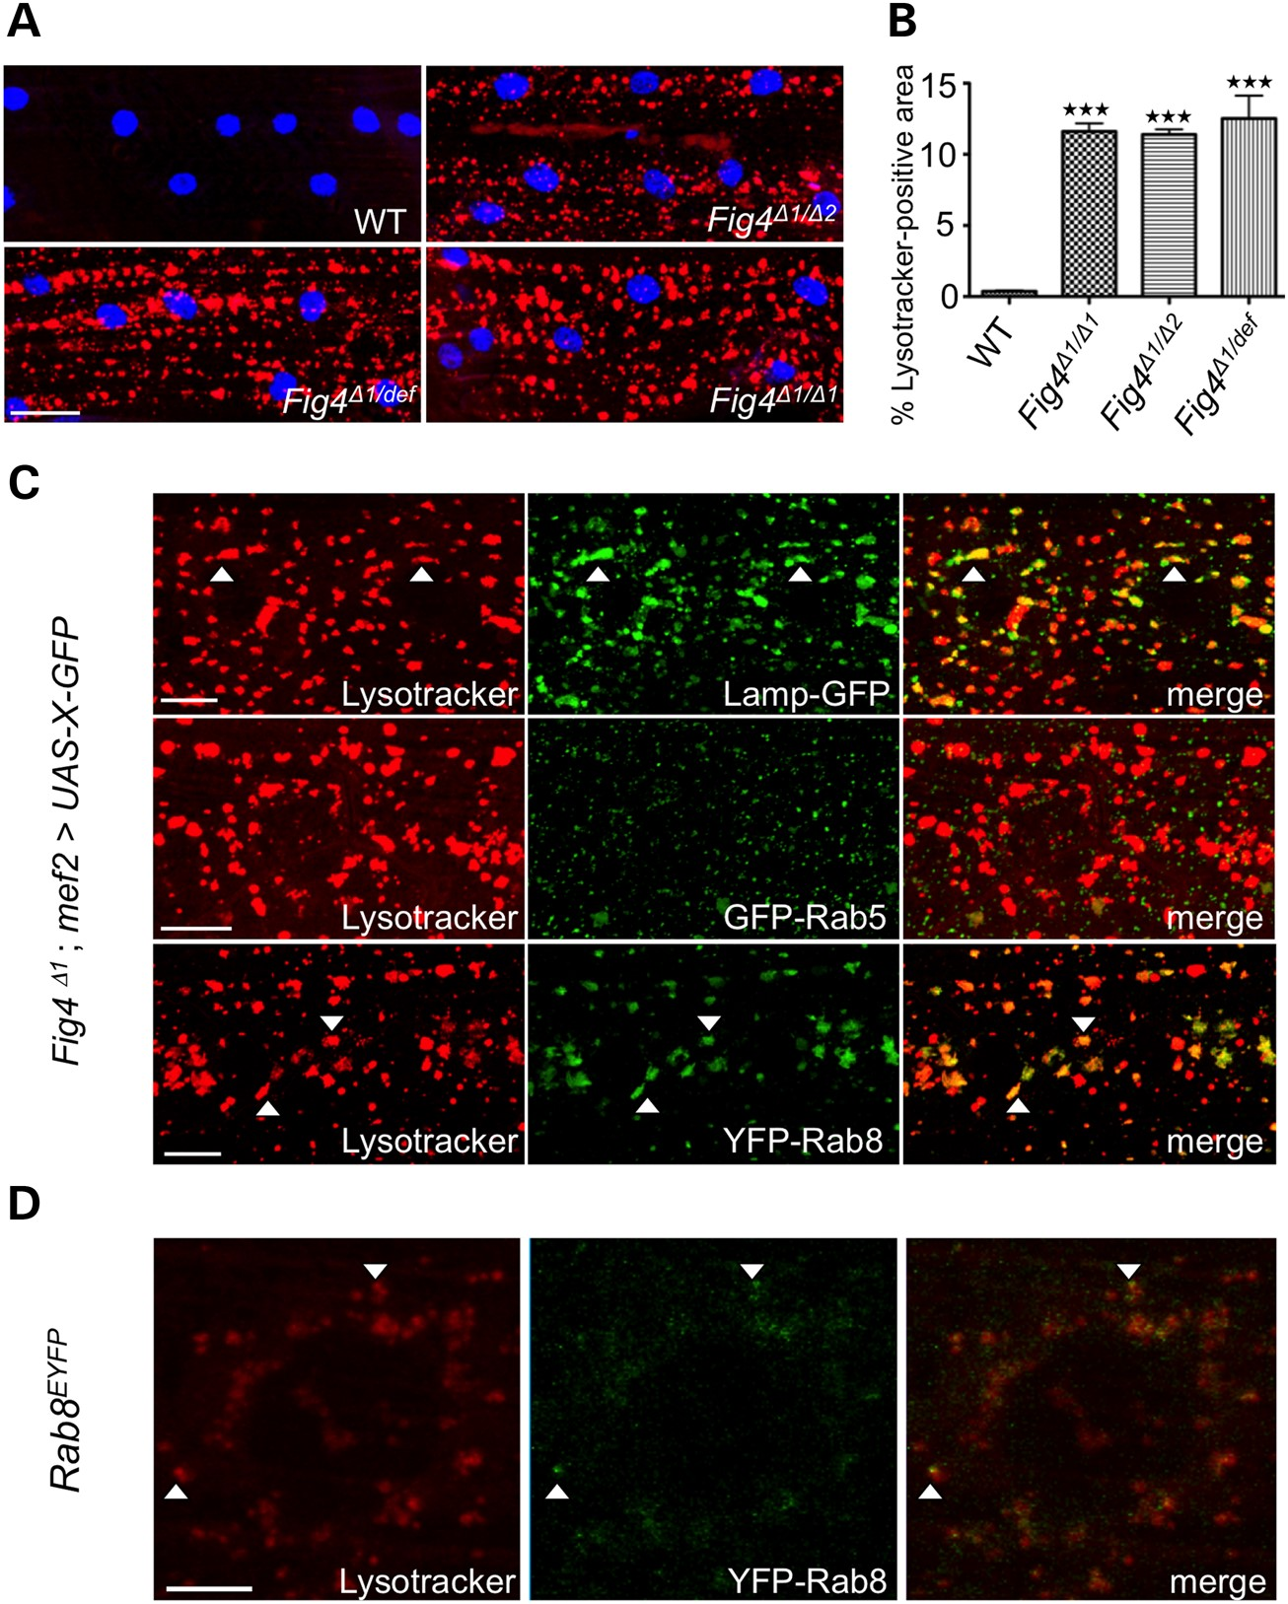
Figure 2. Fig4^{Δ1} mutants show accumulation of Lysotracker-positive structures. (A) WT and Fig4 mutant larvae ...
Notes:
Figure 2. Fig4Δ1 mutants show accumulation of Lysotracker-positive structures. (A) WT and Fig4 mutant larvae stained with Lysotracker (red) and TO-PRO-3 (blue). (B) Quantification of percentage area occupied by Lysotracker-positive structures. Muscles 6/7 in 30 hemisegments were examined for each experiment. Data are mean ± s.e.m. ***P < 0.005. (C) Larval muscles of Fig4Δ1/Δ1 mutants with mef2-Gal4-driven expression of GFP-tagged vesicle markers were stained with Lysotracker. Colocalization between Lysotracker and GFP-positive structures was examined (n = 30 hemisegments). (D) Endogenous YFP-tagged Rab8 partially colocalizes with Lysotracker. Scale bars: 30 μm in (A), 10 μm in (C), 5 μm in (D). Arrowheads highlight colocalization.
Unless provided in the caption above, the following copyright applies to the content of this slide: © The Author 2015. Published by Oxford University Press. All rights reserved. For Permissions, please email: journals.permissions@oup.com

Slide 3
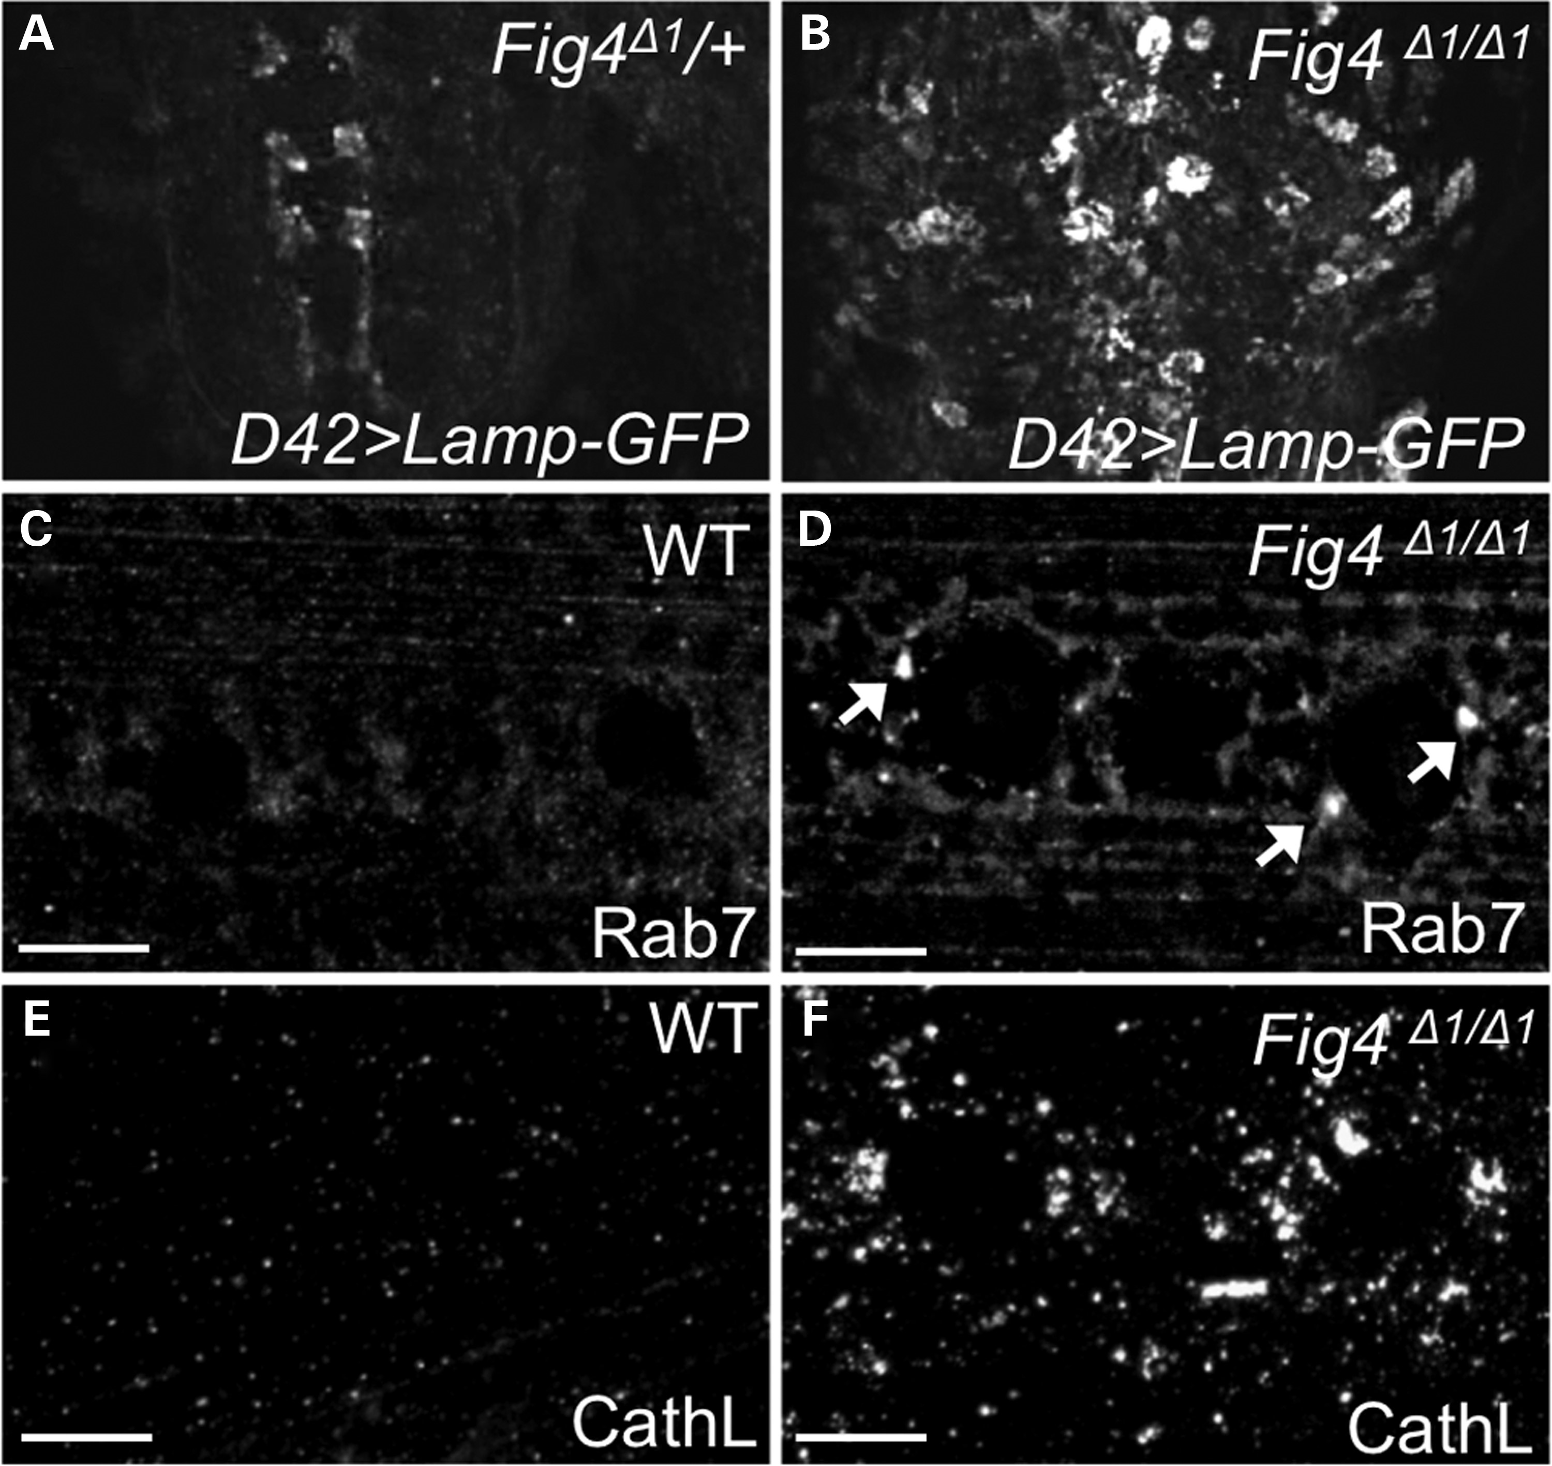
Figure 3. Fig4 mutants exhibit expansion of lysosomal compartment in brain and muscles. (A and B) Confocal images of ...
Notes:
Figure 3. Fig4 mutants exhibit expansion of lysosomal compartment in brain and muscles. (A and B) Confocal images of Fig4Δ1/WT and Fig4Δ1/Δ1 larval brain, expressing Lamp-GFP driven by D42 Gal4 driver. In heterozygous animals, Lamp-GFP is difficult to detect in motor neuron cell bodies, whereas it is robustly expressed in motor neuron cytoplasm in Fig4 null animals. The Lamp-GFP staining present in control animals highlights axon terminals of rare sensory neurons labeled by D42-GAL4. (C–F) WT and Fig4Δ1/Δ1 larval muscles stained with anti-Rab7 (C and D) to label late endosomes and anti-CathL (E and F) to label lysosomes. Arrows highlight occasional expanded Rab7-positive late endosomes. Scale bars: 10 μm.
Unless provided in the caption above, the following copyright applies to the content of this slide: © The Author 2015. Published by Oxford University Press. All rights reserved. For Permissions, please email: journals.permissions@oup.com

Slide 4
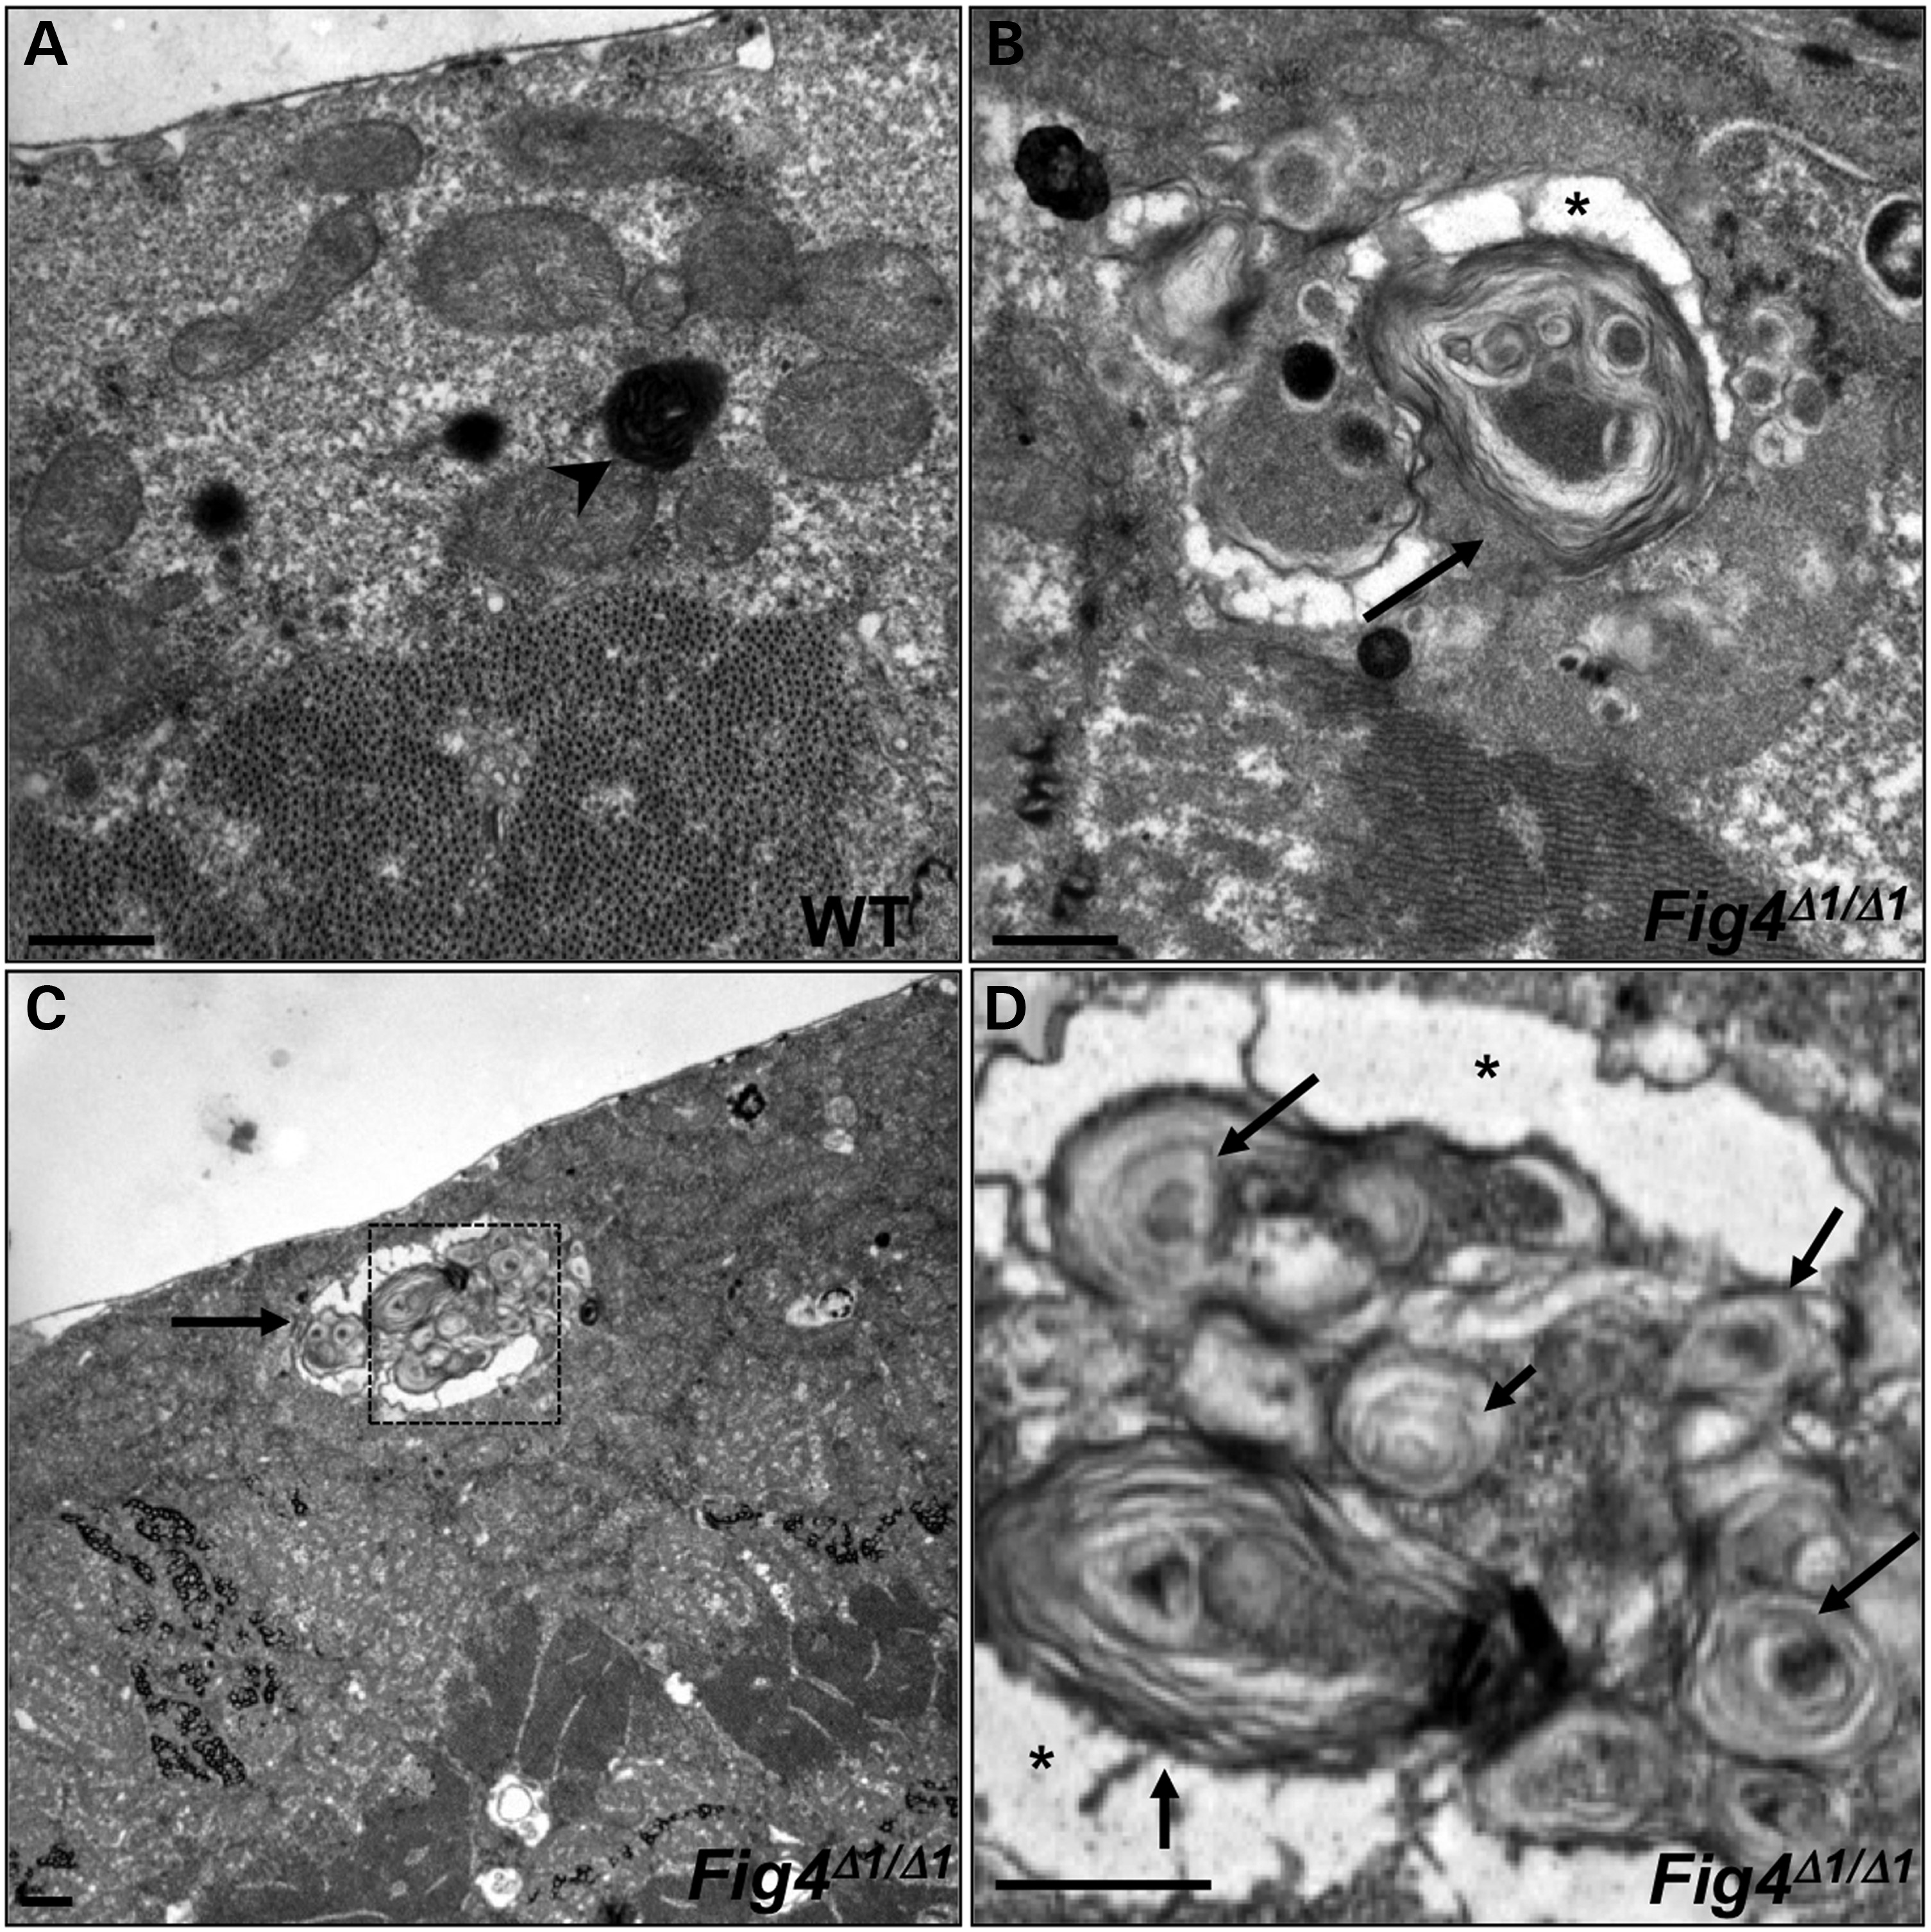
Figure 4. Ultrastructural analysis of WT (A) and Fig4^{Δ1/Δ1} mutant (B–D) larval muscles. Boxed ...
Notes:
Figure 4. Ultrastructural analysis of WT (A) and Fig4Δ1/Δ1 mutant (B–D) larval muscles. Boxed area in (C) is magnified in (D). WT lysosomes are small and electron-dense (arrowhead in A), whereas many Fig4Δ1/Δ1 lysosomes are markedly expanded (arrows in B–D) and contain numerous membranous whorls. Asterisk indicates electron-lucent regions that surround membranous whorls. Scale bars: 2 μm.
Unless provided in the caption above, the following copyright applies to the content of this slide: © The Author 2015. Published by Oxford University Press. All rights reserved. For Permissions, please email: journals.permissions@oup.com

Slide 5
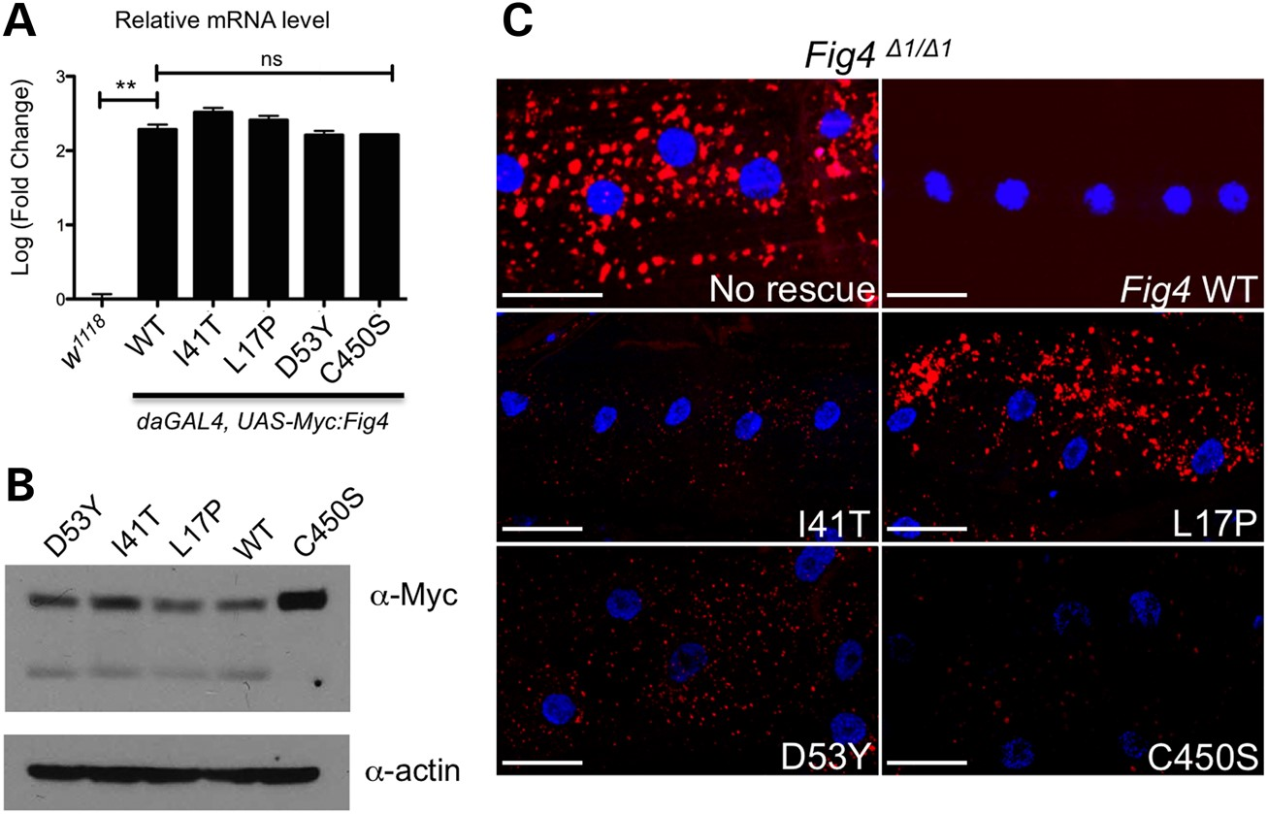
Figure 5. Functional significance of human disease-related Fig4 mutations. (A) Quantitative RT-PCR analysis ...
Notes:
Figure 5. Functional significance of human disease-related Fig4 mutations. (A) Quantitative RT-PCR analysis demonstrates that ubiquitous overexpression of N-terminal Myc-tagged Fig4 transgenes are expressed at >100× endogenous levels. (B) Western blot of whole body lysates from adult flies expressing N-terminal Myc-tagged Drosophila Fig4 transgenes under control of actin-Gal4. (C) Transgenes carrying Drosophila Fig4 with orthologous disease-associated mutations were expressed in muscle cells using Mef2-Gal4 in a Fig4 null background. Whereas wild-type FIG4 protein expression fully rescues the lysosome expansion phenotype (lysosomes labeled with Lyostracker red), CMT4J (I41T and L17P) and D53Y mutants only partially rescue this phenotype. Interestingly, a catalytically inactive mutation (C450S) in the Fig4 phosphatase domain also rescues the lysosome expansion phenotype. Scale bars: 30 μm. **P < 0.01 using pairwise t-test.
Unless provided in the caption above, the following copyright applies to the content of this slide: © The Author 2015. Published by Oxford University Press. All rights reserved. For Permissions, please email: journals.permissions@oup.com

Slide 6
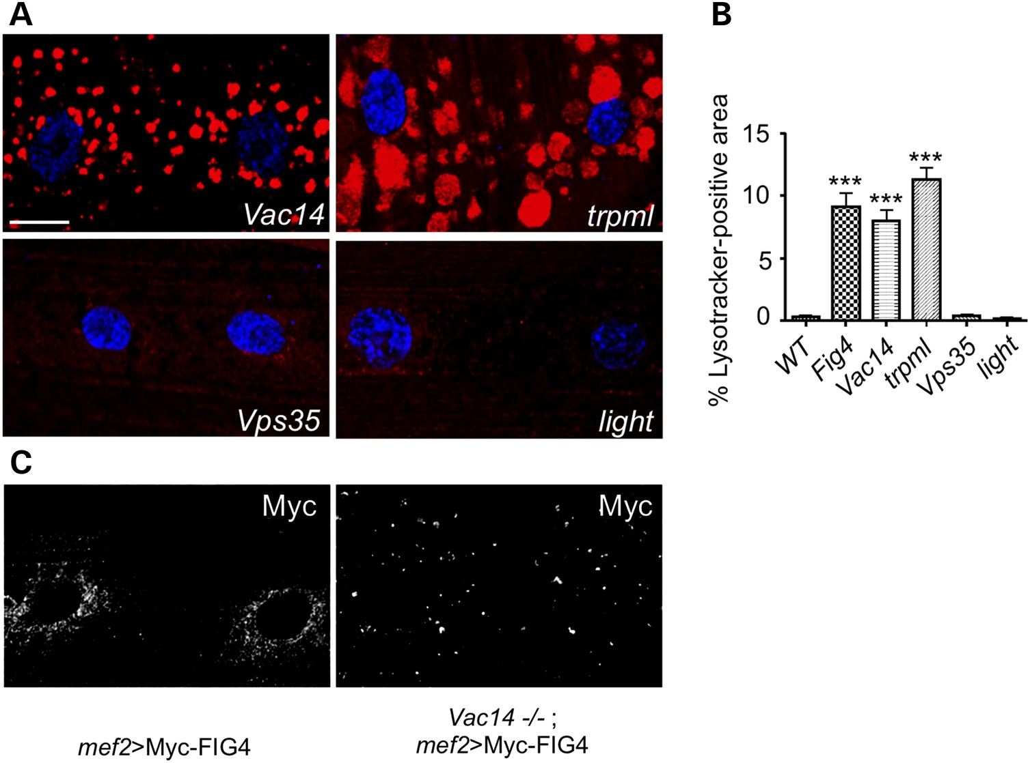
Figure 6. FIG4 interactors VAC14 and TRPML also regulate lysosomal size. (A) Larval fillet preps from indicated ...
Notes:
Figure 6. FIG4 interactors VAC14 and TRPML also regulate lysosomal size. (A) Larval fillet preps from indicated genotypes were stained with Lysotracker (red) and TO-PRO-3 (blue). (B) Quantification of lysosomal defects observed in indicated genotypes. Data are mean ± s.e.m. ***P < 0.005. (C) Examination of mef2Gal4-driven Myc-FIG4 localization in WT and Vac14 null mutants reveals that VAC14 is required for normal FIG4 localization. n = 30 hemisegments for all experiments. Scale bars: 15 μm in (A) and (C).
Unless provided in the caption above, the following copyright applies to the content of this slide: © The Author 2015. Published by Oxford University Press. All rights reserved. For Permissions, please email: journals.permissions@oup.com

Slide 7
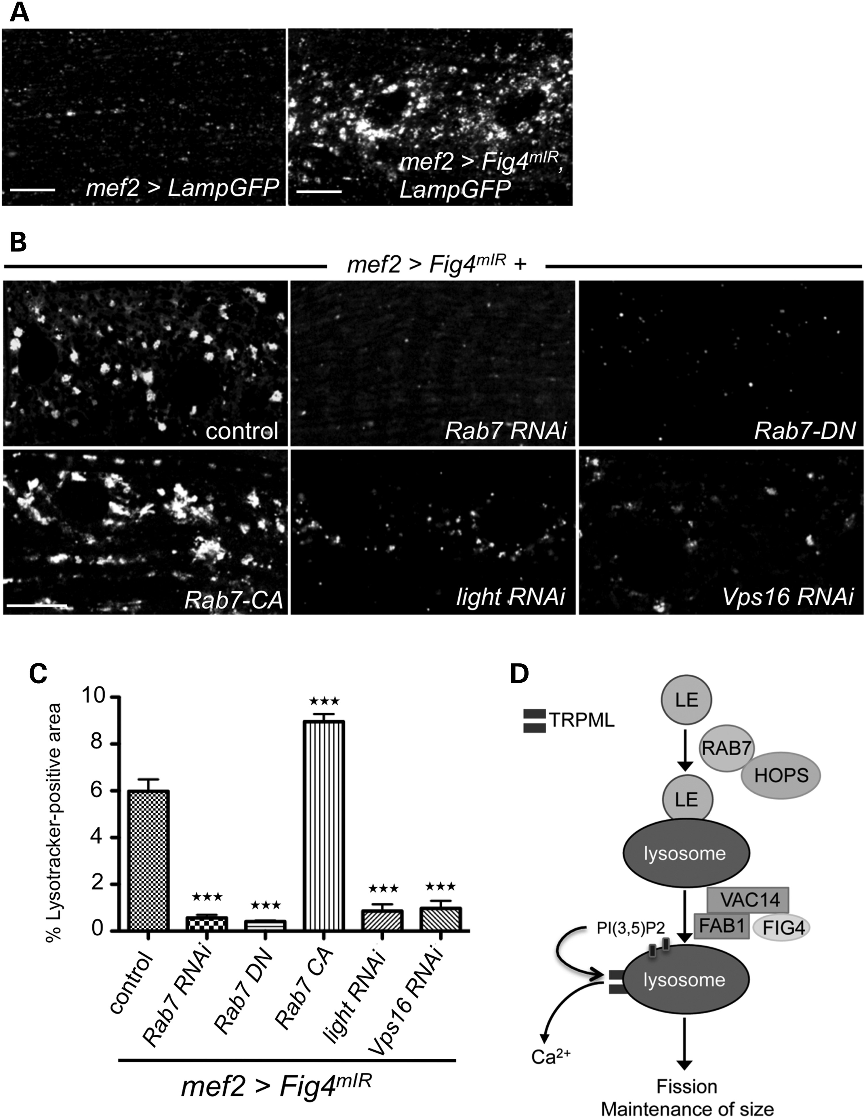
Figure 7. Lysosomal defects in response to disruption of Fig4 can be suppressed by depletion of Rab7 and HOPS complex ...
Notes:
Figure 7. Lysosomal defects in response to disruption of Fig4 can be suppressed by depletion of Rab7 and HOPS complex components. (A) mIR-mediated knockdown of Fig4 in muscles with mef2-GAL4 reproduces the Fig4 null lysosome accumulation phenotype (lysosomes labeled with Lamp-GFP). (B) Candidate-based screen for modifiers of lysosome expansion (Lysotracker-positive punctae) identifies Rab7 and HOPS complex components (light and Vps16). (C) Quantification of suppression of Fig4 phenotype by various transgenes. n = 30 hemisegments. Data are mean ± s.e.m. ***P < 0.005. (D) Model for FIG4 function in lysosomal homeostasis: Late endosome (LE) fusion with the lysosome requires the Rab7/HOPS complex, but not FIG4. The FIG4-VAC14-FAB1 complex is required for PI(3,5)P2 formation, which activates TRPML function; TRPML causes calcium efflux from the lysosome which maintains lysosome size, possibly by activating lysosomal fission. This function of FIG4 requires VAC14, but not phosphatase activity, and is disrupted by mutations that cause CMT4J.
Unless provided in the caption above, the following copyright applies to the content of this slide: © The Author 2015. Published by Oxford University Press. All rights reserved. For Permissions, please email: journals.permissions@oup.com

