Slide 1
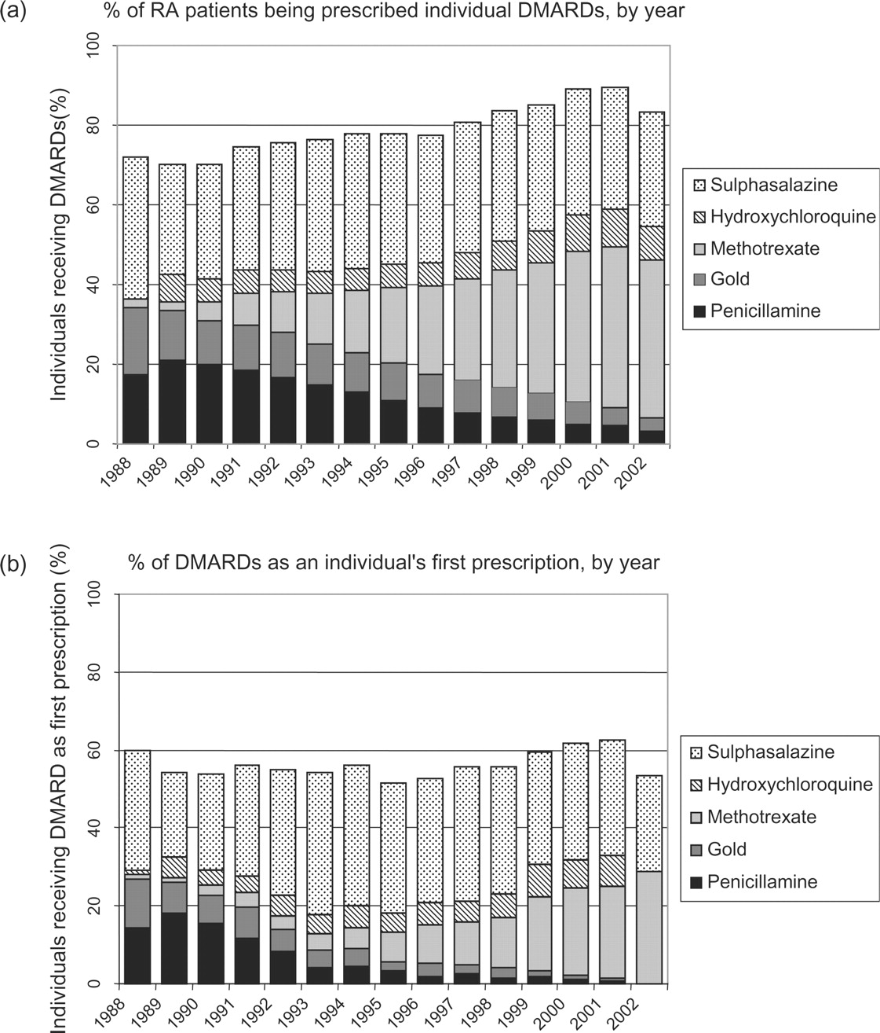
Fig. 1. (a) Changing trends in the use of DMARDS over the 15-yr study period from 1987 to 2002. (b) Changing trends ...
Notes:
Fig. 1. (a) Changing trends in the use of DMARDS over the 15-yr study period from 1987 to 2002. (b) Changing trends in the first ever DMARD prescriptions in RA over the 15-yr study period from 1987 to 2002.
Unless provided in the caption above, the following copyright applies to the content of this slide: © The Author 2005. Published by Oxford University Press on behalf of the British Society for Rheumatology. All rights reserved. For Permissions, please email: journals.permissions@oxfordjournals.org

Slide 2
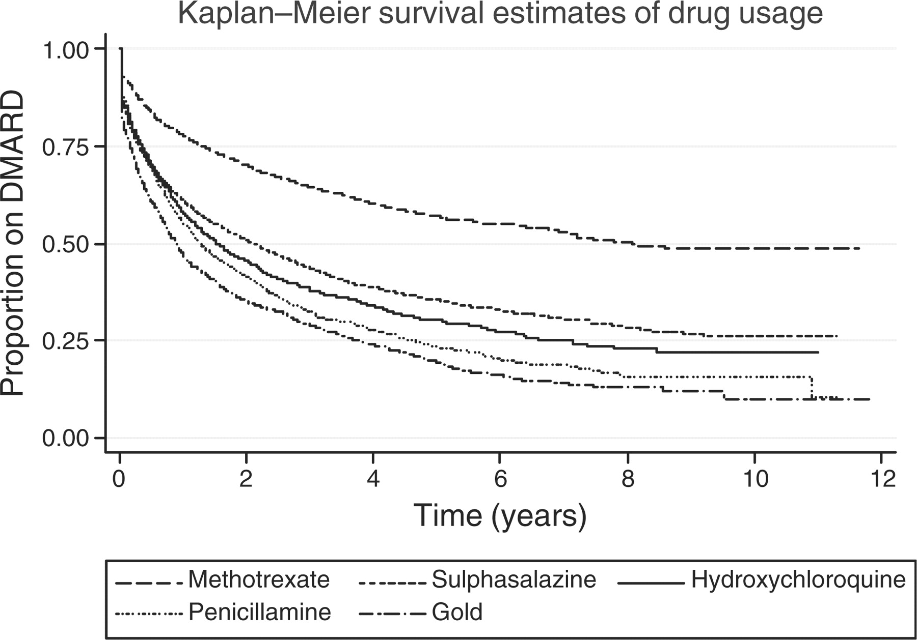
Fig. 2. Kaplan–Meier survival estimates of DMARD use over the 15-yr study period.
Notes:
Fig. 2. Kaplan–Meier survival estimates of DMARD use over the 15-yr study period.
Unless provided in the caption above, the following copyright applies to the content of this slide: © The Author 2005. Published by Oxford University Press on behalf of the British Society for Rheumatology. All rights reserved. For Permissions, please email: journals.permissions@oxfordjournals.org

