Slide 1
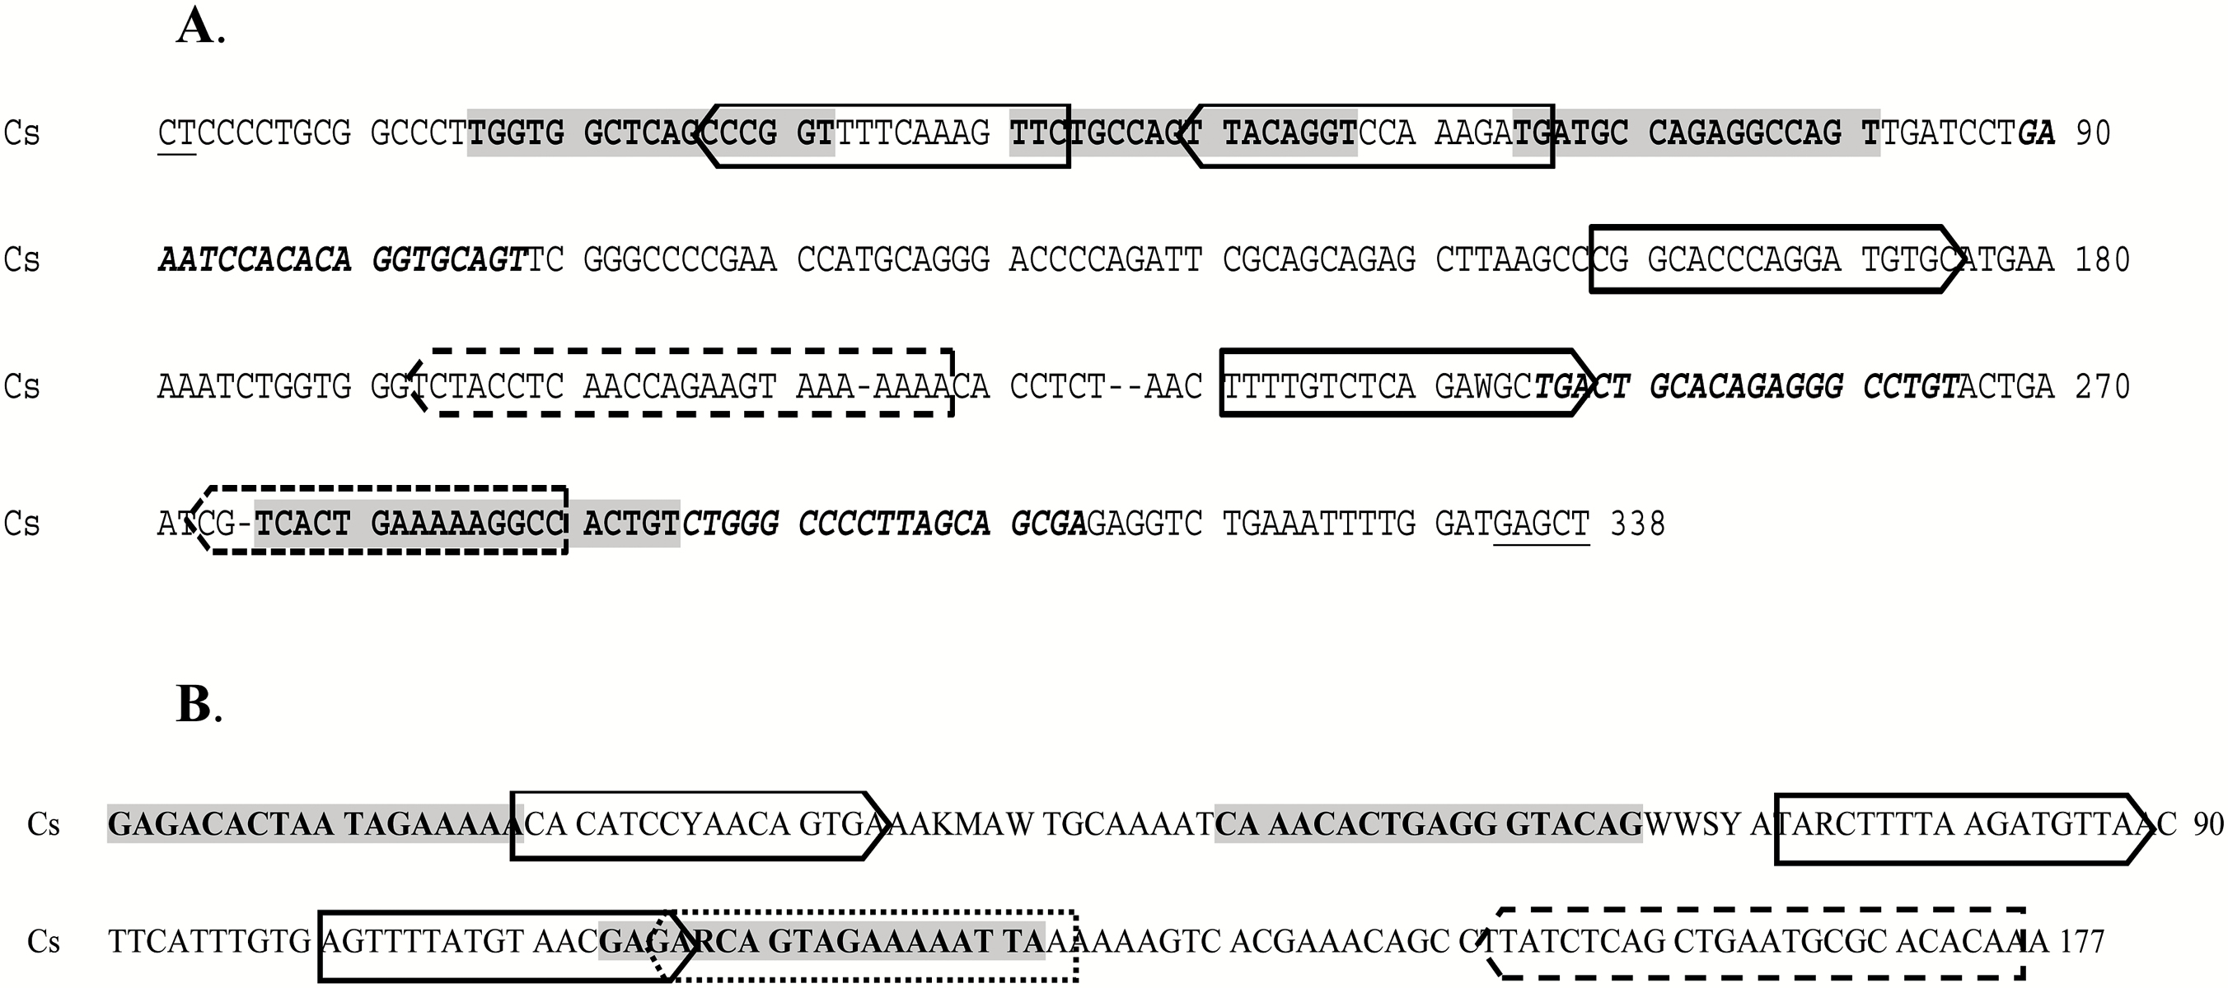
Figure 1. (A) Consensus sequence (Cs) of satellite DNA SacI of Hippoglossus hippoglossus. The sequences highlighted in ...
Notes:
Figure 1. (A) Consensus sequence (Cs) of satellite DNA SacI of Hippoglossus hippoglossus. The sequences highlighted in grey (16 bp) and in italics (20 bp) correspond to internal repetitions with main homologies of 52.7% (grey) and 55.1% (italics). The SacI enzyme restriction site is underlined. In both figures, boxed sequences present similarities with centromeric motives as CENP-B (solid line), CDEIII (broken line), and PJα (dotted line). (B) Consensus sequence (Cs) of satellite-DNA PvuII of Solea senegalensis. The sequences highlighted in grey (18 bp) correspond to an internal repetition with main homologies of 66.7%.
Unless provided in the caption above, the following copyright applies to the content of this slide: © The American Genetic Association 2016. All rights reserved. For permissions, please e-mail: journals.permissions@oup.com

Slide 2
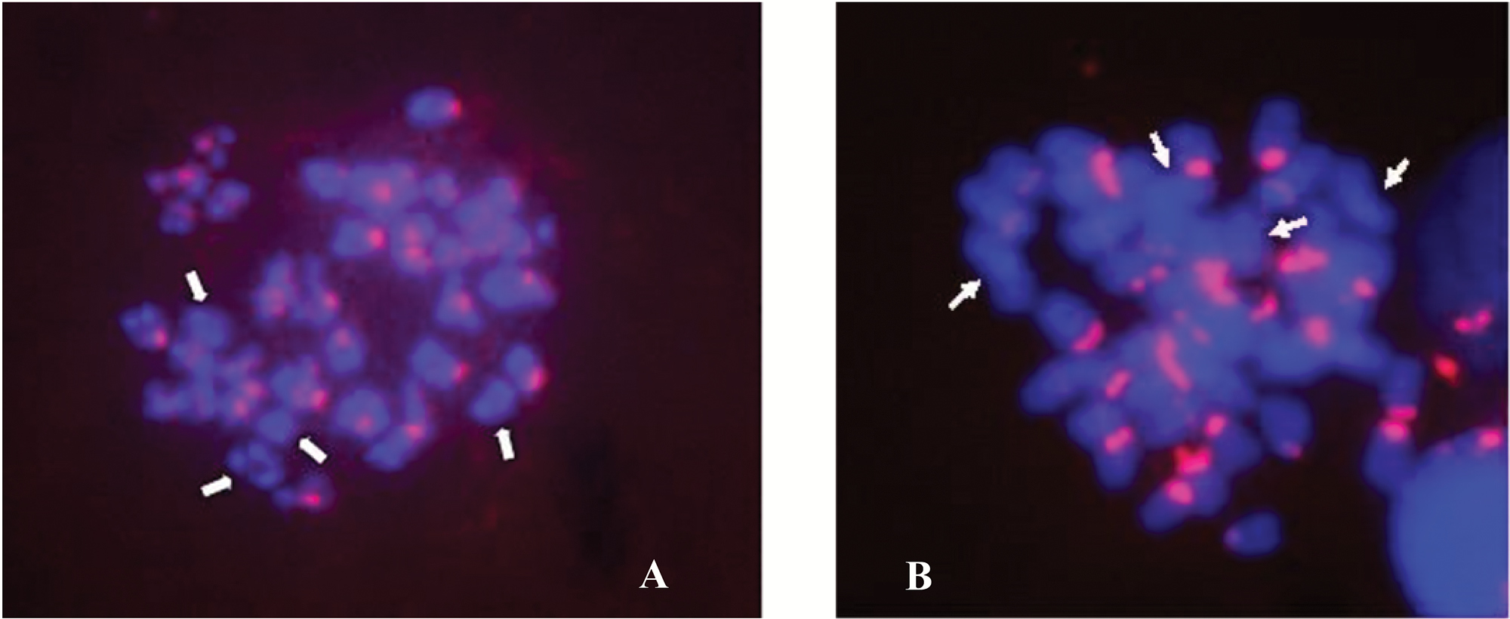
Figure 2. (A) Chromosomal locations of SacI-family satellite DNA by FISH in mitotic metaphase of Hippoglossus ...
Notes:
Figure 2. (A) Chromosomal locations of SacI-family satellite DNA by FISH in mitotic metaphase of Hippoglossus hippoglossus. Arrows indicate chromosomes lacking hybridization signals. (B) Chromosomal locations of PvuII-family satellite DNA by FISH in mitotic metaphase of Solea senegalensis. Arrows indicate chromosomes lacking hybridization signals.
Unless provided in the caption above, the following copyright applies to the content of this slide: © The American Genetic Association 2016. All rights reserved. For permissions, please e-mail: journals.permissions@oup.com

Slide 3
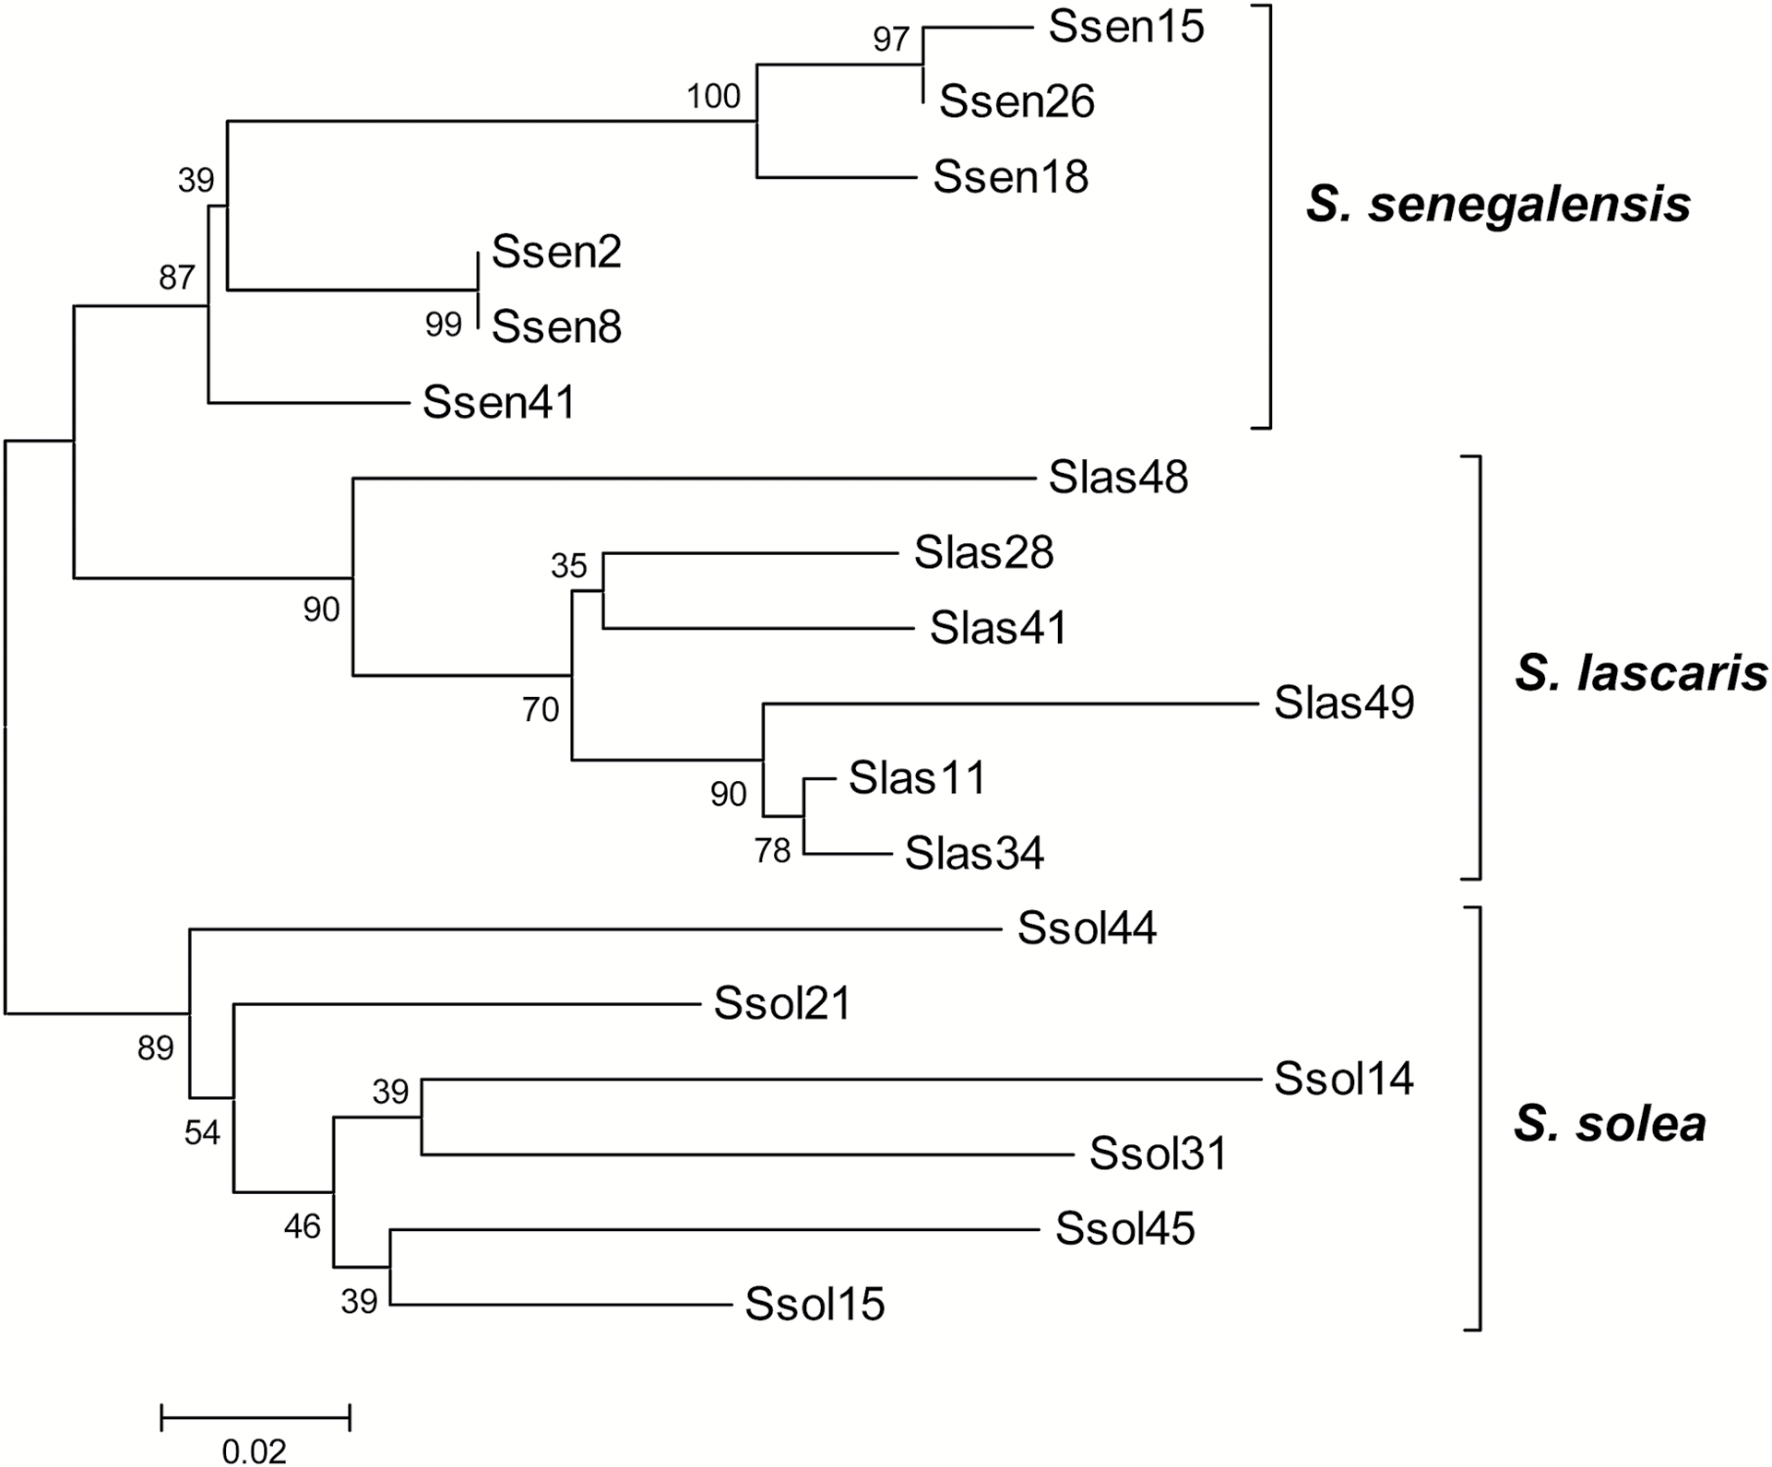
Figure 3. Unrooted neighbor-joining tree of PvuII sequences from Solea species. The numbers next to the name of the ...
Notes:
Figure 3. Unrooted neighbor-joining tree of PvuII sequences from Solea species. The numbers next to the name of the species indicates the clone analyzed. Numbers are bootstrapping indices for the level of support for individual nodes.
Unless provided in the caption above, the following copyright applies to the content of this slide: © The American Genetic Association 2016. All rights reserved. For permissions, please e-mail: journals.permissions@oup.com

