Slide 1
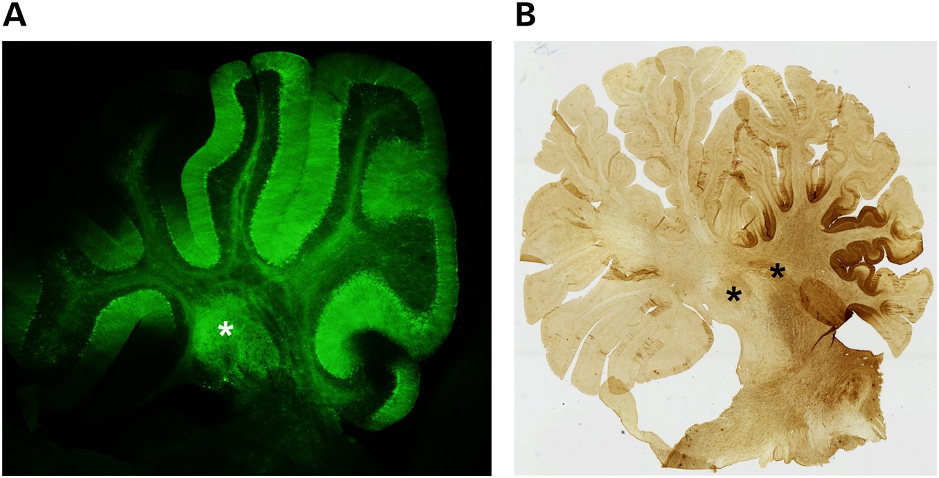
Figure 3. Transgene expression in the mouse and NHP cerebellum following AAV-mediated expression in the DCN. (A) ...
Notes:
Figure 3. Transgene expression in the mouse and NHP cerebellum following AAV-mediated expression in the DCN. (A) Sagittal section of mouse cerebellum following direct delivery of AAV2/5 expressing an miRNA targeting Atxn1 and eGFP to the DCN. Green staining demonstrates biodistribution to multiple lobules from single injection site. (B) Sagittal section of NHP cerebellum following direct delivery of AAV2/1 expressing and an miRNA targeting ATXN1 and eGFP to the DCN. Brown staining shows biodistribution throughout multiple lobules. *DCN.
Unless provided in the caption above, the following copyright applies to the content of this slide: © The Author 2015. Published by Oxford University Press. All rights reserved. For Permissions, please email: journals.permissions@oup.com

Slide 2
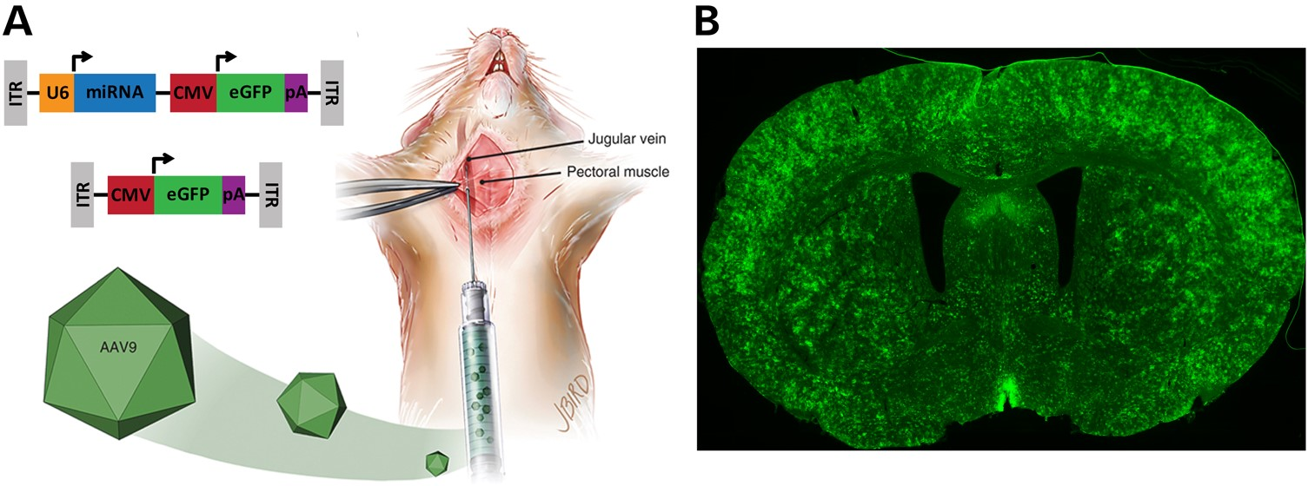
Figure 2. Global suppression of HTT in the transgenic HD mouse brain. (A) Cartoon depicting the delivery of an AAV9 ...
Notes:
Figure 2. Global suppression of HTT in the transgenic HD mouse brain. (A) Cartoon depicting the delivery of an AAV9 vector expressing an mHTT-specific miRNA and a GFP control gene (top construct, AAV9-mi2.1-GFP) or AAV9 vector expressing GFP alone (bottom construct, AAV9-GFP) into the mouse jugular vein. (B) Vascular delivery of AAV9-mi2.1-GFP resulted in widespread expression of both the therapeutic miRNA and GFP throughout the N171–82Q transgenic mouse brain and a concomitant reduction in mHTT in several brain regions including the cortex, striatum, hypothalamus, hippocampus and thalamus (57).
Unless provided in the caption above, the following copyright applies to the content of this slide: © The Author 2015. Published by Oxford University Press. All rights reserved. For Permissions, please email: journals.permissions@oup.com

Slide 3
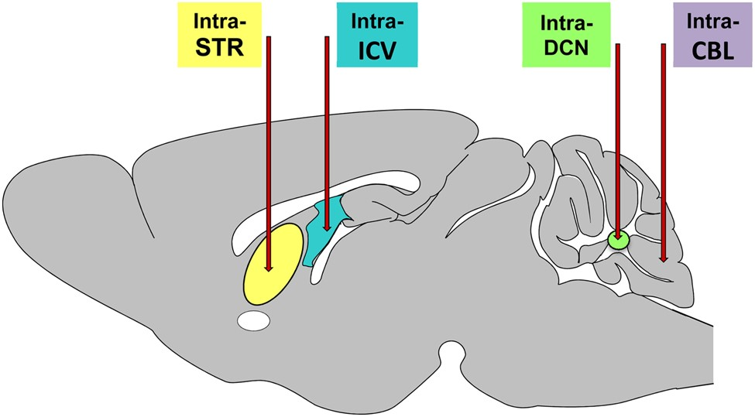
Figure 1. Cartoon of common delivery sites for gene suppression constructs evaluated in mouse models of HD and the ...
Notes:
Figure 1. Cartoon of common delivery sites for gene suppression constructs evaluated in mouse models of HD and the SCAs. Primary delivery sites include the striatum, lateral ventricle, DCN and the cerebellar cortex. Delivery into the striatum (STR) (7,8,50,53,54,58,59,79), DCN (67,68,71,74,80) and cerebellar cortex (CBL) (6) result largely in focal expression of the injected construct, with evidence if anterograde and retrograde transport when AAVs are used as the delivery vehicle. In contrast, injection into the CSF via injections into the lateral ventricle (ICV) (2,35,38,51,64,66) or the cisterna magna (CM) result in more widespread delivery throughout the brain.
Unless provided in the caption above, the following copyright applies to the content of this slide: © The Author 2015. Published by Oxford University Press. All rights reserved. For Permissions, please email: journals.permissions@oup.com

