Slide 1
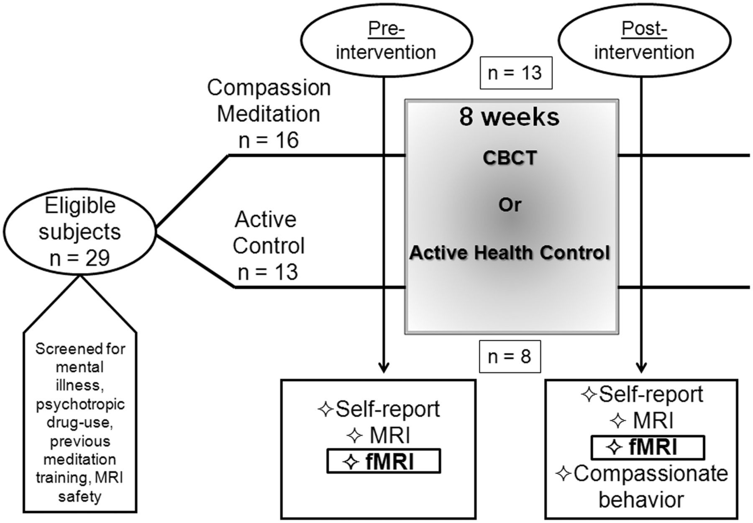
Fig. 1 Schematic of entire study design. FMRI assessments are the focus of the current study.
Notes:
Fig. 1 Schematic of entire study design. FMRI assessments are the focus of the current study.
Unless provided in the caption above, the following copyright applies to the content of this slide: © The Author(s) (2012). Published by Oxford University Press.This is an Open Access article distributed under the terms of the Creative Commons Attribution Non-Commercial License (http://creativecommons.org/licenses/by-nc/4.0/), which permits non-commercial re-use, distribution, and reproduction in any medium, provided the original work is properly cited. For commercial re-use, please contact journals.permissions@oup.com

Slide 2
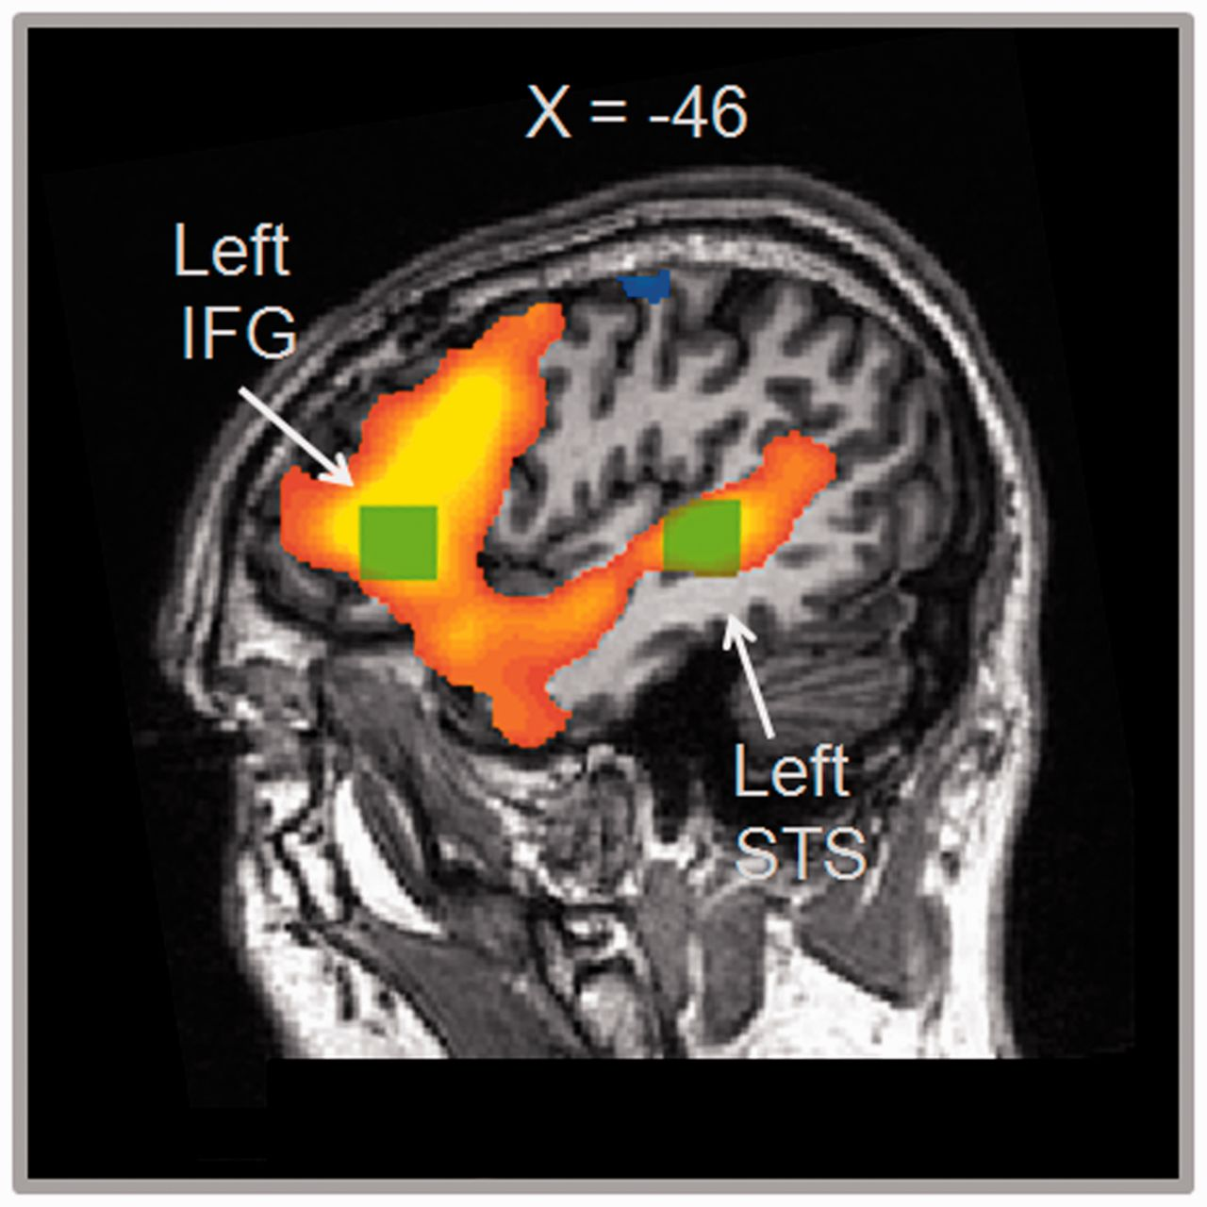
Fig. 2 Activation map (emotion–gender) was thresholded at P < 0.001. Location of functional ROIs in left IFG and ...
Notes:
Fig. 2 Activation map (emotion–gender) was thresholded at P < 0.001. Location of functional ROIs in left IFG and posterior STS indicated by arrow.
Unless provided in the caption above, the following copyright applies to the content of this slide: © The Author(s) (2012). Published by Oxford University Press.This is an Open Access article distributed under the terms of the Creative Commons Attribution Non-Commercial License (http://creativecommons.org/licenses/by-nc/4.0/), which permits non-commercial re-use, distribution, and reproduction in any medium, provided the original work is properly cited. For commercial re-use, please contact journals.permissions@oup.com

Slide 3
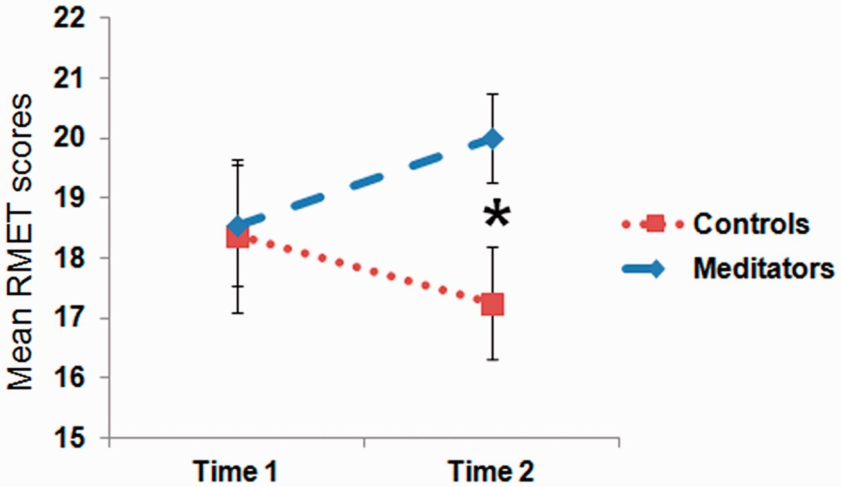
Fig. 3 Repeated measures of empathic accuracy scores broken up according to group. At Time 2, the meditation group ...
Notes:
Fig. 3 Repeated measures of empathic accuracy scores broken up according to group. At Time 2, the meditation group scored significantly higher than the control group [t(19) = 2.31, P = 0.03].
Unless provided in the caption above, the following copyright applies to the content of this slide: © The Author(s) (2012). Published by Oxford University Press.This is an Open Access article distributed under the terms of the Creative Commons Attribution Non-Commercial License (http://creativecommons.org/licenses/by-nc/4.0/), which permits non-commercial re-use, distribution, and reproduction in any medium, provided the original work is properly cited. For commercial re-use, please contact journals.permissions@oup.com

Slide 4
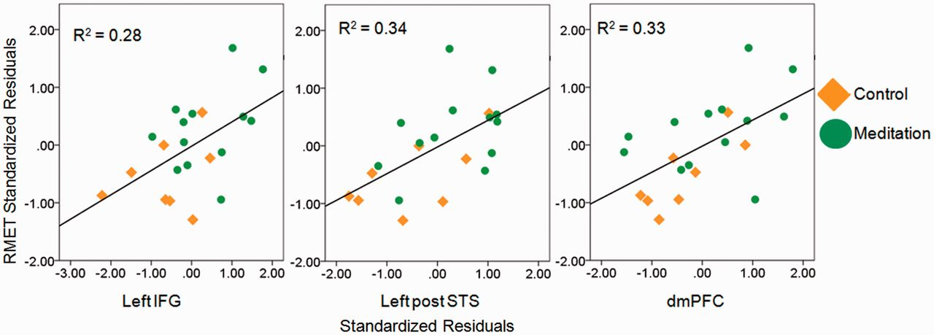
Fig. 4 Correlation of standardized residual change in RMET scores with standardized residual change in brain ...
Notes:
Fig. 4 Correlation of standardized residual change in RMET scores with standardized residual change in brain activity in the left IFG [r(19) = 0.55, P = 0.01], left posterior STS (left post STS) [r(19) = 0.59, P = 0.01] and dmPFC [r(19) = 0.56, P = 0.01].
Unless provided in the caption above, the following copyright applies to the content of this slide: © The Author(s) (2012). Published by Oxford University Press.This is an Open Access article distributed under the terms of the Creative Commons Attribution Non-Commercial License (http://creativecommons.org/licenses/by-nc/4.0/), which permits non-commercial re-use, distribution, and reproduction in any medium, provided the original work is properly cited. For commercial re-use, please contact journals.permissions@oup.com

