Slide 1
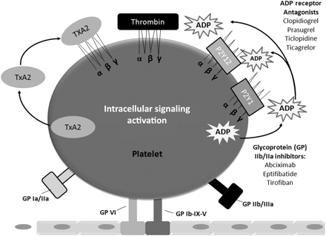
Figure 1 Targets for anti-platelet therapy. Adapted with permission from Meadows and Bhatt.⁶³
Notes:
Figure 1 Targets for anti-platelet therapy. Adapted with permission from Meadows and Bhatt.63
Unless provided in the caption above, the following copyright applies to the content of this slide: Published on behalf of the European Society of Cardiology. All rights reserved. © The Author 2010. For permissions please email: journals.permissions@oxfordjournals.org

Slide 2
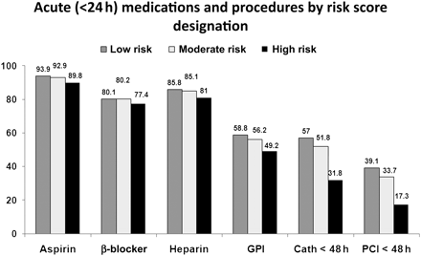
Figure 2 Acute treatment patterns by risk category. Adapted with permission from Roe et al.⁸¹
Notes:
Figure 2 Acute treatment patterns by risk category. Adapted with permission from Roe et al.81
Unless provided in the caption above, the following copyright applies to the content of this slide: Published on behalf of the European Society of Cardiology. All rights reserved. © The Author 2010. For permissions please email: journals.permissions@oxfordjournals.org

