Slide 1
Figure 1 Male-to-female variance ratios (and 95% CIs) of spouse number (left-hand panel) and number of offspring ...
Notes:
Figure 1 Male-to-female variance ratios (and 95% CIs) of spouse number (left-hand panel) and number of offspring (right-hand panel). Values above 1.00 indicate higher variance in men than in women.
Unless provided in the caption above, the following copyright applies to the content of this slide: © The Author 2010. Published by Oxford University Press on behalf of the International Society for Behavioral Ecology. All rights reserved. For permissions, please e-mail: journals.permissions@oxfordjournals.org

Slide 2
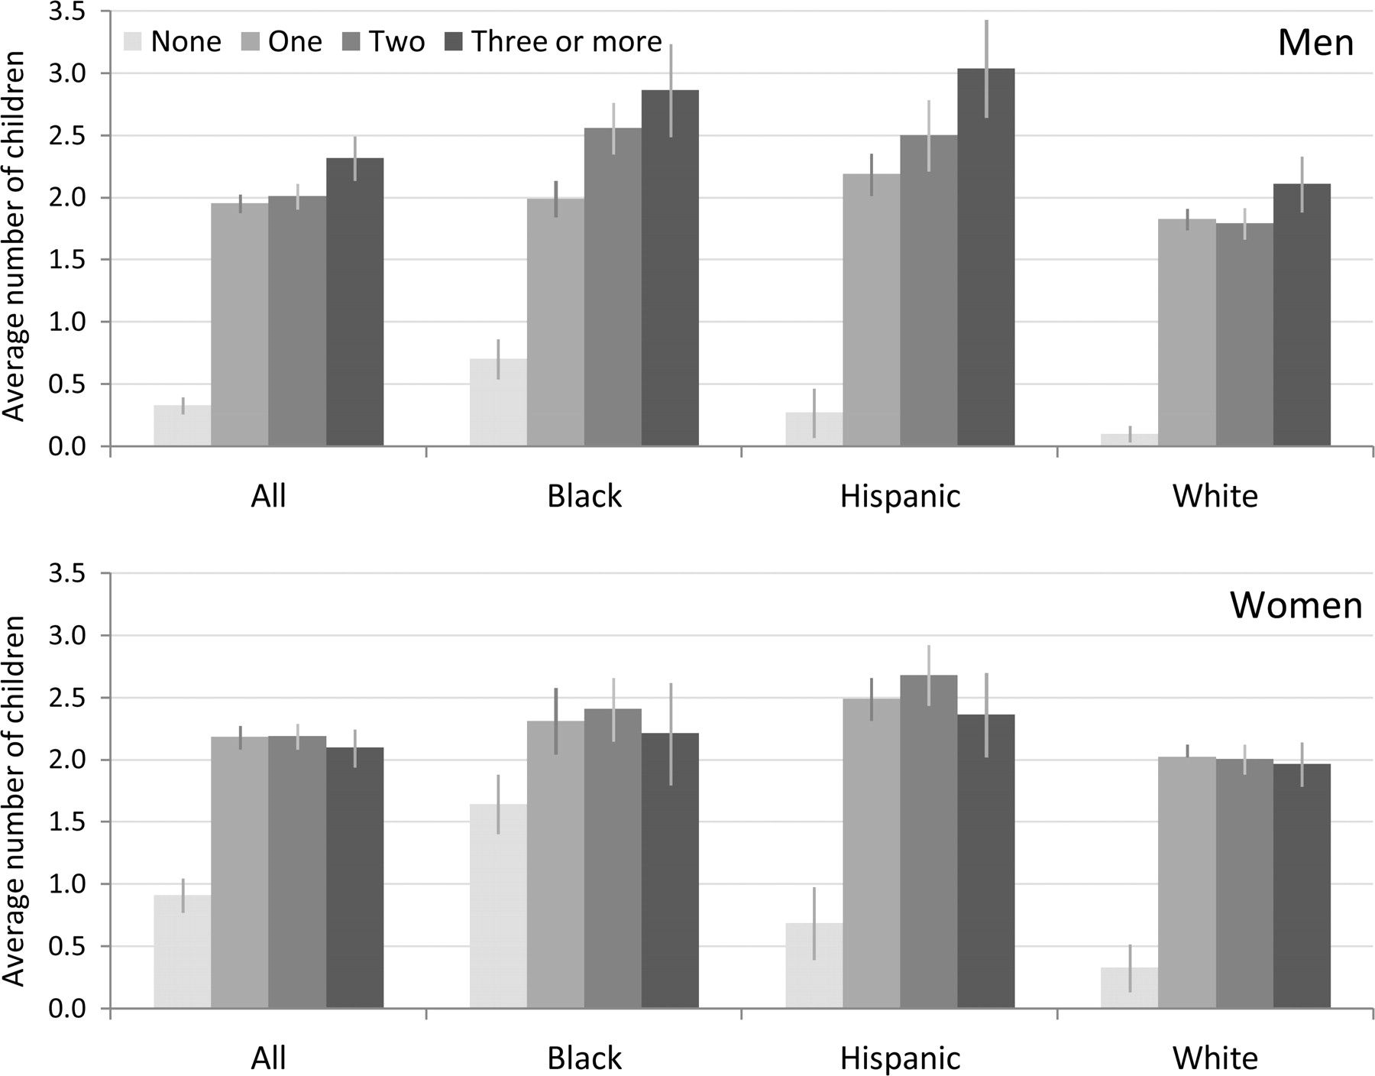
Figure 2 Average number of biological children at age 40–47 years by spouse number and ethnic group in men and women, ...
Notes:
Figure 2 Average number of biological children at age 40–47 years by spouse number and ethnic group in men and women, adjusted for birth year and subsample membership. The vertical lines are 95% CIs.
Unless provided in the caption above, the following copyright applies to the content of this slide: © The Author 2010. Published by Oxford University Press on behalf of the International Society for Behavioral Ecology. All rights reserved. For permissions, please e-mail: journals.permissions@oxfordjournals.org

