Slide 1
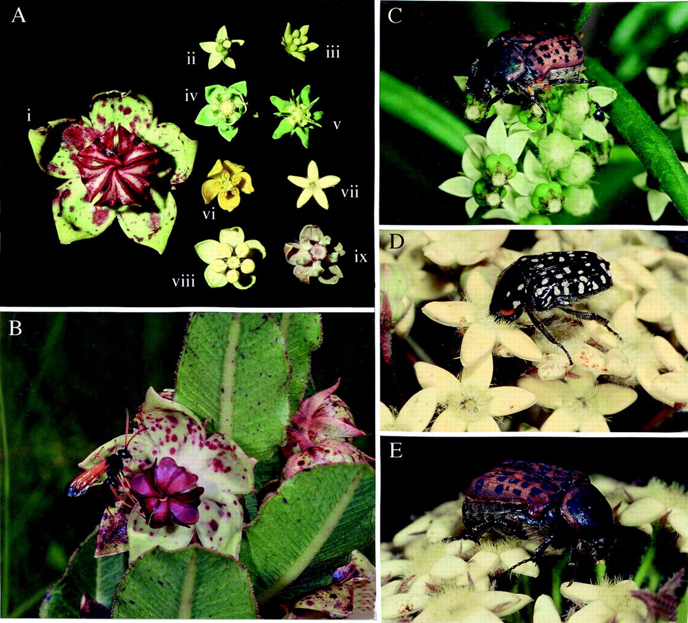
Fig. 1. A, The nine species of asclepiad included within this study: (i) Pachycarpus natalensis; (ii) ...
Notes:
Fig. 1. A, The nine species of asclepiad included within this study: (i) Pachycarpus natalensis; (ii) Xysmalobium involucratum Decne; (iii) xysmalobium gerrardii Scott Elliott; (iv) Miraglossum verticillare (Schltr.) Kupicha; (v) Miraglossum pilosum (Schltr.) Kupicha; (vi) Aspidonepsis diploglossa (Turcz.) A. Nicholas; (vii) Sisyranthus trichostomus (Harv.) K. Schum. and D.J. Goyder; (viii) Asclepias woodii (Schltr.) Schltr.; (ix) Asclepias cucullata (Schltr.) Schltr. B, Hemipepsis hilaris (Hymenoptera: Pompilidae) visiting a flower of Pachycarpus natalensis. C, Atrichelaphinis tigrina (Coleoptera: Scarabaeidae: Cetoniini) visiting flowers of Xysmalobium involucratum; note the yellow pollinaria attached to the legs. D, Cyrtothyrea marginalis (Coleoptera: Scarabaeidae: Cetoniini) visiting Sisyranthus trichostomus and feeding through the hairs within the floral tube. E, Atrichelaphinis tigrina visiting Sisyranthus trichostomus; note the pollinaria attached to the mouthparts.
Unless provided in the caption above, the following copyright applies to the content of this slide: Annals of Botany Company

Slide 2
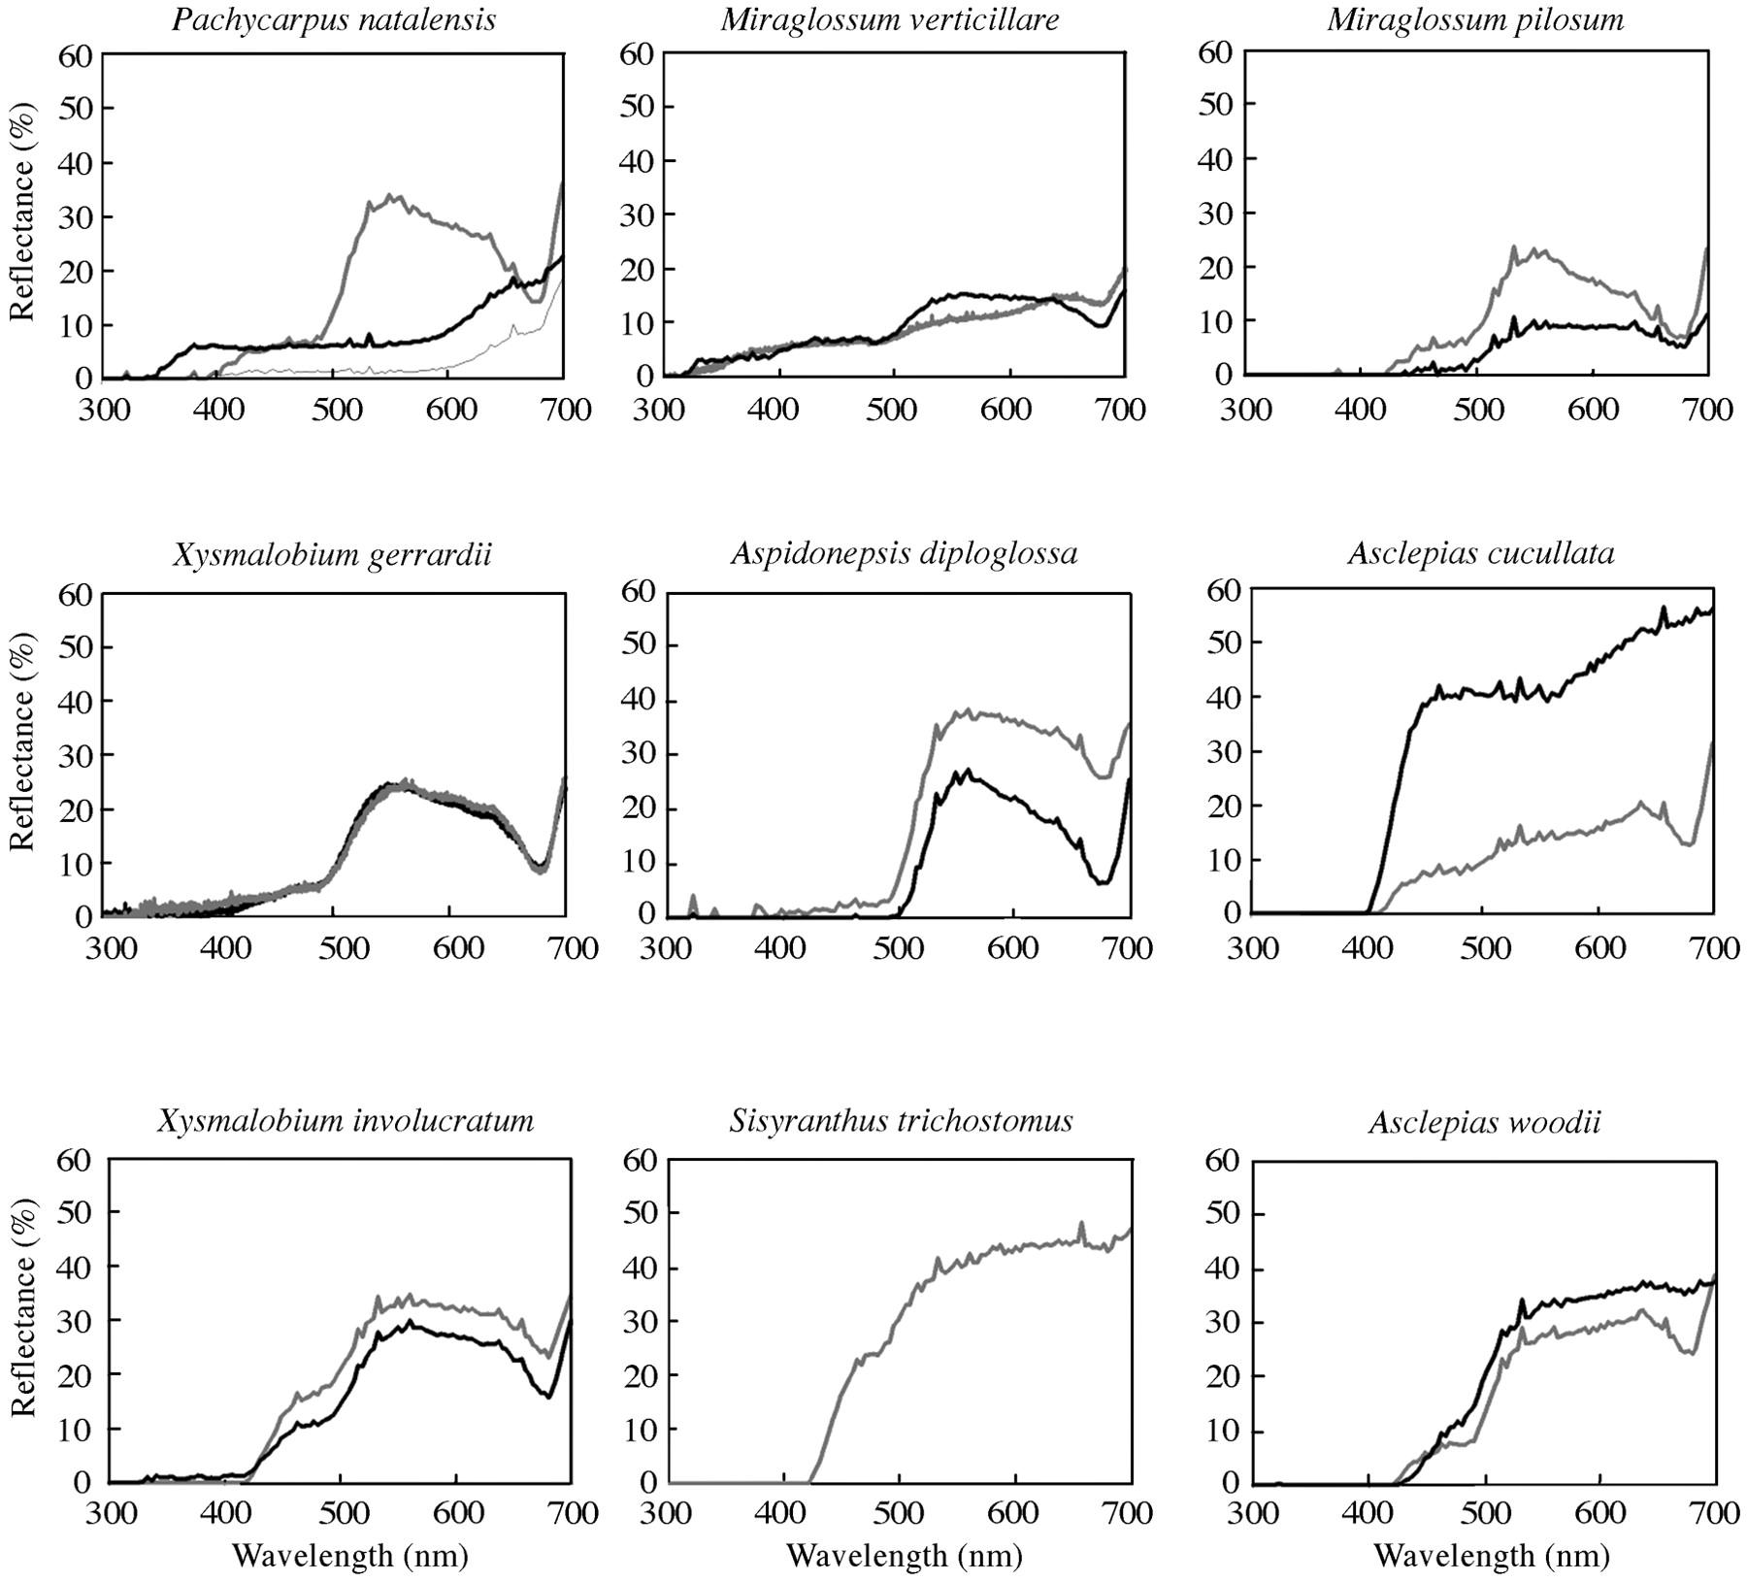
Fig. 2. Reflectance spectra of flowers of the nine asclepiads from Wahroonga. In all cases the dark line is ...
Notes:
Fig. 2. Reflectance spectra of flowers of the nine asclepiads from Wahroonga. In all cases the dark line is the spectrum of the corona and the light line is the spectrum of the corolla. For Pachycarpus natalensis, the lower, light coloured line is the spectrum for the large purple patches (see Fig. 1A and B). For Sisyranthus trichostomus, the corona is not visible without dissecting the flower.
Unless provided in the caption above, the following copyright applies to the content of this slide: Annals of Botany Company

Slide 3
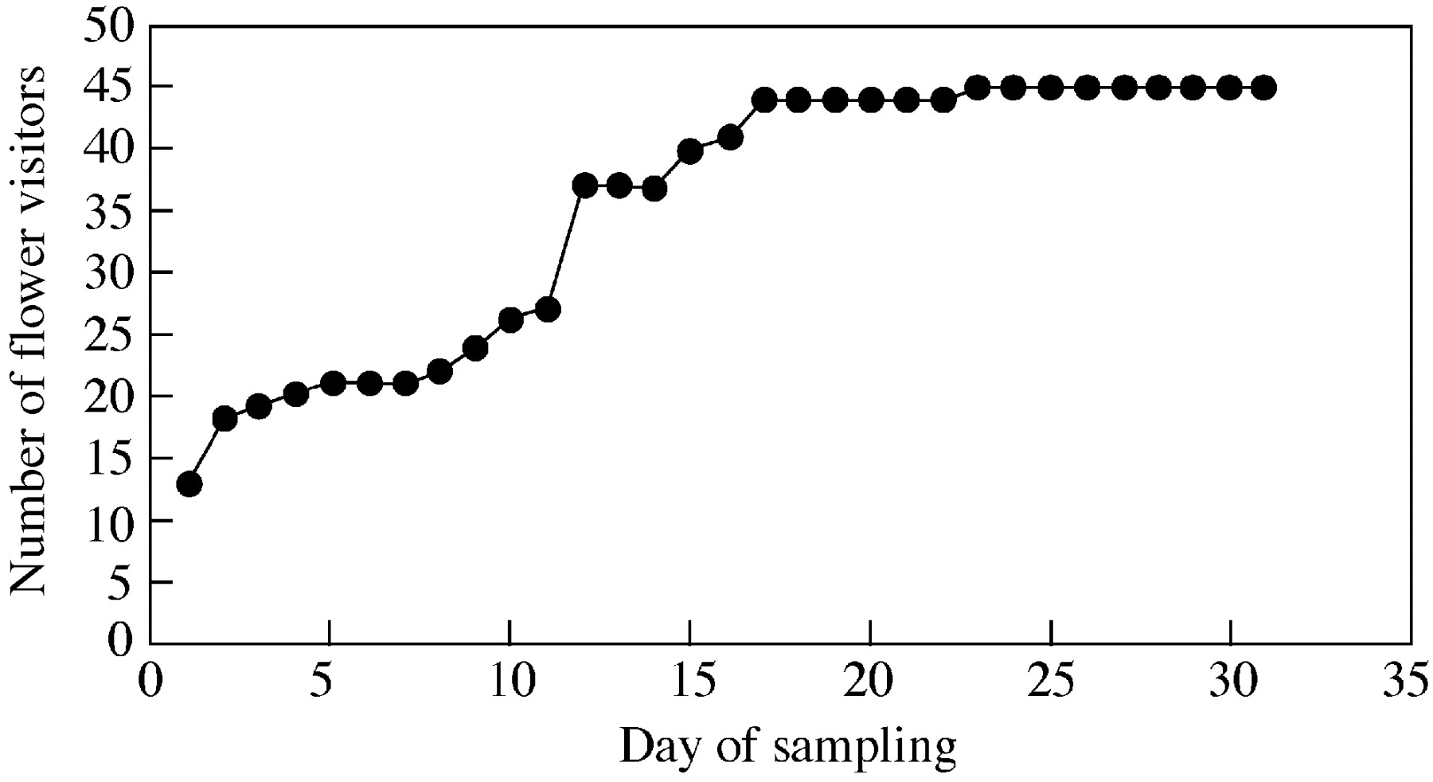
Fig. 3. The relationship between sampling effort and number of recorded flower visitors of the nine ...
Notes:
Fig. 3. The relationship between sampling effort and number of recorded flower visitors of the nine asclepiads. The curve is the cumulative number of insect species recorded as flower visitors over the period of observation.
Unless provided in the caption above, the following copyright applies to the content of this slide: Annals of Botany Company

Slide 4
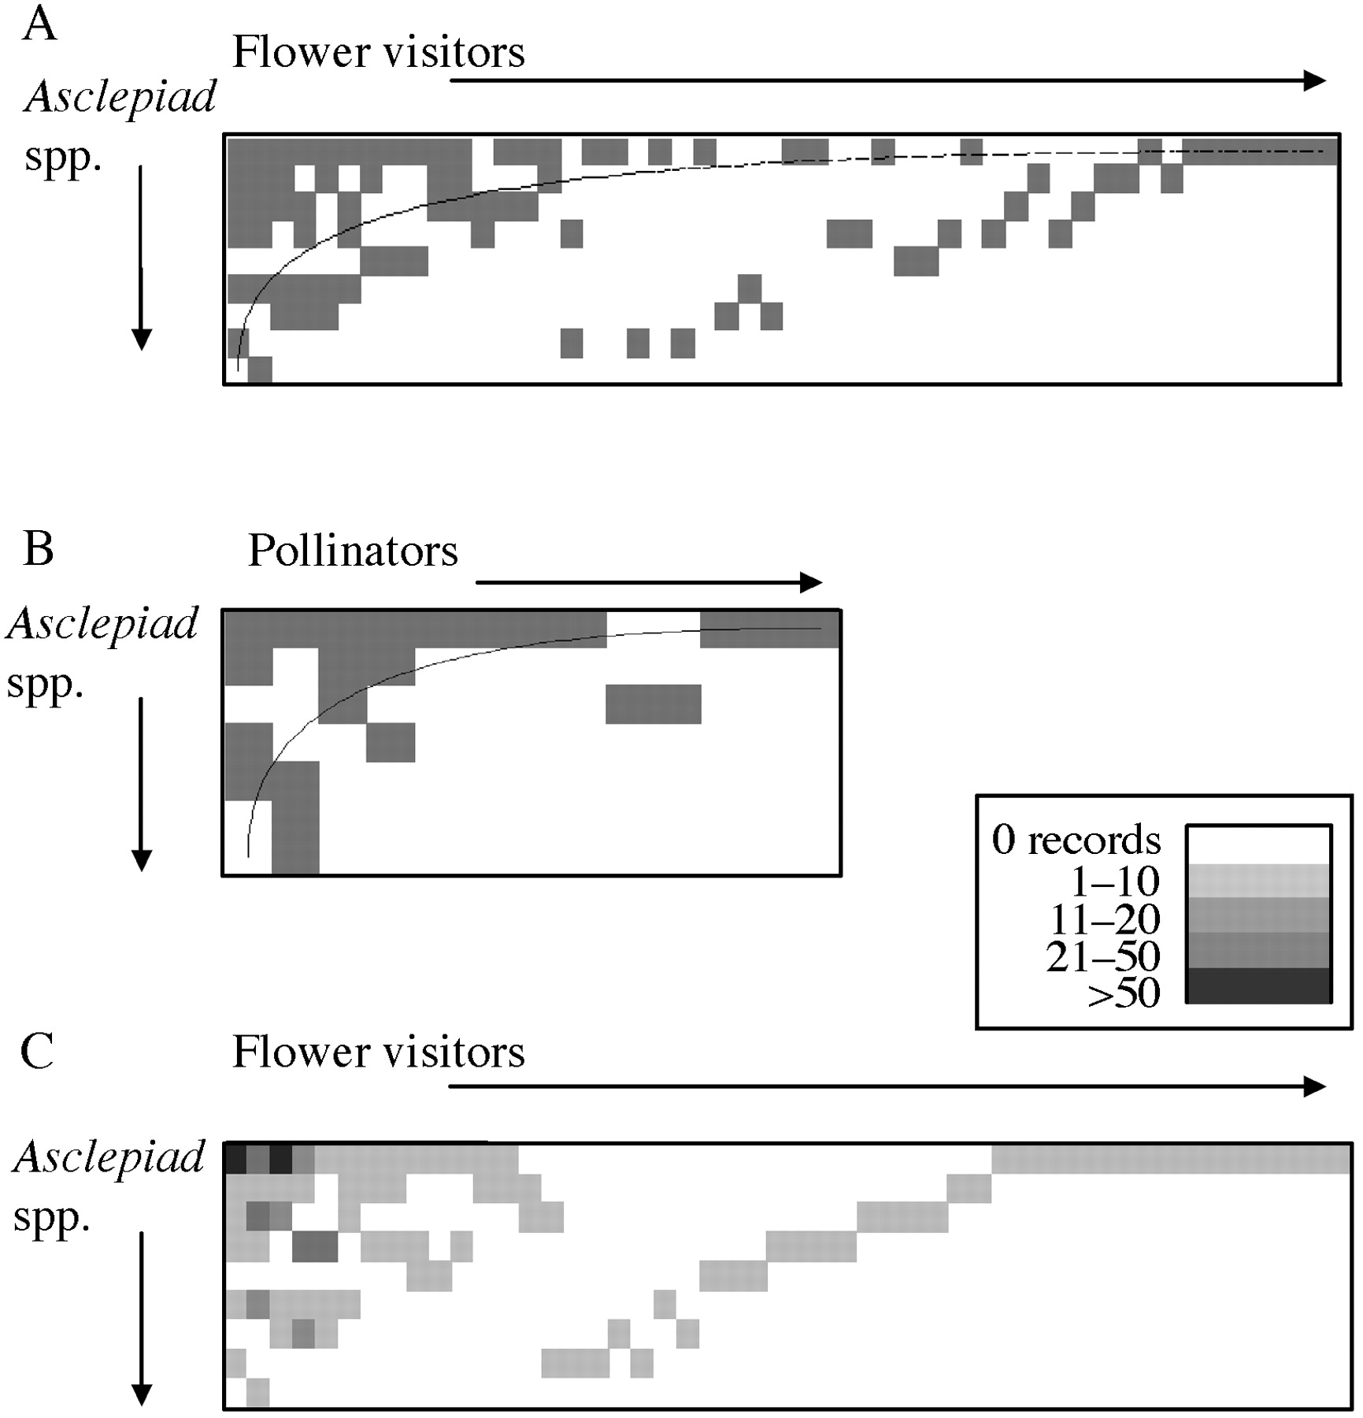
Fig. 4. Nestedness analyses of A, the flower visitor–plant interactions matrix; B, the pollinator–plant ...
Notes:
Fig. 4. Nestedness analyses of A, the flower visitor–plant interactions matrix; B, the pollinator–plant interaction matrix; C, the flower visitor–plant interactions matrix with abundance of insect species overlain. Note the legend. The matrix is identical to that in Fig. 4A except that the order of some insect species is different.
Unless provided in the caption above, the following copyright applies to the content of this slide: Annals of Botany Company

Slide 5
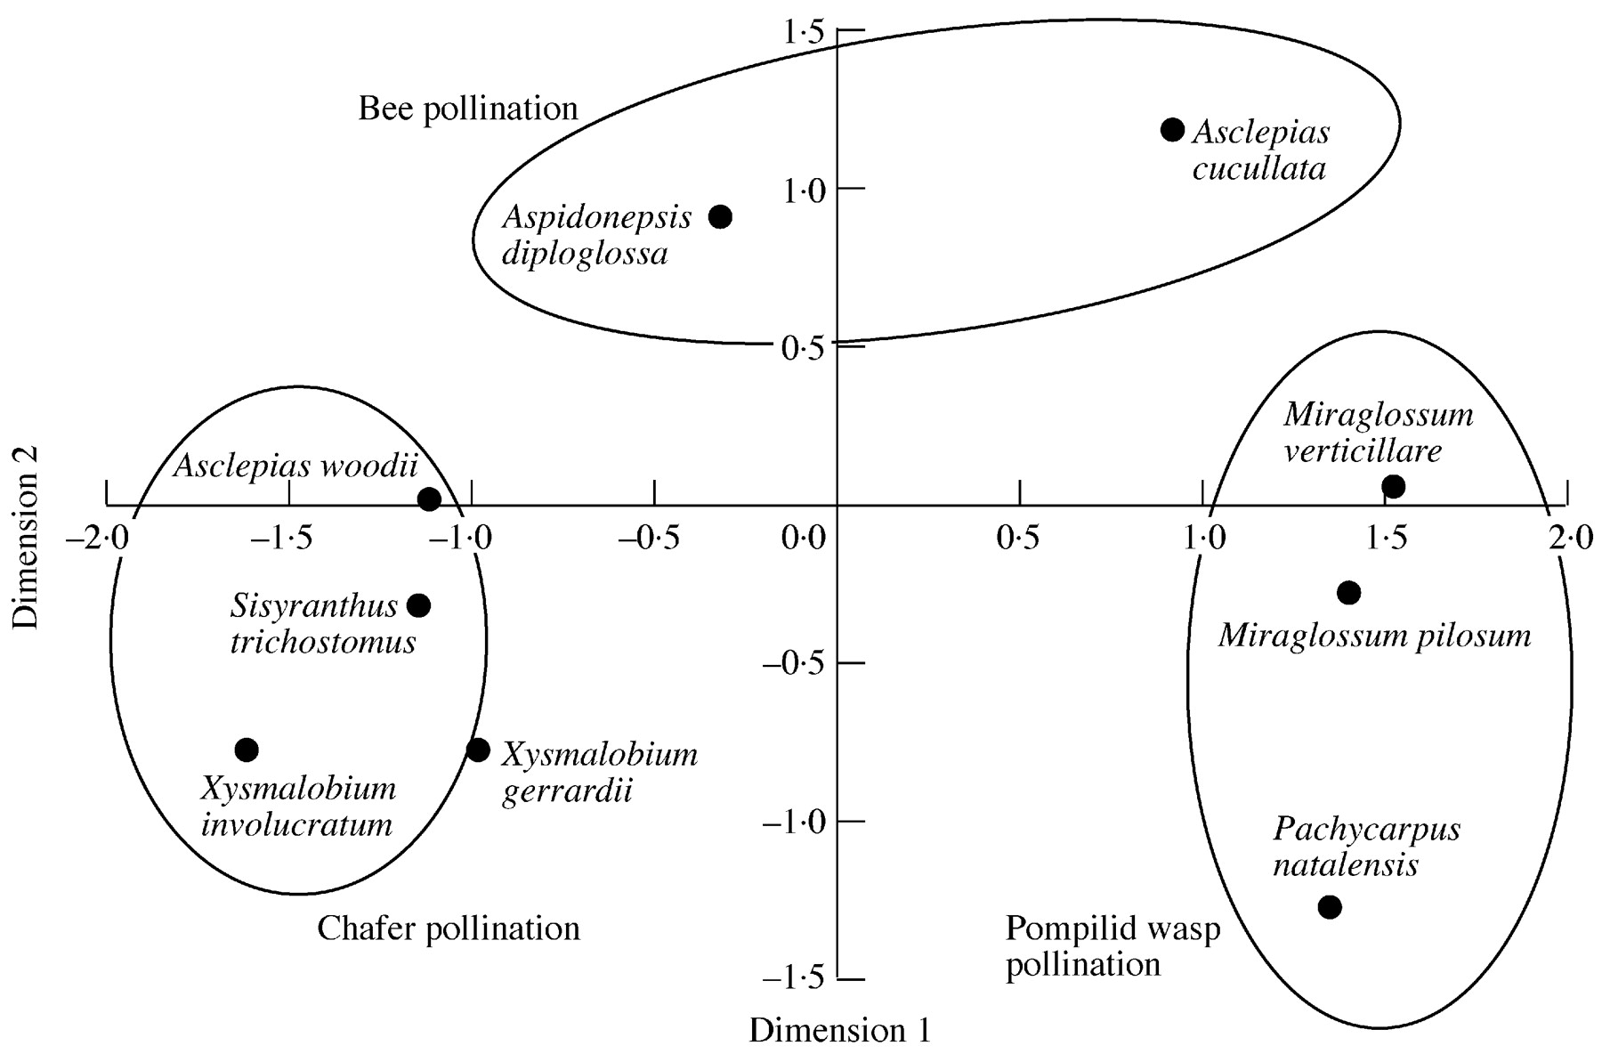
Fig. 5. Multidimensional scaling analysis of the floral traits of the nine asclepiads (see the Appendix). ...
Notes:
Fig. 5. Multidimensional scaling analysis of the floral traits of the nine asclepiads (see the Appendix). Pollination systems are mapped onto the clusters of species.
Unless provided in the caption above, the following copyright applies to the content of this slide: Annals of Botany Company

Slide 6
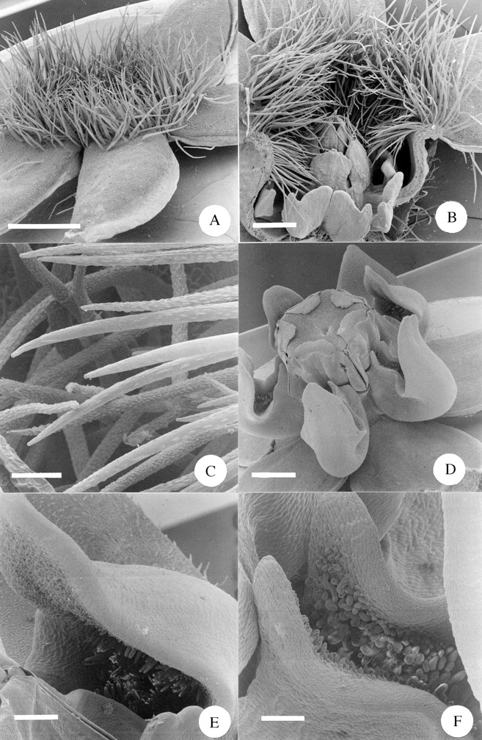
Fig. 6. A, Scanning electron micrograph (SEM) of a whole flower of Sisyranthus trichostomus. Scale bar = ...
Notes:
Fig. 6. A, Scanning electron micrograph (SEM) of a whole flower of Sisyranthus trichostomus. Scale bar = 1·0 mm. B, SEM of a half flower of Sisyranthus trichostomus. Note the hairs blocking the corolla tube arching down into the nectar‐holding corona cups. Scale bar = 0·5 mm. C, SEM close‐up of the hairs blocking the corolla tube of Sisyranthus trichostomus, showing the parallel ridges running along the main axis of each hair. Scale bar = 50 µm. D, SEM of a whole flower of Asclepias cucullata. Scale bar = 1·0 mm. E, SEM close‐up of the portion of the nectar cup distal to the gynostegium of Asclepias cucullata. Note the dense papillae within the cup. Scale bar = 250 µm. F, SEM close‐up of the portion of the nectar cup proximal to the gynostegium of Asclepias cucullata. Note the dense papillae within the cup. Scale bar = 150 µm.
Unless provided in the caption above, the following copyright applies to the content of this slide: Annals of Botany Company

Slide 7
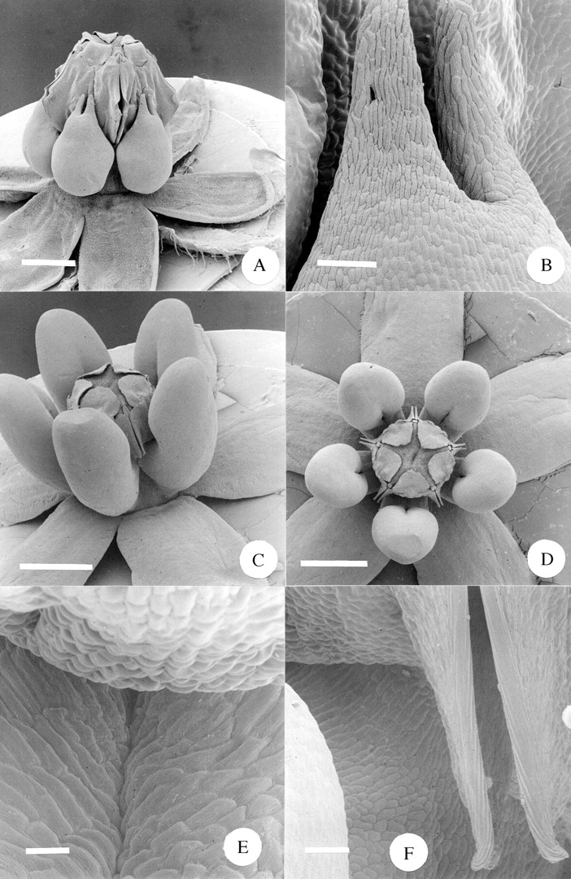
Fig. 7. A, SEM of whole flower of Xysmalobium involucratum. Scale bar = 1·0 mm. B, SEM close‐up of the top ...
Notes:
Fig. 7. A, SEM of whole flower of Xysmalobium involucratum. Scale bar = 1·0 mm. B, SEM close‐up of the top portion of the corona of Xysmalobium involucratum. Scale bar = 100 µm. C, SEM of whole flower of Xysmalobium gerrardii. Scale bar = 1·0 mm. D, SEM top view of whole flower of Xysmalobium gerrardii. Scale bar = 1·0 mm. E, SEM close‐up of Xysmalobium gerrardii, showing the space between the gynostegium (top of picture) and the inner surface of the corona (bottom of picture). Scale bar = 25 µm. F, SEM close‐up of Xysmalobium gerrardii, showing the region where the gynostegium and the corona meet, with the lower portion of the guide rails to the right. Scale bar = 50 µm.
Unless provided in the caption above, the following copyright applies to the content of this slide: Annals of Botany Company

Slide 8
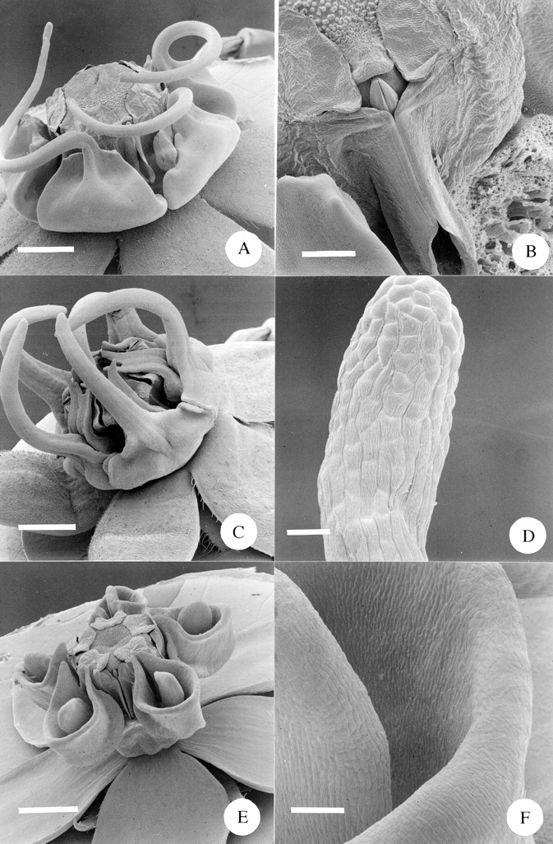
Fig. 8. A, SEM of whole flower of Miraglossum verticillare. Note that the spiral arms of the two distant ...
Notes:
Fig. 8. A, SEM of whole flower of Miraglossum verticillare. Note that the spiral arms of the two distant corona elements were lost during specimen processing. Scale bar = 1·0 mm. B, SEM close‐up of the guide rails of Miraglossum verticillare, with the pollinarium in situ. To the left is the edge of an adjacent corona element; the one to the right has been removed. Scale bar = 250 µm. C, SEM of whole flower of Miraglossum pilosum. Note that the filiform corona elements are usually straight and were deformed during specimen processing. Scale bar = 1·0 mm. D, SEM close‐up of the terminal end of a filiform corona element of Miraglossum pilosum. Scale bar = 50 µm. E, SEM of whole flower of Aspidonepsis diploglossa. Scale bar = 1 mm. F, SEM close‐up of the inner wall of the nectar cup of Aspidonepsis diploglossa. To the left is the ‘tongue’ situated within the cup. Scale bar = 100 µm.
Unless provided in the caption above, the following copyright applies to the content of this slide: Annals of Botany Company

Slide 9
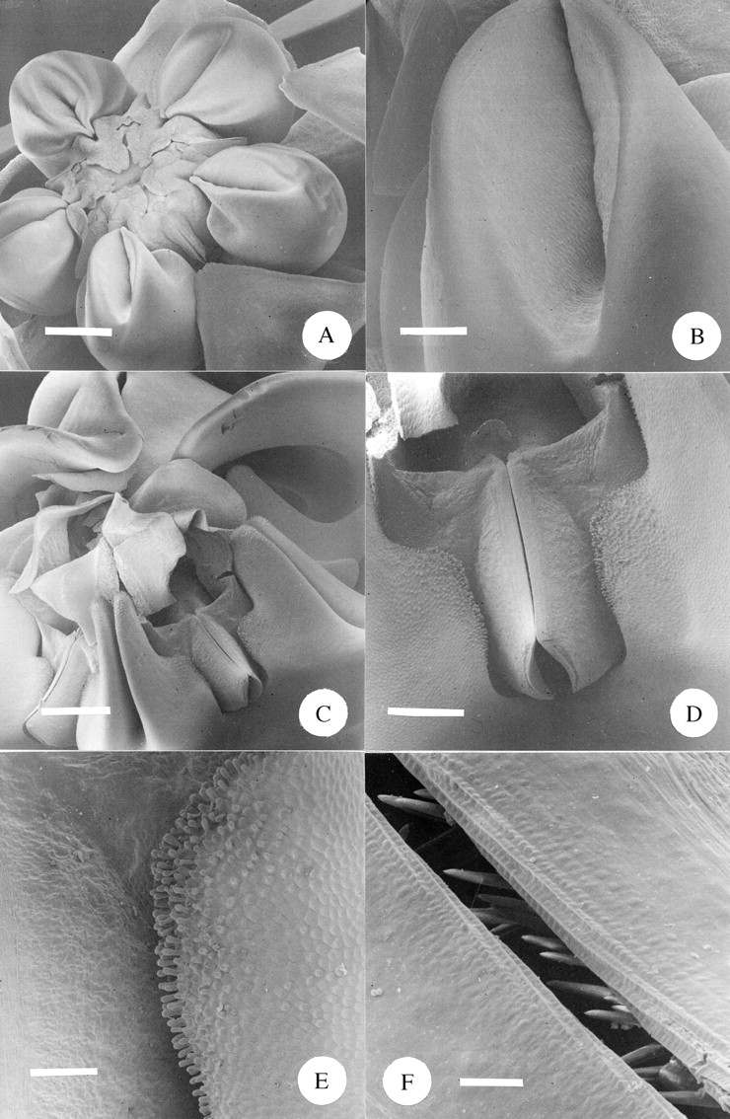
Fig. 9. A, SEM of a whole flower of Asclepias woodii. Scale bar = 1·0 mm. B, SEM close‐up of the inner ...
Notes:
Fig. 9. A, SEM of a whole flower of Asclepias woodii. Scale bar = 1·0 mm. B, SEM close‐up of the inner surface of the nectar ‘cup’ of Asclepias woodii. Scale bar = 0·25 mm. C, SEM of the central portion of the large flower of Pachycarpus natalensis. The over‐arching portions of the three closest corona lobes have been removed to facilitate a view of the gynostegium. Scale bar = 1·0 mm. D, SEM close‐up of guide rails of Pachycarpus natalensis. The adjacent corona lobes fuse with the gynostegium at either side. Scale bar = 0·5 mm. E, SEM close‐up of Pachycarpus natalensis, showing the point at which the gynostegium (to the left) meets with the corona (to the right). Note the densely papillate epidermis of the corona. Scale bar = 150 µm. F, SEM close‐up of the guide rails of Pachycarpus natalensis. Note the upward‐pointing ‘teeth’ within the guide rails. Scale bar = 20 µm.
Unless provided in the caption above, the following copyright applies to the content of this slide: Annals of Botany Company

Slide 10
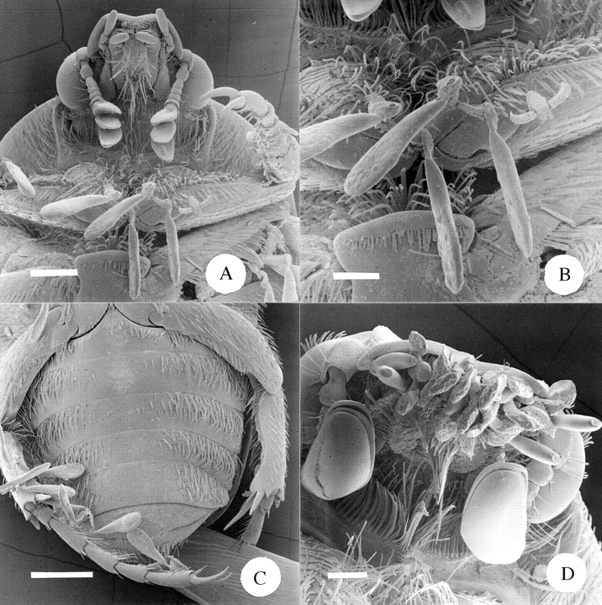
Fig. 10. A, SEM of the underside of the head and thorax of Atrichelaphinis tigrina, showing the attachment of ...
Notes:
Fig. 10. A, SEM of the underside of the head and thorax of Atrichelaphinis tigrina, showing the attachment of pollinaria of Xysmalobium involucratum to the hairs of the thorax (cf. Fig. 1C). Scale bar = 0·5 mm. B, SEM close‐up view of Fig. 10A, showing the attachment of pollinaria to the hairs of the thorax. The pollinarium to the right has had both of its pollinia removed, presumably during pollination. Scale bar = 250 µm. C, SEM of the underside of the abdomen of Atrichelaphinis tigrina, showing the attachment of pollinaria of Xysmalobium involucratum to the hairs on the rear legs. Scale bar = 1 mm. D, SEM of the underside of the head of Cyrtothyrea marginalis, showing the attachment of pollinaria of Sisyranthus trichostomus to the mouthparts (cf. Fig. 1E). Scale bar = 250 µm.
Unless provided in the caption above, the following copyright applies to the content of this slide: Annals of Botany Company

Slide 11
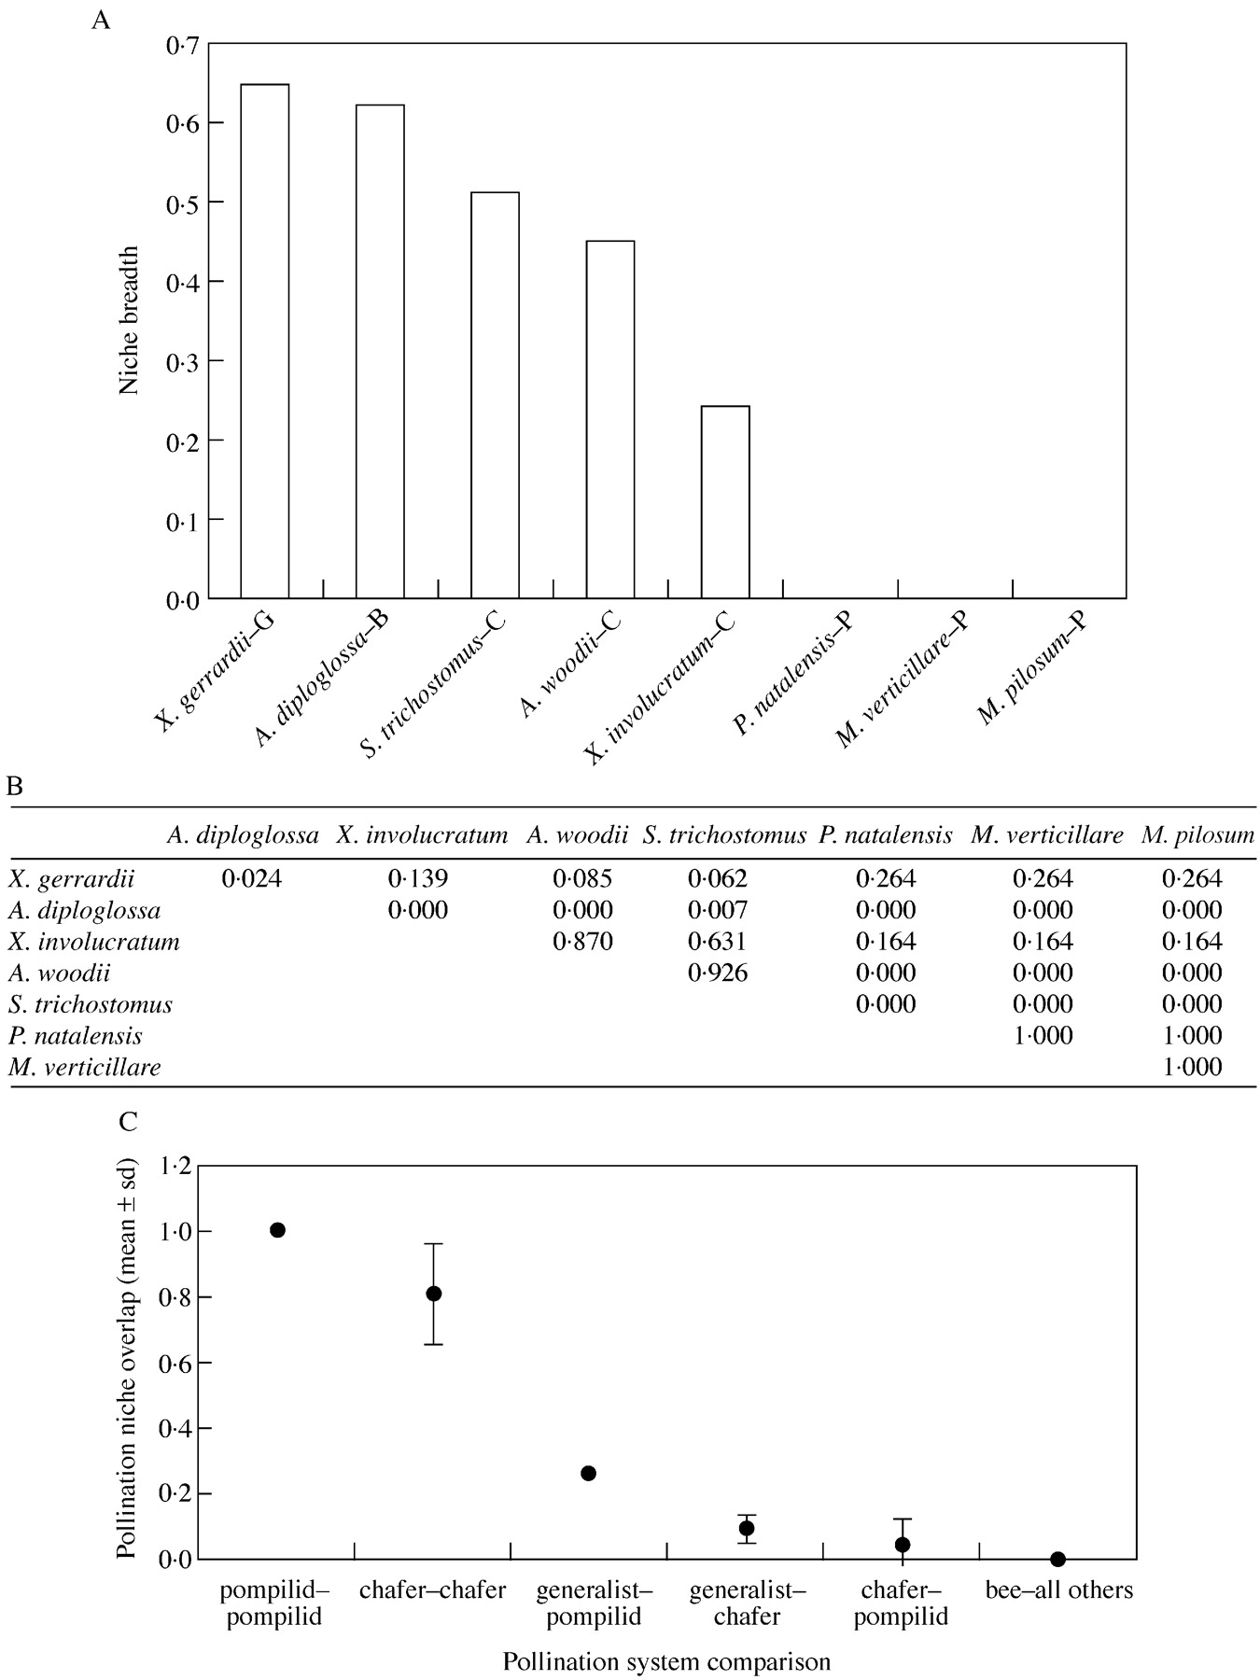
Fig. 11. Niche breadth and overlap statistics. A, Pollination niche breadths of the eight species of ...
Notes:
Fig. 11. Niche breadth and overlap statistics. A, Pollination niche breadths of the eight species of asclepiads for which pollinators were identified. The single letter suffixes to the names of taxa indicate the pollination system of that species (G, generalist; B, bee (?); C, chafer; P, pompilid wasp). This index starts at 0·0, indicating complete specialization on a single pollinator. B, Pollination niche overlap between all pairs of asclepiads. The index of overlap scales between 0·0 (no overlap in pollinator use) to 1·0 (complete overlap in pollinator use). C, Mean pollination niche overlap comparisons between taxa having the same and different pollination systems. Data points are mean values ± s.d. (from Fig. 11B). Note that, for three sets of comparisons, s.d. = 0.
Unless provided in the caption above, the following copyright applies to the content of this slide: Annals of Botany Company

Slide 12
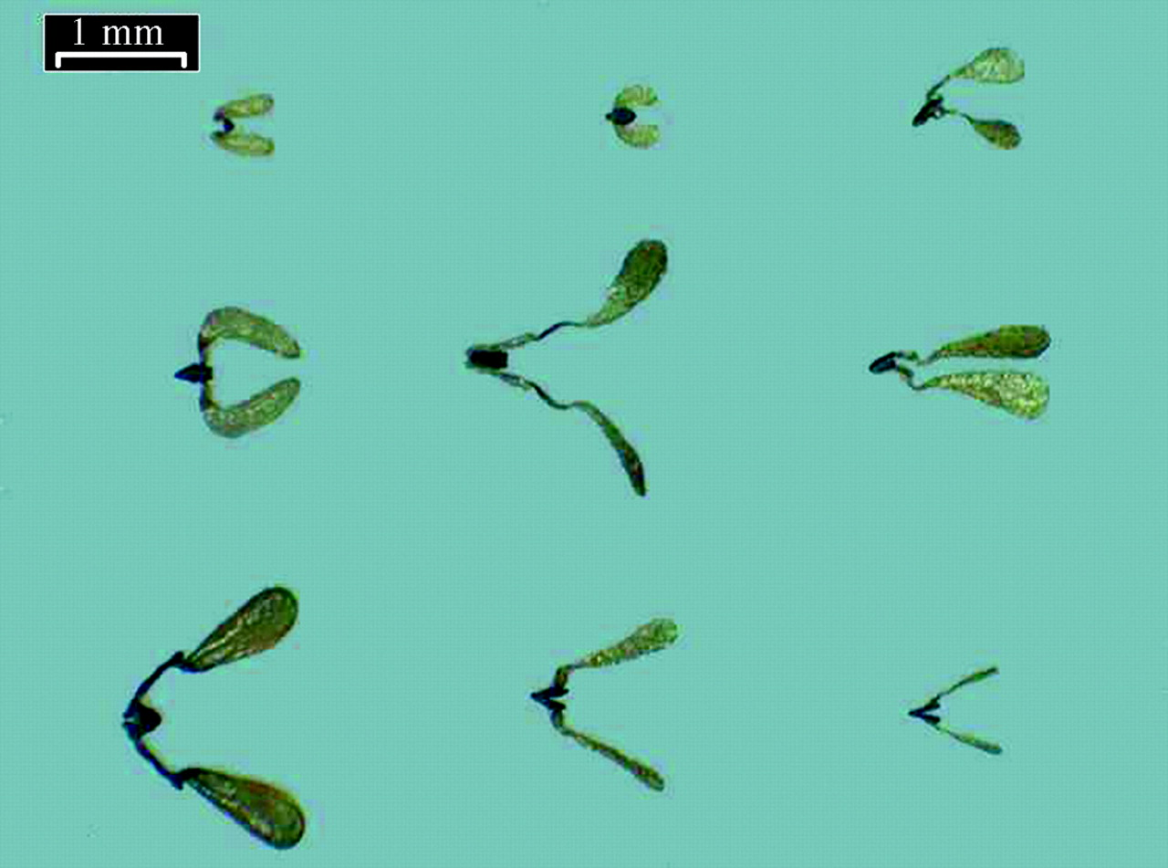
Fig. 12. Pollinaria of the nine species of asclepiad. Top row, from left to right: Miraglossum pilosum, ...
Notes:
Fig. 12. Pollinaria of the nine species of asclepiad. Top row, from left to right: Miraglossum pilosum, Sisyranthus trichostomus, Aspidonepsis diploglossa. Middle row: Miraglossum verticilata, Asclepias woodii, Asclepias cucullata. Bottom row: Pachycarpus natalensis, Xysmalobium involucratum, Xysmalobium gerrardii. Scale bar = 1 mm.
Unless provided in the caption above, the following copyright applies to the content of this slide: Annals of Botany Company

Slide 13
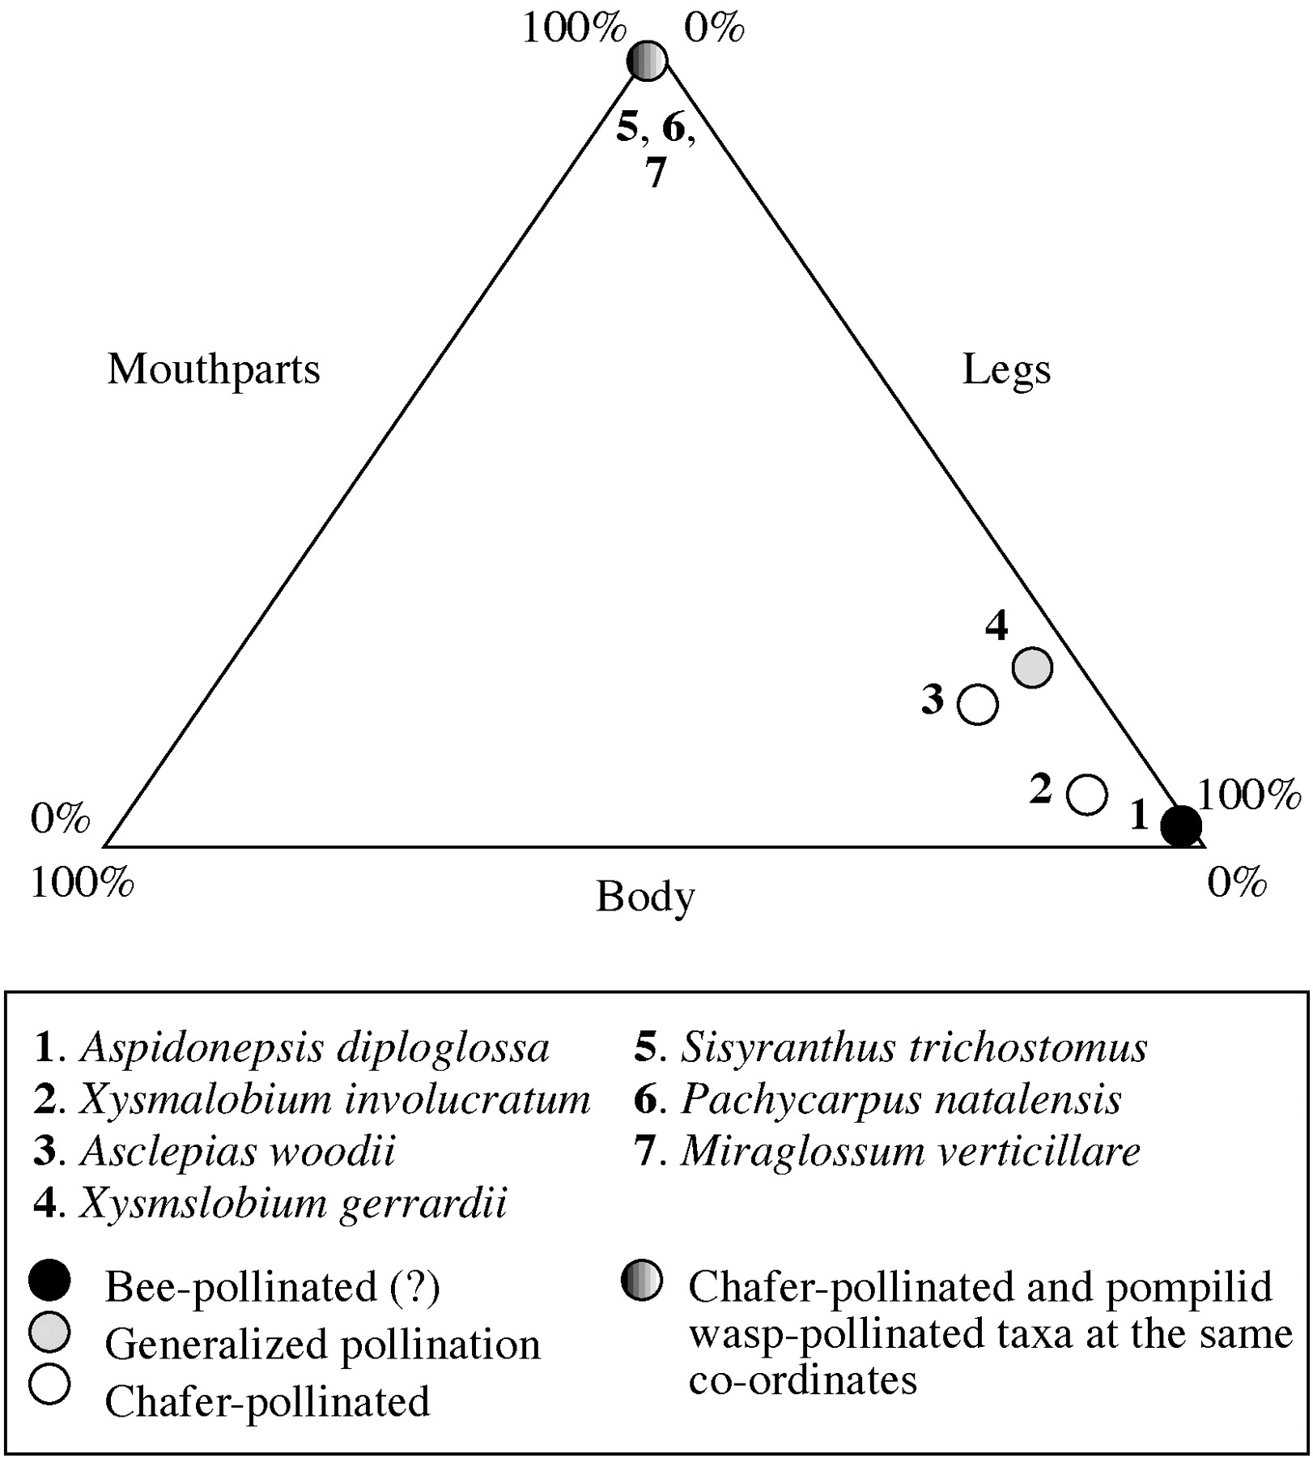
Fig. 13. Placement of pollinaria onto the bodies of the pollinators of the nine asclepiads, plotted onto a ...
Notes:
Fig. 13. Placement of pollinaria onto the bodies of the pollinators of the nine asclepiads, plotted onto a triangular graph. Each data point represents the proportion of pollinaria (as a percentage of the total) found on the legs, body and mouthparts of the pollinating insects of the seven species of asclepiad for which pollinators were confirmed.
Unless provided in the caption above, the following copyright applies to the content of this slide: Annals of Botany Company

Slide 14
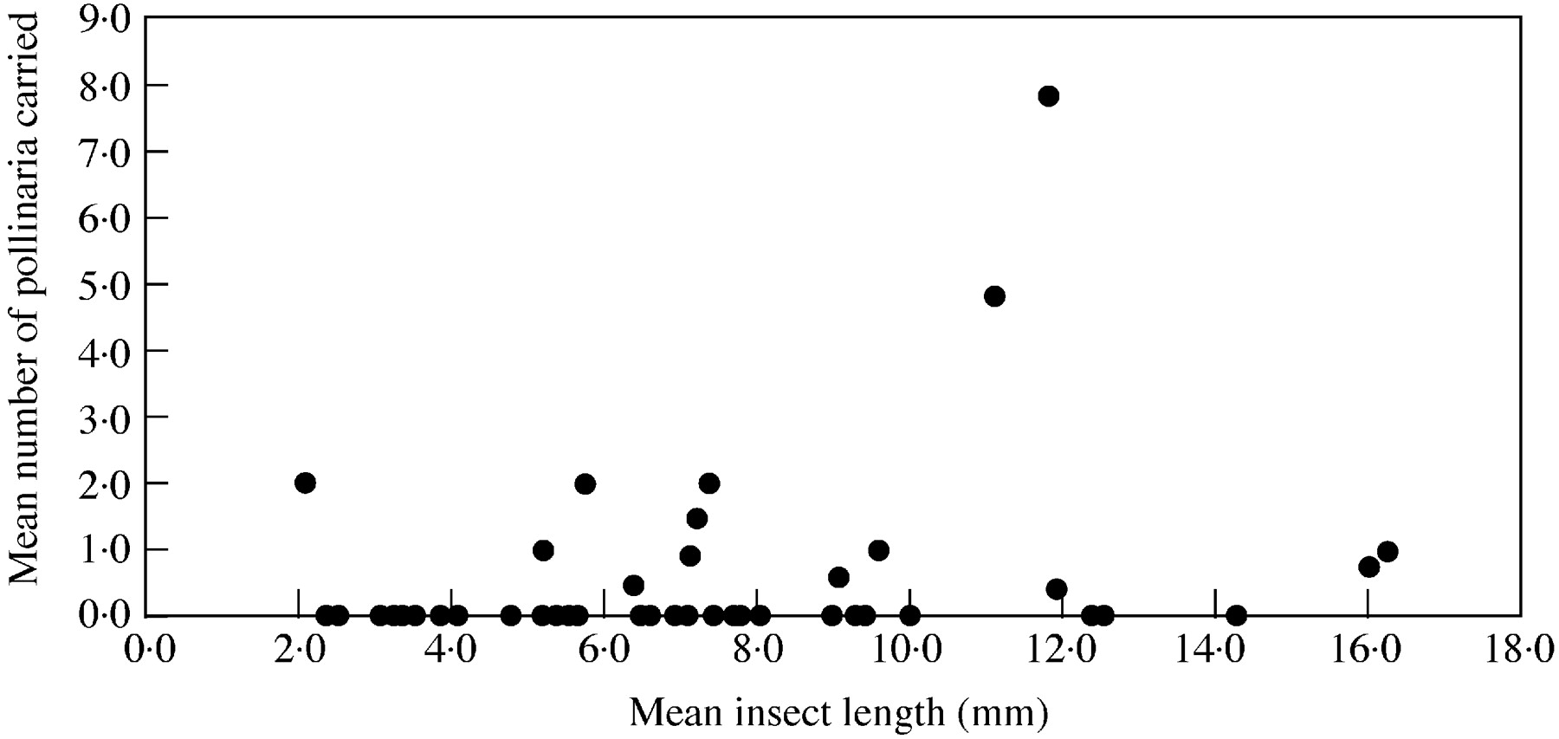
Fig. 14. The relationship between insect body length and number of pollinaria carried per insect.
Notes:
Fig. 14. The relationship between insect body length and number of pollinaria carried per insect.
Unless provided in the caption above, the following copyright applies to the content of this slide: Annals of Botany Company

Slide 15
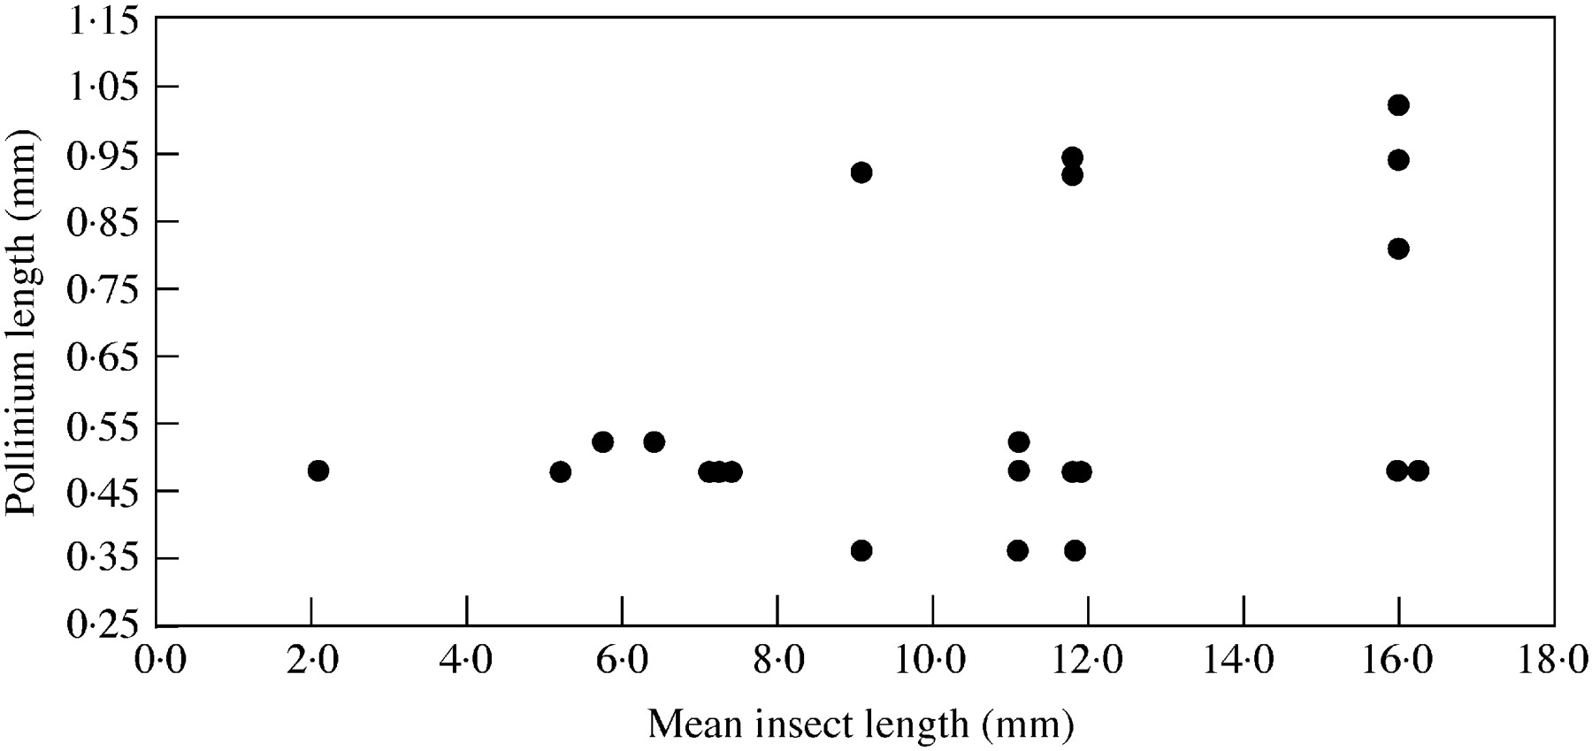
Fig. 15. The relationship between insect body length and pollinium length.
Notes:
Fig. 15. The relationship between insect body length and pollinium length.
Unless provided in the caption above, the following copyright applies to the content of this slide: Annals of Botany Company

