Slide 1
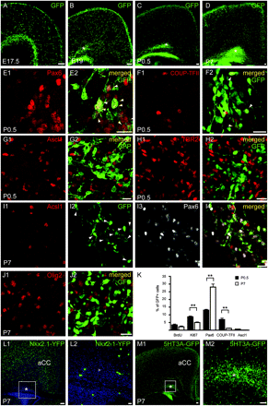
Figure 1. A large pool of GAD65-GFP–labeled cells accumulate in the early postnatal dorsal white matter; express Pax6 ...
Notes:
Figure 1. A large pool of GAD65-GFP–labeled cells accumulate in the early postnatal dorsal white matter; express Pax6 and COUP-TFII but not Ascl1, Tbr2, and Olig2; and is derived from 5-HT3A-GFP+ domains. (A–D) Epifluorescent images of coronal sections showing that GAD65-GFP+ cells accumulate in the WMPP (* indicates WMPP) between P0.5 (C) and P7 (D). Note that the WMPP is absent at E17.5 (A) and starts to appear at E19 (B). Confocal images of the WMPP at P0.5 showing that a large fraction of GAD65-GFP+ cells express the transcription factor Pax6 (E), to a lesser extent the transcription factor COUP-TFII (F), but not the transcription factors Ascl1 (G) and TBR2 (H). (I–J) Confocal images of the WMPP at P7 showing that a fraction of GAD65-GFP+ cells express Pax6 (I3) but not Ascl1 (I1) or the transcription factor Olig2 (J). (K) Graph showing that the percentage of GAD65-GFP+ cells labeled for Ki67 significantly decreases from P0.5 to P7 (**P < 0.01). Note also that the percentage of GAD65-GFP+ cells labeled for Pax6 significantly increases from P0.5 to P7 but significantly decreases for COUP-TFII during the same period of time (**P < 0.01). (L) Images showing that the WMPP at P7 contains very few Nkx2.1-Cre-YFP+ cells. (M) Images showing that 5-HT3A-GFP+ cells populate the dorsal white matter at P7. White boxed areas depict higher magnifications images. Scale bars: 20 μm for (E–J, L2, M2); 100 μm for (A–D, L1, M). GFP, GAD65-GFP.
Unless provided in the caption above, the following copyright applies to the content of this slide: © The Author 2011. Published by Oxford University Press. All rights reserved. For permissions, please e-mail: journals.permissions@oup.com

Slide 2
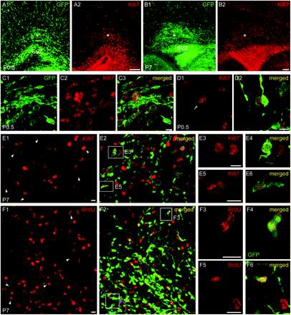
Figure 2. A fraction of GAD65-GFP+ cells proliferate in the postnatal dorsal white matter. (A–B) Epifluorescent images ...
Notes:
Figure 2. A fraction of GAD65-GFP+ cells proliferate in the postnatal dorsal white matter. (A–B) Epifluorescent images showing in the WMPP (*) a pool of cells labeled with the endogenous cell cycle marker Ki67 at P0.5 (A) and P7 (B). (C) Confocal images of the WMPP at P0.5 showing GAD65-GFP+ cells immunoreactive for Ki67. (D) Confocal images of the WMPP at P0.5 showing a moderately labeled GAD65-GFP+ precursor cell immunoreactive for Ki67 (arrow) and a strongly labeled GAD65-GFP+ cell with a migrating neuronal morphology and negative for Ki67. (E–F) Confocal images of the WMPP at P7 showing GAD65-GFP+ cells immunoreactive for Ki67 (E) and BrdU (F). White boxed areas depict higher magnification images. Arrowheads point to double-labeled cells. Scale bars: 100 μm for (A, B); 10 μm for (C–F). GFP, GAD65-GFP.
Unless provided in the caption above, the following copyright applies to the content of this slide: © The Author 2011. Published by Oxford University Press. All rights reserved. For permissions, please e-mail: journals.permissions@oup.com

Slide 3
Figure 3. A large pool of GAD65-GFP+ cells express DCX and migrate in the postnatal dorsal white matter region ventral ...
Notes:
Figure 3. A large pool of GAD65-GFP+ cells express DCX and migrate in the postnatal dorsal white matter region ventral to the aCC. (A–C) Images showing that at P7 (A), P14 (B), and P21 (C), GAD65-GFP+ cells persist in the WMPP (*). (A) At P7, a large number of GAD65-GFP+ cells in the WMPP express the immature neuronal marker DCX (A5). (B) Note at P14 the presence of GAD65-GFP+ cells that form DCX+ chain-like structures (arrowhead) (B5). (C) At P21, DCX+/GAD65-GFP+ cells are present in the WMPP but also in deep layer VI of the aCC (arrows) (C5). (D) Confocal images showing at P7 DCX+/GAD65-GFP+ interneurons displaying neuronal migratory morphologies in the aCC (arrowheads) (D3–D4) and a large pool of DCX-positive GAD65-GFP+ cells in the adjacent WMPP (D5–D6). (E) Confocal images showing at P21 in the WMPP a small cluster of DCX+ cells expressing low levels of GAD65-GFP (arrows). In the vicinity of this cluster, a DCX+ cell with high expression of GAD65-GFP and displaying a migratory-like leading process is observed entering the aCC (arrowhead). (F) Confocal images showing that at P21 DCX+/GAD65-GFP+ cells with neuronal migratory morphologies and expressing calretinin (arrowhead) are present in the WMPP. (G) Epifluorescent time-lapse sequence of a P7 coronal slice at the level of the dorsal WMPP showing migratory tracks of GAD65-GFP+ cells (superposed color lines). (H) Graph showing that the majority of GAD65-GFP+ cells in the WMPP at P7 are motile and display a range of migratory speeds. White boxed areas depict higher magnification images. Scale bars: 100 μm for (A, B1–B4, C); 10 μm for (B5, B6, D–G). GFP, GAD65-GFP; Hst, Hoechst.
Unless provided in the caption above, the following copyright applies to the content of this slide: © The Author 2011. Published by Oxford University Press. All rights reserved. For permissions, please e-mail: journals.permissions@oup.com

Slide 4
Figure 4. A fraction of GAD65-GFP+ interneurons migrate in the prospective postnatal aCC. (A–B) Epifluorescent images ...
Notes:
Figure 4. A fraction of GAD65-GFP+ interneurons migrate in the prospective postnatal aCC. (A–B) Epifluorescent images of coronal slices at the level of the aCC at P0.5 (A1) and P4.5 (B1). Time-lapse sequences showing the migration of GAD65-GFP–labeled interneurons at P0.5 (A2–A5) and P4.5 (B2–B5). At P0.5, a large fraction of GAD65-GFP–labeled interneurons are motile (colored arrowheads). In contrast, the majority of GAD65-GFP–labeled interneurons at P4.5 are stationary (yellow arrows). Superposed color lines represent migratory tracks. (C) Graph showing that the percentage of migrating interneurons in the aCC progressively decreases from P0.5 to P4.5 (**P < 0.01). (D) Graph showing a significant decrease in the mean migratory speed of GAD65-GFP+ interneurons in the aCC between E17.5 and P4.5 (**P < 0.01). (E) Graph showing a significant shift in the speed distribution of migrating interneurons between E17.5 and P4.5 with a majority of GAD65-GFP+ cells at P4.5 migrating at lower speed intervals (**P < 0.01). (F) Scatter graphs showing the final position of GAD65-GFP–labeled interneurons in the prospective aCC after a 190-min time-lapse sequence at P0.5 (F1) and at P4.5 (F2). The starting point for each cell is the intersection between the x- and y-axes (0,0) and directionality toward the pial surface is given by positive values in the y-axis. Note that interneurons migrate in all directions with a preferential direction toward the pial surface. (G) Graph showing that a significantly higher proportion of GAD65-GFP+ cells at P0.5, P2.5, and P4.5 migrate toward the pial surface compared with other directions (*P < 0.05, **P < 0.01). (H) Schematic coronal section depicting during the first postnatal week migration of GAD65-GFP+ cells from the WMPP toward cortical regions. (I) Epifluorescent images at low (I1) and higher (I2) magnification showing at P2.5 a pool of GAD65-GFP–labeled cells in the WMPP and dorsal SVZ. (J) A 180-min time-lapse sequence at P0.5 showing GAD65-GFP+ cells exiting the WMPP and migrating toward the prospective aCC. White boxed areas depict higher magnification images. Scale bars: 100 μm for (A1, B1, I); 20 μm for (A2–A5, B2–B5, J1–J2). GFP, GAD65-GFP; Hst, Hoechst; M, motor cortex; Vent, ventricle; CC, corpus callosum; CPu, caudate putamen; Lat, lateral; Med, medial.
Unless provided in the caption above, the following copyright applies to the content of this slide: © The Author 2011. Published by Oxford University Press. All rights reserved. For permissions, please e-mail: journals.permissions@oup.com

Slide 5
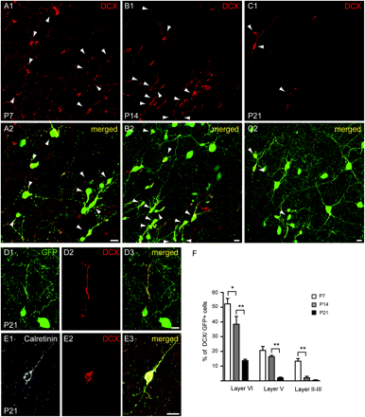
Figure 5. A fraction of GAD65-GFP+ interneurons express the immature neuronal marker DCX in the postnatal aCC. (A–C) ...
Notes:
Figure 5. A fraction of GAD65-GFP+ interneurons express the immature neuronal marker DCX in the postnatal aCC. (A–C) Confocal images of aCC layer VI showing that a fraction of GAD65-GFP+ interneurons expressing DCX are present in the aCC and gradually decrease between P7 (A), P14 (B), and P21 (C). Note that DCX is preferentially expressed in GAD65-GFP+ interneurons. (D) Confocal images of aCC layer VI at P21 showing a GAD65-GFP–labeled interneuron with an immature migratory-like morphology. (E) Confocal images of aCC layer VI at P21 showing a GAD65-GFP–labeled interneuron expressing DCX and the neuronal marker calretinin. (F) Graph showing that the percentage of DCX+/GAD65-GFP+ interneurons significantly decreases from P7 to P21 in all cortical layers (**P < 0.01). Note that at P21 DCX+/GAD65-GFP+ interneurons are mainly found in layer VI at all time points. Arrowheads depict double-labeled cells. Scale bar: 10 μm for all images. GFP, GAD65-GFP.
Unless provided in the caption above, the following copyright applies to the content of this slide: © The Author 2011. Published by Oxford University Press. All rights reserved. For permissions, please e-mail: journals.permissions@oup.com

Slide 6
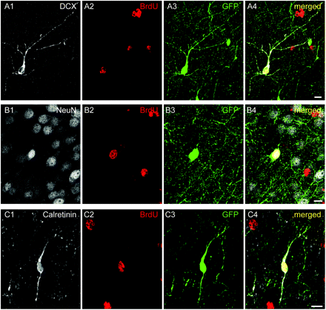
Figure 6. A fraction of GAD65-GFP–labeled interneurons in the aCC are generated postnatally. (A–C) Confocal images of ...
Notes:
Figure 6. A fraction of GAD65-GFP–labeled interneurons in the aCC are generated postnatally. (A–C) Confocal images of aCC layer VI at P10 showing GAD65-GFP+ interneurons labeled for BrdU and DCX (A), BrdU and Neuronal Nuclei (B), and BrdU and calretinin (C). BrdU was injected postnatally at P0.5 (3 × 20 mg/kg i.p.), and animals were sacrificed at P10. Scale bar: 10 μm for all images. GFP, GAD65-GFP.
Unless provided in the caption above, the following copyright applies to the content of this slide: © The Author 2011. Published by Oxford University Press. All rights reserved. For permissions, please e-mail: journals.permissions@oup.com

